Slide 1

Python Kids
Chapter 3

Slide 2
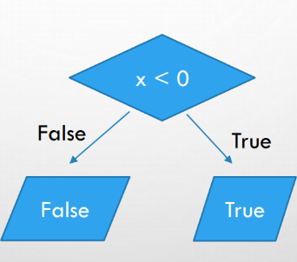
If Statement
"if" statement helps a program make decisions. It checks if something is true, and if it is, it does something special!
When you write an if statement, you’re telling the computer to do something only if a certain condition is true.
if 7 > 3: print(“Greater”)
Example

Slide 3
Let’s write some program with “if”statement

Slide 4
If Statement
if age > 20: print('You are too old!')
cookies = 3
if cookies > 0: print("You can take a cookie!")
weather = "rainy“
if weather == "rainy": print("Don’t forget your raincoat!")

Slide 5
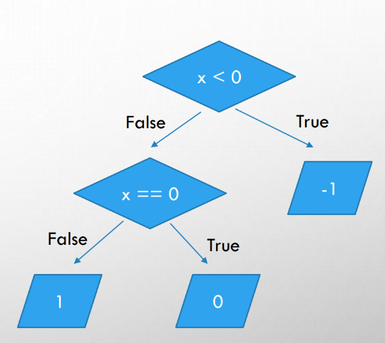
If-else Statement
With an if-else statement, you’re giving the computer two choices:
Do one thing if the condition is true.
Do something else if the condition is false.
if 7 > 3: print(“Greater")
Else:
print(“smaller”)
Example

Slide 6
Let’s write some program with “if-else”statement

Slide 7
If-else Statement
money = 2000 if money > 1000:
print("I'm rich!!")
else:
print("I'm not rich!!")
wakeup =8
if wakeup>=8:
print('Yoy will punish')
else:
print('You will not punish')
cookies = 3
if cookies > 0: print("You can take a cookie!")
Else:
print(“Sorry, no cookies left”)
score = 85
if score >= 50:
print("You passed the test!")
Else:
print(“You need to study more.”)

Slide 8
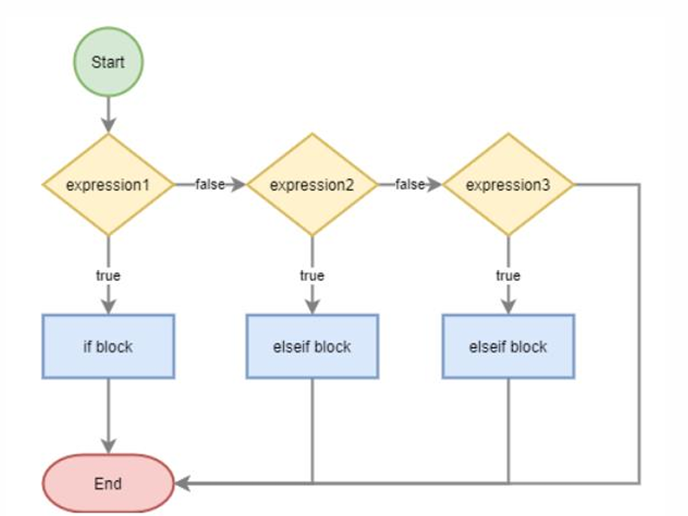
If-elseif-else Statement
An if-elseif-else statement is like asking a question and choosing what to do based on the answer. It’s like deciding what to wear based on the weather!

Slide 9
Let’s write some program with “if-elseif-else”statement

Slide 10
If-elif-else Statement
temperature = 25
if temperature > 30:
print("It's hot! Wear shorts and a t-shirt.")
elif temperature > 20:
print("It's warm! Wear jeans and a t-shirt.")
elif temperature > 10:
print("It's cool. Wear a sweater.")
else: print("It's cold! Wear a jacket.")
number = 12
if number < 5:
print(“small")
elif number<10:
print(“Medium”)
else:
print(“Greater”)

Slide 11
If-elseif-else Statement
result =30
if result >=80:
print('You pass with D')
elif result >= 40:
print('You pass')
else:
print("You Fail")

Slide 12
Thanks!
Realistic Infotech Group
IT Training & Services
No.79/A, First Floor
Corner of Insein Road and Damaryon Street
Quarter (9), Hlaing Township
Near Thukha Bus Station
09256675642, 09953933826
http://www.rig-info.com

