Slide 1

Python Kids
Chapter 4

Slide 2
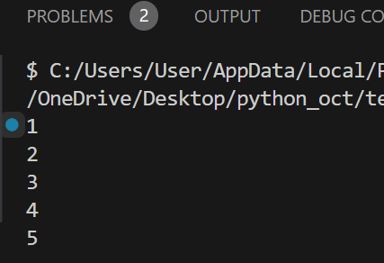
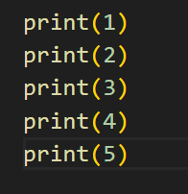
Using Loop
If you want to print “1 2 3 4 5”, you can enter the following code:

Slide 3
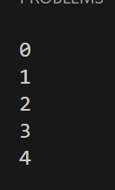
Using Loop(for loop)
When you use the loop, you will not have to write so many lines of code. Most programmers hate performing the same action multiple times; that’s why they prefer to use the for loop.
used to do something a number of times:
Start at 0
Stop Before 5
for i in range(0,5):
print(i)

Slide 4
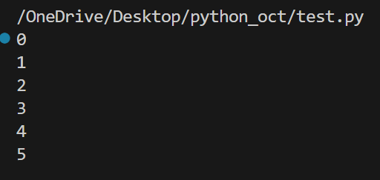
Using Loop(for loop)
If you want to print (0 1 2 3 4 5), you can add(+ 1) as following:
for i in range(0,5+1):
print(i)

Slide 5
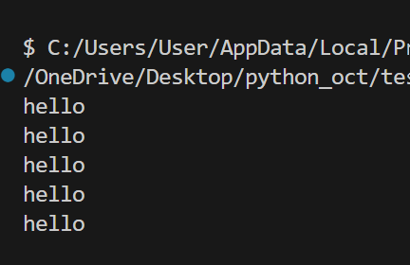
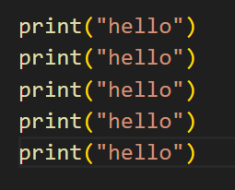
Using Loop
If you want to print the word hello five times, you can enter the following code:

Slide 6

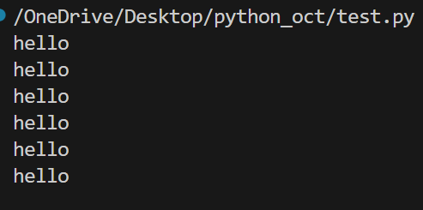
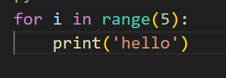
Let’s write the word “Hello” with loop
Or

Slide 7
Let’s write loop for list
wizard_list = ['spider legs', 'toe of frog', 'snail tongue', 'bat wing', 'slug butter’, 'bear burp']

Slide 8
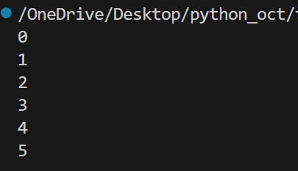

Write Loop with function
def up(n):
for i in range(0,n+1):
print(i)
up(5)
def up(n):
for i in range(0,n+1):
print(i , end=‘ ’)
up(5)

Slide 9
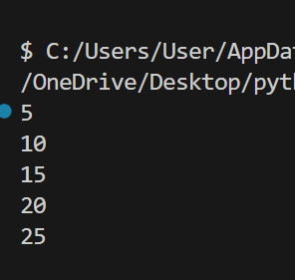
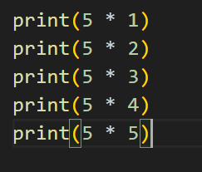
Write a timetable

Slide 10
Let’s write timetable with looping

Slide 11
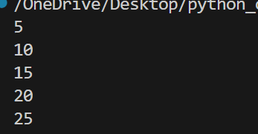
Write a function to print a times table of any size
def time(n):
for i in range(0,n+1):
print(i * 5)
time(5)

Slide 12
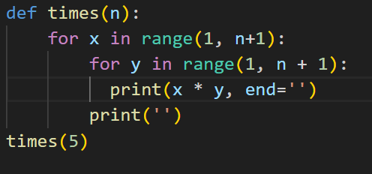
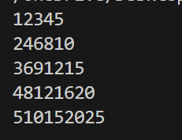
Write a function to print a times table of any size

Slide 13
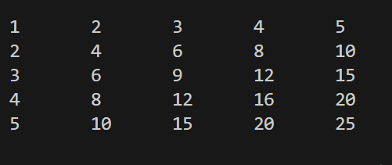
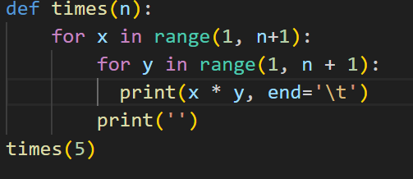
Print with prettier
end = ‘ \ t ’

Slide 14
Let’s write program with for loop

Slide 15
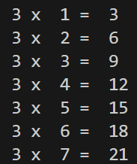
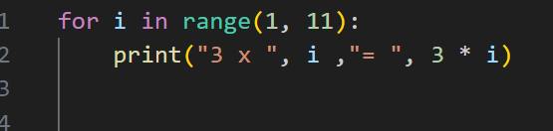
Multiplication Table of 3
Output
Or
print(f"3 x {i} = {3 * i}")

Slide 16
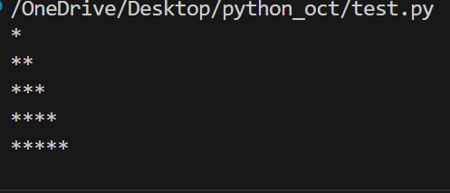

Creating a Simple Pattern
Output

Slide 17
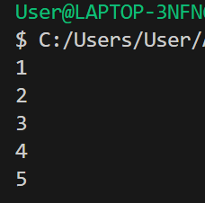
Using Loop(while loop)
A while loop is used to repeat a set of actions as long as a condition is true.
A while loop keeps doing something over and over until a condition becomes false.
count = 1
while count <= 5:
print(count)
count +=1

Slide 18
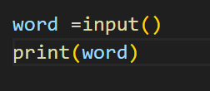

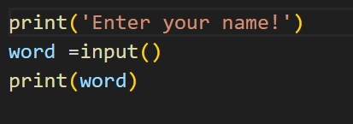
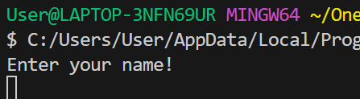
Input() function

Slide 19

Input() function

Slide 20
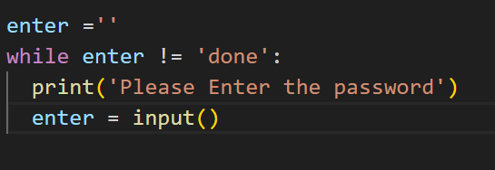
An unknown number of times
What if we do not know how many times to repeat an action until we begin?
• We can use the while construct.
• For example, let us ask the user for a password before proceeding:
allows the user to type in a line of text

Slide 21
Let’s write program with while loop

Slide 22
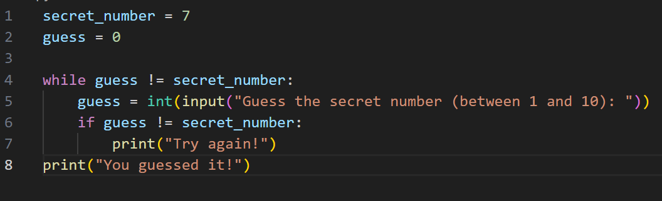
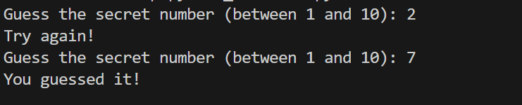
Guessing a Number
The loop continues until the user guesses the secret number.

Slide 23
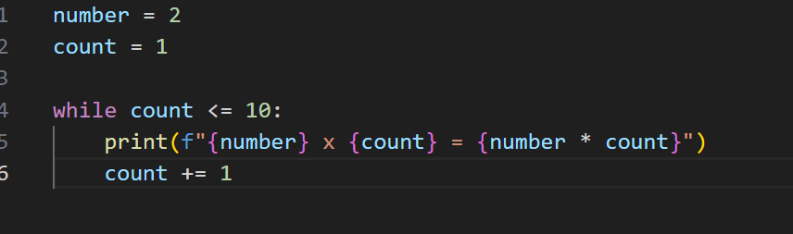
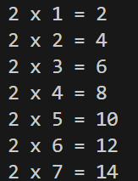
Multiplication Table
This prints the multiplication table of 2 up to 10.
Or
print(number ,'x', count ,'=',number * count)

Slide 24
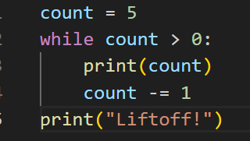
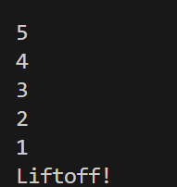
Countdown
This counts down from 5 to 1 and ends with "Liftoff!".
Count = count-1

Slide 25
Looping with enumerate()
Use enumerate() to get both index and value.
fruits = ["Apple", "Banana", "Cherry", "Mango"]
for index, fruit in enumerate(fruits):
print(f"Index {index}: {fruit}")
Index 0: Apple
Index 1: Banana
Index 2: Cherry
Index 3: Mango

Slide 26
Thanks!
Realistic Infotech Group
IT Training & Services
No.79/A, First Floor
Corner of Insein Road and Damaryon Street
Quarter (9), Hlaing Township
Near Thukha Bus Station
09256675642, 09953933826
http://www.rig-info.com

