Slide 1


Since 2011
Our outcomes are over 5000 trainees.
Get IT Right from RIG

Slide 2

Full Stack Development
with
Turtle
Learn, Create, and Shine
Digital Space

Slide 3
Courses
• Building Your First Python GUI Application With Tkinter
• Working With Widgets
• Controlling Layout With Geometry Managers
• Making Your Applications Interactive

Slide 4
Introduction
The turtle Library is primarily designed to introduce children to the world of programming. With the help of Turtle's library, new programmers can get an idea of how we can do programming with Python in a fun and interactive way.
It is beneficial to the children and for the experienced programmer because it allows designing unique shapes, attractive pictures, and various games. We can also design the mini games and animation. In the upcoming section, we will learn to various functionality of turtle library.

Slide 5
Programming with turtle
Forward
Backward
Left
Right

Slide 6
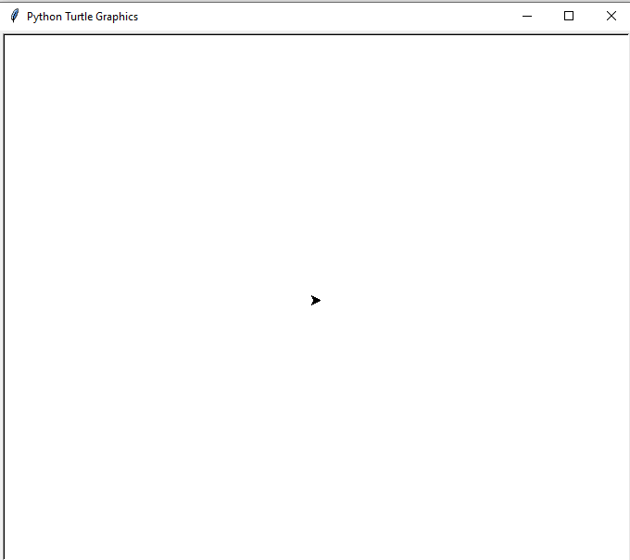
Introduction
import turtle
s = turtle.getscreen()
turtle.mainloop()

Slide 7
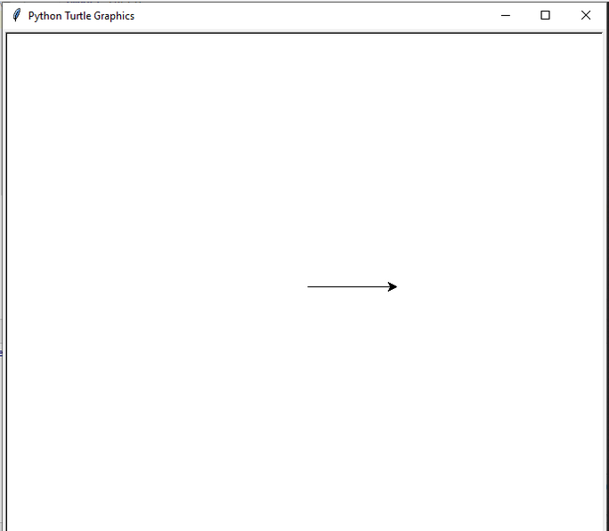
Forward
import turtle
t = turtle.Turtle()
t.forward(100)
turtle.mainloop()

Slide 8
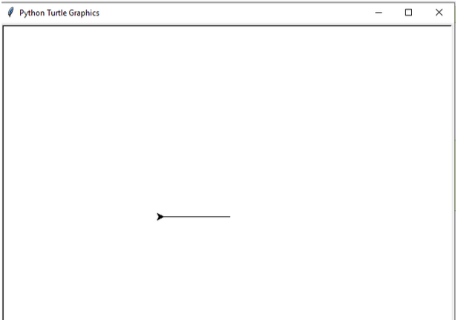
Backward
import turtle
t = turtle.Turtle()
t. backward(100)
turtle.mainloop()

Slide 9
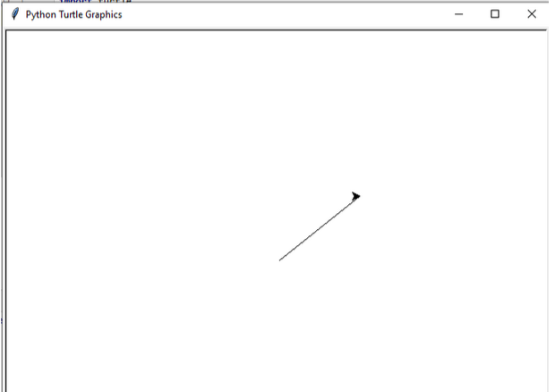
GoTo
import turtle
t = turtle.Turtle()
t.goto(100, 80)
turtle.mainloop()

Slide 10
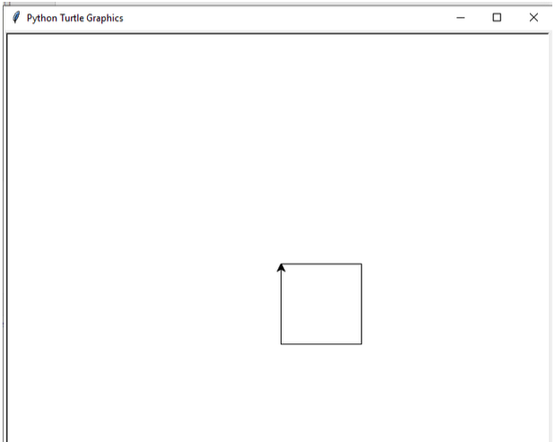
GoTo
import turtle
t = turtle.Turtle()
t.goto(100, 80)
t.fd(100)
t.rt(90)
t.fd(100)
t.rt(90)
t.fd(100)
t.rt(90)
t.fd(100)
turtle.mainloop()

Slide 11
GoTo
import turtle
t = turtle.Turtle()
t.goto(100, 80)
t.fd(100)
t.rt(90)
t.fd(100)
t.rt(90)
t.fd(100)
t.rt(90)
t.fd(100)
turtle.mainloop()

Slide 12
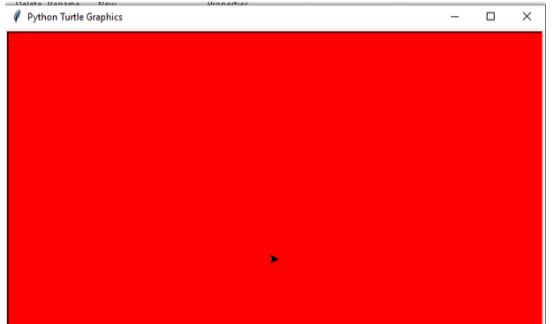
Changing the Screen Color
import turtle
t = turtle.Turtle()
turtle.bgcolor("red")
turtle.mainloop()

Slide 13
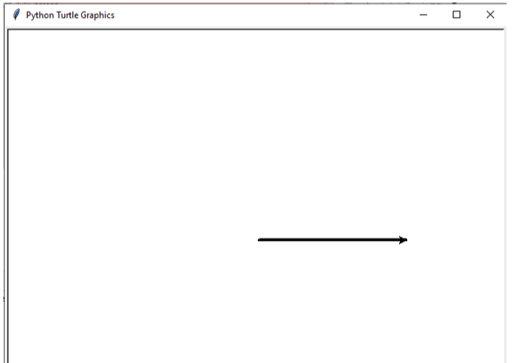
Changing the Pen Size
import turtle
t = turtle.Turtle()
t.pensize(4)
t.forward(200)
turtle.mainloop()

Slide 14
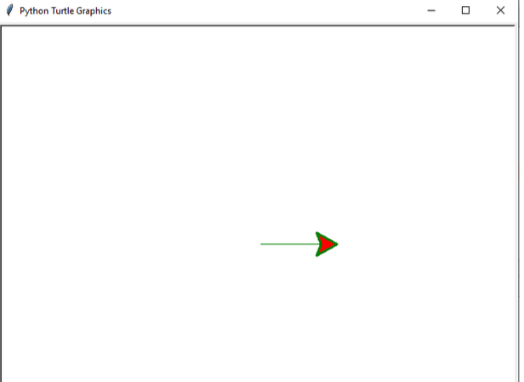
Changing the Pen Color
import turtle
t = turtle.Turtle()
t.shapesize(3,3,3)
t.color("green", "red")
t.forward(100)
turtle.mainloop()

Slide 15

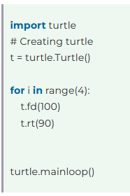
Turtle Loop
Notes:
https://www.tpointtech.com/drawing-a-polygon-in-turtle-python

Slide 16
Drawing a Polygon
forward(p) : The turtle (pen) is moved forward by an amount equal to p.
reverse(p) : shifts the turtle's (pen's) position backward by an amount equal to p.
right(q) : clockwise rotate the turtle (pen) by q degrees.
left(q) : Rotate the turtle (pen) by q degrees counterclockwise by pressing the left(q)

Slide 17

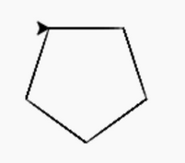
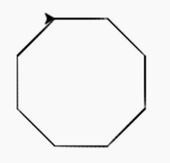
Drawing a Polygon
from turtle import *
import turtle as turt
tr = turt.Turtle()
side = int(input("The number of sides : "))
lngth = int(input("The length of each side : "))
for j in range(side):
tr.forward(lngth)
tr.right(360/side)

