Slide 1


Since 2011
Our outcomes are over 5000 trainees.
Get IT Right from RIG

Slide 2

Full Stack Development
Matplotlib
Python and React
Learn, Create, and Shine
Digital Space

Slide 3
Courses
What is Matplotlib?
Installation of Matplotlib
Import Matplotlib
Checking Matplotlib Version
Essential Role of Pyplot in Matplotlib
Types of Plots

Slide 4
What is Matplot
Matplotlib is a low level graph plotting library in python that serves as a visualization utility.
Matplotlib was created by John D. Hunter.
Matplotlib is open source and we can use it freely.
Matplotlib is mostly written in python, a few segments are written in C, Objective-C and Javascript for Platform compatibility.

Slide 5
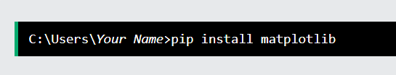
Installation of Matplotlib

Slide 6
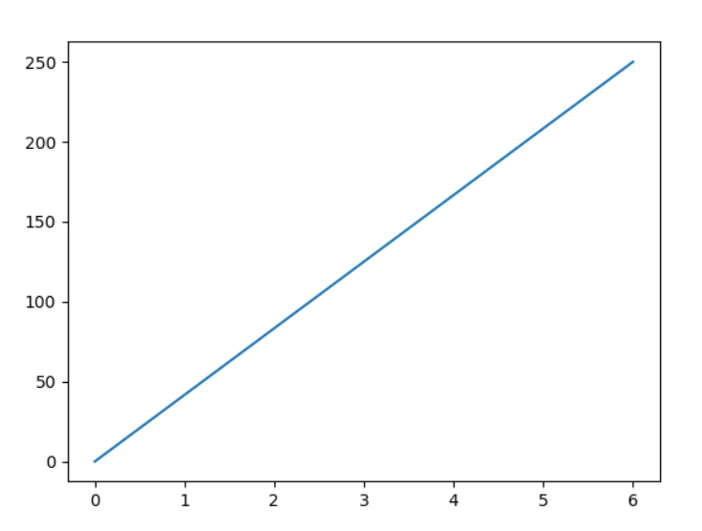
Line Chart
import matplotlib.pyplot as plt import numpy as np xpoints = np.array([0, 6]) ypoints = np.array([0, 250]) plt.plot(xpoints, ypoints) plt.show()

Slide 7
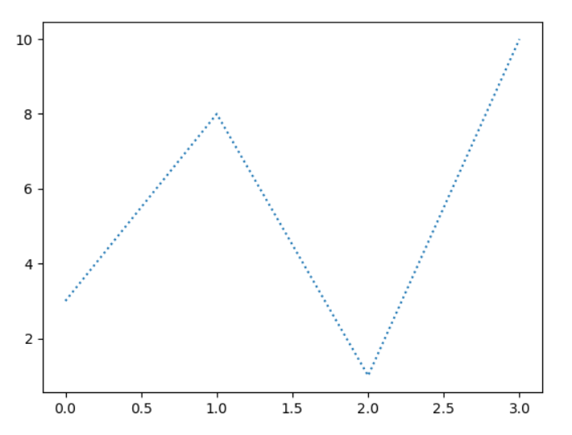
Line Chart
import matplotlib.pyplot as plt import numpy as np ypoints = np.array([3, 8, 1, 10]) plt.plot(ypoints, linestyle = 'dotted') plt.show()

Slide 8
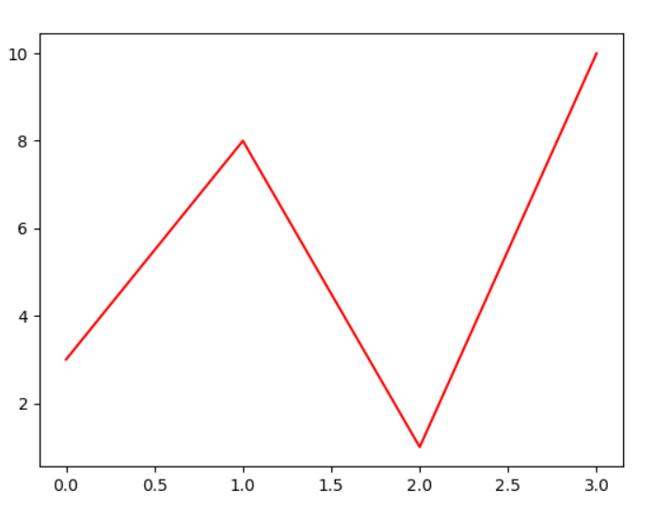
Line Chart
import matplotlib.pyplot as plt import numpy as np ypoints = np.array([3, 8, 1, 10]) plt.plot(ypoints, color = 'r') plt.show()

Slide 9
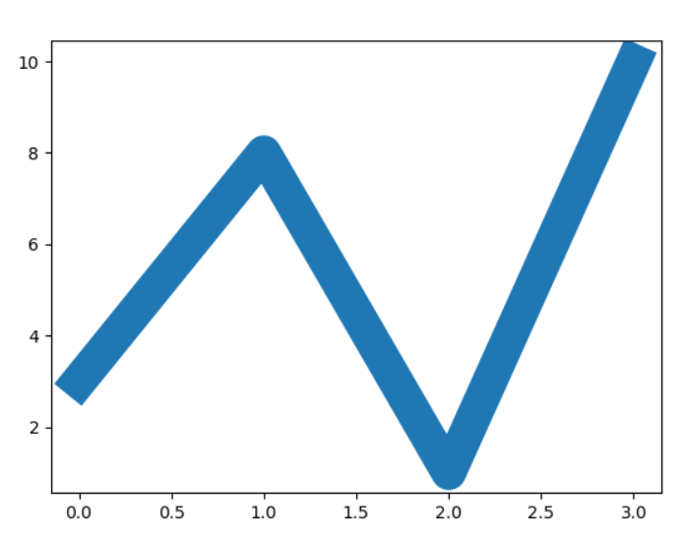
Line Chart
import matplotlib.pyplot as plt import numpy as np ypoints = np.array([3, 8, 1, 10]) plt.plot(ypoints, linewidth = '20.5') plt.show()

Slide 10
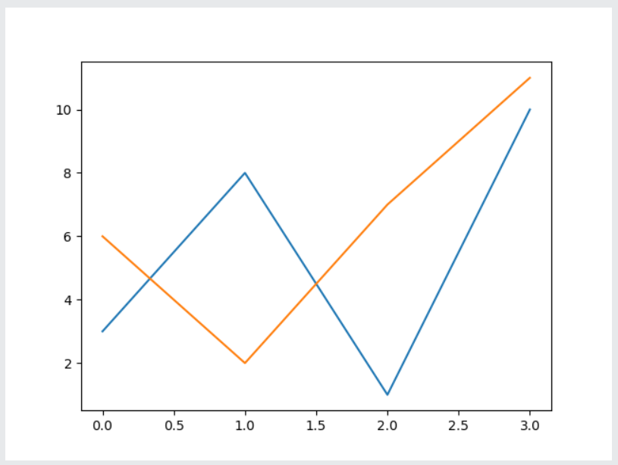
Multi Line
import matplotlib.pyplot as plt import numpy as np y1 = np.array([3, 8, 1, 10]) y2 = np.array([6, 2, 7, 11]) plt.plot(y1) plt.plot(y2) plt.show()

Slide 11
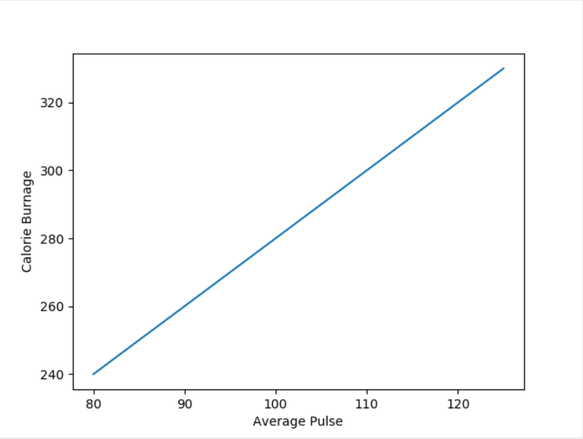
Matplotlib Labels and Title
import numpy as np import matplotlib.pyplot as plt x = np.array([80, 85, 90, 95, 100, 105, 110, 115, 120, 125]) y = np.array([240, 250, 260, 270, 280, 290, 300, 310, 320, 330]) plt.plot(x, y) plt.xlabel("Average Pulse") plt.ylabel("Calorie Burnage") plt.show()

Slide 12
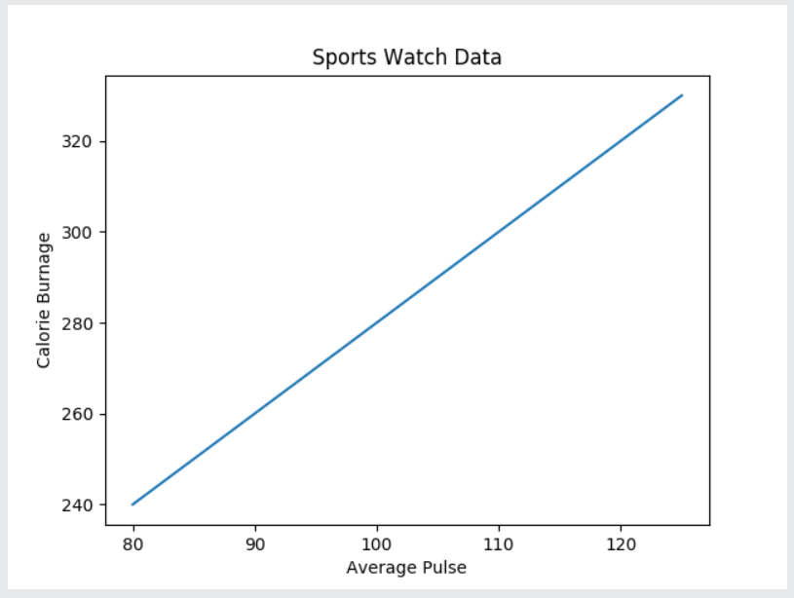
Create a Title for a Plot
import numpy as np import matplotlib.pyplot as plt x = np.array([80, 85, 90, 95, 100, 105, 110, 115, 120, 125]) y = np.array([240, 250, 260, 270, 280, 290, 300, 310, 320, 330]) plt.plot(x, y) plt.title("Sports Watch Data") plt.xlabel("Average Pulse") plt.ylabel("Calorie Burnage") plt.show()

Slide 13
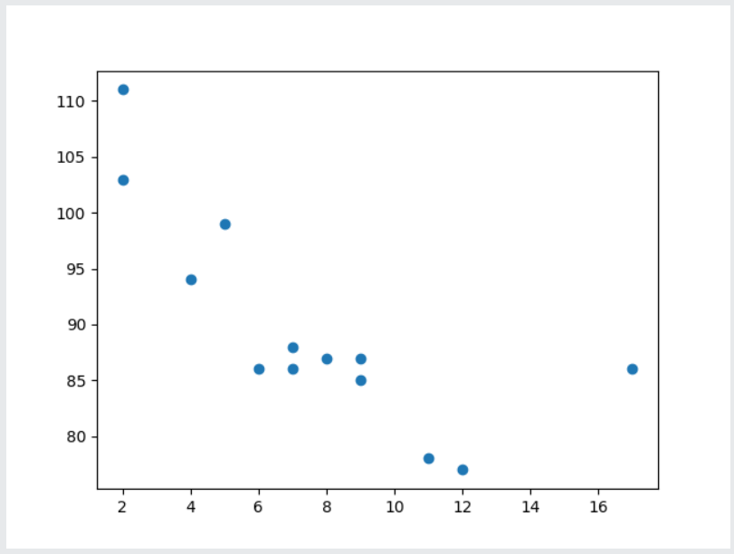
Creating Scatter Plots
import matplotlib.pyplot as plt import numpy as np x = np.array([5,7,8,7,2,17,2,9,4,11,12,9,6]) y = np.array([99,86,87,88,111,86,103,87,94,78,77,85,86]) plt.scatter(x, y) plt.show()

Slide 14
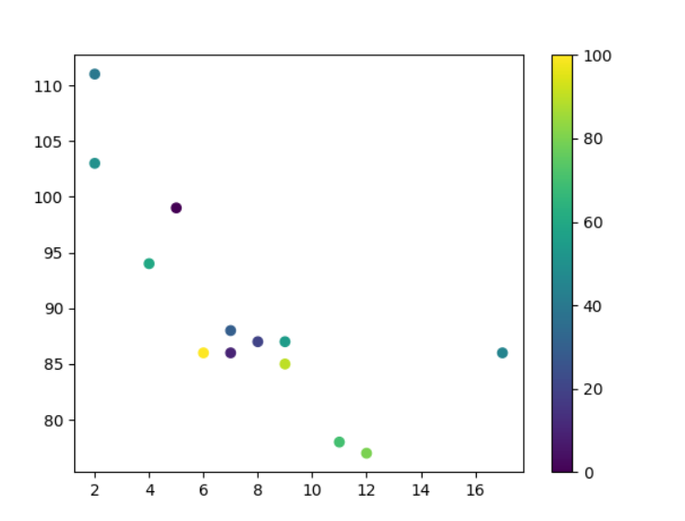
Use the ColorMap
import matplotlib.pyplot as plt import numpy as np x = np.array([5,7,8,7,2,17,2,9,4,11,12,9,6]) y = np.array([99,86,87,88,111,86,103,87,94,78,77,85,86]) colors = np.array([0, 10, 20, 30, 40, 45, 50, 55, 60, 70, 80, 90, 100]) plt.scatter(x, y, c=colors, cmap='viridis') plt.colorbar() plt.show()

Slide 15
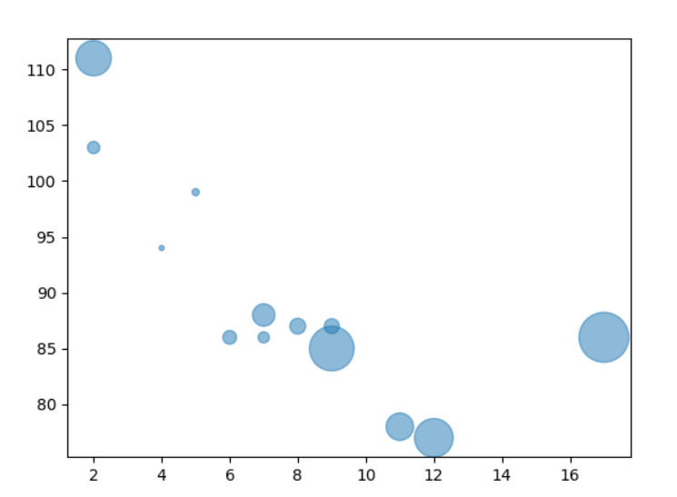
Use the Alpha
import matplotlib.pyplot as plt import numpy as np x = np.array([5,7,8,7,2,17,2,9,4,11,12,9,6]) y = np.array([99,86,87,88,111,86,103,87,94,78,77,85,86]) sizes = np.array([20,50,100,200,500,1000,60,90,10,300,600,800,75]) plt.scatter(x, y, s=sizes, alpha=0.5) plt.show()

Slide 16
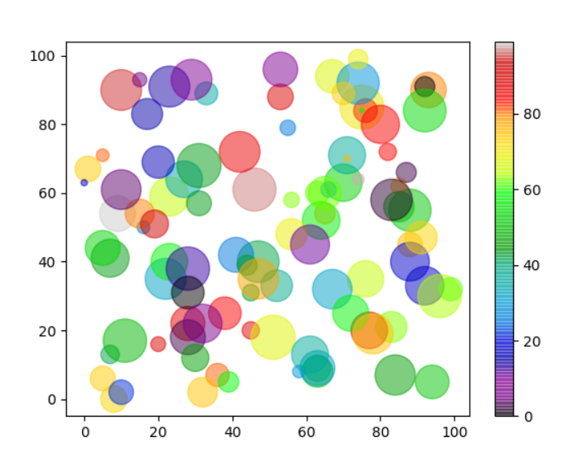
Use the Alpha
import matplotlib.pyplot as plt import numpy as np x = np.random.randint(100, size=(100)) y = np.random.randint(100, size=(100)) colors = np.random.randint(100, size=(100)) sizes = 10 * np.random.randint(100, size=(100)) plt.scatter(x, y, c=colors, s=sizes, alpha=0.5, cmap='nipy_spectral') plt.colorbar() plt.show()

Slide 17
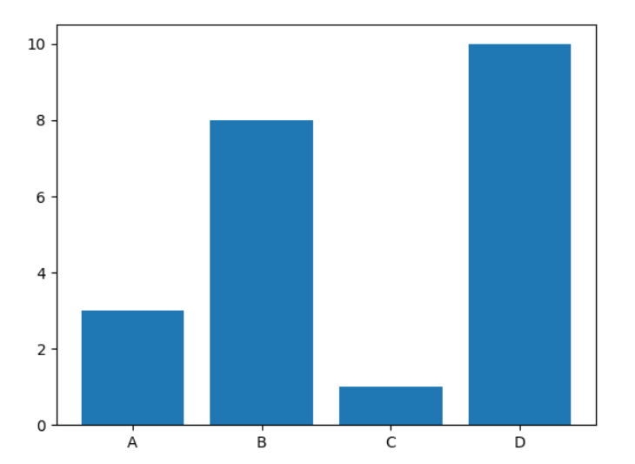
Creating Bars
import matplotlib.pyplot as plt import numpy as np x = np.array(["A", "B", "C", "D"]) y = np.array([3, 8, 1, 10]) plt.bar(x,y) plt.show()

Slide 18
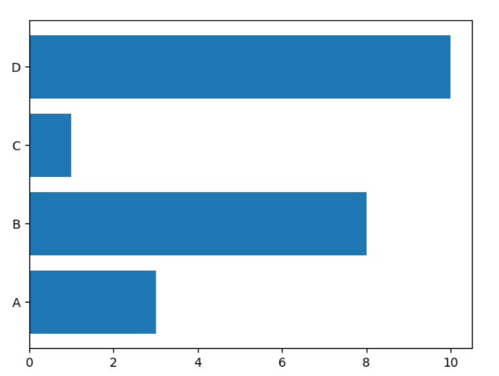
Horizontal Bars
import matplotlib.pyplot as plt import numpy as np x = np.array(["A", "B", "C", "D"]) y = np.array([3, 8, 1, 10]) plt.barh(x, y) plt.show()

Slide 19
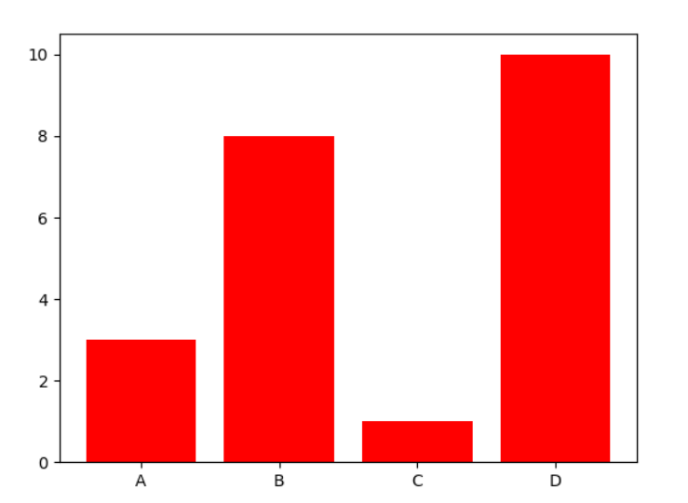
Bar Color
import matplotlib.pyplot as plt import numpy as np x = np.array(["A", "B", "C", "D"]) y = np.array([3, 8, 1, 10]) plt.bar(x, y, color = "red") plt.show()

Slide 20
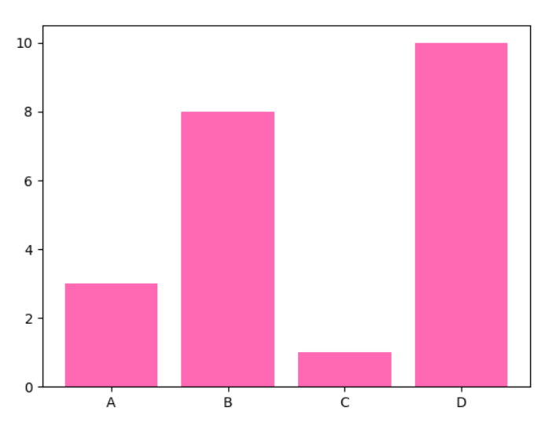
Bar Color
import matplotlib.pyplot as plt import numpy as np x = np.array(["A", "B", "C", "D"]) y = np.array([3, 8, 1, 10]) plt.bar(x, y, color = "hotpink") plt.show()

Slide 21
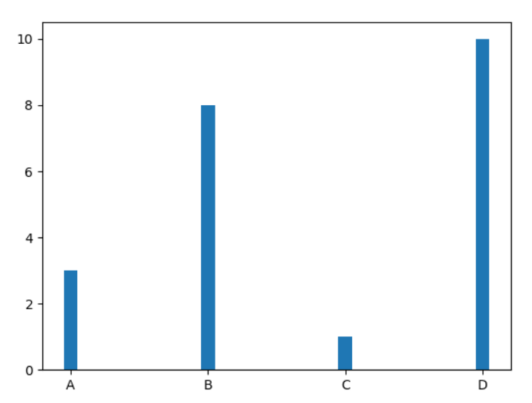
Width
import matplotlib.pyplot as plt import numpy as np x = np.array(["A", "B", "C", "D"]) y = np.array([3, 8, 1, 10]) plt.bar(x, y, width = 0.1) plt.show()

Slide 22
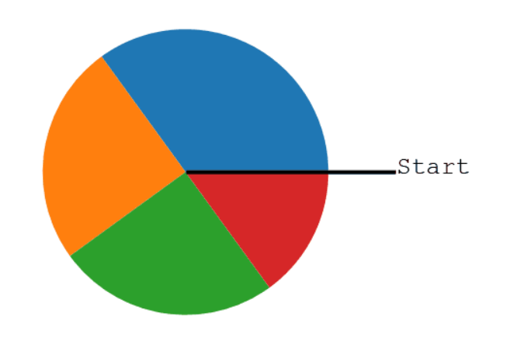
Creating Pie Charts
import matplotlib.pyplot as plt import numpy as np y = np.array([35, 25, 25, 15]) plt.pie(y) plt.show()

Slide 23
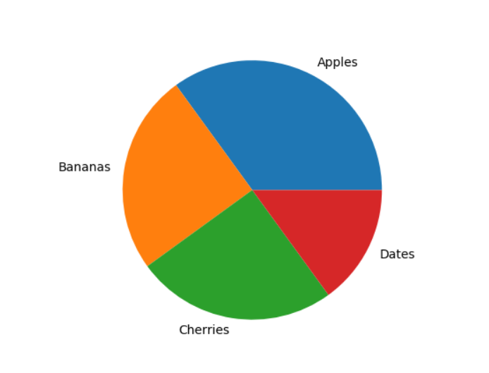
Creating Pie Charts Labels
import matplotlib.pyplot as plt import numpy as np y = np.array([35, 25, 25, 15]) mylabels = ["Apples", "Bananas", "Cherries", "Dates"] plt.pie(y, labels = mylabels) plt.show()

Slide 24
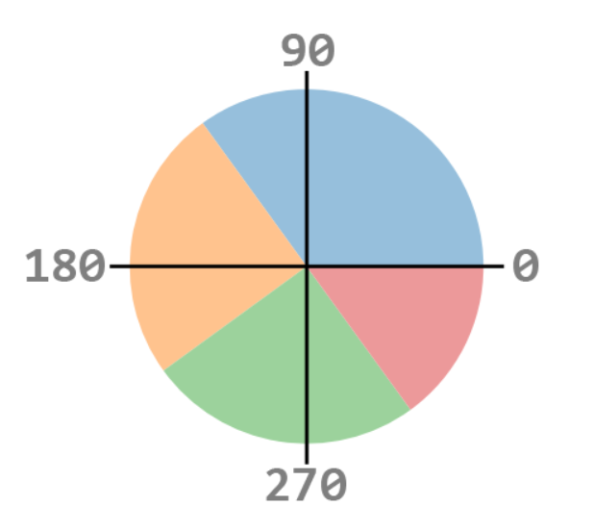
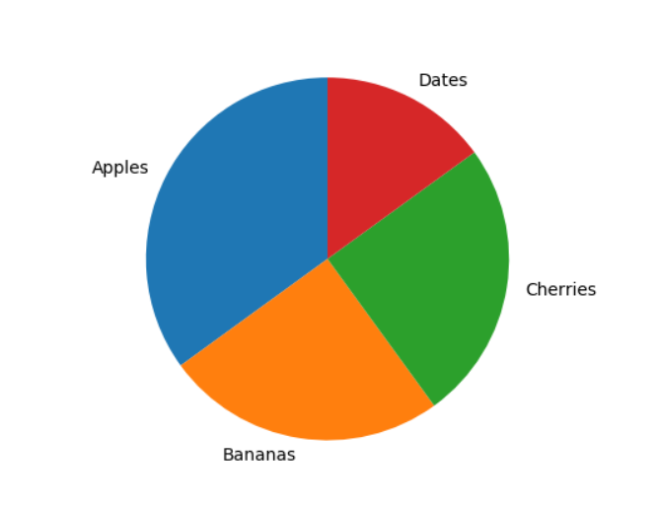
Start Angle
import matplotlib.pyplot as plt import numpy as np y = np.array([35, 25, 25, 15]) mylabels = ["Apples", "Bananas", "Cherries", "Dates"] plt.pie(y, labels = mylabels, startangle = 90) plt.show()

Slide 25
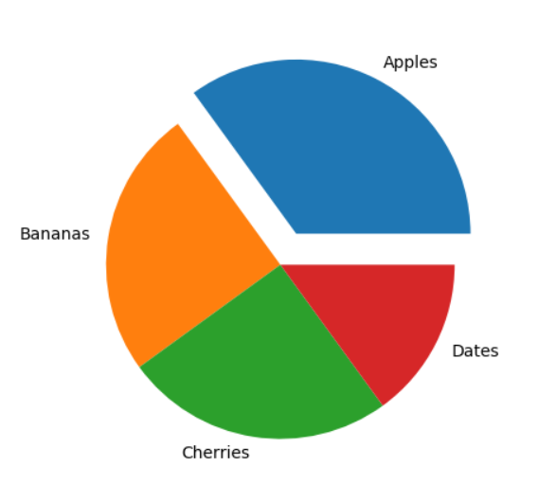
Explode
import matplotlib.pyplot as plt import numpy as np y = np.array([35, 25, 25, 15]) mylabels = ["Apples", "Bananas", "Cherries", "Dates"] myexplode = [0.2, 0, 0, 0] plt.pie(y, labels = mylabels, explode = myexplode) plt.show()

Slide 26
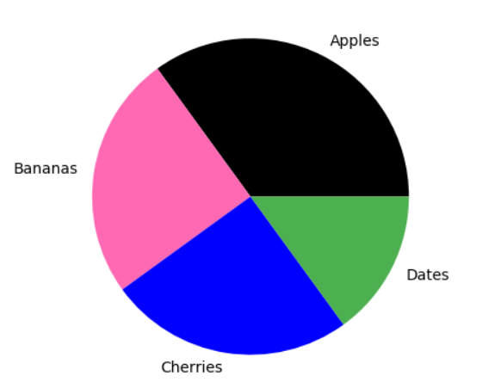
Colors
import matplotlib.pyplot as plt import numpy as np y = np.array([35, 25, 25, 15]) mylabels = ["Apples", "Bananas", "Cherries", "Dates"] mycolors = ["black", "hotpink", "b", "#4CAF50"] plt.pie(y, labels = mylabels, colors = mycolors) plt.show()

Slide 27
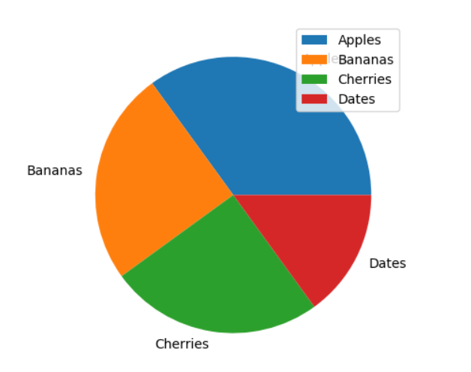
Legend
import matplotlib.pyplot as plt import numpy as np y = np.array([35, 25, 25, 15]) mylabels = ["Apples", "Bananas", "Cherries", "Dates"] plt.pie(y, labels = mylabels) plt.legend() plt.show()

