Slide 1


Since 2011
Our outcomes are over 5000 trainees.
Get IT Right from RIG

Slide 2

Full Stack Development
with
Python and React
Learn, Create, and Shine
Digital Space

Slide 3
Courses
• Building Your First Python GUI Application With Tkinter
• Working With Widgets
• Controlling Layout With Geometry Managers
• Making Your Applications Interactive

Slide 4
Introduction
Tkinter is Python’s standard GUI framework, making it convenient for developing graphical user interfaces. As a cross-platform library, Tkinter ensures your applications appear native across Windows, macOS, and Linux. Despite criticisms of its outdated appearance, Tkinter remains a practical choice for quickly creating functional and cross-platform GUI applications.

Slide 5
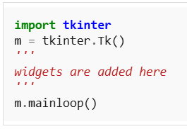
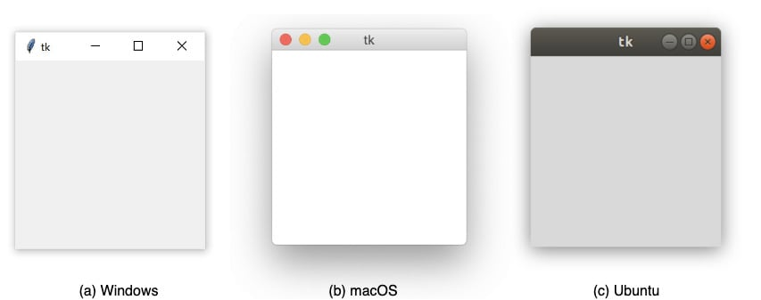
Widgets

Slide 6
Tkinter Widgets
Label
Button
Entry
CheckButton
RadioButton
Listbox
Scrollbar
Menu
Combobox
Scale
TopLevel
Message
Progressbar
SpinBox
Text
PannedWindow

Slide 7
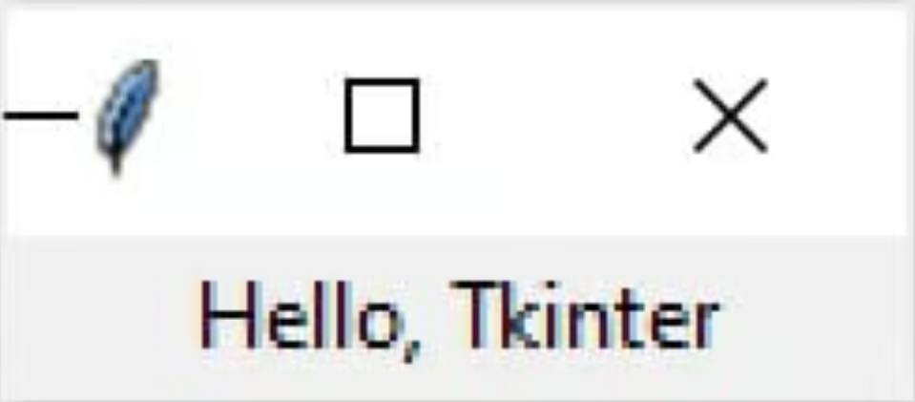
Label
from tkinter import *
root = Tk()
w = Label(root, text=‘Hello, Tkinter')
w.pack()
root.mainloop()

Slide 8

Button
import tkinter as tk
r = tk.Tk()
r.title('Counting Seconds')
button = tk.Button(r, text='Stop', width=25, command=r.destroy)
button.pack()
r.mainloop()

Slide 9
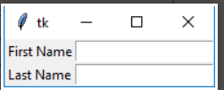
Button
from tkinter import *
master = Tk()
Label(master, text='First Name').grid(row=0)
Label(master, text='Last Name').grid(row=1)
e1 = Entry(master)
e2 = Entry(master)
e1.grid(row=0, column=1)
e2.grid(row=1, column=1)
mainloop()

Slide 10
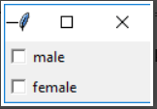
Check Button
from tkinter import *
master = Tk()
var1 = IntVar()
Checkbutton(master, text='male', variable=var1).grid(row=0, sticky=W)
var2 = IntVar()
Checkbutton(master, text='female', variable=var2).grid(row=1, sticky=W)
mainloop()

Slide 11
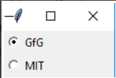
Radio Button
from tkinter import *
root = Tk()
v = IntVar()
Radiobutton(root, text='GfG', variable=v, value=1).pack(anchor=W)
Radiobutton(root, text='MIT', variable=v, value=2).pack(anchor=W)
mainloop()

Slide 12
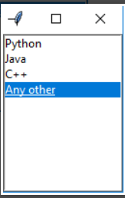
Listbox
from tkinter import *
top = Tk()
Lb = Listbox(top)
Lb.insert(1, 'Python')
Lb.insert(2, 'Java')
Lb.insert(3, 'C++')
Lb.insert(4, 'Any other')
Lb.pack()
top.mainloop()

Slide 13
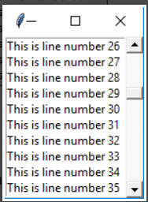
Scrollbar
from tkinter import *
root = Tk()
scrollbar = Scrollbar(root)
scrollbar.pack(side=RIGHT, fill=Y)
mylist = Listbox(root, yscrollcommand=scrollbar.set)
for line in range(100):
mylist.insert(END, 'This is line number' + str(line))
mylist.pack(side=LEFT, fill=BOTH)
scrollbar.config(command=mylist.yview)
mainloop()

Slide 14
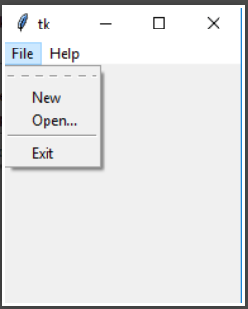
Menu
from tkinter import *
root = Tk()
menu = Menu(root)
root.config(menu=menu)
filemenu = Menu(menu)
menu.add_cascade(label='File', menu=filemenu)
filemenu.add_command(label='New')
filemenu.add_command(label='Open...')
filemenu.add_separator()
filemenu.add_command(label='Exit', command=root.quit)
helpmenu = Menu(menu)
menu.add_cascade(label='Help', menu=helpmenu)
helpmenu.add_command(label='About')
mainloop()

Slide 15
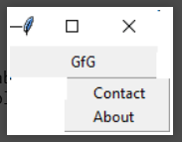
Menu Button
from tkinter import *
top = Tk()
mb = Menubutton ( top, text = "GfG")
mb.grid()
mb.menu = Menu ( mb, tearoff = 0 )
mb["menu"] = mb.menu
cVar = IntVar()
aVar = IntVar()
mb.menu.add_checkbutton ( label ='Contact', variable = cVar )
mb.menu.add_checkbutton ( label = 'About', variable = aVar )
mb.pack()
top.mainloop()

Slide 16
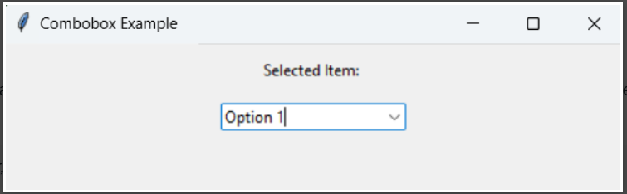
Combobox
Notes:
import tkinter as tk
from tkinter import ttk
def select(event):
selected_item = combo_box.get()
label.config(text="Selected Item: " + selected_item)
root = tk.Tk()
root.title("Combobox Example")
# Create a label
label = tk.Label(root, text="Selected Item: ")
label.pack(pady=10)
# Create a Combobox widget
combo_box = ttk.Combobox(root, values=["Option 1", "Option 2", "Option 3"])
combo_box.pack(pady=5)
# Set default value
combo_box.set("Option 1")
# Bind event to selection
combo_box.bind("<<ComboboxSelected>>", select)
root.mainloop()

Slide 17
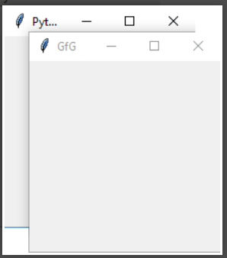
Toplevel
from tkinter import *
root = Tk()
root.title('GfG')
top = Toplevel()
top.title('Python')
top.mainloop()

Slide 18

Message
from tkinter import *
main = Tk()
ourMessage = 'This is our Message'
messageVar = Message(main, text=ourMessage)
messageVar.config(bg='lightgreen')
messageVar.pack()
main.mainloop()

Slide 19

Spinbox
from tkinter import *
master = Tk()
w = Spinbox(master, from_=0, to=10)
w.pack()
mainloop()

Slide 20
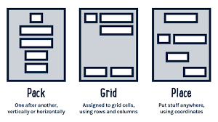
Tkinter Geometry Managers

Slide 21
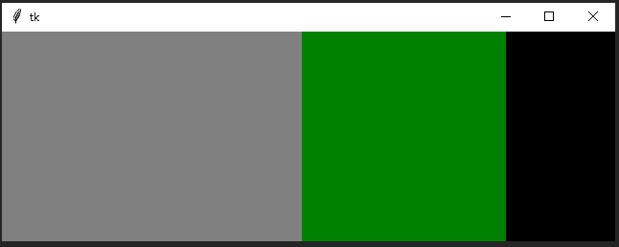
Pack( )

Slide 22
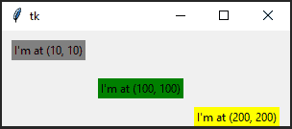
Place( )

Slide 23
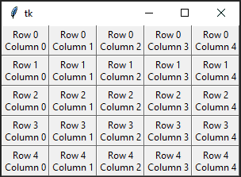
Grid( )

Slide 24
Grid( )

