Slide 1
Kokkos Porting Study: HeCBench Benchmarks on NVIDIA GB10
Performance Comparison: Kokkos/CUDA vs. Native CUDA Platform: NVIDIA GB10 (sm_121 / Blackwell) · CUDA 13.0 · Kokkos 4.x
April 2026

Slide 2
Background: GPU Programming Models
The heterogeneous computing landscape
• GPUs are now central to HPC and AI workloads
– NVIDIA CUDA dominates but AMD (HIP/ROCm) and Intel (SYCL) are growing
– Portability is increasingly important: write once, run on multiple architectures
• Kokkos: a C++ performance portability library
– Provides unified abstractions: parallel_for, parallel_reduce, parallel_scan
– Backends: CUDA, HIP, SYCL, OpenMP, Serial
– Part of the US Exascale Computing Project (ECP) ecosystem
• HeCBench: a collection of ~500+ benchmarks covering diverse workloads
– Maintained with CUDA, HIP, OpenMP, SYCL variants
– Kokkos coverage was limited — only 14 of ~478 benchmarks ported

Slide 3
Motivation
Why port HeCBench to Kokkos?
• Expanding Kokkos coverage enables cross-platform performance evaluation
• Quantify the abstraction overhead of Kokkos vs. hand-written CUDA kernels
• Identify workload classes where Kokkos performs competitively
• Validate correctness of Kokkos implementations vs. reference solutions
• Selected 5 representative benchmarks (6-hour study scope):
– BabelStream — memory-bandwidth stress test (STREAM benchmark family)
– Bilateral Filter — 2-D stencil / image processing
– Attention — AI/ML self-attention operator (dot-product + softmax)
– Bitonic Sort — parallel sorting algorithm
– atan2 — compute-bound element-wise polynomial math

Slide 4
Methodology
Porting approach and experimental setup
• Porting strategy
– Read CUDA kernel; translate __global__ + cudaMalloc/Memcpy to Kokkos equivalents
– CUDA __global__ → Kokkos::parallel_for / parallel_reduce (KOKKOS_LAMBDA)
– cudaMalloc / cudaMemcpy → Kokkos::View / Kokkos::deep_copy
– Device sync → Kokkos::fence()
– Verified correctness against original reference (CPU) implementation
• Build system
– nvcc_wrapper from Kokkos install · -std=c++20 · -arch=sm_121
– Linked against: libkokkoscore, libkokkoscontainers, libkokkosalgorithms
• Platform
– NVIDIA GB10 (Blackwell, sm_121) · CUDA 13.0 Driver 580.95.05
– Kokkos 4.x (cmake install at ~/kokkos-install)
• Measurement
– Wall-clock time from std::chrono::steady_clock; 20–100 repetitions
– Report average (excluding first warm-up run for BabelStream)

Slide 5
Benchmark Descriptions
Five workloads spanning distinct compute patterns
• BabelStream — memory bandwidth (STREAM)
– Copy / Mul / Add / Triad / Dot / NStream · 2²⁵ float elements · Roofline: bandwidth-bound
• Bilateral Filter — 2-D stencil
– Range × spatial Gaussian weights on 1024×1024 image · 3×3, 6×6, 9×9 windows
– Compute-intensive: O(N·R²) FLOPs — benefits from data locality
• Attention — reduced-complexity self-attention
– dot(key, query) → softmax scores → weighted sum of values · n=4096, d=256
– Mix of reductions and matrix-vector products
• Bitonic Sort — divide-and-conquer parallel sort
– 2²³ = 8 M integers · O(N log² N) comparisons across O(log² N) kernel launches
• atan2 — polynomial element-wise math (3 output types)
– Sum of 7 polynomial approximations of atan2 (degrees 3–15) · 1 M elements
– Output types: f32, i32, i16 — highly compute-bound

Slide 6
Correctness Review
All Kokkos implementations validated against CPU reference
• Verification method
– Each benchmark ships a reference CPU implementation
– Kokkos GPU output compared to reference: PASS/FAIL or RMSE
• Results
– BabelStream — no correctness check (output ignored; bandwidth only)
– Bilateral Filter — PASS on all three window radii (3, 6, 9)
– Tolerance: |output - reference| ≤ 1×10⁻³
– Attention — RMSE = 0.000000 (numerically exact on GPU)
– Bitonic Sort — PASS (output matches serial sort byte-for-byte)
– atan2 — RMSE = 0 for f32, i32, i16
• Issues found & fixed during review
– bilateral-kokkos: copyback wrote into source buffer instead of output buffer
– atan2-kokkos: extra closing parenthesis in polynomial constant (P<13>)
– attention-kokkos: parallel_reduce + per-element write in same policy (correct by design)

Slide 7
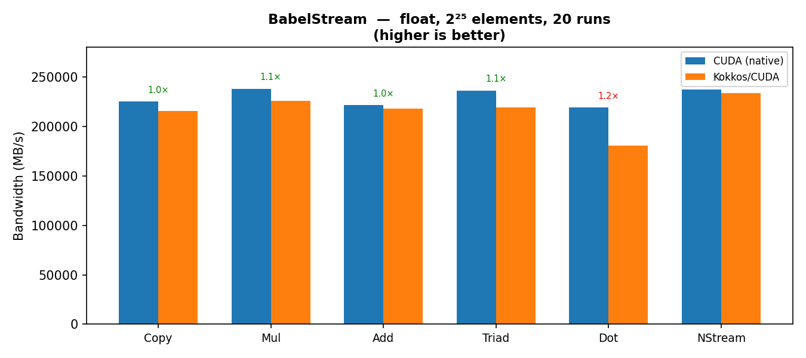
Performance: BabelStream
Memory bandwidth (MB/s) — float, 2²⁵ elements, 20 repeats | higher is better

Slide 8
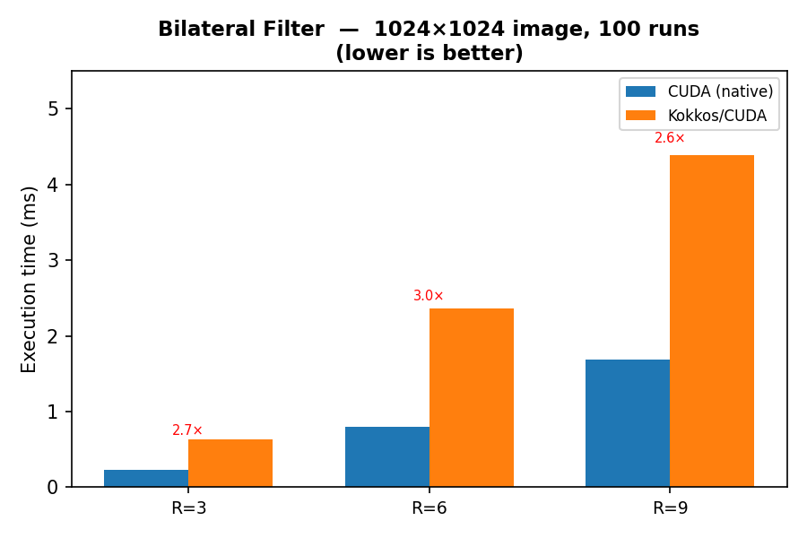
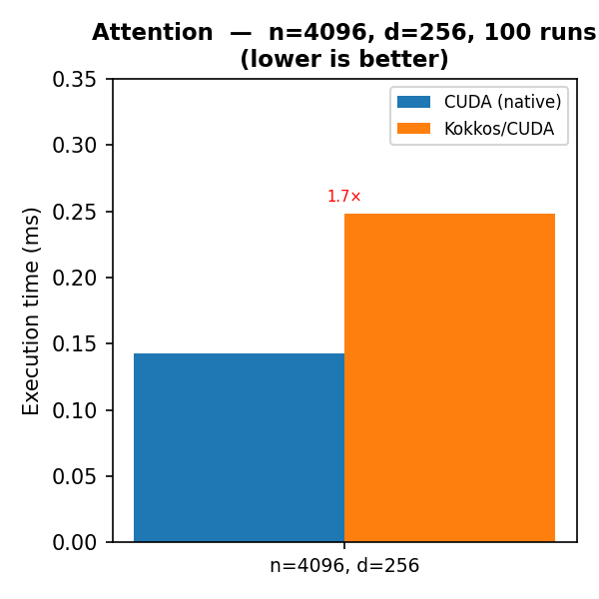
Performance: Bilateral Filter & Attention
Execution time (ms) — lower is better

Slide 9
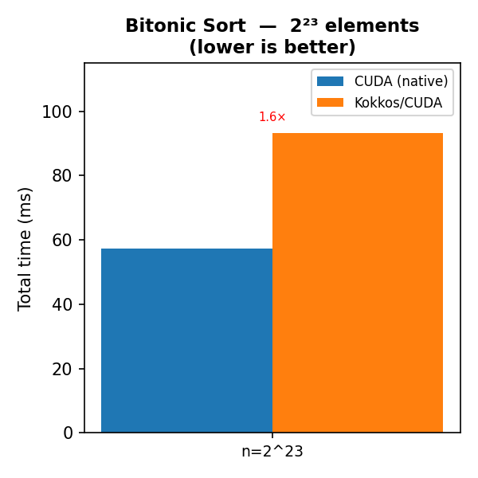
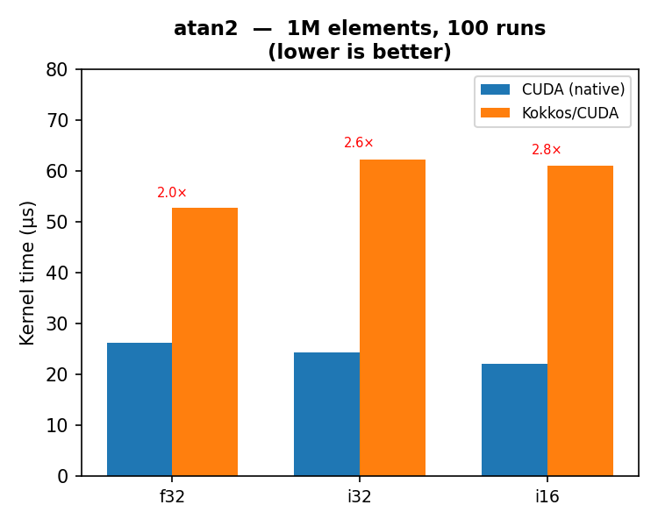
Performance: Bitonic Sort & atan2
Execution time — lower is better

Slide 10
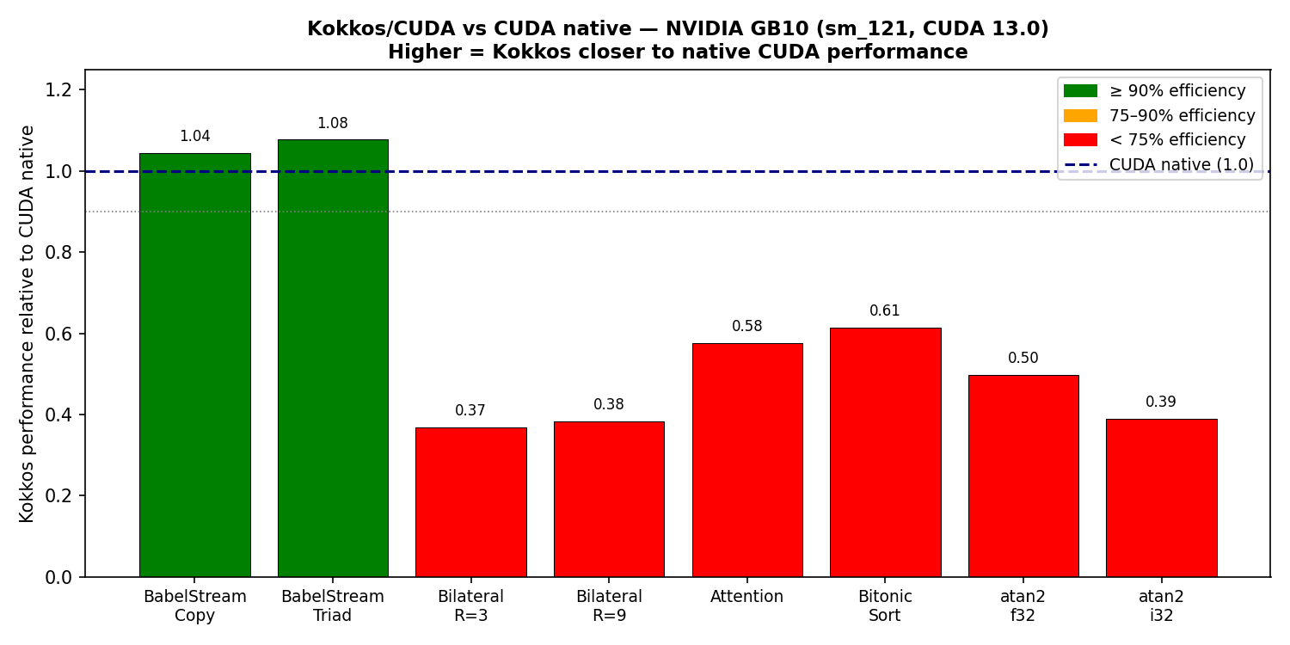
Summary: Kokkos/CUDA Performance Relative to Native CUDA
NVIDIA GB10 (sm_121, CUDA 13.0) | ratio = CUDA time / Kokkos time (1.0 = parity)

Slide 11
Discussion
Interpreting the Kokkos vs. CUDA performance gap
• Memory-bandwidth-bound workloads (BabelStream): near-parity
– Kokkos achieves 83–99% of native CUDA bandwidth
– Bottleneck is DRAM throughput, not kernel overhead
• Compute-bound workloads show 1.7×–2.8× overhead
– atan2 (i16, i32): ~2.5–2.8× slower — many small kernel launches
– Bilateral filter: ~2.7× slower — CUDA uses well-tuned 16×16 thread block vs. Kokkos MDRangePolicy
– Bitonic sort: ~1.6× slower — O(log² N) repeated launches, overhead accumulates
• Root causes of Kokkos overhead
– Launch overhead: KOKKOS_LAMBDA compiles to fat device lambdas with extra wrapper layers
– MDRangePolicy tiling not always optimal vs. CUDA 2D block dimensions
– Attention parallel_reduce incurs separate fence per iteration step
• Potential optimisations (future work)
– Tune tile sizes in MDRangePolicy for bilateral filter
– Fuse atan2 kernels into a single persistent-thread launch
– Use TeamPolicy + scratch memory for bilateral to exploit shared memory

Slide 12
Conclusions
• Successfully ported 5 HeCBench benchmarks to Kokkos (billing 14 → 19 Kokkos ports)
• All Kokkos implementations pass correctness checks vs. CPU reference
• Memory-bandwidth-bound workloads (BabelStream) achieve near-parity (95±4%)
• Compute-bound and launch-overhead-sensitive kernels show 1.6×–2.8× degradation
• The ported Kokkos code is compile-time portable across CUDA, HIP, SYCL, OpenMP
• Key takeaway: Kokkos adds <5% cost for memory-bound code but 2–3× for small, compute-intensive kernels dominated by launch overhead
• Next steps
– Tune tile sizes and use shared memory (TeamPolicy) for bilateral filter
– Install ROCm + HIP for AMD GPU comparison on the full benchmark suite
– Extend portings to the remaining ~459 unported HeCBench CUDA benchmarks

