Slide 1


Open OnDemand on Fugaku

Slide 2
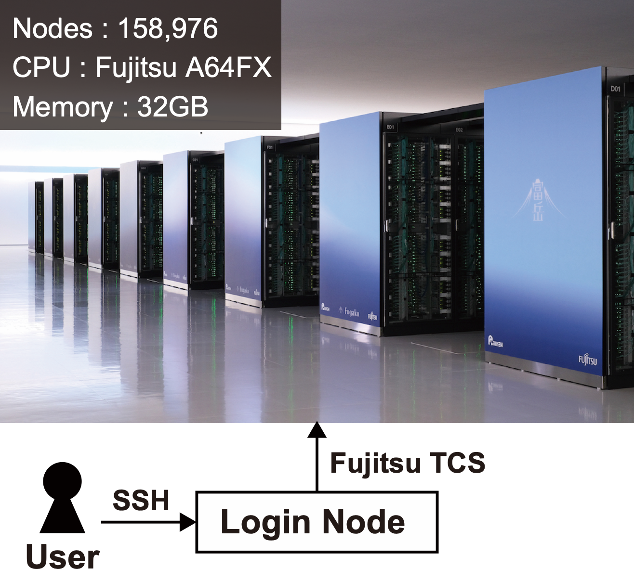


The supercomputer Fugaku
RIKEN Center for Computational Science has operated Fugaku
The conventional method of using Fugaku is to enter the login node via SSH and submit a job through the job scheduler (Fujitsu TCS)
The issue with HPC clusters such as Fugaku is that there is a lot of prerequisite knowledge for using HPC clusters, so the learning cost is high for beginners
Generate SSH key pair and register public key
Command line interface
Job scheduler
https://openondemand.org
Notes:
プリーレクィズィト
To resolve this issue, we decide to use Open OnDemand on Fugaku

Slide 3
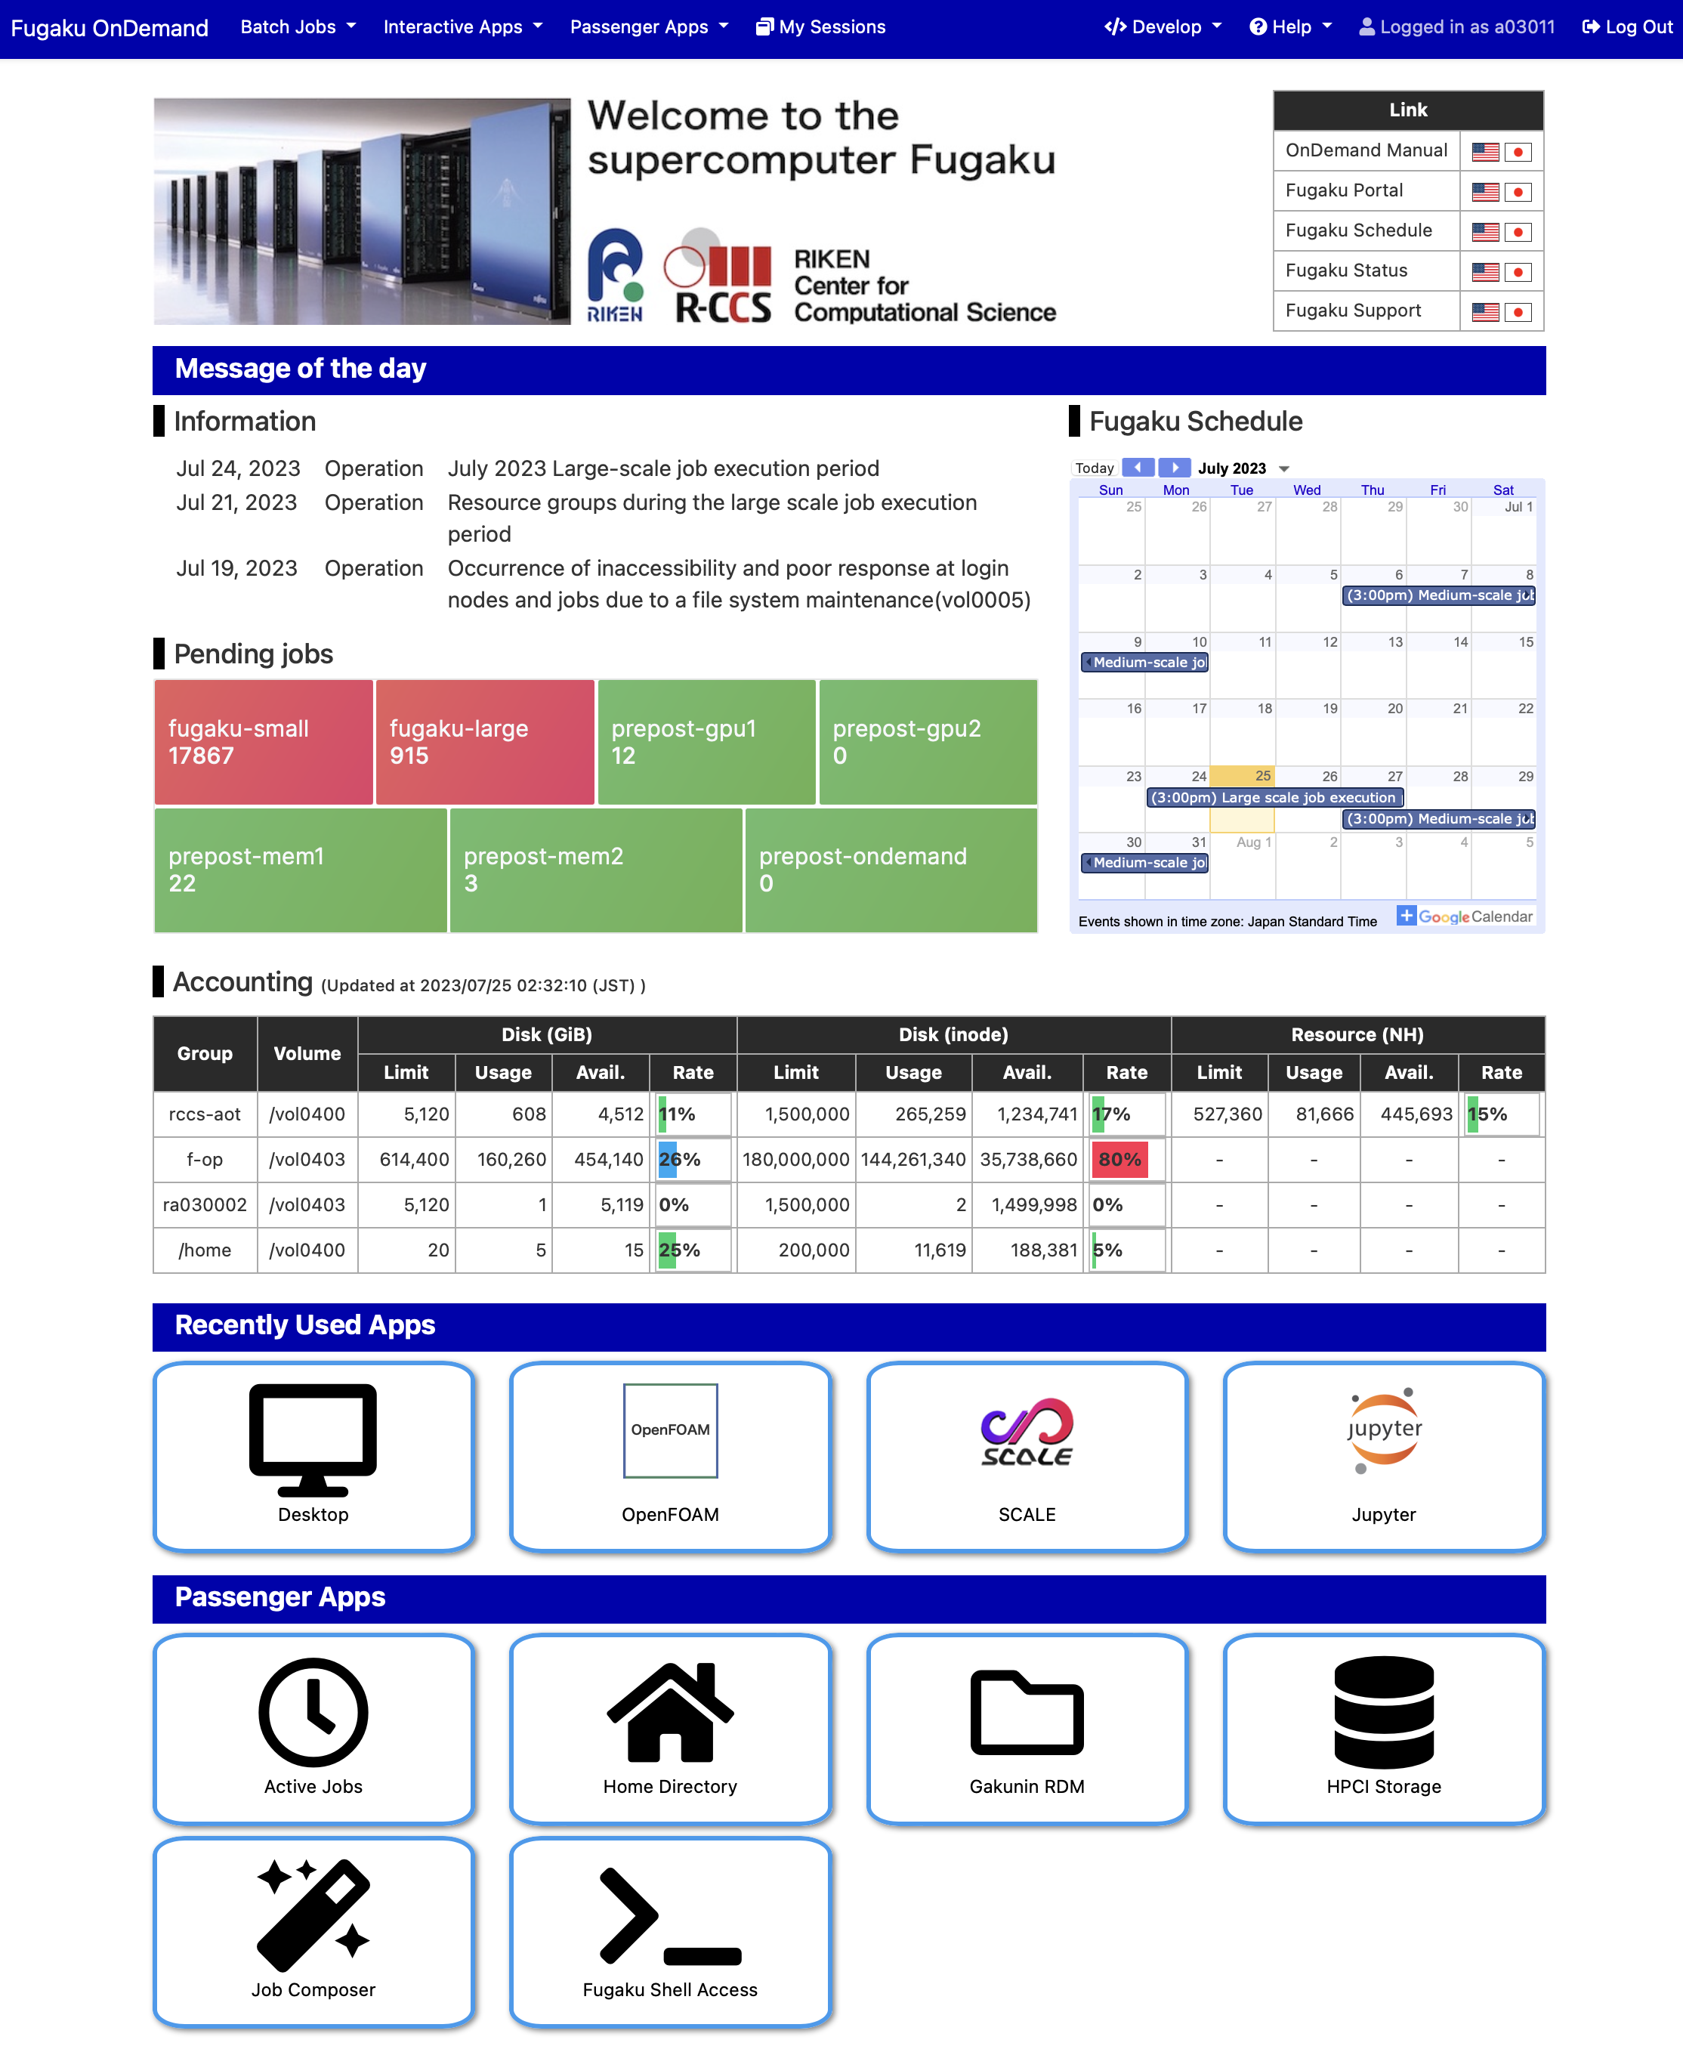
Open OnDemand on Fugaku
Open OnDemand empowers researchers with remote web access to HPC clusters
Run entirely in your web browser
Support interactive applications (e.g. remote desktop)
We have customized Fugaku Open OnDemand
Support Fujitsu TCS
Top page to display useful information for users
Operational information/calendar
Job congestion (from grafana)
User resource usage
Install about 50 applications
Develop applications for external storages in Japan
Notes:
コンジェスチョン

Slide 4
Installed applications
Interactive application
July 31, 2023
Category | Application
Development | Desktop, Jupyter, MATLAB*, RStudio, VSCode
Profiler | NVIDIA Visual Profiler*, NVIDIA Nsight Compute*, NVIDIA Nsight Systems*, Vampir*
Viewer | AVS/Express*, C-Tools, GaussView*, ImageJ, OVITO, Paraview, PyMOL, SALMON view, Smokeview, VESTA, VMD, VisIt, XCrySDen
Workflow | WHEEL
Batch application
* commercial application
Category | Application
Climate | SCALE
Computer Aided Engineering | FDS, FrontFlow (blue/X), FrontISTR, OpenFOAM (Foundation/OpenCFD)
Condensed Matter Physics | ALAMODE, AkaiKKR, HΦ, mVMC, OpenMX, PHASE/0, Quantum Espresso, SALMON
Molecular Dynamics | GENESIS, GROMACS, LAMMPS, MODYLAS
Quantum Chemistry | ABINIT-MP, Gaussian*, NTChem, SMASH
Quantum Simulation | braket
Notes:
These tables show applications installed in Fugaku Open OnDemand. Many applications can be launched from your web browser.

Slide 5
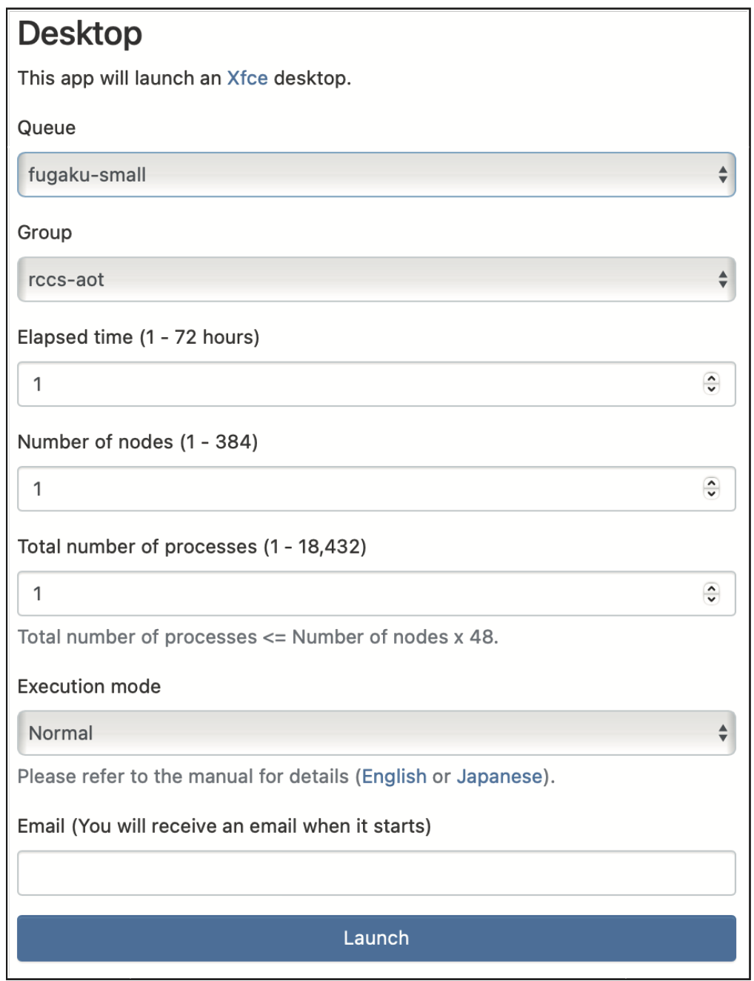
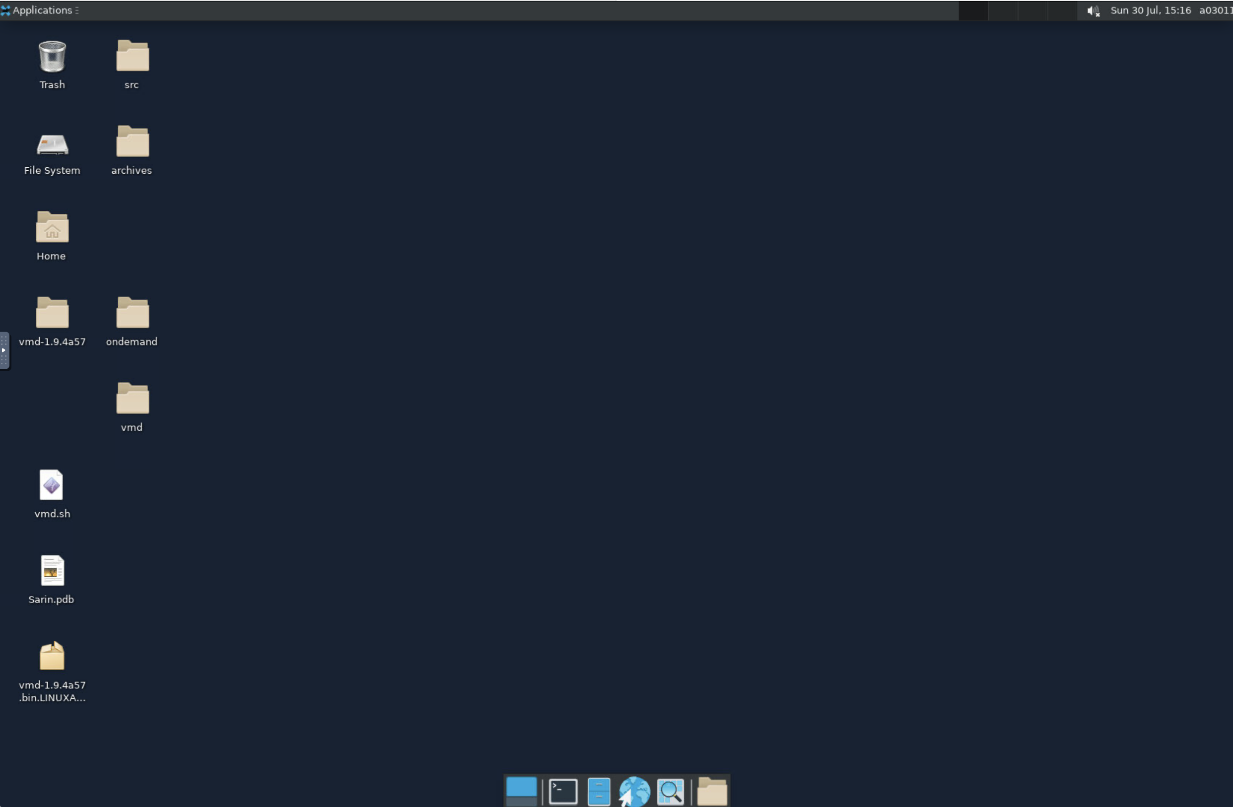
How to use Fugaku Open OnDemand
https://ondemand.fugaku.r-ccs.riken.jp
Remote Desktop runs in your
web browser
Click
Click
Submit a job to Fugaku though Fujitsu TCS
Notes:
First, open the Fugaku Open OnDemand at this URL in your web browser. Next, click the Remote Desktop icon. Next, enter the time of use and other information in the web form.
Finally, click this button and Remote Desktop will run in your web browser.

Slide 6
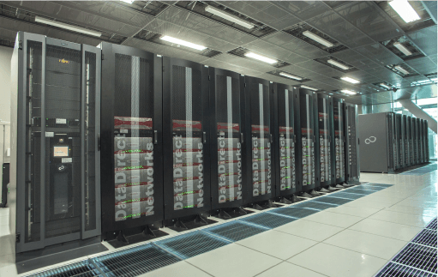
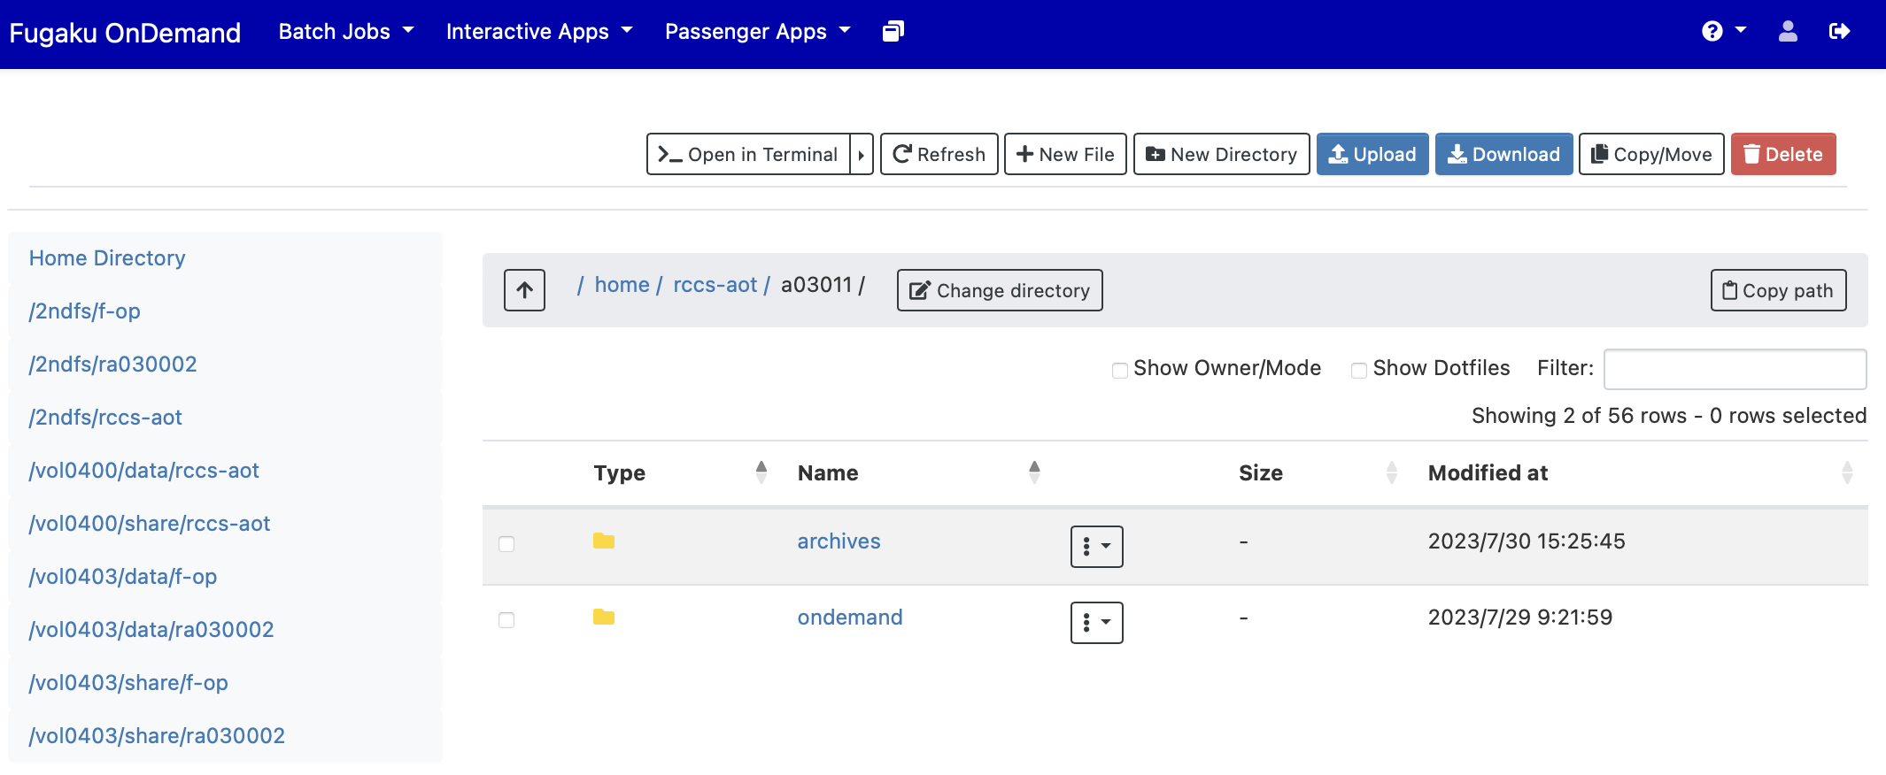

Transferring data to external storage
We develop applications on Open OnDemand to share data for HPCI Shared Storage and GakuNin RDM
HPCI Shared Storage is a large-scale data sharing infrastructure for high-speed and secure sharing of research data among Japanese research organizations
GakuNin RDM is a research data management service for sharing research data with collaborators in Japan
Users can share data between Fugaku and these storages in your web browser
HPCI Shared Storage
Fugaku Open OnDemand
Notes:
In addition, we develop applications on ..

Slide 7
Demo
Notes:
Next, I will demonstrate Fugaku Open OnDemand.

