Slide 1

Crop yield management and prediction by analyzing environmental data
Group 2
Presented by-
Arun Pratap Tomar - 11652000
Namratha Modalavalasa - 11652002
Padmaja Kodati - 11647780
Rikhita Koganti - 11641222

Slide 2
Idea
Problem Statement: Although Farmers are trying new tools, fertilizers and seeds for the growth of crop, its production is getting decreased every year. This is happening because of different climatic factors such as humidity, temperature and most importantly rainfall and soil fertility.
Solution: Predicting the performance of crop production based on specific region, area and rainfall so that farmers will be able to predict the type of crop needed and according to rainfall they can change the crop type they are going to sow and get better production.

Slide 3
Introduction
With the increasing demand for food production, it is essential to optimize crop yield through effective management and prediction techniques.
big data analytics tools like PySpark have gained popularity in agriculture for analyzing enormous amounts of data gathered from various sources, including weather stations, soil sensors, and satellite images.
Patterns can be found in the data by querying it in Cassandra, and these patterns can be used to forecast agricultural yields in the future.

Slide 4
Motivation
Seeing the crop growing in fields
Statistics of crop production annually and watching news of deteriorating lifestyle of farmers.
With its strong Cassandra integration, PySpark is a potent platform for distributed data processing and machine learning. As a result, we can use PySpark to analyze and model crop data stored in Cassandra while also utilizing its collaborative computing capabilities to process sizable datasets swiftly and effectively.
Cassandra and PySpark for agricultural yield management and prediction can help to increase the precision and efficiency of crop production and can assist farmers in making better choices regarding planting, fertilization, irrigation, and other variables that can affect crop growth and production

Slide 5
Literature Survey
Paper 1: Crop yield prediction with deep convolutional neural networks
Paper 2: Prediction of Crop Yield using Regression Analysis
Paper 3: Predicting Yield of Crop Using Machine Learning Algorithm.
Paper 4: Crop yield prediction using Agro Algorithm in Hadoop
Paper 5: Crop Prediction using Machine Learning Approaches
Paper 6: Crop yield prediction using machine learning techniques
Paper 7: A comprehensive performance analysis of Apache Hadoop and Apache Spark for large scale data sets using HiBench
Paper 8: The Transition from RDBMS to NoSQL. A Comparative Analysis of Three Popular Non-Relational Solutions: Cassandra, MongoDB and Couchbase

Slide 6
Analysis we could make
Farmers’ life-style has remained same throughout the time.
Farmers are still following same traditional approach.
They are going up with market trends (hybrid seeds and fertilizers) for changing the production rather than focusing on natural factors(rainfall, humidity and soil fertility).
Model can be built which can help farmers and the farming sector to help in increment of crop production and get valued payback for their crops using market price patterns with every changing year.

Slide 7
Approach
After analysis we came up with some thoughts :
There is large scope of improvement in agriculture world.
We can incorporate various technological approaches like prediction in the farming sector.
We can build the model which can help farmers to increase their crop production in forthcoming years.
Using spark framework is a valuable approach as it allows for the processing of large volumes of data quickly and efficiently.

Slide 8
Designing the approach
The steps are:
Step 1: Data should be explored and collected.
Step 2 : Merging of datasets and cleaning needs to be done.
Step 3 : Data Manipulation and imputation should be done.
Step 4 : Model should be built with high accuracy and desired outcome.

Slide 9
Work Flow of Solution
Data Exploration
Data Collection
Data Refining
Data Representation
Building the model

Slide 10
Data Exploration
According to the attributes which were required to build the model, we started exploring in different publicly available sources. After some attempts and research we were able to find the related datasets.

Slide 11
Data Collection
Datasets were collected from the publicly available resources of the Indian government website mygov.in. The first dataset consists of year, production, area, state name, second dataset consists of subdivisions of states and rainfall annually, monthly and quarterly. Third dataset consists of state, district_name, year and rainfall annually, monthly and quarterly.
Dataset which is used for study was prepared after merging the above datasets together. It consists of different attributes such as year in which the specified crop is grown, Season, type of crop, specific area, production of crop, and annual_rainfall. Three datasets were merged together for better analysis and were stored as .csv file.

Slide 12
Data Refining
In Pyspark, For data cleaning, first, the null values were checked in the dataset and were filled by taking the mean of the entries of that respected column for production or by dropping those null values. After that correlation was checked among attributes using heatmap to extract the knowledge as which analysis pattern is to be used.
In Cassandra, different queries were executed for better refinement of data using select, by putting where clause and using group by clause to get the desired data. For example, if we want to fetch data only for specific state we have to execute query as select * from crop where state = ‘Kerala’.

Slide 13
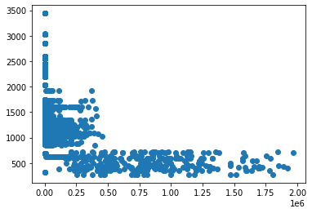
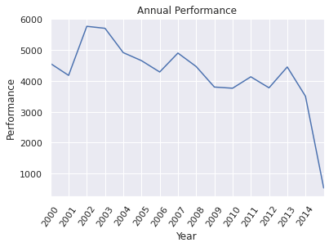
Data Representation
Different graphs are used for representing the different target outputs such as scatter plot, heat map, bar graph etc.
Scatter plot for wheat data
Performance of crop year wise

Slide 14
Building the model
In this, the discussion of building the prediction model for Gradient Boosting Classifier, Decision Tree Classifier, and Random Forest Classifier was done. These are predictive modeling technique that show the correlation between target variables and independent variables. For this model, production was considered as a dependent variable and other attributes(crop_year, area, annual_rainfall) were considered as independent variables.

Slide 15
Decision Tree Classifier
Decision Tree classifier is a technique that classifies data and makes judgments by using a tree-like structure. Recursively dividing the data into subsets depending on the values of the input features and ensuring that each subset has comparable properties results in the construction of the model. Model Accuracy : 0.9169
Precision Score : 0.869

Slide 16
Random Forest
This technique is used for types of analysis algorithms classification and regression. It also forms the model by combining different decision trees like gradient boosting but aggregates the decision trees at the end.
Model Accuracy : 0.896
Precision Score : 0.994
Recall Score: 0.978

Slide 17
Gradient Boosting
It is an ML technique for different types of analysis problems such as classification and regression. It predicts the model by forming different decision trees and combining them from the starting
Model Accuracy : 0.919
Recall Score : 0.720

Slide 18
Conclusion
We can predict yields of crops based on environmental information and create management strategies for it using big data techniques like Spark and Cassandra as well as machine learning algorithms.
The project will analyze the data and create models to precisely estimate crop yield by utilizing machine learning algorithms. Decisions about when to start growing, fertilizing, and harvesting crops can then be made using these models in an informed manner.

Slide 19
Future Work
Statistics of production for every year according to the state and rainfall.
Applying deep learning algorithms to find plant disease and suggest the way to prevent crop from disease.

Slide 20
Difficulties faced during research
Right from the beginning, individual were not sure about using these technologies in agricultural sector.
Getting related data from online sources was difficult.
Unstructured and not related data.
Building the model and getting desired output.

Slide 21
Demo Link
https://drive.google.com/file/d/1Hc3IqDpurtrjskKIoigp06MT9XG6VCdR/view?usp=share_link

Slide 22
Thank You

