Slide 1
Varsha Rainfall Chatbot
Detailed Change Summary — Frontend & Backend
Session date: 11 August 2026 · Product: iRAINS / IMD
Repos: iru-irains-backend + IRAINS-frontend · Feature: Clarification flows, category answers, UI polish

Slide 2
Agenda
1. Overview — what we built yesterday
2. Clarification flow (Did you mean → Period → Data)
3. Backend changes (clarification.js, chatService, apiExecutor)
4. Frontend changes (Varsha UI, chips, answer formatting)
5. Bug fixes from live testing (with before/after)
6. Category miss messaging (Excess vs actual category)
7. Date / period handling (June month, Historical, Season so far)
8. Files touched & test plan
9. Summary & next recommendations
iRAINS · Varsha Chatbot · Changes 11 Aug 2026 · 2/17

Slide 3
1. Target User Flow
Example: “can you give me chenai data of excess” / “no rain” / “large excess”
1
2
3
4
5
User question
Typo + category + unclear period
Did you mean?
Yes / No chips for Chennai
Pick period
Today / Yesterday This month / …
Optional month
Specific month or type March 2023
Data answer
Category hit or category miss
Rule: never skip Did-you-mean when a place looks misspelled. Never invent a place from English words (e.g. “than” ≠ Thane). Period chips must not glue onto the place name (e.g. “goa monthly”).
iRAINS · Varsha Chatbot · Changes 11 Aug 2026 · 4/17

Slide 4
2. Overview — Yesterday’s Goals
Product intent
Outcome
Make Varsha behave like a guided rainfall assistant, not a free-form LLM.
• Catch typos before calling APIs
• Ask Yes/No for place corrections
• Ask for period when timeframe is unclear
• Answer category questions correctly
• Never contradict itself (e.g. show departure then say “no data”)
• Polish clarify UI (chips, hints, no raw HTML)
New clarification layer on backend
Frontend clarify chips + free-text matching
Deterministic answers for category misses
Safer location fuzzy-matching
Correct month/year & historical ranges
Professional clarify message layout
Backend ~+578 LOC | Frontend ~+837 LOC
iRAINS · Varsha Chatbot · Changes 11 Aug 2026 · 3/17

Slide 5
3. Backend — Files & Responsibilities
NEW clarification.js
UPDATED chatService.js
UPDATED apiExecutor.js
Pre-chat validation layer
• Fuzzy place matching
• Did-you-mean Yes/No
• Invalid date / location
• Suspicious mm values
• Mixed temp+rain intent
• Category period chips
• Specific-month picker
• Location master (DB + seed)
• healPlaceFilterLevel()
Wires clarification into chat
• runPreChatClarifications()
• Category-miss answer rules
• Override LLM when empty
category filter (no “data
not available” contradiction)
• Prompt: category_miss ≠
missing rainfall data
• Strip confirmed_rainfall_mm
token before planning
Date & category healers
• extractCategoriesFromQuestion
• sanitizeDatesFromQuestion
• applyMonthRangeFromQuestion
• Historical → season start
• category_miss payload
• State/district fallbacks
• sanitizeRainfallAction
Docs: IRAINS_API_CATALOG.md
(Q5c place + category)
iRAINS · Varsha Chatbot · Changes 11 Aug 2026 · 5/17

Slide 6
3a. Backend Clarification Types
did_you_mean
chenai → Chennai
Yes / No chips; Yes rewrites place then continues
ambiguous_timeframe
place known, no period
Today, Yesterday, Last 7 days, This/Last month, Specific month / Season so far
which_month
Specific month picked
Last 12 months + Year 20XX chips; free text e.g. March 2023
invalid_location
unknown place
Suggest nearby district names as chips
invalid_date
31 Feb etc.
Ask for a valid date
suspicious_rainfall_value
4000mm
Yes 40 mm / Keep 4000 mm; no re-ask loop
mixed_concept
temp + rain
Rainfall available; Temperature disabled
iRAINS · Varsha Chatbot · Changes 11 Aug 2026 · 6/17

Slide 7
3b. Date & Period Handling
sanitizeDatesFromQuestion / applyMonthRange
Live bug: Goa June
Relative phrases always win over LLM-copied catalog dates.
• today / yesterday → single day
• last 7 days / this week → rolling week
• this month / monthly → 1st → today
• last month → full previous month
• historical / season so far / seasonal
→ SW monsoon start (1 June) → today
Whole-month phrases (current year if omitted):
• in June / on June / June month / month of June
• June 2024 keeps explicit year
• Prevents LLM inventing 2023-06-01…06-30
User: rainfall in goa on june month
Before:
• Answered June 2023 (catalog example)
• All values “Not available”
After:
• Forces 2026-06-01 → 2026-06-30
(server year when year omitted)
Also renamed vague “Historical” chip
→ “Season so far” so the range is clear.
iRAINS · Varsha Chatbot · Changes 11 Aug 2026 · 8/17

Slide 8
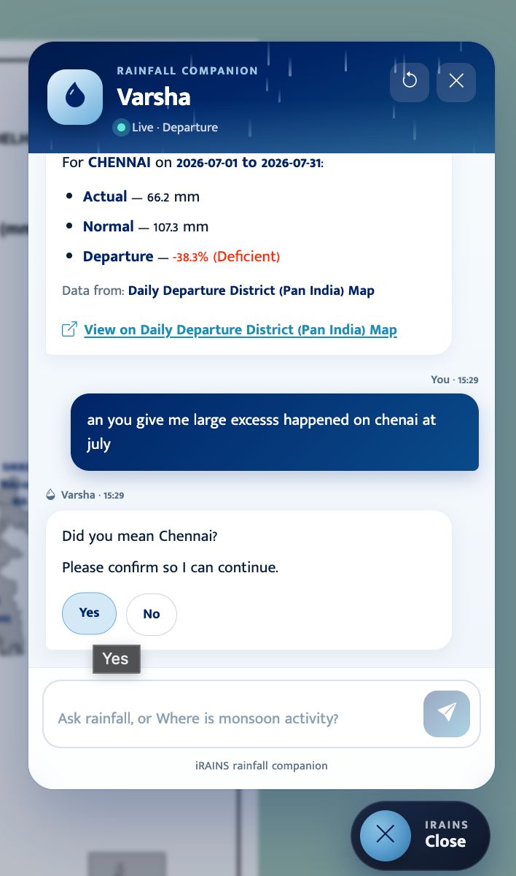
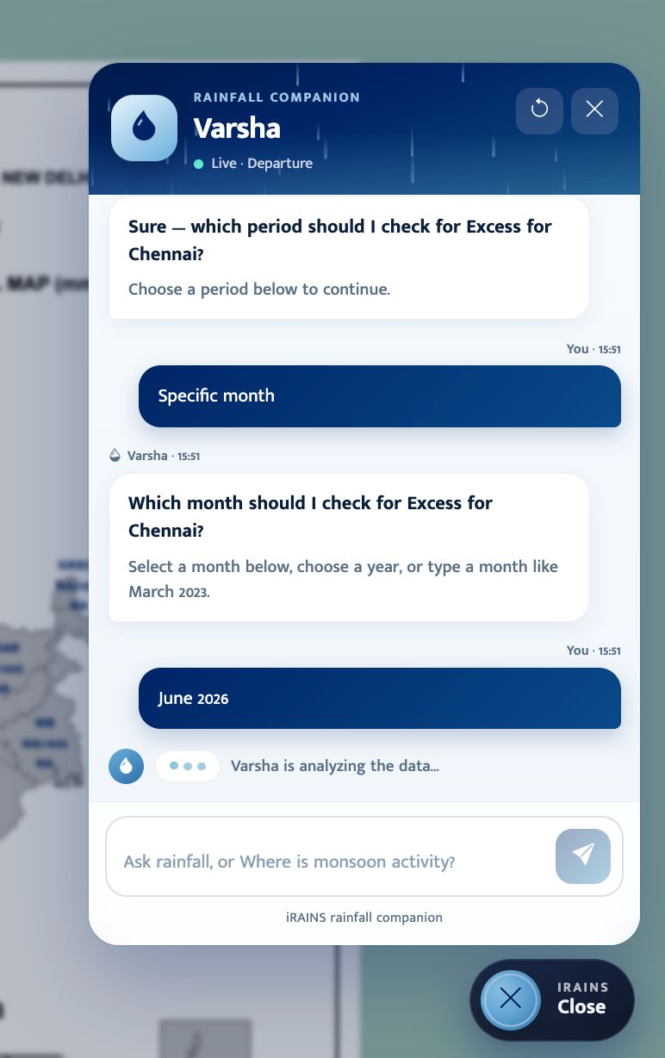
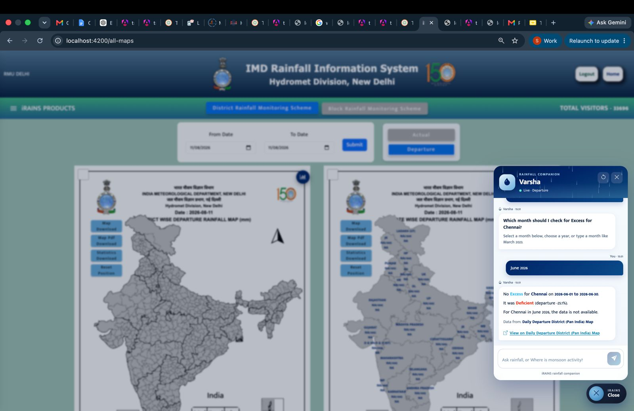
3c. SCREENSHOTS
iRAINS · Varsha Chatbot · Changes 11 Aug 2026 · 9/17

Slide 9
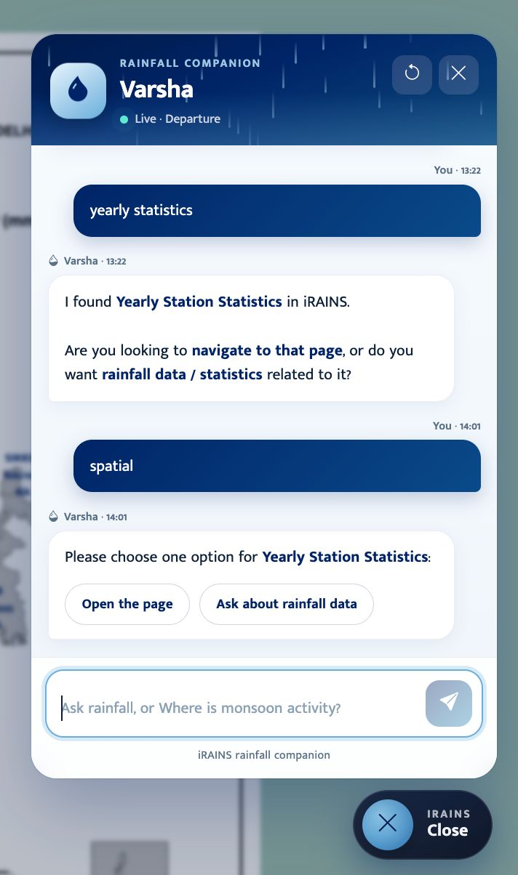
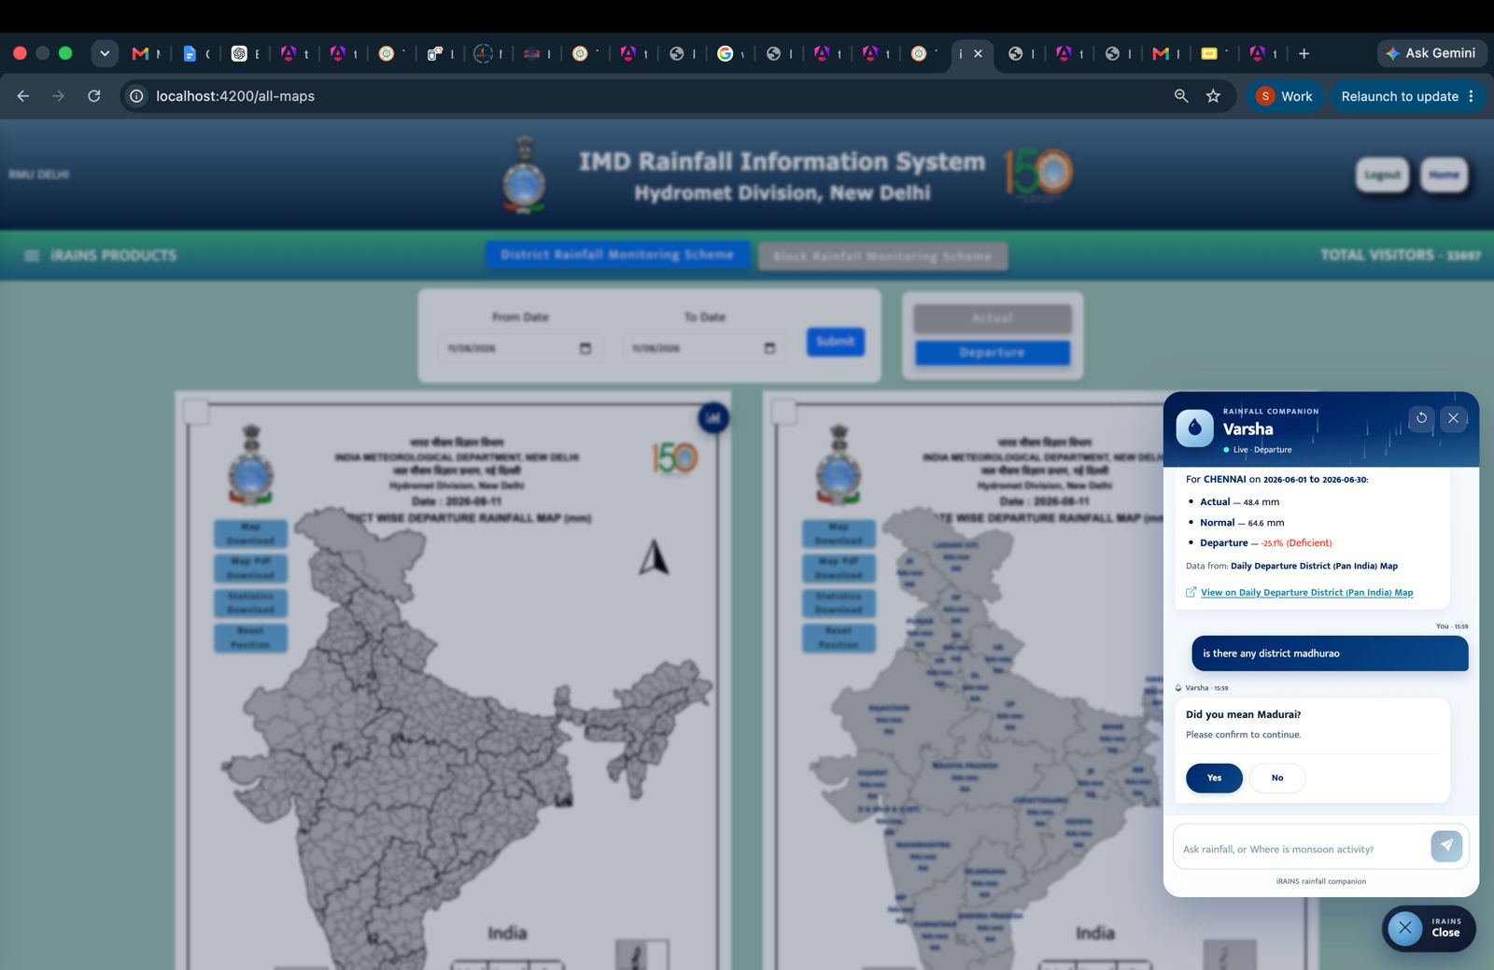
4a. SCREENSHOTS

Slide 10
4b. Frontend Question Rewrites
did_you_mean + Yes
Replace typo token: “chenai …” → “Chennai …” then re-ask backend (period chips next).
ambiguous_timeframe / which_month
Aliases: monthly→this month, historical→season so far.
Insert period into rainfall phrase: “this month rainfall in goa” (avoids “goa monthly”).
Specific month → “month of March 2024”; Year chip → “specific_month 2023”.
suspicious_rainfall_value
Rewrite 4000mm / 4000 mm → 40 mm. Keep 4000 adds confirmed_rainfall_mm so backend won’t loop.
Free-text while chips open
Matches Yes/No, period labels, “Yes, 40 mm”, typed months — otherwise nudges user to tap a chip.
iRAINS · Varsha Chatbot · Changes 11 Aug 2026 · 12/17

Slide 11
5. Live Bugs Fixed Yesterday
Issue
Root cause
Fix
chenai + no rain → “for No?”
Skipped Did-you-mean; place=No from “no rain”
Typo first; scrub categories from place extract
Yes 40 mm looped on 4000mm
\b4000\b failed on glued 4000mm
Replace NNmm unit; confirmed_rainfall_mm for Keep
“more than 40mm” → Thane?
than fuzzy-matched Thane
Stop words + stricter similarity + skip threshold typos
Goa + Monthly → goa monthly
Period glued to place → invalid_location
Period aliases + strip period from place; safer rewrite
Historical = today only
historical not in date sanitizer
Map to season start→today; chip “Season so far”
June month → June 2023
LLM copied catalog year; “on june month” missed
applyMonthRange recognizes on/june month; force current year
Excess miss + “no data”
LLM appended contradictory line
Deterministic category_miss answer; override LLM
iRAINS · Varsha Chatbot · Changes 11 Aug 2026 · 13/17

Slide 12
6. Recommended Test Plan
1. chenai + excess / no rain → Did you mean Chennai? → Yes → period → answer
2. Did you mean → No → asks to retype place
3. Specific month → chips + type “March 2023” → no month re-loop
4. Chennai Excess for June 2026 → category_miss copy (not “no data”) if Deficient
5. “more than 40mm” → lists districts; never “Did you mean Thane?”
6. “more than 4000mm” → Yes 40 mm continues once; Keep 4000 continues once
7. rainfall in goa → period chips → This month / Season so far → real range
8. rainfall in goa on june month → 2026-06-01..30 (not 2023)
9. Clarify UI shows title/hint + chips only (no <em>, no pipe list)
iRAINS · Varsha Chatbot · Changes 11 Aug 2026 · 15/17

Slide 13
7. Summary
Task Name | Previous Week | This Week | Progress Delta | Target Date | Status
Chatbot Implementation (Varsha) | 35% | 15% | +15% | Sep 30, 2026 | In Progress
iRAINS · Varsha Chatbot · Changes 11 Aug 2026 · 16/17

