Slide 1
IPL SALES ANALYSIS

Slide 2
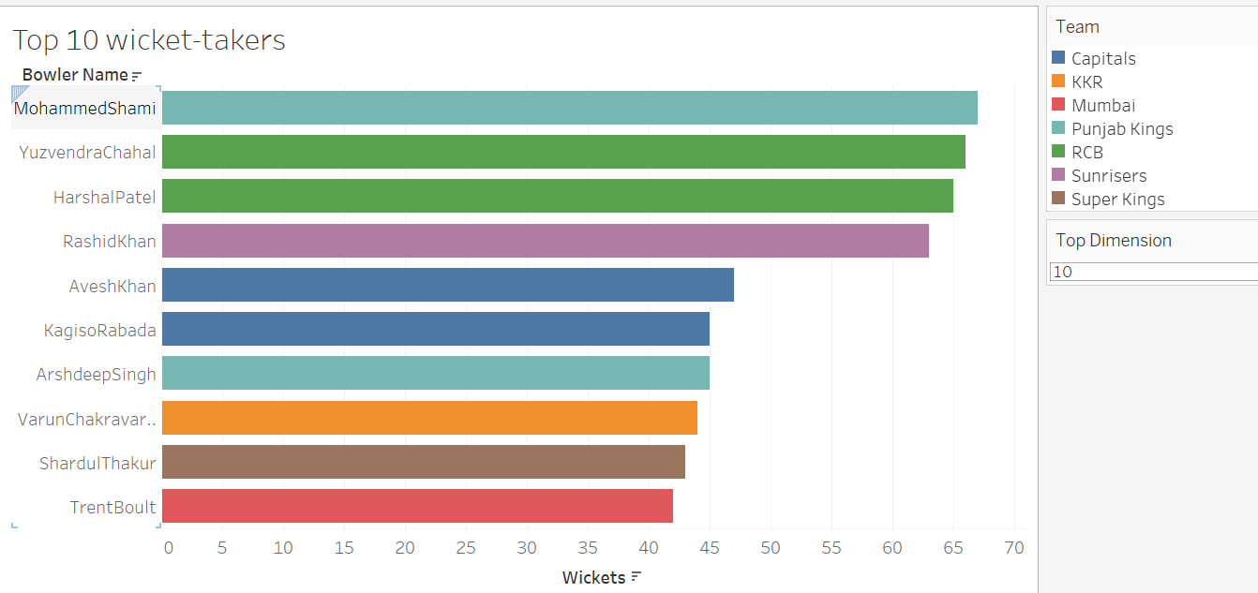
TOP-10 WICKET-TAKERS

Slide 3
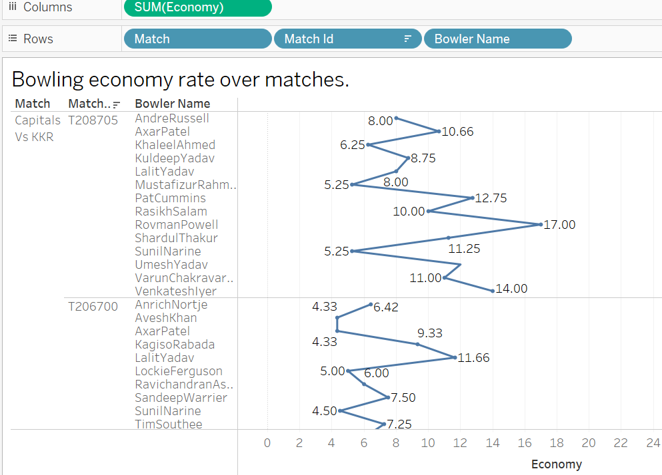
Bowling economy rate over matches

Slide 4
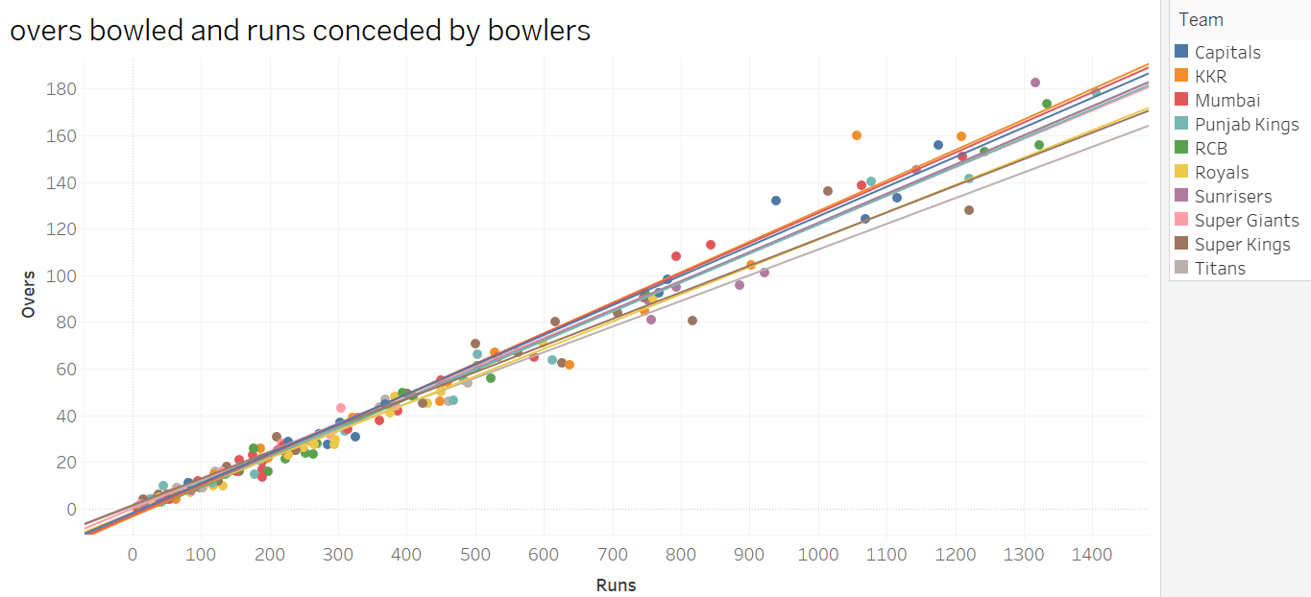
Over bowled and runs conceded by bowlers

Slide 5
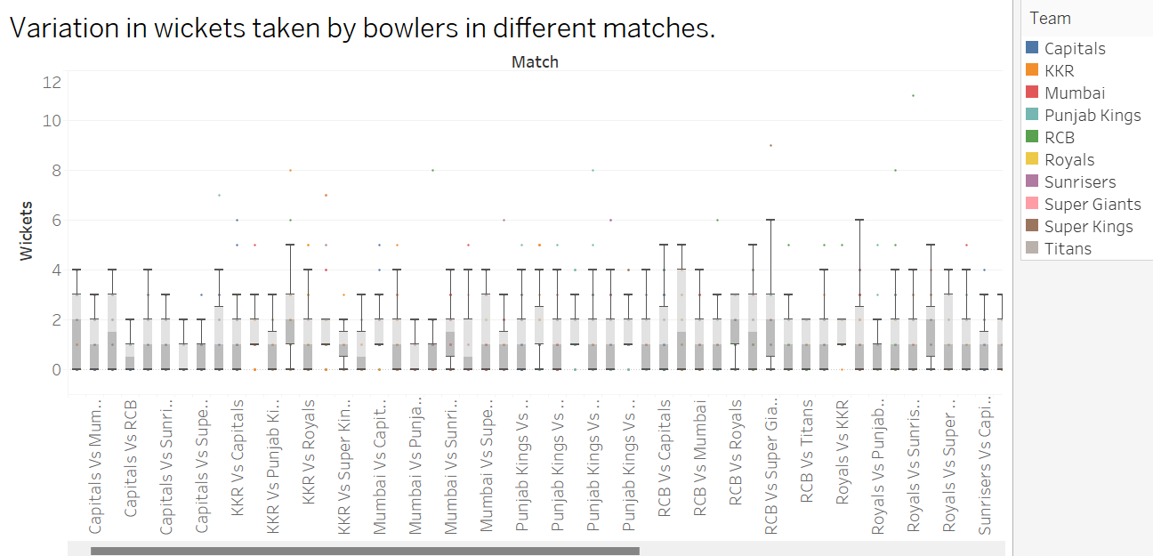
Variation in wickets taken by bowlers in different matches.

Slide 6
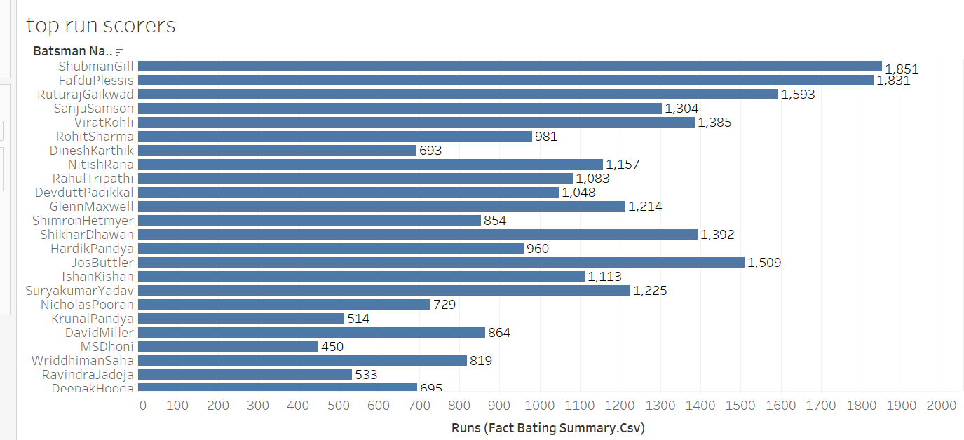
TOP RUN SCORERS

Slide 7
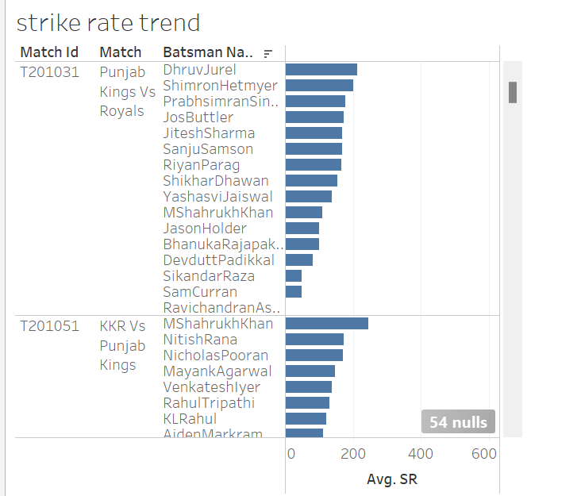
STRIKE RATE TREND

Slide 8
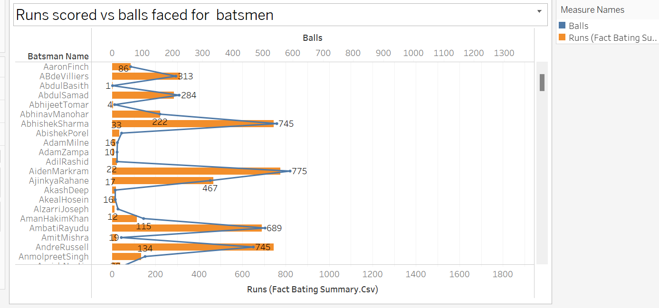
RUNS SCORED VS BALLS FACED

Slide 9
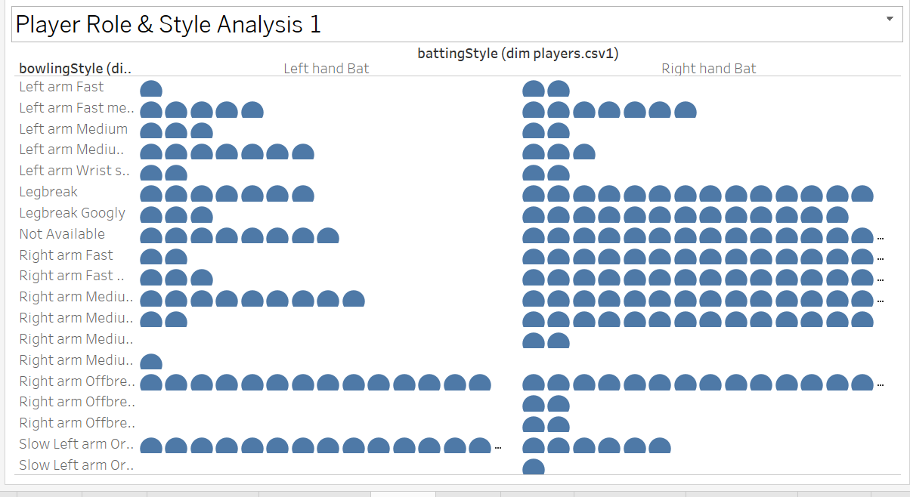
PLAYERS BY BATING AND BOWLING STYLE

Slide 10
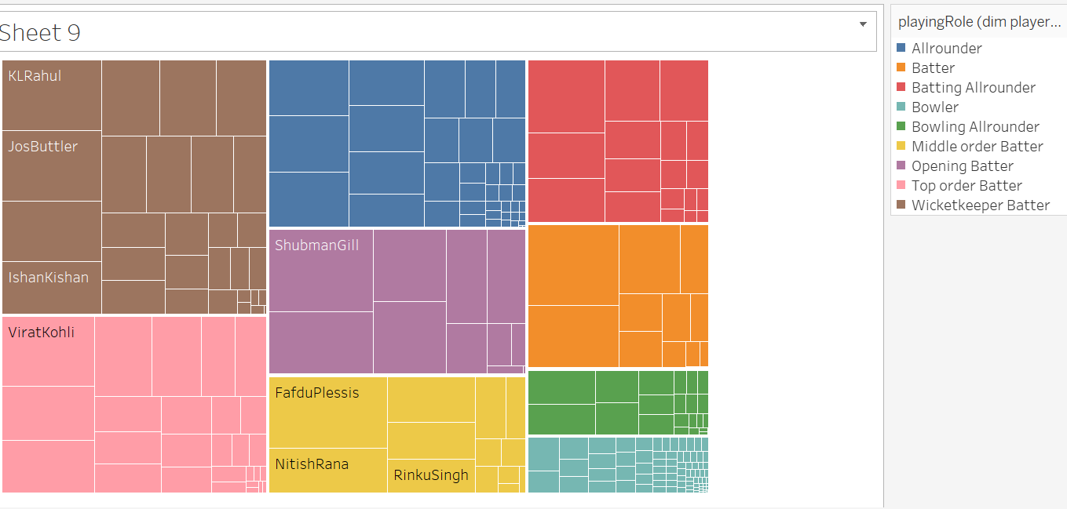
ROLE OF PLAYERS

Slide 11
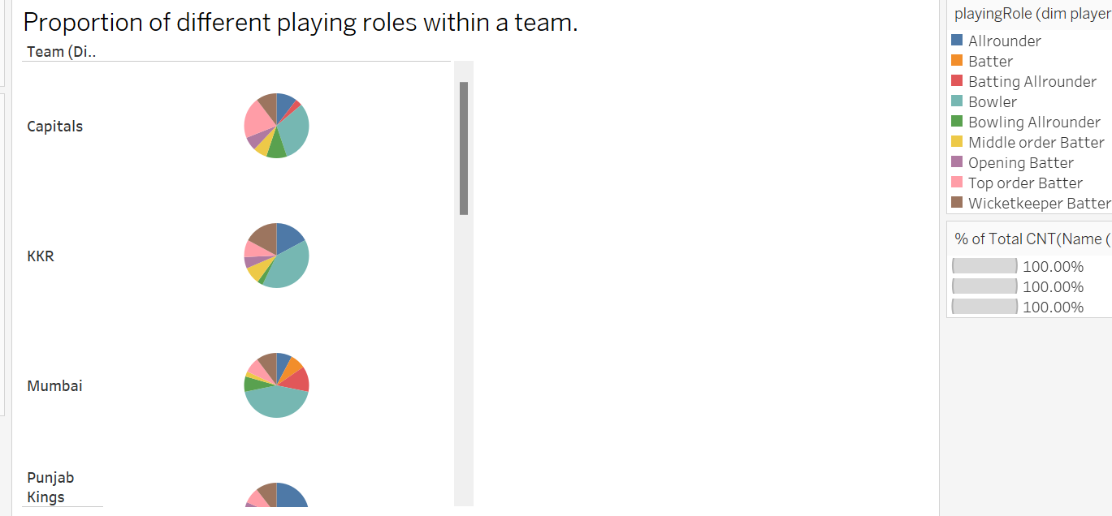
Proportion of different playing roles within a team.

Slide 12
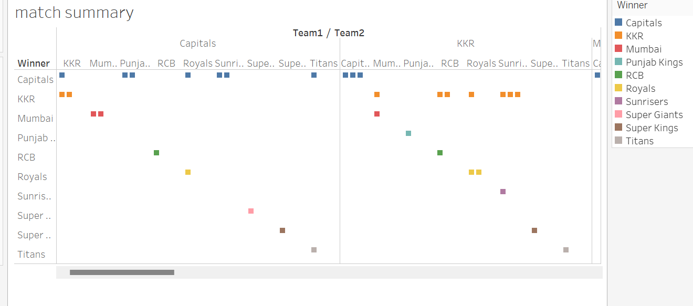
MATCH SUMMARY

