Slide 1

W-MODEL
By: Chouikhane Othman
Mekkaoui Zakaria
Pr: Khourdifi Youness

Slide 2
01
02
03
04
Table of contents
Definition
when to use W-Model?
Phases of W-Model
Architecture
05
Testing techniques
used in W-Model
06
Advantages &
Disadvantages
Ways of Using
Model in Test
Strategy
07
08
Summary

Slide 3

01
Definition

Slide 4
Definition
Paul Herzlich in 1993.
Extension of V-Model.
The testing activities starts simultaneously with the software development.
The software development process is made through various stages of planning, developing and testing before the final version is delivered.
It is a model designed to achieve various demands and requirements of a developer.
It address and tackle the shortcomings of V-Model.
W-model highlights the one-to-one relationship that exists between the documents and the test activities.

Slide 5
When to use W-Model?
02

Slide 6
When to use W-Model?
We use this model when we have a vague vision of the project.
This will allow us to have a quality gain for the deliverable.
When there are much more activities to do.
Performed when the V model is not enough.
Can be implemented when technical design, architecture and functionality
comes to the picture

Slide 7
Phases of W-Model
03

Slide 8
Phases of W-Model
Using W-model helps in ensuring that each phase of the product development is verified and validated. W-model can be divided into a number of stages that includes:
Phase 1 – Building test plan and test strategy
Phase 2 – Identifying the scenario for the product.
Phase 3 –Test case preparation from Specification document and design
documents.
Phase 4 – Reviewing the test cases and sharing an update on the basis of review comments.
Phase 5 – The product is then sent for testing using various testing methodologies such as unit testing, integration testing and specification-based testing, etc.
Phase 6 - Once the product is tested rigorously, it, then, undergoes regression test cycles and user acceptance testing.

Slide 9
Architecture
04

Slide 10
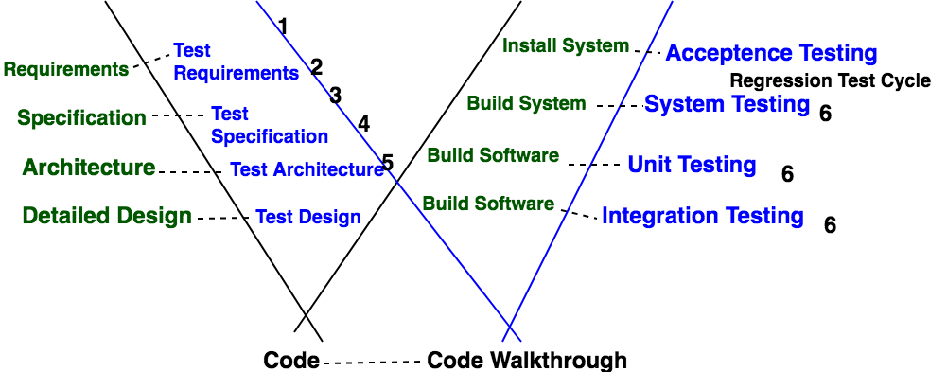
Architecture

Slide 11
Testing techniques used in w-model
05

Slide 12
Regression Testing
retesting the unchanged parts of the application.
test cases are re-executed in order to check whether the previous functionality of the application is still working properly
This is the method of verification.
verify that the bugs and errors in the program are fixed properly
check whether the newly added features have not been created during the problem in previous working version of the software.

Slide 13
Static Testing
code free testing
The software is tested without the execution of the code.
Conducted during the early stages of software development cycle.
Static testing is also known as Verification Testing.
executed either manually or through various software testing tools available in the market.
Static Testing is further divided into two parts:
Review: Typically used to find and eliminate errors or ambiguities in documents such as requirements, design, test cases, and more.
Static Analysis: The code written by the developers is analysed usually with the assistance of tools to find structural defects that may lead to errors and functional problems in the later stages of the development.

Slide 14
Dynamic Testing:
process of interactions with the program while it is still running.
It focuses on testing the software for the input values and analyzing the output values.
the validation part of Verification and Validation in W-Model.
Dynamic testing is the validation part in the W-Model.

Slide 15
Advantages/ Disadvantages
06

Slide 16
Advantages & Disadvantages
Advantages:
In W-Model there is no strict division between constructive tasks on the left-hand side and the more destructive tasks on the right-hand side.
During the test phase, the developer is responsible for the removal of defects and the correction of the implementation.
Emphasis the fact that testing is more than just construction, execution and evaluation of test cases.
The importance of the tests and the ordering of the individual activities for testing are clear.

Slide 17
Advantages & Disadvantages
Disadvantages:
The real facts are simplified in this model.
There is a need for a simple model if all people involved in a project are to accept it.
For highly critical applications the test activities certainly have higher weighting or at least equal weighting with other activities.

Slide 18
Ways of Using Model in Test Strategy
06

Slide 19
Ways of Using Model in Test Strategy
Identify the specific risks of concern during the development.
Specify the products that need to be tested.
Select test techniques to be used on products to address the risks.
Schedule test activities as close as practicable to the development activity, which generated the products to be tested.

Slide 20
Summary
07

Slide 21
References:
https://www.professionalqa.com/w-model
https://www.testbytes.net/blog/v-model-and-w-model-software-testing/
https://shiftasia.com/column/difference-between-v-model-and-w-model-in-software-testing/

Slide 22
THANKS

