Slide 1
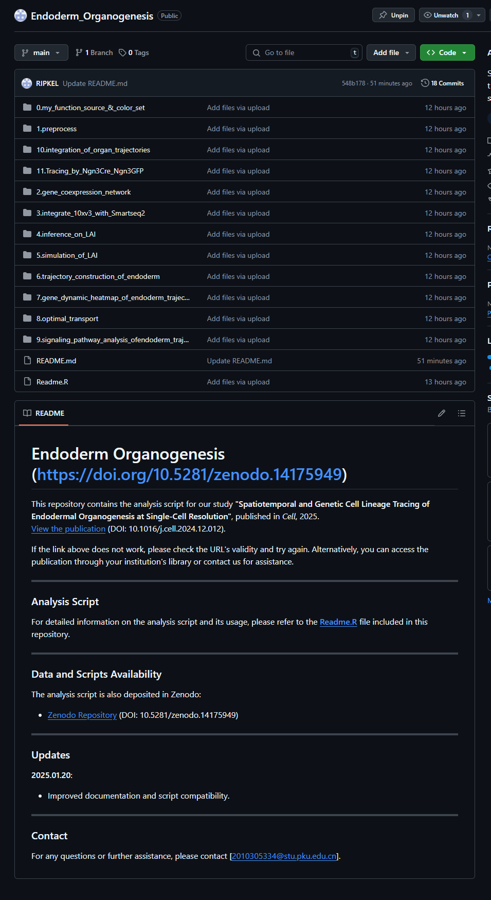
Endoderm_Organogenesis/
0.my_function_source_&_color_set/
0.1_function.source.R
0.2_color.set.R
1.preprocess/
1.preprocess_1.1.R
1.preprocess_1.2.R
10.integration_of_organ_trajectories/
10.1_lung_pha5_fromFG34_.R
10.2_liver_fromFG4AL124.R
10.3_stomach_intestine.R
10.4_pancreas_remake.R
10.5_organ.plot.R
10.6_pattern.plot.R
11.Tracing_by_Ngn3Cre_Ngn3GFP/
11.1_Ngn3Cre.R
11.2_Ngn3GFP.R
11.3_Ngn3Merge.R
2.gene_coexpression_network/
2.GCN.R
3.integrate_10xv3_with_Smartseq2/
3.integrated_with_Smartseq2.R
4.inference_on_LAI/
4.inference_on_LAI.R
5.simulation_of_LAI/
5.Simulation of LAI.R
6.trajectory_construction_of_endoderm/
6.0_bin_function.R
6.10_hg1.R
6.11_hg2.R
6.12_mg1.R
6.13_mg2.R
6.14_mg3.R
6.15_mg3_sub_10x.R
6.16_plot_summary.R
6.17_trajectory_integrated.R
6.1_al12.R
6.2_al3.R
6.3_al3_sub_10x.R
6.4_fg16.R
6.5_fg2.R
6.6_fg3.R
6.7_fg4.R
6.8_fg4_sub_10x.R
6.9_fg5.R
7.gene_dynamic_heatmap_of_endoderm_trajectories/
7.0_bin_function.R
7.1_al3.sm3.R
7.2_al12_sm3.R
7.3_fg1256_sm3.R
7.4_fg3_sm3.R
7.5_fg4_sm3.R
7.6_hg1_sm3.R
7.7_hg2_sm3.R
7.8_mg12_sm3.R
7.9_mg3.sm3.fin.R
8.optimal_transport/
8.optimal_transport_8.1_8.3.R
8.optimal_transport_8.2.py
9.signaling_pathway_analysis_ofendoderm_trajectories/
9.0_summary.R
9.1_set_function.R
9.2_trajectories.R
9.3_time_order.R
9.4_singaling_pattern.R
Readme.R
https://github.com/RIPKEL/Endoderm_Organogenesis

Slide 2
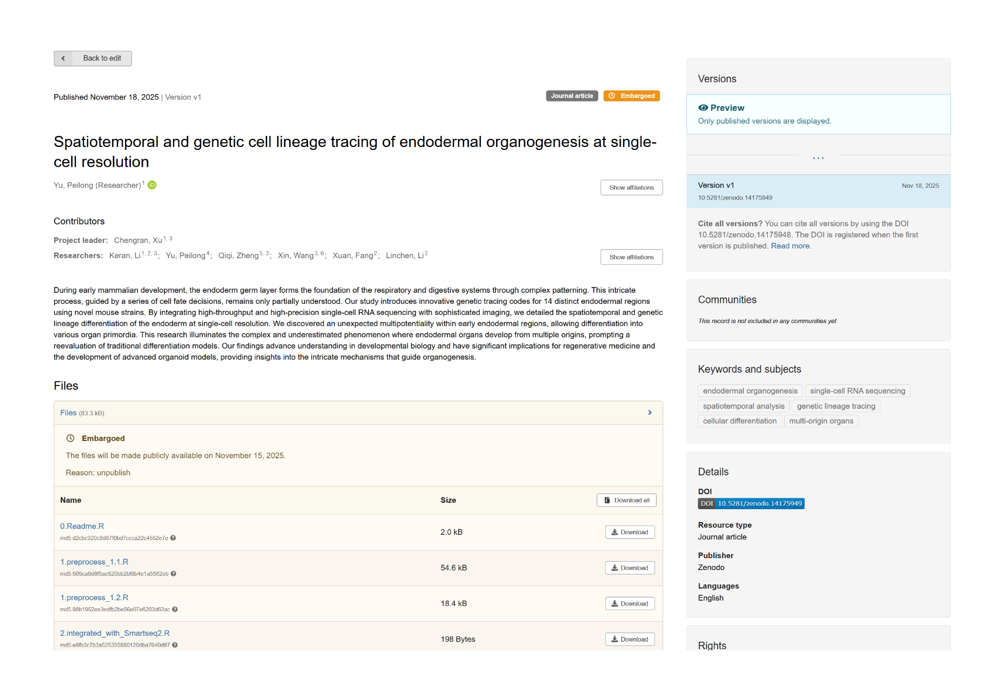
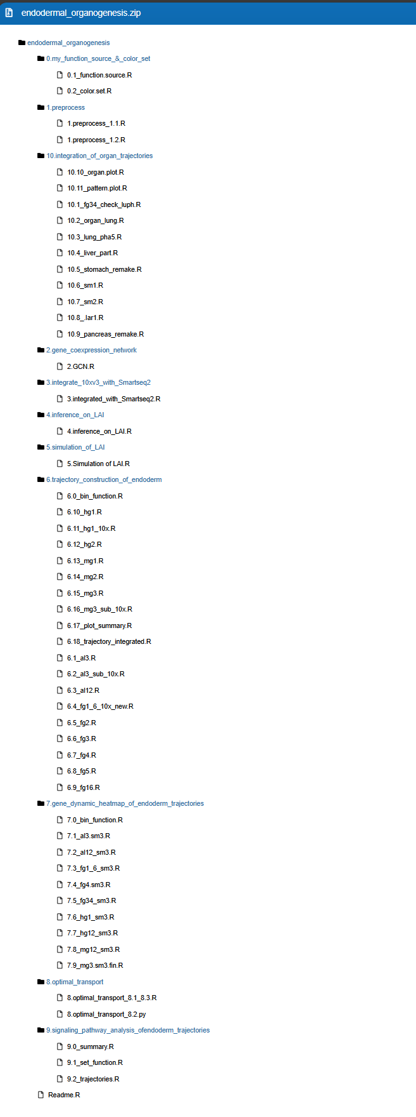
https://doi.org/10.5281/zenodo.14175949

