Slide 1

ZINNIA Show that you care …

Slide 2

Story brand
While zinnia has many different meanings, it is usually associated with friendship, endurance, daily remembrance, goodness, and lasting affection. The Victorian meaning of zinnia are thoughts of an absent friend or a friend you haven't seen in a while. Zinnias are one tough bloom!

Slide 3


Slogan: Show that you care.
Tagline: The universe blooms wherever we are

Slide 4


Slide 5




Our values:
Eco friendly packing.
We have an expertise in flower meaning , help you to choose the right bouquet for the right person in the right occasion.

Slide 6
Brand functions | Descriptive Modifier | Emotional Modifier | Brand
Good Smell | Friends | Caring | ZINNIA Show that you care …

Slide 7
Brand voice: Friendly
Brand tone:
Warm

Slide 8
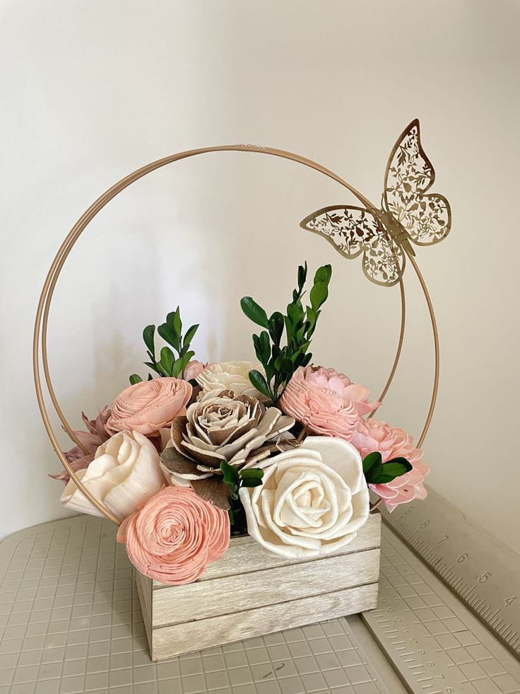
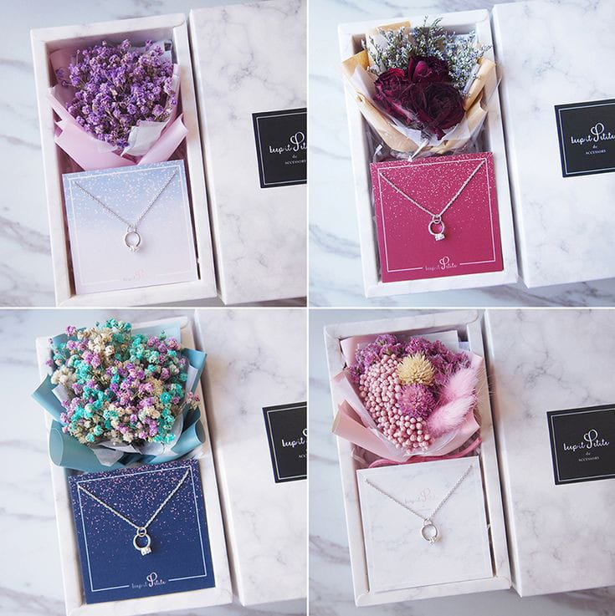
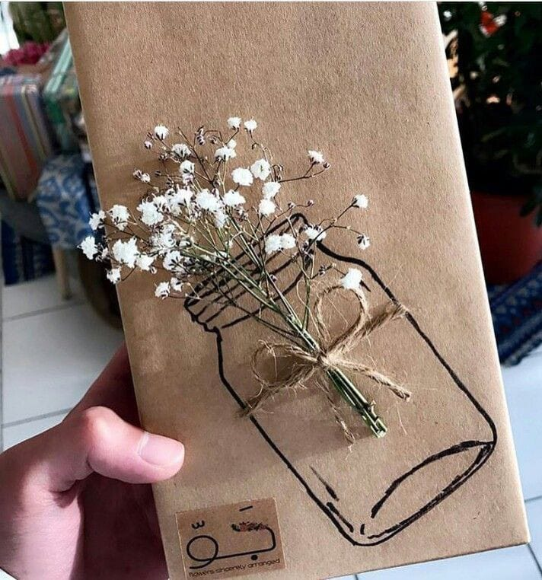
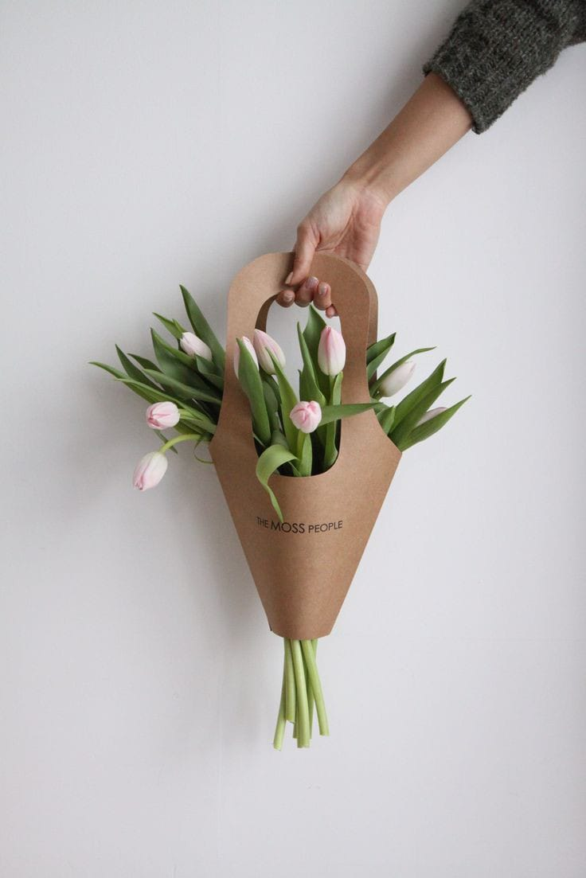
We have different unique packaging

Slide 9


Thank you

