Slide 1
Bernard Becker Medical Library
Delivering knowledge, informing decisions

Slide 2

Computing Basics
Maze Ndukum
ndukummaze@wustl.edu
Sr. Support Scientist
Research Computing
Becker Medical Library
Elyn Fritz-Waters
elyn@wustl.edu
HPC Research Facilitator
Research Infrastructure Services WashU IT

Slide 3
Welcome to Computing Basics
Box link to workshop materials: https://wustl.box.com/s/rg1nzoj1h47ihl5rf6st3x91gtp8mz25
During the session, type your questions in the chat box. If we don’t get to answer your question today, we’ll follow up with you after the workshop

Slide 4
Computing Basics
RIS provides high performance computing (HPC) resources for large-scale data analysis on large files or large number of files when your laptop or computer can’t
RIS compute: https://ris.wustl.edu/services/compute/
Notes:
Need to connect to the HPC cluster (remote computer) to be able to submit and run jobs on the remote system. To use HPC cluster, users need a local laptop/computer (Linux or Mac, or Windows) with command line interface (CLI), software for computing and basic Unix knowledge.

Slide 5
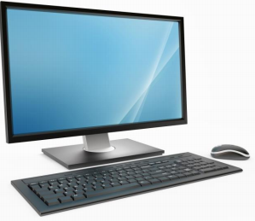


Main components of a compute cluster
User/local computer
Batch Job Scheduler software:
RIS compute uses IBM’s Spectrum Load Sharing Facility (LSF)
login nodes
Containers
RIS compute uses Docker containers:
high-speed internet
Docker container images and LSF tells the RIS compute system how to process the jobs.
Use commands or Open On Demand web interface
compute nodes
storage
Notes:
A high performance computing cluster is basically multiple computers set up to work together in a way that they are viewed as a single unit (computer). Includes: job scheduler, high speed internet, server, nodes (storage, login, compute)
Needs ssh protocol (installed on users personal computer) to connect/interact with computer cluster
The RIS Scientific compute’s Batch Job Scheduler software, runs large scale, parallel computing tasks with access to many CPU and GPU cores, large amounts of RAM, high-speed networks, and high-performance storage systems. A user logs on and lands on login nodes, submits job to compute node for execution. RIS uses container technology (docker) and job scheduler/queue system to submit, manage jobs/tasks input, execution and output. High speed internet network is essential for this interaction

Slide 6
Computing Basics Workshops
Addresses the main hurdles to using RIS Scientific compute:
Lack of Unix knowledge
Using Docker and the queuing system
Notes:
Education provides basics, helps those who are new to remote computing get ready for ongoing learning

Slide 7
Computing Basics Workshops
Open On Demand on RIS Scientific Compute Platform – 4/10/2024, 1 PM – 2:30 PM
OOD is a web-based interface for connecting to and working in high performance computing environments. Attendees will learn how to run jobs using Open On Demand (OOD) on the RIS scientific compute platform.
The Unix Shell and Command Line Basics​ – 4/17/2024, 1 PM – 2:30 PM
Unix command line interface, the Unix file system, and basic Unix commands. Attendees will learn to create, explore, and manage Unix files and folders.
Software Applications Used in High Performance Computing Environments – 4/24/2024, 1 PM – 2:30 PM
Text editors, shell and batch scripts, Docker container technology, and the SSH protocol. Attendees will learn how to write, edit, and run shell scripts, how to create a simple Docker container, and how to connect to the RIS compute platform.
Submitting Jobs to RIS Scientific Compute Platform – 5/1/2024, 1 PM – 2:30 PM
Basic commands for submitting jobs to the queue on the RIS compute platform via the command line. Attendees will learn how to submit and run jobs/tasks using Docker and queuing system commands.
https://becker.wustl.edu/services/research-computing/
Notes:
This series provides the basics, and prepares those new to remote computing for ongoing learning
2. The Unix Shell and Command Line Basics​

Slide 8
Today’s Workshop
The Unix Shell and Command Line Basics​ – 4/17/2024
Presentation:
What is Unix Shell/command line interface
Basic Unix commands
Demonstration Exercises:
Get a terminal /Command Line Interface (CLI) shell
Explore a CLI, create and manage folders/files

Slide 9
What is Unix?
Unix is an Operating System (OS)
Users either have a Unix OS on a Linux computer or Mac or Windows OS on their laptop/computer
Notes:
Similar to how Windows and Mac are computer Operating Systems (OS), Unix is the Operating System for Linux computers. The Unix command line (CLI) shell or terminal is the user interface for interacting with the OS in Linux.

Slide 10
What is a Shell?
A shell is a user interface interacting with the Operating System (OS)
Two types of user interfaces:
GUI – Graphical User Interface (point and click)
CLI – Command Line Interface (text commands)
Notes:
Users interact with the OS with a GUI or CLI

Slide 11
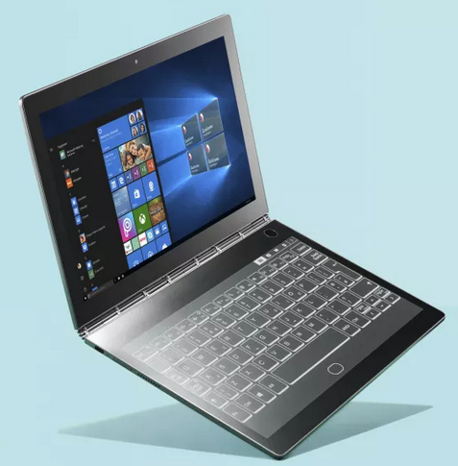
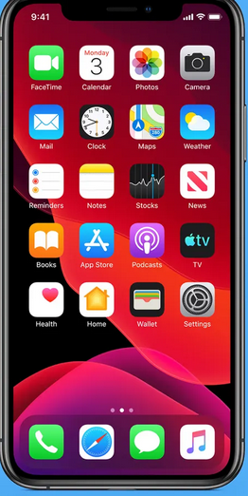
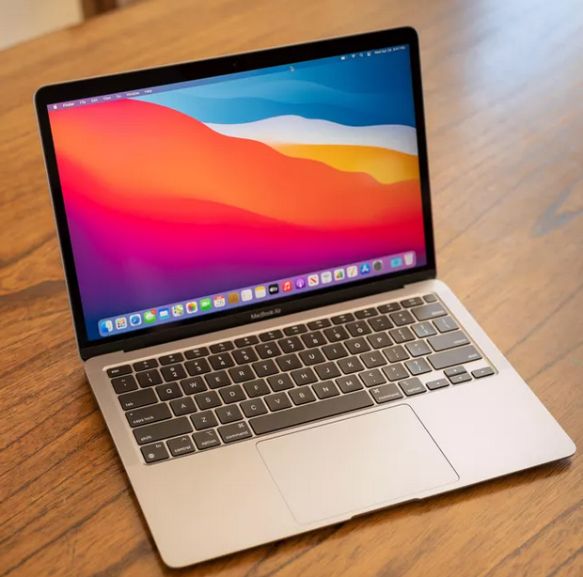
What is a GUI Shell?
- Very popular, familiar, intuitive and easy to learn
- Available on Mac/Windows computers, cell phones, tablets, etc.
- Can click on icons to explore folders/files and run programs
Notes:
GUI’s use “touch/tap an icon” or “point to an icon and click” method to carry out tasks. Example tasks are: run a program, launch a software or app, open a file, close a file, delete a file, list files in a folder etc.

Slide 12
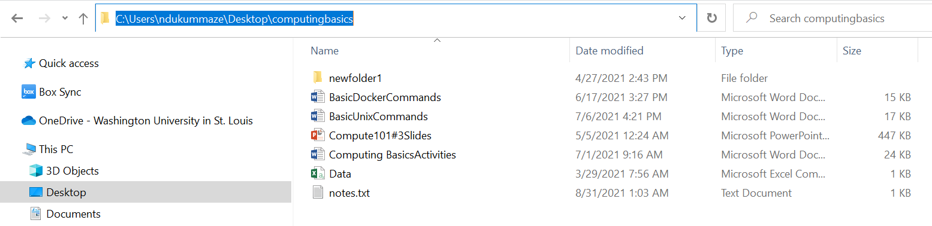
What is a GUI Shell?
GUI – use point and click options to view list of folders and files
Pathname for the computingbasics folder is: C:\Users\ndukummaze\Desktop\computingbasics
Notes:
View of the list of files and folders on the desktop of my windows computer, notice that there’s a pathname to the location, usually not thought about too much so seems to be in the background

Slide 13
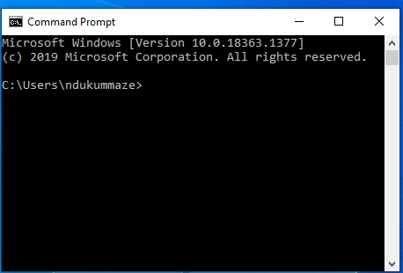
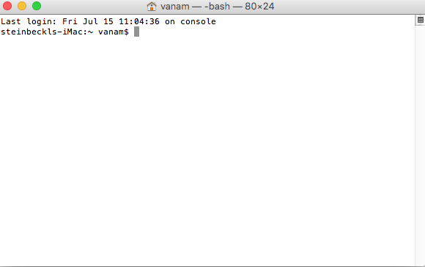
What is a CLI Shell?
CLI – Windows
CLI – Mac
- Not popular, it’s a CLI terminal and a scripting language
- Must learn commands, steep learning curve
- Use text commands to explore folders/files and run programs (has command prompt symbol like > or $ or % or # etc.,)
Notes:
The CLI terminal displays a command prompt when it is ready for commands to be typed in. A command prompt is a sequence of characters that may include information like the pathname of the current working location (folder/directory) or a hostname for a remote machine and usually ends with a symbol. Command prompt symbols are not unique, different types of symbols exist. Here are some popular ones: $, %, #, :, >.

Slide 14
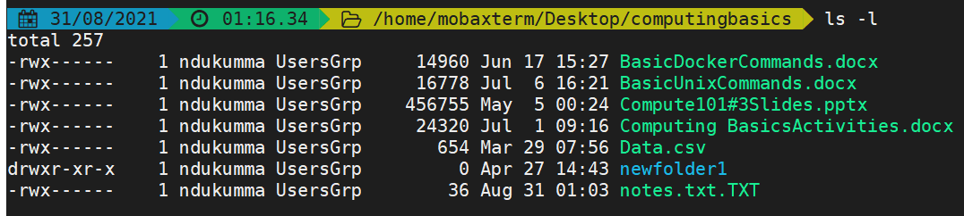
What is a CLI Shell?
CLI – use text commands to view list of folders and files
Pathname for the computingbasics folder is: /home/mobaxterm/Desktop/computingbasics

Slide 15
How to get a CLI Shell on your computer?
CLI shell is also commonly called a terminal
Linux and MacOS have built-in CLI shell
Windows – PowerShell, or need to install Windows Subsystem for Linux (WSL) or 3rd party software such as MobaXterm or PuTTY
WSL – Install from Microsoft store or website
PuTTY – https://www.putty.org/
MobaXterm – http://mobaxterm.mobatek.net/
Notes:
Linux and MacOS computers have built-in CLI shell, it’s also available on Virtual machines and Linux machines running in the cloud. Windows computers can get CLI shell or terminal from a Windows Subsystem for Linux (WSL) installation or from other 3rd party software such as MobaXterm or Putty.

Slide 16
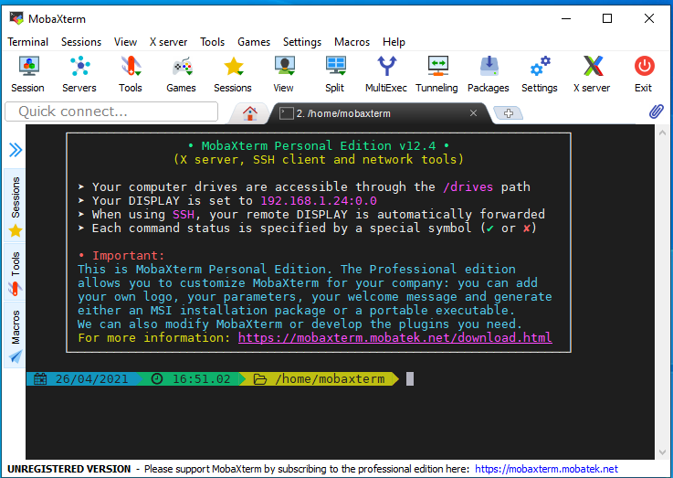
MobaXterm CLI Terminal Emulator for Windows
Notes:
To execute or run Unix commands, type the specific text command(s) next to the prompt symbol, then hit Enter (Windows Users) or Return (MacOS Users) on the computer keyboard. When a command is finished executing, the prompt may change and any output that is generated gets displayed below the prompt. Also, the command prompt returns ready for another command to be typed in.

Slide 17
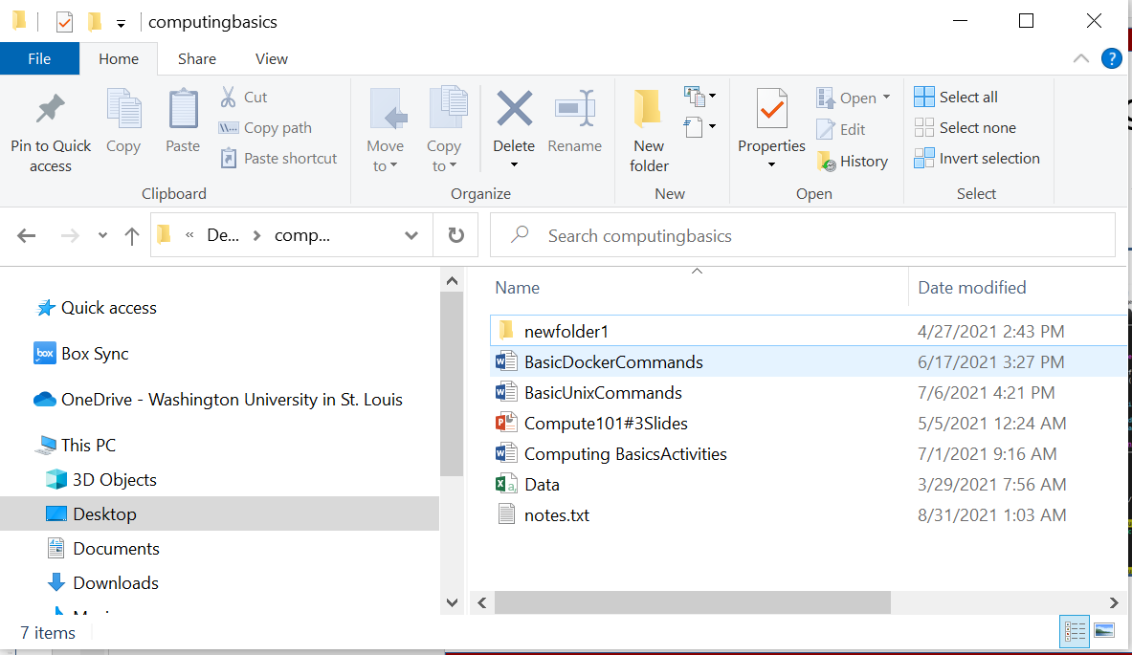
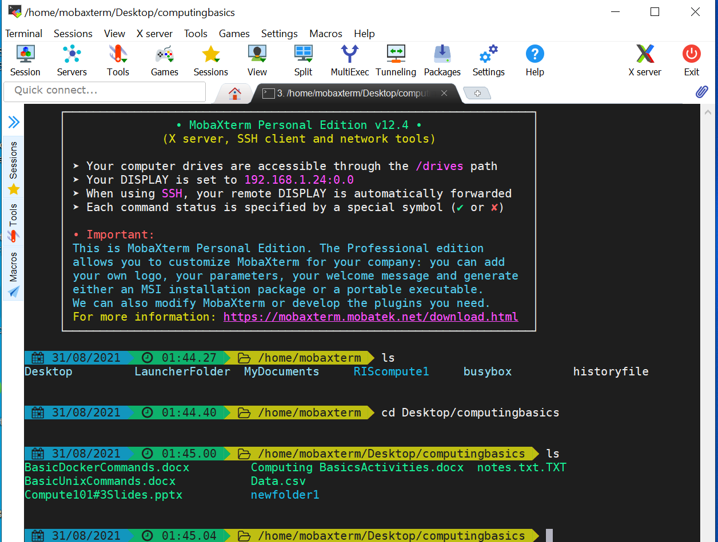
How CLI Folders/Files are organized?
The files/folders in CLI shell occur similar to those in GUI shell
GUI
CLI
Notes:
GUI and CLI file and folders display similarly – shows filenames, folder names and details about the files and folders such as last date modified, size etc.

Slide 18
How CLI Folders/Files are organized?
Unix CLI files/folders are organized in a hierarchical nature, commonly called Unix tree structure
/
Root Directory
Top level = The root directory
/Directory
/Directory
/Directory
Folders and files can occur at any level (directories ≡ folders)
/Directory
/Directory
/Directory
File
File
File
File
Notes:
CLI arrangement is meant to provide secure access to users since it’s a multiuser system

Slide 19
How CLI Folders/Files are organized?
Unix file-tree – starting at the top is the root directory
/
Top level = Root directory
/home
/usr
/lib
/tmp
User’s home
directory
file
/home/username
/usr/bin
/lib/binmode.o
/home/username/Desktop
/home/username/MyDocuments
/home/username/Desktop/file1
Notes:
Top level is root, then next levels can have folders and files.
Data folders and program files/folders help system work properly

Slide 20
Accessing Folders and Files in CLI
Need to use text commands to open, close, move, and delete folders, subfolders and files
Directory (folder, subfolder) locations and files are referenced by either absolute or relative pathnames

Slide 21
Accessing Folders and Files in CLI
Two types of pathnames:
Absolute pathname – path to a file or directory starting at the root directory (/)
Relative pathname – path to a file or directory starting from or in relation to your current location (directory) in the file system

Slide 22
Absolute pathname starts from the root directory
/
Root directory
/home
/usr
/lib
/tmp
User’s home
directory
file
/home/username
/usr/bin
/lib/binmode.o
/home/username/Desktop
/home/username/MyDocuments
/home/username/Desktop/folder1
/home/username/Desktop/folder1/file1
Absolute pathname for file1

Slide 23
Relative pathname starts relative to a folder
/
Root directory
/home
/usr
/lib
/tmp
file
User’s home directory
/home/username
/usr/bin
/lib/binmode.o
/home/username/Desktop
/home/username/MyDocuments
/home/username/Desktop/folder1
/home/username/Desktop/folder1/file1
Relative path to file1
starting from the Desktop folder = folder1/file1

Slide 24
Can use aliases to shorten pathnames
~ = alias for home directory (/home/username)
Absolute pathname for file1, starting from root directory: /home/username/Desktop/folder1/file1
Shortcut using the alias ~ :
~/Desktop/folder1/file1

Slide 25
Avoid spaces in CLI file names
Filenames can have spaces in Windows and Mac GUI
Computing 101 Activities.txt
CLI shell treats filenames with spaces as commands with options and arguments
command option argument

Slide 26
Avoid spaces in CLI file names
Can add the “\” character to spaces in the filename and CLI will recognize it as a filename:
Computing\ 101\ Activities.txt
Best practice for filenames in CLI is to avoid spaces:
Computing101Activities.txt
Computing-101-Activities.txt

Slide 27
Basics of Unix Commands
Write commands that do one thing and do it well
Write commands to work together well with other commands
http://www.linfo.org/unix_philosophy.html

Slide 28
Basics of Unix Commands
Unix commands can be simple, typically short text typed in lower case – many basic commands are only two characters long
Examples:
ls lists names of files/folders
cd change or move to a different location/folder

Slide 29
Basics of Unix Commands
Unix commands can be complex - may have several options, may require arguments
command option1 option2 argument1 argument2
Command syntax includes spaces between commands, options and arguments
Notes:
Text commands have several powerful options, can combine commands to automate tasks (shell scripts)
Many commands must be learned, can be a steep learning curve for beginners

Slide 30
Basics of Unix Commands
Unix commands can be complex – options always contain a dash, and precedes arguments in a command syntax
command option argument
Example – using an option:
ls –l = list names and details of files/folders
Notes:
Text commands have several powerful options, can combine commands to automate tasks (shell scripts)
Many commands must be learned, can be a steep learning curve for beginners

Slide 31
Basics of Unix Commands
Unix commands can be complex – options always contain a dash, and precedes arguments in a command syntax
command option argument
Example – using an argument:
ls Desktop = list names of files/folders in Desktop
Notes:
Text commands have several powerful options, can combine commands to automate tasks (shell scripts)
Many commands must be learned, can be a steep learning curve for beginners

Slide 32
Basics of Unix Commands
Unix commands can be complex – options always contain a dash, and precedes arguments in a command syntax
command option argument
Example – use option and argument to list files/folders in the Desktop folder:
ls –l Desktop = correct
ls Desktop –l = incorrect order of option and argument

Slide 33
Basics of Unix Commands
Basic help documentation is usually available for specific commands
command --help
Example:
ls = list names of files/subdirectory
ls –-help = display list of options for the ls command

Slide 34
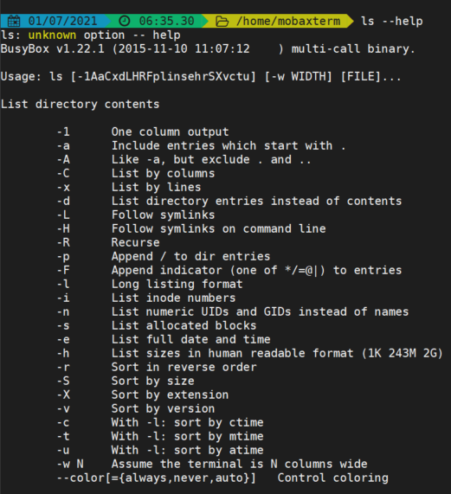
Basics of Unix Commands
Basic help documentation for ls command: ls –-help
Notes:
The up/down arrow or space bar on your computer keyboard can be used to scroll through and browse the help pages. When finished reading the help page, press ‘q’ on your keyboard to quit the page and return the prompt.

Slide 35
Basics of Unix Commands
man(ual) pages:
The ‘man’ page for a command, provides the most accurate description, options and arguments for that command.
Manuals for a command includes a short description, a list of all options for the command and usage examples
Notes:
The up/down arrow or space bar on your computer keyboard can be used to scroll through and browse the manual pages. When finished reading the man page, press ‘q’ on your keyboard to quit the ‘man’ page and return the prompt. Linux and MacOS terminals will display manual pages, but MobaXterm has limited Unix features and lacks some manual pages. This is not a major problem for using MobaXterm when it comes to implementing features for the many other functionalities needed for working in a CLI shell.

Slide 36
Basics of Unix Commands
Display the manual pages for a command
man command
Example:
man ls = displays manual for the ls command
NOTE: Use keyboard up and down arrows to browse manual, when finished, press q on keyboard to exit manual

Slide 37
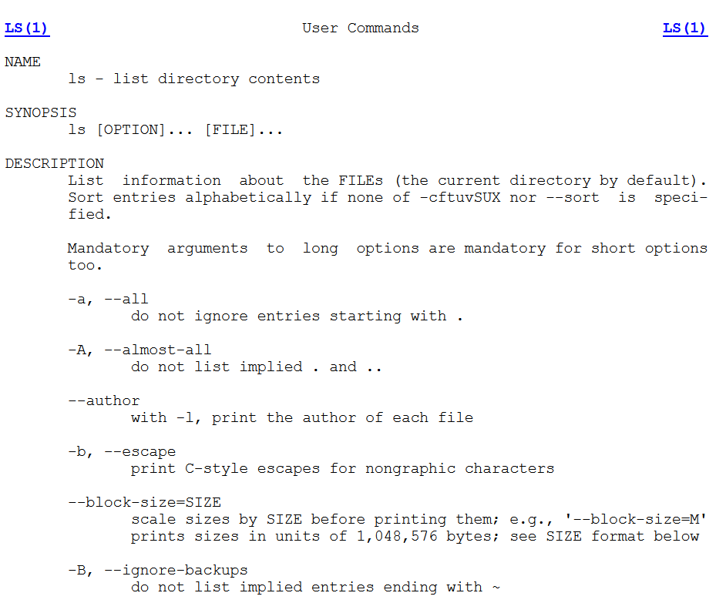
Basics of Unix Commands
Unix Online manual - http://man.he.net/

Slide 38
Keyboard Shortcuts
ctrl + c = stop current command and return CLI prompt
Up and down arrow returns previously run commands
Press Tab for auto completion after typing a few letters for names of files or folders that exist in the current location
CLI cheat sheet: https://cheatography.com/davechild/cheat-sheets/linux-command-line/

Slide 39
Demonstration exercises
Get a terminal or Unix Command Line Interface (CLI) shell
Use some basic Unix commands to:
- navigate the CLI
- create, explore and manage Unix files/folders

Slide 40
How to get help from RIS
Users have varied needs and diverse use cases, it’s best to speak with RIS Staff about your needs:
Schedule one-on-one at Virtual Office Hours: https://ris.wustl.edu/support/
Create a ticket at Service Desk: https://ris.wustl.edu/support/service-desk/

Slide 41
Additional Helpful Resources
Bioinformatics Workshop Series at WUSM Campus:
Computing basics provide beginner level education. For additional in-depth training if appropriate for your needs, visit https://github.com/genome/bfx-workshop
Lectures are recorded and participants can join anytime throughout the year
Notes:
Workshops occur in the Fall and Spring. To view the Fall 2023 schedule and the Spring 2024 topics, visit https://github.com/genome/bfx-workshop.

Slide 42
Additional Helpful Resources
RIS Services User Manual – https://docs.ris.wustl.edu/
Becker’s Research Computing workshops page – https://becker.wustl.edu/services/research-computing/
O’Reilly/Safari Tech Books Online – access through Becker Library using your WashU email https://www.oreilly.com/library-access/
LinkedIn Learning for WUSTL - https://it.wustl.edu/home/how-to/linkedin-learning/
Find the meaning of each command used in a syntax - https://explainshell.com/
Google
RIS Support: https://ris.wustl.edu/support/
Becker Library Contact: ndukummaze@wustl.edu
RIS contact: elyn@wustl.edu

Slide 43

Bernard Becker Medical Library
660 S. Euclid Avenue | Campus Box 8132 | St. Louis, MO 63110

