Slide 1
Bernard Becker Medical Library
Delivering knowledge, informing decisions

Slide 2

Welcome to Computing Basics
Box link to workshop materials: https://wustl.box.com/s/zwdcyfxzrujt8qpltdlkd6ylciei1eoz
During the session, type your questions in the chat box. If we don’t get to answer your question today, we’ll follow up with you after the workshop

Slide 3
Computing Basics
Maze Ndukum
ndukummaze@wustl.edu
Sr. Support Scientist
Research Computing
Becker Medical Library
Elyn Fritz-Waters
elyn@wustl.edu
HPC Research Facilitator
WUIT – Research Infrastructure Services

Slide 4
Computing Basics Workshops
Open On Demand on RIS Scientific Compute Platform – 4/10/2024, 1 PM – 2:30 PM
OOD is a web-based interface for connecting to and working in high performance computing environments. Attendees will learn how to run jobs using Open On Demand (OOD) on the RIS scientific compute platform.
The Unix Shell and Command Line Basics​ – 4/17/2024, 1 PM – 2:30 PM
Unix command line interface, the Unix file system, and basic Unix commands. Attendees will learn to create, explore, and manage Unix files and folders.
Software Applications Used in High Performance Computing Environments – 4/24/2024, 1 PM – 2:30 PM
Text editors, shell and batch scripts, Docker container technology, and the SSH protocol. Attendees will learn how to write, edit, and run shell scripts, how to create a simple Docker container, and how to connect to the RIS compute platform.
Submitting Jobs to RIS Scientific Compute Platform – 5/1/2024, 1 PM – 2:30 PM
Basic commands for submitting jobs to the queue on the RIS compute platform via the command line. Attendees will learn how to submit and run jobs/tasks using Docker and queuing system commands.
https://becker.wustl.edu/services/research-computing/
Notes:
This series provides the basics, and prepares those new to remote computing for ongoing learning
Why use a cluster?
What software applications are needed to work on a cluster?
- Text editors, shell and batch scripts,
- Containers (Docker), the ssh protocol
Demonstration Exercises
- Learn to write/run shell scripts
- Create/run a simple Docker container
- Connect to RIS Scientific Compute Platform
​

Slide 5
Why use a computing cluster?
Speed up computing tasks: When analyzing your data takes a really long time on your laptop or lab computer
Automate tasks: When you need to analyze a large number of files or datasets
Handle large scale data analysis: When your file(s) or dataset(s) are really very large
Notes:
Workflow on a cluster:
Transfer your data onto the cluster from your local computer or access/mount your data from a storage location that interacts directly with the cluster
Generate a batch script or implement container tools (Docker), which will tell the system how to process your data and manage input and output

Slide 6
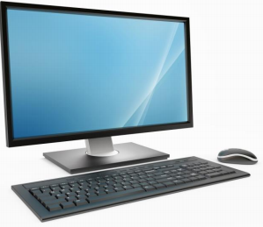


Main components of a compute cluster
Docker container images and LSF tells the RIS compute system how to process the jobs
login nodes
User/local computer
(Mac or Linux or Windows)
Batch Job Scheduler software:
- RIS compute uses IBM’s Spectrum Load Sharing Facility (LSF)
high-speed internet
RIS compute uses Docker containers:
compute nodes
storage
Notes:
A high performance computing cluster is basically multiple computers set up to work together in a way that they are viewed as a single unit (computer). Includes: job scheduler, high speed internet, server, nodes (storage, login, compute)
Users either have Linux, Mac or Windows computer, and needs ssh protocol (installed on users personal computer) to connect/interact with computer cluster
The RIS Scientific compute’s Batch Job Scheduler software, runs large scale, parallel computing tasks with access to many CPU and GPU cores, large amounts of RAM, high-speed networks, and high-performance storage systems. LSF gives everyone access efficiently and fairly
A user logs on and lands on login nodes, submits job to compute node for execution. RIS uses container technology (docker) and job scheduler/queue system to submit, manage jobs/tasks input, execution and output. High speed internet network is essential for this interaction

Slide 7
Tools needed to work in computing clusters
Text editors
Shell Scripts
Secure SHell (SSH) protocol
Batch scripts
Containers – e.g Docker container)
https://docs.ris.wustl.edu/doc/compute/workshops/ris-compute-101.html
https://docs.ris.wustl.edu/doc/compute/workshops/ris-compute-102.html

Slide 8
Text Editors
Application used to write and edit text commands and code for programming languages
Many options are available:
Command Line Interface – vi, nano
Graphical User Interface – notepad, gVim, Emacs )
Notes:
Editor to edit an existing file or to create a new file from scratch

Slide 9
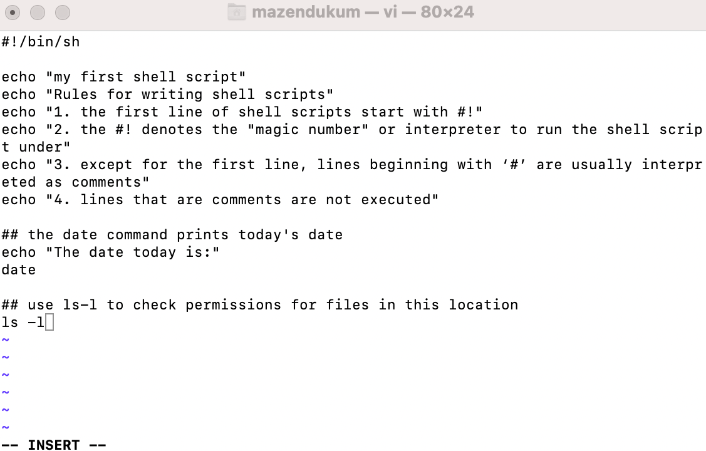
Text Editors
Vi is a Command Line Interface text editor
Notes:
Vi tutorial - https://www.tutorialspoint.com/unix/unix-vi-editor.htm

Slide 10
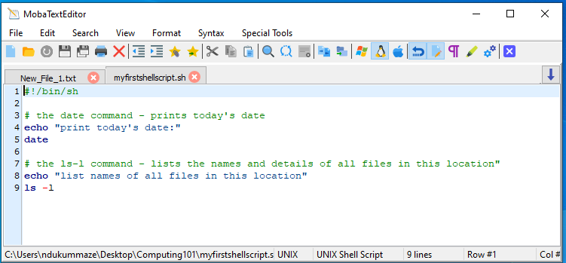
Text Editors
MobaXterm’s text editor is called MobaTextEditor

Slide 11
Shell Scripts
Text file with a series of commands (in Unix or other programming languages)
The first line in Unix shell scripts defines what interpreter to run it under
Shell scripts with ‘#!/bin/sh’ as the first line, run under a bourne shell, other shell interpreters exist

Slide 12
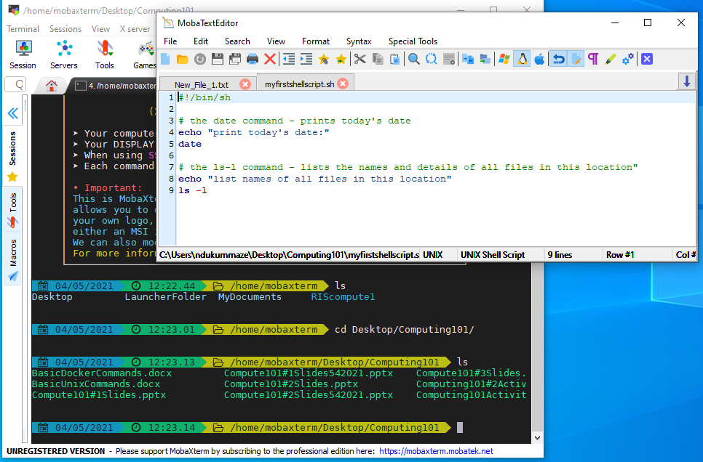
Shell Scripts
First line in Unix shell scripts defines what interpreter to use
First line in shell script

Slide 13
Shell Scripts
Additional lines in shell script:
series of commands to be execute, on separate lines
explanatory comments that starts with ‘#’ are not executed

Slide 14
Workflow for Unix Shell Scripts
Write the script in a text editor
Make the script executable
Run the script

Slide 15
Write the script in a text editor
Saving a new CLI files grants it default file permissions. Shell scripts need eXecute permissions for them to work. In CLI, each new file or directory has three user permissions:
r = Read
w = Write
x = eXecute
https://www.linux.com/training-tutorials/understanding-linux-file-permissions/

Slide 16
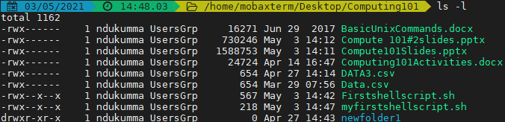
Unix File and Directory Permissions
Use ls -l command to check permissions for files/folders. The first permission indicates if this is a file or a directory
- = file
d = directory

Slide 17
Unix File and Directory Permissions
Next three sets of permissions is for owner of file/folder
r = Read
w = Write
x = eXecute

Slide 18
Unix File and Directory Permissions
Another three sets of permissions is for the group that has been assigned to the file/folder
r = Read
w = Write
x = eXecute

Slide 19
Unix File and Directory Permissions
Last set of three permissions for all users of the system
r = Read
w = Write
x = eXecute

Slide 20
Make the shell script executable
Use ls -l command to check file permissions for shell scripts
Notice that myshellscript.sh gets the default file permissions and will need eXecute permissions to work

Slide 21

Make the shell script executable
Use the chmod command to change file permissions
Command to grant eXecute permissions to myshellscript.sh is as follows:
Run chmod +x myshellscript.sh

Slide 22
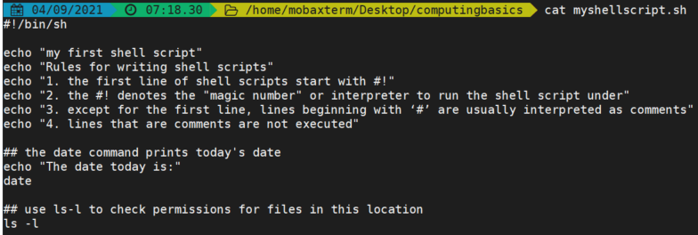
Run the shell script
Use cat command to display shell script on CLI, the script automates the running of the commands on each line
contents of the example shell script

Slide 23
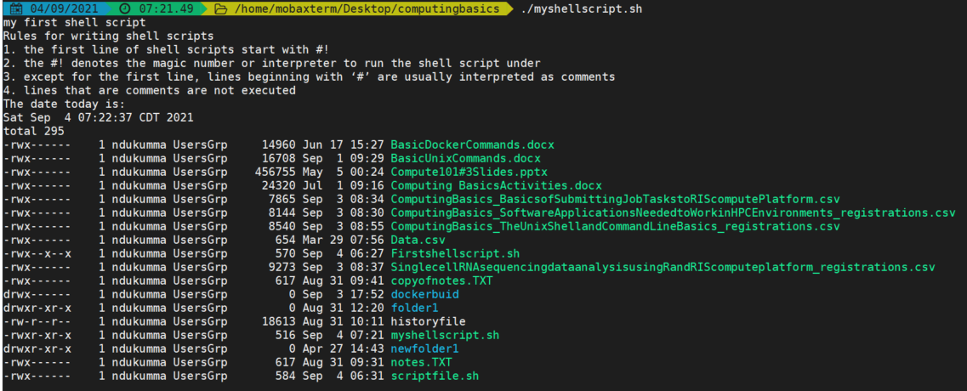
Run the shell script
Type a dot ‘.’ and the absolute or relative pathname to the shell script at the prompt and run it. The dot ‘.’ refers to the current directory
./myfirstshellscript.sh
Output from executing the example shell script

Slide 24
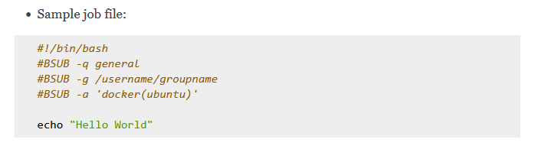
Batch Scripts
Batch script is a shell script with additional functionality, that tells the system how to run jobs and process data
https://docs.ris.wustl.edu/doc/compute/compute-ood.html
Notes:
Can include text in batch scripts, these would be interpreted as comments.
It’s more convenient to include command options in a batch script than passing them directly to the command line.
Batch scripts are used on a variety of computing systems, however, RIS scientific compute platform was designed for use with container technology, specifically, Docker containers https://docs.ris.wustl.edu/doc/compute/workshops/ris-docker-workshop.html.

Slide 25
Secure SHell (SSH) protocol
Secure way to connect local computer to remote computers (HPC clusters)
A variety of software options are available for SSH protocol implementation
Needs a username and password or an SSH key-pair to be able to connect

Slide 26
Secure SHell (SSH) protocol
CLI version of SSH is built-in for Linux and Mac computers
SSH Options for Windows :
- Windows PowerShell
- PuTTY – https://www.putty.org
- MobaXterm – http://mobaxterm.mobatek.net/
We’ll use MobaXterm for the workshop demos

Slide 27
Basic SSH command
To connect to the HPC cluster, type the ssh command in CLI prompt on a local computer and run it
User ID: USERNAME
HPC cluster ID: MACHINE-ID
Basic ssh command:
ssh USERNAME@MACHINE-ID

Slide 28
Connect to RIS Scientific Compute Platform
Basic ssh command:
ssh USERNAME@MACHINE-ID
Connecting to RIS Scientific Compute Platform:
USERNAME: wustlkey
MACHINE-ID: compute1-client-1.ris.wustl.edu
Password: wustlkey password
Basic ssh command to connect to RIS Scientific Compute Platform: ssh wustlkey@compute1-client-1.ris.wustl.edu
NOTE: VPN is needed for off-campus access

Slide 29
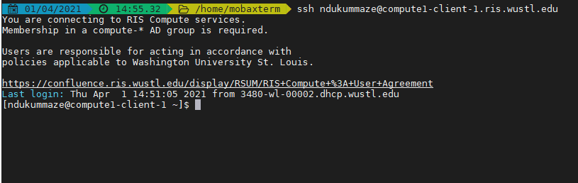
Connect to RIS Scientific Compute Platform
ssh ndukummaze@compute1-client-1.ris.wustl.edu
Password: Maze’s wustlkey password

Slide 30
Connect to RIS Scientific Compute Platform
Connection to RIS Scientific Compute Platform provides a command line interface (CLI) shell, access to storage and more
Can use Unix commands to create, explore and manage file/directories as introduced in other Basic Computing workshops

Slide 31
Connect to RIS Scientific Compute Platform
At the top of the Unix file-tree is the root directory: directories ≡ folders)
/
Top level = Root directory
/home/username
/scratch/username
/home
/usr
/scratch
/tmp
/home/ndukummaze
/home/username
/usr/bin
/scratch/ndukummaze
/scratch/username

Slide 32
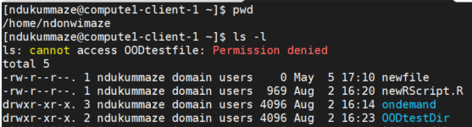
Connect to RIS Scientific Compute Platform
Home directory on RIS is 10G: https://docs.ris.wustl.edu/doc/compute/compute-faq.html#why-is-this-limited-to-10g-can-i-have-more
[ndukummaze@compute1-client-1 ~]$ pwd
[ndukummaze@compute1-client-1 ~]$ ls

Slide 33
Connect to RIS Scientific Compute Platform
RIS scientific compute platform integrates with storage platform
Can transfer files to and from your storage allocation (use smb protocol or globus for large files) https://docs.ris.wustl.edu/doc/storage/03_storage.html?highlight=mount%20storage

Slide 34
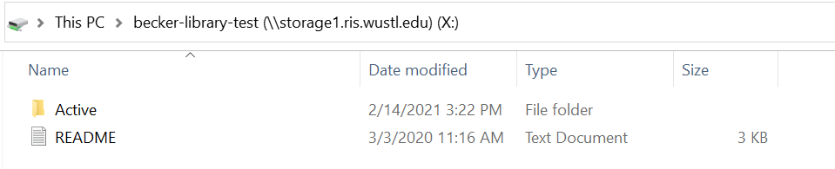
Connect to RIS Scientific Compute Platform
Can access data storage from a local computer, below is the view on my Windows computer (needs VPN for off-campus access)

Slide 35
Connect to RIS Scientific Compute Platform
Can access data storage platform from the compute platform, must use full pathnames
The storage space is: /storage1/fs1/${COMPUTE_GROUP}
COMPUTE_GROUP is group (lab or PI) you are assigned to.
Maze's COMPUTE_GROUP is becker-library-test
Maze’s storage space is: /storage1/fs1/becker-library-test

Slide 36
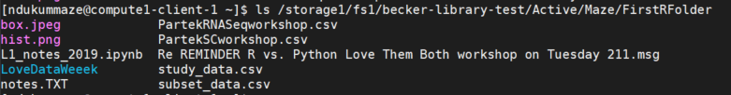
Connect to RIS Scientific Compute Platform
Can access data storage platform from the compute platform, must use full pathnames
Maze’s storage space is: /storage1/fs1/becker-library-test
Display a list of files in Maze’s storage:
[ndukummaze@compute1-client-1 ~]$ ls /storage1/fs1/becker-library-test

Slide 37
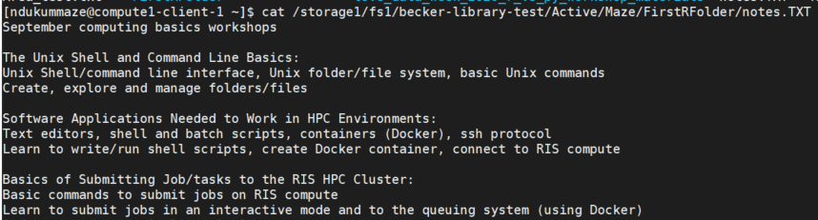
Connect to RIS Scientific Compute Platform
Must use full pathnames to access data storage platform from the compute platform
Maze’s storage space is: /storage1/fs1/becker-library-test
Display the contents of a file located in Maze’s storage:
[ndukummaze@compute1-client-1 ~]$ cat /storage1/fs1/becker-library-test/Active/Maze/FirstRFolder/notes.TXT

Slide 38
Connect to RIS Scientific Compute Platform
Use LSF_DOCKER_VOLUMES to specify which storage volumes to make visible to your compute job. Compute accesses scratch space and a cached view of storage.
The storage space is: /storage1/fs1/${COMPUTE_GROUP}
The scratch space is: /scratch1/fs1/${COMPUTE_GROUP}
Maze's COMPUTE_GROUP is becker-library-test
https://docs.ris.wustl.edu/doc/compute/recipes/ris-compute-storage-volumes.html?highlight=mount%20storage

Slide 39
Connect to RIS Scientific Compute Platform
Use LSF_DOCKER_VOLUMES to specify which storage volumes to make visible to your compute job. Compute accesses scratch space and a cached view of storage.
Maze's COMPUTE_GROUP is becker-library-test
[ndukummaze@compute1-client-1 ~]$ LSF_DOCKER_VOLUMES="/storage1/fs1/becker-library-test/Active:/storage1/fs1/becker-library-test/Active /scratch1/fs1/becker-library-test:/scratch1/fs1/becker-library-test"
https://docs.ris.wustl.edu/doc/compute/recipes/ris-compute-storage-volumes.html?highlight=mount%20storage

Slide 40
Docker
Docker is open source software platform used to create, develop and run applications
Docker container (application) - includes code, software with any needed dependencies, and an operating system
Can create Docker container from scratch or from a pre-made Docker image, requires a free Docker Hub account
https://docs.docker.com/get-started/overview/
https://docs.docker.com/get-started/
Notes:
A Docker image can be called a container image because the image is a template like a set of instructions for creating the container. Think of image as a recipe for cake and container as cake itself. We can create many containers from the same image, each with it’s own unique data and state.

Slide 41
Docker
Some basic Docker commands:
docker build – build image
docker images – list all docker images
docker run – run image (create docker container)
docker push – push container to docker hub
docker rm – delete docker image
https://docs.docker.com/engine/reference/commandline/docker/

Slide 42
Working with Docker
Get Docker - install Docker Desktop for your specific Operating System (Linux, Mac or Windows)
Can run Docker in Mac and Linux terminal, or in Windows PowerShell or in an integrated development environment like Visual Studio Code
https://www.docker.com/products/docker-desktop

Slide 43
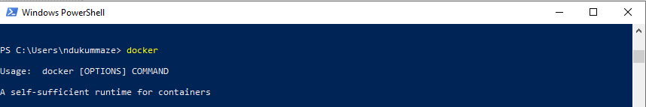
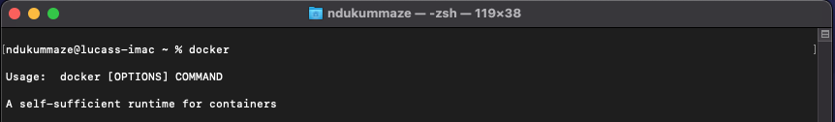
How to get Docker
Type and execute the docker command at Windows PowerShell or on Mac terminal prompt to start the Docker
Mac terminal

Slide 44
How to build a Docker container?
Can create a Docker container from pre-made Docker images, pulled from Docker Hub or other repository
Or can create Docker container from scratch:
- write a Dockerfile
- build an image from the Dockerfile
- run the image to create a container

Slide 45
How to Write a Dockerfile
A Dockerfile is a text file named ‘Dockerfile’ containing a series of instructions for building a specific Docker image.
Some specific Dockerfile instructions:
FROM
MAINTAINER
RUN
CMD
Dockerfile cheat sheet: https://kapeli.com/cheat_sheets/Dockerfile.docset/Contents/Resources/Documents/index

Slide 46
How to Write a Dockerfile
Simple example:
# first line starts with ‘FROM’ defines the base image or operating system to start the build process
FROM ubuntu
# full name and email address of author or image creator
MAINTAINER maze ndukum ndukummaze@wustl.edu
# command to be executed
RUN apt-get update
# specific command to be executed within the container
CMD ["echo", "hello world...! from my first docker image"]

Slide 47
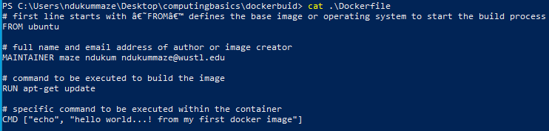
How to Write a Dockerfile
Simple example:

Slide 48
How to build a Docker image
Use the docker build command to build the image
docker build -t username/image:tag .
-t username -specify Docker hub username
image - assign a name to new image
tag -assign a version to the new image
. -denotes the current working directory

Slide 49
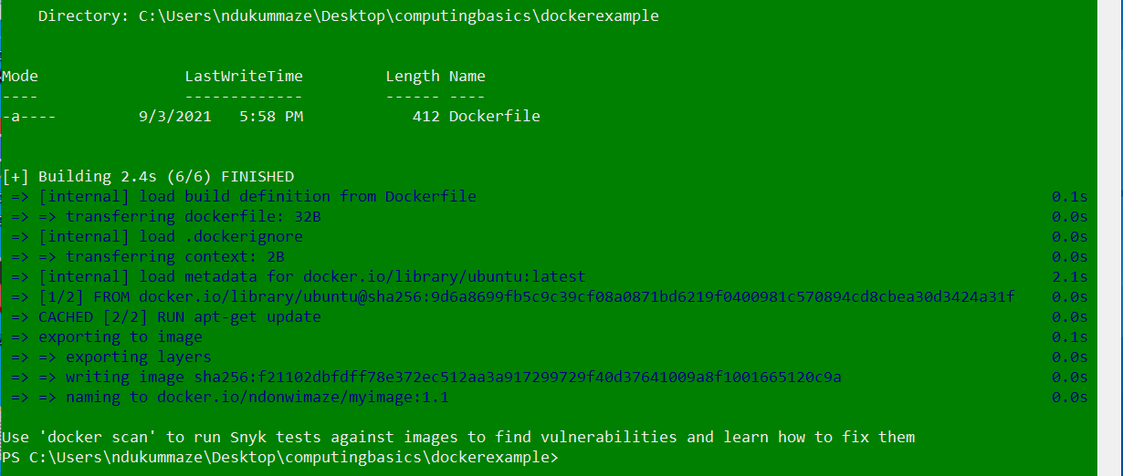
How to build a Docker image
Use docker build command to build image from the Dockerfile
docker build -t username/image:tag .
docker build -t ndonwimaze/myimage:1.1 .

Slide 50
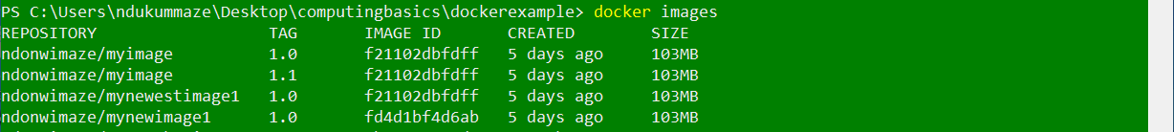
How to build a Docker image
Run the docker images command to see a list of available images
docker images
The image ID for myimage is f21102dbfdff

Slide 51
How to build a Docker image
Use the docker run command and image ID to run the image
docker run imageID
docker run f21102dbfdff

Slide 52
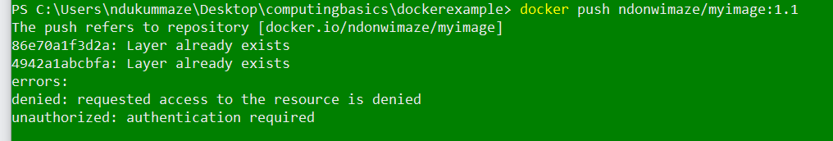
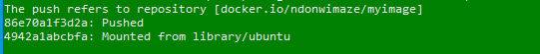
How to build a Docker image
Run docker push command to push the image to Docker hub, must be logged into with Docker Desktop for it to work
docker push username/imagename:tag
docker push ndonwimaze/myimage:1.1
Not logged into Docker Desktop
logged into Docker Desktop

Slide 53
How to build a Docker image
When the push command is finished running successfully, a ‘pushed’ message gets displayed on the screen

Slide 54
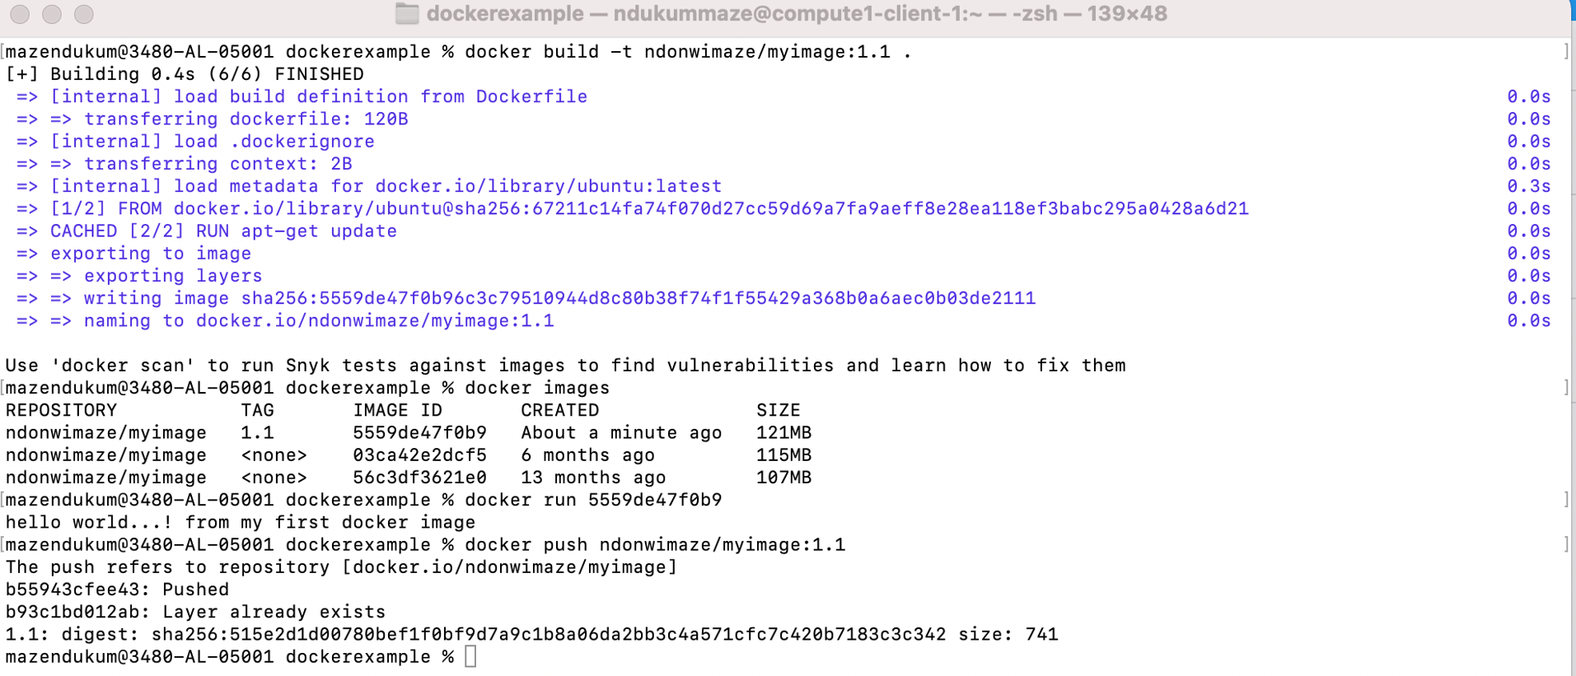
How to build a Docker image

Slide 55
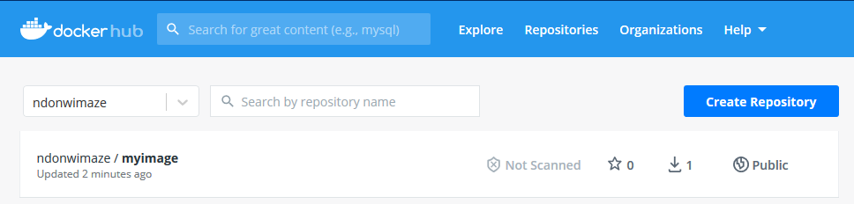
How to build a Docker image
Go to Docker hub https://hub.docker.com/, log on to your account and confirm that the image is there

Slide 56
How to build a Docker image
Many images are available, can use docker pull command to pull an image from Docker hub for building a container for a specific task
Can build Docker container locally or on a computing cluster
Using Docker on RIS Scientific Compute Platform: https://docs.ris.wustl.edu/doc/compute/workshops/ris-docker-workshop.html#using-a-docker-container-on-the-compute-platform

Slide 57
Hands-on Activities
Write a simple shell script, make it executable and run it
Get SSH and connect to RIS Scientific Compute Platform
Run commands in the background
Check process status – what is currently executing?
Exit RIS Scientific Compute Platform
Write a simple Dockerfile, build a Docker image/container and push to Docker hub (all done on your local computer)

Slide 58
Additional Helpful Resources
Bioinformatics Workshop Series at WUSM Campus:
Computing basics provide beginner level education. For additional in-depth training if appropriate for your needs, visit https://github.com/genome/bfx-workshop
Lectures are recorded and participants can join anytime throughout the year
Notes:
Workshops occur in the Fall and Spring. To view the Fall 2023 schedule and the Spring 2024 topics, visit https://github.com/genome/bfx-workshop.

Slide 59
Additional Helpful Resources
RIS Services User Manual – https://docs.ris.wustl.edu/
Becker’s Research Computing workshops page – https://becker.wustl.edu/services/research-computing/
O’Reilly/Safari Tech Books Online – access through Becker Library using your WashU email https://www.oreilly.com/library-access/
LinkedIn Learning for WUSTL - https://it.wustl.edu/home/how-to/linkedin-learning/
Learn more about Docker - https://docker-curriculum.com/
learn more about Dockerfile - https://thenewstack.io/docker-basics-how-to-use-dockerfiles/
Google
RIS Support: https://ris.wustl.edu/support/
Becker Library Contact: ndukummaze@wustl.edu

Slide 60

Bernard Becker Medical Library
660 S. Euclid Avenue | Campus Box 8132 | St. Louis, MO 63110

