Slide 1
Bernard Becker Medical Library
Delivering knowledge, informing decisions

Slide 2

Welcome to Computing Basics
Box link to workshop materials: https://wustl.box.com/s/lf2f458g0vxuvm0104bhigdq0zuzr1kr
During the session, type any questions you have in the chat box, if we don’t get to answer your question today, we’ll follow up with you after the workshop

Slide 3
Computing Basics
Maze Ndukum
ndukummaze@wustl.edu
Sr. Support Scientist
Research Computing
Becker Medical Library
Elyn Fritz-Waters
elyn@wustl.edu
HPC Research Facilitator
WUIT – Research Infrastructure Services

Slide 4
Computing Basics Workshops
Open On Demand on RIS Scientific Compute Platform – 4/10/2024, 1 PM – 2:30 PM
OOD is a web-based interface for connecting to and working in high performance computing environments. Attendees will learn how to run jobs using Open On Demand (OOD) on the RIS scientific compute platform.
The Unix Shell and Command Line Basics​ – 4/17/2024, 1 PM – 2:30 PM
Unix command line interface, the Unix file system, and basic Unix commands. Attendees will learn to create, explore, and manage Unix files and folders.
Software Applications Used in High Performance Computing Environments – 4/24/2024, 1 PM – 2:30 PM
Text editors, shell and batch scripts, Docker container technology, and the SSH protocol. Attendees will learn how to write, edit, and run shell scripts, how to create a simple Docker container, and how to connect to the RIS compute platform.
Submitting Jobs to RIS Scientific Compute Platform – 5/1/2024, 1 PM – 2:30 PM
Basic commands for submitting jobs to the queue on the RIS compute platform via the command line. Attendees will learn how to submit and run jobs/tasks using Docker and queuing system commands.
https://becker.wustl.edu/services/research-computing/
Notes:
This series provides the basics, and prepares those new to remote computing for ongoing learning
Why use a cluster?
What software applications are needed to work on a cluster?
- Text editors, shell and batch scripts,
- Containers (Docker), the ssh protocol
Demonstration Exercises
- Learn to write/run shell scripts
- Create/run a simple Docker container
- Connect to RIS Scientific Compute Platform
​

Slide 5
Basics of Submitting Jobs to the RIS Scientific Compute Platform
What is the queuing system?
How to submit jobs to the queue?
Demonstrations:
Learn to submit jobs to RIS scientific compute queues:
General-interactive
General
Notes:
RIS services - https://ris.wustl.edu/services/
WashU Faculty members can request storage and compute from here: https://servicedesk.ris.wustl.edu/
Review RIS’ user manual: https://docs.ris.wustl.edu/

Slide 6
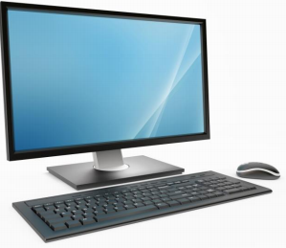


Main components of a compute cluster
Docker container images and LSF tells the RIS compute system how to process the jobs
login nodes
User/local computer
(Mac or Linux or Windows)
Batch Job Scheduler software:
- RIS compute uses IBM’s Spectrum Load Sharing Facility (LSF)
high-speed internet
RIS compute uses Docker containers:
compute nodes
storage
Notes:
A high performance computing cluster is basically multiple computers set up to work together in a way that they are viewed as a single unit (computer). Includes: job scheduler, high speed internet, server, nodes (storage, login, compute)
Users either have Linux, Mac or Windows computer, and needs ssh protocol (installed on users personal computer) to connect/interact with computer cluster
The RIS Scientific compute’s Batch Job Scheduler software, runs large scale, parallel computing tasks with access to many CPU and GPU cores, large amounts of RAM, high-speed networks, and high-performance storage systems. LSF gives everyone access efficiently and fairly
A user logs on and lands on login nodes, submits job to compute node for execution. RIS uses container technology (docker) and job scheduler/queue system to submit, manage jobs/tasks input, execution and output. High speed internet network is essential for this interaction

Slide 7
Workflow on RIS Compute Platform
1. Connect to RIS Scientific Compute Platform
2. Mount data from the Storage Platform
3. Use Docker containers and the queue system commands to submit jobs to the queuing system in interactive or non- interactive mode
You must be connected to a WashU network to access RIS Scientific Compute

Slide 8
Connect to RIS Scientific Compute
Each user account is represented by the user’s wustlkey, and users belong to compute groups (needed to access storage and submit jobs)
Can run the echo $HOME command to confirm pathname to a user’s home directory

Slide 9
Connect to RIS Scientific Compute
RIS group names are important for accessing storage and submitting jobs, can run the groups command to confirm a user’s compute group
Maze's storage allocation = storage-becker-library-test
Maze's job submission group = compute-becker-library-test
Run the groups command to display your group name(s)

Slide 10
What does LSF Job Scheduler do?
LSF (Load Sharing Facility) software submits jobs, manages resources to run jobs and monitors progress of jobs
LSF (commands options) and Docker images tells the RIS compute system how to process the job
Compute Quick Start:
https://docs.ris.wustl.edu/doc/compute/compute-quick-start.html
Using a Docker container on RIS compute platform: https://docs.ris.wustl.edu/doc/compute/workshops/ris-docker-workshop.html#using-a-docker-container-on-the-compute-platform
Notes:
- Similar to a shared lab instrument, HPC is a shared computer system. Users need to specify job requirements e.g, what kind of environment/software/docker image to run task in, how much memory is needed etc., Also, users manage software in their Docker images, unlike traditional HPC where HPC staff manages software versions/updates/changes etc.,
Working with Docker images makes it easy when it comes to research reproducibility

Slide 11
What does LSF Job Scheduler do?
RIS compute is a shared system, job scheduler needs to manage all jobs, and decides which nodes to run which jobs on
Individual users may have varied needs/different use cases, LSF need to balance needs of diverse users and provide tools to make life easier to end users
LSF job scheduler may need to manage hundreds or thousands of jobs at any given time
Notes:
LSF provides everyone access efficiently and fairly, users have varied needs and different use cases, LSF provides tools - commands and options – to make life easier for end users

Slide 12
What does a Job Scheduler do?
RIS compute is organized into queues, LSF commands can be passed to command line or included in shell scripts
LSF commands can take options and arguments:
COMMAND [OPTIONS] COMMAND [ARGUMENTS]
bsub [OPTIONS] COMMAND [ARGUMENTS]
​

Slide 13
What does a Job Scheduler do?
Some common LSF commands:
bqueues – see available queues
bsub – submit job to a queue
bjobs – check job status
bkill – kill job
LSF commands:
https://hpc.llnl.gov/banks-jobs/running-jobs/lsf-commands

Slide 14
What does a Job Scheduler do?
LSF commands can run in command line interface/terminal and so, can check man page for LSF commands:
man command
Check man page for bsub command:
​man bsub
NOTE: Use keyboard up and down arrows to browse man page, when finished, press q on keyboard to exit the man page
​

Slide 15
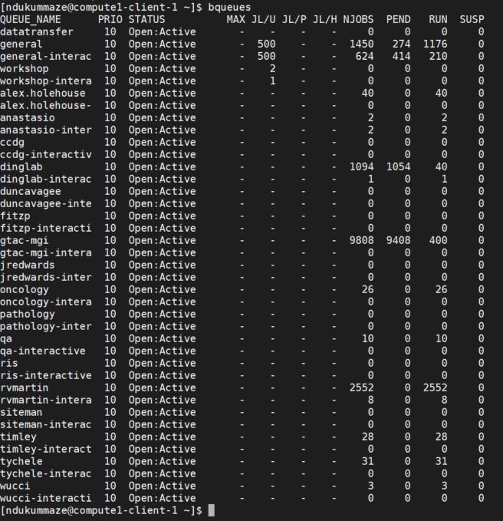
What does a Job Scheduler do?
The bqueues command shows all available queues on RIS compute
Default queues:
general
general-interactive

Slide 16
Submit jobs to RIS Scientific Compute
LSF commands can take options and arguments - general syntax for submitting jobs starts with the bsub command
bsub [OPTIONS] COMMAND [ARGUMENTS]
bsub -Is -q general-interactive -G compute-becker-library-test -a 'docker(alpine)' echo “hello world”
-Is specifies use of interactive queue, omitted if general queue
-q specifies the queue (general-interactive or general)
-G specifies your compute group
-a specifies the command to run (docker container)
Job execution examples:
https://docs.ris.wustl.edu/doc/compute/recipes/job-execution-examples.html ​
Notes:
This simple task/job runs the docker alpine image
A job/task = any command or series of commands that is run on the cluster
The process of using the queuing system/job scheduler is called batch job submission
Jobs may run for a few seconds or minutes or hours or days – set up to receive and email when job is finished

Slide 17
Submit jobs to RIS Scientific Compute
General-interactive queue connects a user to a compute node, is useful when trying to get a job to run, gives you immediate feedback, good when testing and troubleshooting
General-interactive queue has a max runtime of 24 hours
General queue is useful when you know your job is likely to work, has a max runtime of 28 days
​

Slide 18
Submit jobs to RIS Scientific Compute
Submit a simple job to general-interactive queue using Alpine docker image, Alpine has a Linux operating system
bsub command submits the job
This job runs the echo “hello world” command:
bsub -Is -q general-interactive -G compute-becker-library-test -a 'docker(alpine)' echo “hello world”
Options:
-Is specifies use of interactive mode
-q specifies the queue
-G specifies a compute group
-a specifies the command to run
Job execution examples:
https://docs.ris.wustl.edu/doc/compute/recipes/job-execution-examples.html ​

Slide 19
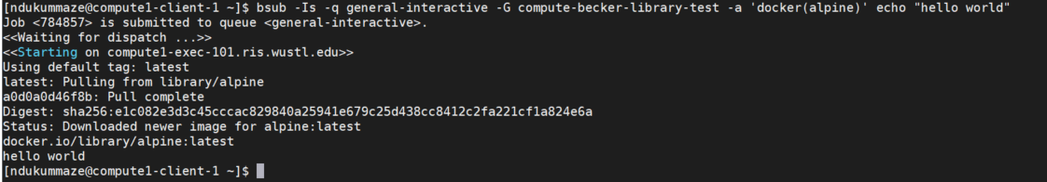
Submit jobs to RIS Scientific Compute
Submit a simple job to general-interactive queue using Alpine docker image
This job runs the echo “hello world” command :
bsub -Is -q general-interactive -G compute-becker-library-test -a 'docker(alpine)' echo “hello world”
bsub submits the job, generates a unique JOBID number, displays output on screen
JOBID
Output

Slide 20
Submit jobs to RIS Scientific Compute
Submit a simple job to general queue, using Alpine docker image:
bsub -q general -G compute-becker-library-test -a 'docker(alpine)' /bin/echo “hello world”
Options:
-q specifies a queue
-G specifies a compute group
-a specifies the command to run
​

Slide 21
Submit jobs to RIS Scientific Compute
Submit a simple job to general queue, using alpine docker image:
bsub -q general -G compute-becker-library-test -a 'docker(alpine)' /bin/echo “hello world”
bsub will submit the job and generates a unique JOBID number
bjobs will displays the status of the job:
PEND = Pending
RUN = Running

Slide 22
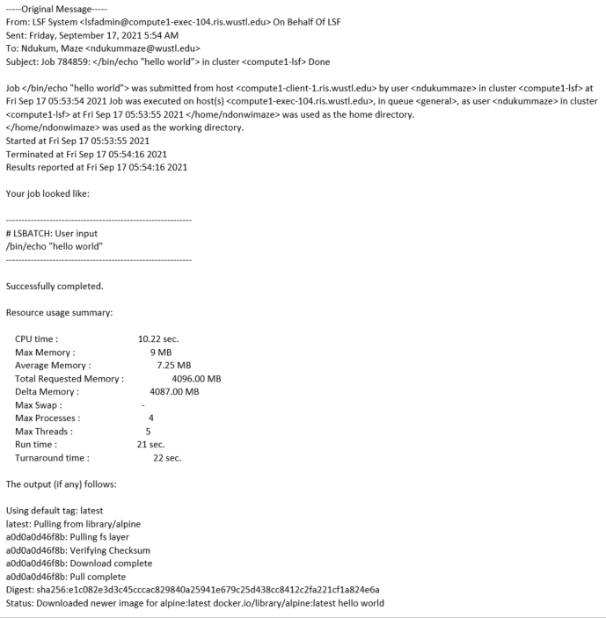
Submit jobs to RIS Scientific Compute
bsub submits job to general queue, output sent to user's email
Input
Job status/outcome, resources used
Output

Slide 23
Submit jobs to RIS Scientific Compute
When bsub submits job to general queue, output is sent to user's email, can use the –o option with bsub command to direct all output to a text file and save in a user’s $HOME directory or storage allocation
How to save output to user’s HOME directory (small only 10GB)
-o $HOME/filename_out.txt
How to save output to Maze’s storage
-o /storage1/fs1/becker-library-test/Active/Maze/filename_out.txt
May be helpful to use separate subdirectories for each job

Slide 24
Submit jobs to RIS Scientific Compute
Submit job to general queue, if something goes wrong with the job, use bkill command to delete JOBID to kill the job
Command to delete JOBID:
bkill JOBID
​

Slide 25
Submit jobs to RIS Scientific Compute
RIS Compute accesses scratch and storage space using full pathnames
Pathnames to scratch and storage1 file system:
/storage1/fs1/${STORAGE_ALLOCATION}/path-to-folders
/scratch1/fs1/${STORAGE_ALLOCATION}/path-to-folders
Maze's STORAGE_ALLOCATION= storage-becker-library-test
Full pathname to Maze’s Active storage:
/storage1/fs1/becker-library-test/Active/Maze
Run ls command to list folders in Maze’s storage:
ls /storage1/fs1/becker-library-test/Active/Maze

Slide 26
Submit jobs to RIS Scientific Compute
Compute jobs need to access features within Docker images and folders in storage allocation. Must first set environment variables before submitting a job
Docker Environment Variables https://docs.ris.wustl.edu/doc/compute/recipes/docker-wrapper-env-vars.html?highlight=docker%20environment%20variables
Accessing storage volumes
https://docs.ris.wustl.edu/doc/compute/recipes/ris-compute-storage-volumes.html?highlight=make%20storage%20visible%20compute ​

Slide 27
Submit jobs to RIS Scientific Compute
Use environment variables to make storage visible to compute job, LSF_DOCKER_VOLUMES specifies which storage volumes (storage folder) to make visible to the job:
[ndukummaze@compute1-client-1 ~]$ export LSF_DOCKER_VOLUMES=''/storage1/fs1/becker-library-test/Active:/storage1/fs1/becker-library-test/Active /scratch1/fs1/becker-library-test:/scratch1/fs1/becker-library-test''
The “export” statement sets the environment variable within the shell making it apply to every command that follows.
Notes:
We need a space between storage declaration and your scratch declaration in your LSF_DOCKER_VOLUMES variable. Each mount need to be separated by a space.

Slide 28
Submit jobs to RIS Scientific Compute
Once the environment variable is set within the shell, it’ll apply to the job command
Submit a job – this job uses docker R base image and sees Maze’s storage:
[ndukummaze@compute1-client-1 ~]$ bsub -Is -G compute-becker-library-test -q general-interactive -a 'docker(elynrfw/r-docker)' /bin/bash
Docker r-base image - https://hub.docker.com/repository/docker/elynrfw/r-docker

Slide 29
Submit jobs to RIS Scientific Compute
When job is submitted to general-interactive queue, job starts right away, accesses docker R base image, connects to a compute node, and the command prompt changes
Prompt when connected to login node:
[ndukummaze@compute1-client-1 ~]$
Prompt for interactive job:
ndukummaze@compute1-exec-120:~$
​

Slide 30
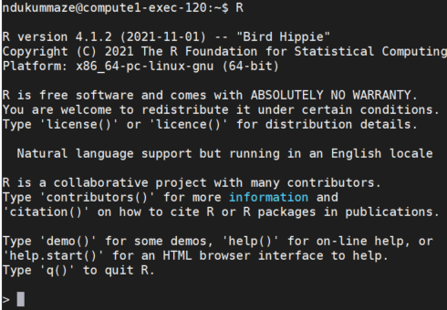
Submit jobs to RIS Scientific Compute
R code example – can run R commands directly in R console or from a script.
Type/run R to get R console and run R commands directly:
ndukummaze@compute1-exec-120:~$
When finished, type q()to quite R, then type exit to return to login node:
[ndukummaze@compute1-client-1 ~]$

Slide 31
Submit jobs to RIS Scientific Compute
R code example – can run R commands directly in R console or from a script
Example Rscript:
[ndukummaze@compute1-client-1 ~]$ cat /storage1/fs1/becker-library-test/Active/Maze/testRscript.R
# calculate
7+8
10-6
10*10
# import data and analyze data
study_data = read.csv("/storage1/fs1/becker-library-test/Active/Maze/study_data.csv")
Study_data
head(study_data)
str(study_data)
summary(study_data)

Slide 32
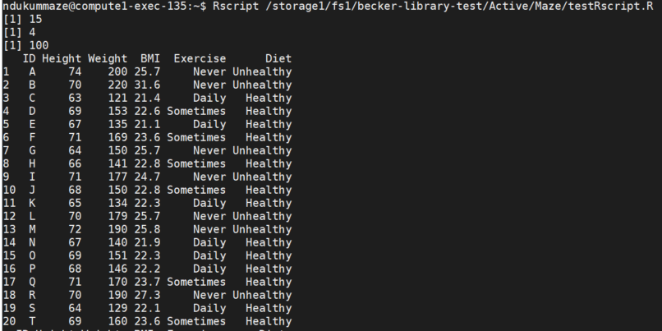
Submit jobs to RIS Scientific Compute
R code example – can run R commands directly in R console or from a script
Type/run R code from R script:
ndukummaze@compute1-exec-120:~$ Rscript /storage1/fs1/becker-library-test/Active/Maze/testRscript.R
When finished, type exit at the compute node prompt to return to the login node:
[ndukummaze@compute1-client-1 ~]$

Slide 33
Submit jobs to RIS Scientific Compute
Different compute nodes are equipped with different resources, request resources for a job using the –R flag.
Different Resource Requirements:
https://docs.ris.wustl.edu/doc/compute/recipes/job-execution-examples.html#resource-requirements

Slide 34
Submit jobs to RIS Scientific Compute
Requesting Memory – Default memory for jobs is 4GB, can use –R flag to set a memory limit, must set a kill threshold using the –M flag
For example – Request 9GB of memory with a kill threshold of 7GB:
bsub -G compute-becker-library-test -q general –R ‘rusage[mem=9GB]’-M 7GB -a 'docker(rocker/r-base)' /bin/bash
This means, allocate 9GB of memory but, if job uses more than 7GB, kill the job.

Slide 35
Submit jobs to RIS Scientific Compute
Also, can check memory usage for a job that’s submitted to the queue using the JOBID
Check memory usage:
bjobs -l JOBID
The ‘Resource usage collected’ section of the output gives an idea of current memory use, with that information, may need to adjust memory and this could prevent over- or under-allocating memory resources

Slide 36
RIS Open On Demand (OOD)
RIS ODD is a great place for new users to start, especially those who need some software (R, Python, MATLAB..) access on RIS Scientific compute
Users must first connect to RIS Scientific compute platform using the ssh protocol on command line interface (CLI) at least once
RIS OOD:
https://docs.ris.wustl.edu/doc/compute/compute-ood.html
https://docs.ris.wustl.edu/doc/compute/compute-quick-start.html
Notes:
After using ssh protocol to connect to RIS compute on CLI once, going forward, users can log on to RIS OOD using single sign on with wustl key without need for VPN

Slide 37
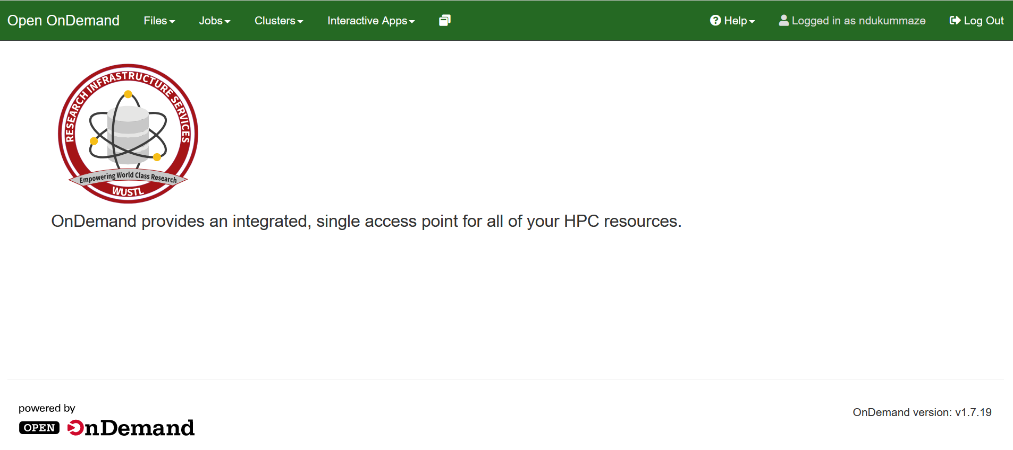
RIS Open On Demand (OOD)
Click http://ood.ris.wustl.edu
Notes:
OOD can:
display files and directories in your home directory not in storage 1 or scratch 1
Show active jobs – pending and running jobs
View job details and kill job if needed
Create and launch batch jobs similar to using a command on commandline like .bsub job file. Job and resource parameter information can be found on the Job Execution Examples page in RIS manual.
Jobs can be created from: - Default template - Specified path - Existing job (running or completed).

Slide 38
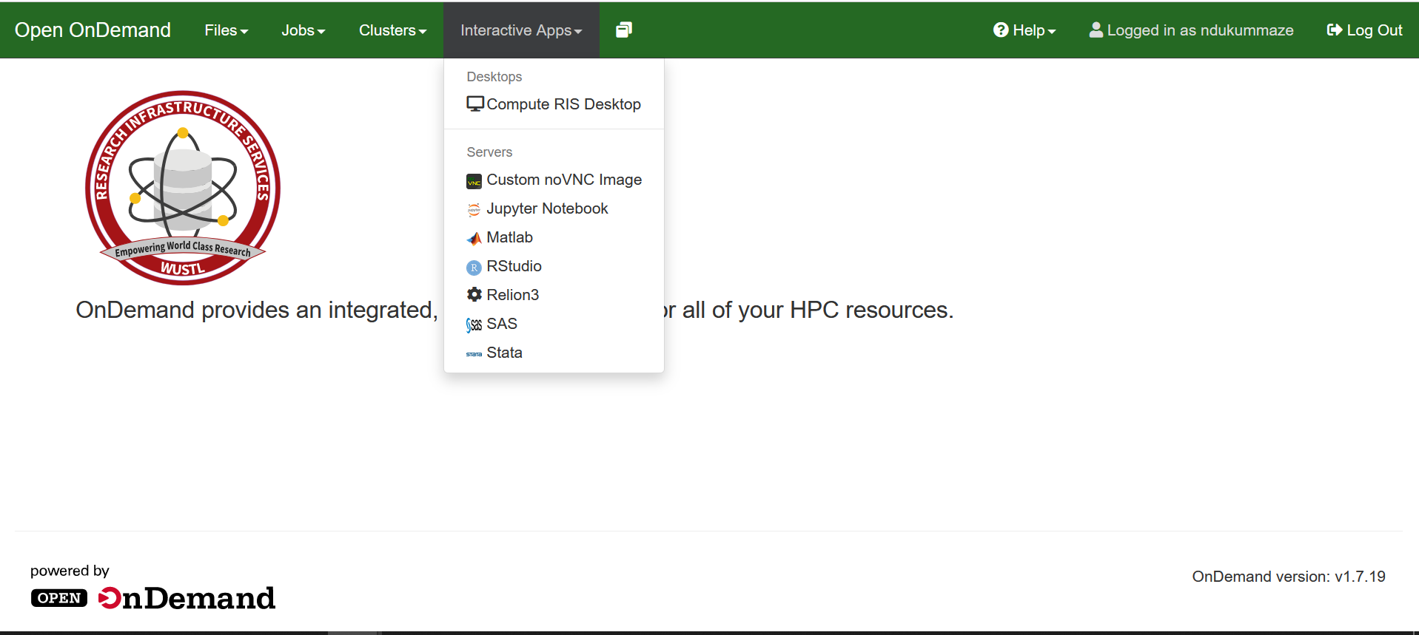
Using ODD on RIS Scientific Compute Platform
Notes:
Interactive Apps:
Run interactive jobs with GUI. - Select application name from the Interactive Apps dropdown. - Configure storage/scratch mounts and resource options for the job. - Select Launch to submit the job.
Custom noVNC Image
Ability to run custom images that specifically leverage the RIS noVNC image via the Custom noVNC Image application. This application also allows for extended resource usage such as spanning multiple hosts jupyter notebook --notebook-dir=.

Slide 39
Using ODD on RIS Scientific Compute Platform
RIS OOD Workshops:
https://wustl.box.com/s/3xihqmwvmn9e8p7nc69czwoz8i7aw8jo
https://wustl.box.com/s/duyl3zktts6djd5cth5x7kml6f2tu84j
Notes:
Interactive Apps:
Run interactive jobs with GUI. - Select application name from the Interactive Apps dropdown. - Configure storage/scratch mounts and resource options for the job. - Select Launch to submit the job.
Custom noVNC Image
Ability to run custom images that specifically leverage the RIS noVNC image via the Custom noVNC Image application. This application also allows for extended resource usage such as spanning multiple hosts jupyter notebook --notebook-dir=.

Slide 40
Submit jobs to RIS Scientific Compute
Users have varied needs and diverse use cases, it’s best to speak with RIS Support Staff:
Schedule one-on-one at Virtual Office Hours: https://ris.wustl.edu/support/
Create a ticket at Service Desk: https://ris.wustl.edu/support/service-desk/

Slide 41
Additional Helpful Resources
Bioinformatics Workshop Series at WUSM Campus:
Computing basics provide beginner level education. For additional in-depth training if appropriate for your needs, visit https://github.com/genome/bfx-workshop
Lectures are recorded and participants can join anytime throughout the year
Notes:
Workshops occur in the Fall and Spring. To view the Fall 2023 schedule and the Spring 2024 topics, visit https://github.com/genome/bfx-workshop.

Slide 42
Demonstration Exercises
Use CLI to submit jobs to RIS compute platform queues:
General-interactive
General

Slide 43
Helpful Resources
BBML Research Computing workshops - https://becker.wustl.edu/services/research-computing/
RIS Compute workshops - https://docs.ris.wustl.edu/doc/compute/compute-workshops.html
Introduction to IBM Spectrum LSF - https://www.ibm.com/docs/en/spectrum-lsf/10.1.0?topic=overview-lsf-introduction
LSF User Manual - https://hpc.llnl.gov/banks-jobs/running-jobs/lsf-user-manual
Introduction to High-Performance Computing - https://epcced.github.io/hpc-intro/13-scheduler/index.html
Google
RIS Support: https://ris.wustl.edu/support/
Becker Library Contact: ndukummaze@wustl.edu

