Slide 1
RISC-V Soft Processor on PolarFire

Slide 2
What is RISC-V
A New free and open ISA developed at UC Berkeley
RISC-V is “Instruction set architecture” (ISA). Not a processor.
The micro architecture implementations can be open or proprietary
Can expand to have open specifications for platforms, accelerators etc.
Permits reuse of the Software across many micro architectures
Goal is to encourage both open-source and proprietary implementations of the RISC-V ISA specification
Designed for
Research, Education & Commercial use
RISC-V foundation
Directs future development and foster adoption
https://riscv.org/

Slide 3
Frozen RISC-V Base & Extensions
Four base integer ISA Variants
RV32I, RV64I, RV32E, RV128I (32, 64, 128 bit machines)
I : Base Integer instruction set
Standard extensions - All frozen in 2014 – Forever
M: Integer multiply/divide
A: Atomic memory operations
F: Single Precision Floating Point
D: Double Precision Floating Point
G: IMAFD, General purpose ISA
Q: Quad Precision Floating Point
C: 16-bit Compressed instruction (RV32C, RV64C)
Future extension
V: Vector extensions – in definition

Slide 4
RISC-V Privileged Architecture
Four privilege modes
User mode – U
Supervisor mode – S
Hypervisor mode – H // not specified yet
Machine mode – M
Supported combinations
M // simple embedded
M, U // embedded with protection
M, S, U // operating systems
M, H, S, U // systems running hypervisors
Expect ratification CQ2

Slide 5
RISC-V Soft Processor on PolarFire
CoreRISCV_AXI4
Based on SiFive’s Coreplex E31 design
Will be available through Libero Catalog
IP Core
CoreRISCV_AXI4 Handbook
CoreRISCV_AXI4 release note
RISC-V privileged ISA spec
RISC-V user level ISA Spec
Key Features
Supports the RISC-V standard RV32IM ISA
Integrated 8Kbytes instructions cache and 8 Kbytes data cache
Two external AXI interfaces for IO and memory
Support up to 31 programmable interrupts
Debug unit with a JTAG interface
Best suited for low-mid range Microcontroller applications

Slide 6
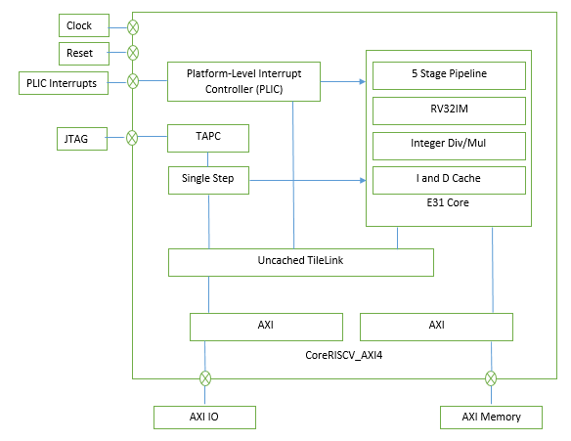
CoreRISCV_AXI4
Block Diagram

Slide 7
CoreRISCV_AXI4
CoreRISCV_AXI4 Processor Core
Based on the E31 Coreplex Core by SiFive
Provides a single hardware thread (hart) (one PC + one set of Registers)
Machine-mode privileged architecture
Supports the RISCV standard RV32IM ISA
“I” stands for “Base Integer”
“M” stands for “Integer Multiplication and Division”

Slide 8
CoreRISCV_AXI4
Two External AXI interfaces
AXI memory interface
Cached access to instruction and data memory
AXI I/O interface
Un-cached accesses to I/O peripherals
Memory System
First-level instruction cache
The instruction cache is 8 KB
Direct-mapped with a 64 bytes line size.
One Clock cycle Access latency.
First-level data cache
The data cache size is 8 KB,
Direct-mapped with a line size of 64 bytes.
The access latency is two clock cycles for full words and three clock cycles for smaller quantities.
Un-cached memory access for I/O

Slide 9
CoreRISCV_AXI4
Interrupt Sources
Local Interrupts
Wired directly to the CPU internally
Standard software interrupts (Exceptions , traps)
Timer interrupt
Global interrupts
Routed via Platform-Level Interrupt Controller(PLIC)
Supports up to 31 external interrupt sources
All external interrupts are single priority level at priority 1.
Supports Level triggered interrupts
External interrupts in the system can be connected here.

Slide 10
CoreRISCV_AXI4
JTAG Interface
Industry-standard 1149.1 JTAG interface
Supports Interactive debug
Supports Hardware breakpoints (maximum 2)
Accessible via FlashPro5 JTAG programmer/Debugger
Unlike CoreCortexM1, UJTAG module is not part of CoreRISCV_AXI4
Use CoreJTAGDebug for JTAG access

Slide 11
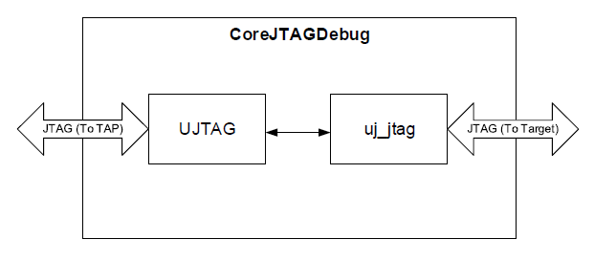
CoreJTAGDebug
Key Features
Facilitates JTAG interface to soft processor CoreRISCV_AXI4
Provides fabric access to the JTAG interface
Configurable IR Code support for JTAG tunneling
Allows debug support for multiple soft-processors
Future version is aimed towards debug support for multiple soft-processors

Slide 12
CoreRISCV_AXI - SoftConsole
SoftConsole 5.0
Installer available here
Works with FlashPro5.
Supported platforms
Ubuntu 14.04.5 LTS Desktop 32 and 64 bit
Ubuntu 16.04.1 LTS Desktop 32 and 64 bit
CentOS/Red Hat Enterprise Linux 6.8 Desktop 32 and 64 bit
CentOS/Red Hat Enterprise Linux 7.2 Desktop 64 bit
OpenSuse Leap 42.1 [Gnome/Kde desktop] 64 bit
Platforms not supported yet
Linux distributions/versions other than those listed above
Microsoft Windows
Virtual machines
Release note available here
Installation instruction
Known issues

Slide 13
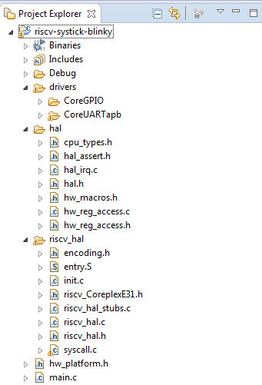
CoreRISCV_AXI - SoftConsole
Firmware project structure
hal
Hardware abstraction layer
Same as CortexM3 HAL on SmartFusion2
Register accesses e.g. HAL_set_32bit_reg
riscv_hal
RISCV Startup code
PLIC control
Equivalent to CMSIS on CortexM3 HAL on SmartFusion2
drivers
user peripheral drivers e.g. CoreSPI, CoreGPIO
riscv_hal is available on github
https://github.com/RISCV-on-Microsemi-FPGA/riscv-hal

Slide 14
CoreRISCV_AXI4 system on PolarFire
PLIC Interrupts
CoreRISCV_AXI4
JTAG
CoreJTAGDebug
Clock
Reset
AXI_MST_MEM
AXI_MST_MMIO
CoreAXI4Interconnect
CoreAXIToAHB
CoreAXI4SRAM
CoreAHBL
CoreAHBtoAPB
CoreAPB
CoreGPIO
CoreTimer
CoreSPI

Slide 15
CoreRISCV_AXI4 – Booting the system
Boot options
Debug Mode
Executing code from LSRAM using JTAG
Release mode
Design Initialization using PolarFire System Controller
Image can reside in sNVM, uPROM, or SPI-Flash
At power-up the image is loaded into LSRAM.
Image is then executed out of LSRAM.
Able to select locations post P&R
CoreBootStrap
Hardware boot-loader
Loads image into LSRAM from SPI-Flash using soft logic

Slide 16
Booting CoreRISCV_AXI4 on PolarFire
Debug Mode:
CoreRISCV_AXI4
JTAG
CoreJTAGDebug
AXI_MST_MEM
AXI_MST_MMIO
CoreAXI4Interconnect
CoreAXIToAHB
CoreAHBL
CoreAXI4SRAM
CoreAHBtoAPB
CoreAPB
CoreGPIO
CoreTimer
CoreSPI
FlashPro5 connected to JTAG port for interactive debug
Download image to CoreAXI4SRAM connected on the CoreRISCV_AXI4 code memory space
After reset CoreRISCV_AXI4 fetches and executes code from CoreAXI4SRAM

Slide 17
Booting CoreRISCV_AXI4 on PolarFire
CoreBootstrap:
RESET
CoreRISCV_AXI4
AXI_MST_MEM
AXI_MST_MMIO
AXI Master
CoreAXIToAHB
CoreBootStrap
AHB Master
CoreAXI4Interconnect
CoreAHBL
CoreAHBtoAPB
CoreSPI
CoreAXI4SRAM
CoreAPB
CoreGPIO
CoreTimer
CoreSPI
On-Board
SPI Flash
Connect CoreAXI4SRAM on code memory space of CoreRISCV_AXI4 memory map.
Use CoreBootStrap IP as first level Boot loader
The CoreBootStrap Holds the CoreRISCV_AXI4 in reset while it copies the application executable from on-board SPI Flash memory to CoreAXI4SRAM after system reset.
Application executable should be pre-loaded on the SPI Flash memory.
Releases reset on CoreRISCV_AXI4 after completion of copying executable to CoreAXI4SRAM
CoreRISCV_AXI4 now fetches and executes code from CoreAXI4SRAM.

Slide 18
Booting CoreRISCV_AXI4 on PolarFire
Design Initialization
CoreRISCV_AXI4
AXI_MST_MEM
AXI_MST_MMIO
CoreAXI4Interconnect
CoreAXIToAHB
Attach application executable as memory client to the RAM using Libero
CoreAHBL
CoreAXI4SRAM
CoreAHBtoAPB
CoreAPB
CoreGPIO
CoreTimer
CoreSPI
Connect CoreAXI4SRAM on code memory space of CoreRISCV_AXI4 memory map.
Use the configurator of CoreAXI4SRAM to attach a memory initialization file to it. This file should contain the application executable.
Use the Libero “Design and memory Initialization” GUI post P&R
The memory client will be stored on chosen memory, e.g. sNVM, uPROM etc. Memory client will be part of bit-stream output of the Libero design.
On system reset, System Controller will initialize the destination CoreAXI4SRAM with memory client from chosen memory.
The CoreRISCV_AXI4 will now execute application executable from CoreAXI4SRAM after it comes out of reset.

Slide 19
Booting CoreRISCV_AXI4 on PolarFire
Design Initialization
– two stage firmware boot
CoreRISCV_AXI4
AXI_MST_MEM
AXI_MST_MMIO
CoreAXI4Interconnect
CoreAXIToAHB
On-Board
SPI Flash
CoreSPI
CoreAHBL
CoreAXI4SRAM_2
CoreAXI4SRAM_1
CoreAHBtoAPB
CoreAPB
Attach first level boot-loader executable as memory client to the RAM using Libero
CoreGPIO
CoreTimer
CoreSPI
Connect CoreAXI4SRAM_1 in the code memory space of CoreRISCV_AXI4 memory map.
Use the configurator of CoreAXI4SRAM_1 to attach a memory initialization file to it. This file should contain the first level boot loader executable code.
Use the Libero “Design and memory Initialization” GUI post P&R
The memory client will be stored on chosen memory, e.g. sNVM, uPROM etc. Memory client will be part of bit-stream output of the Libero design.
At system initialization time, System Controller will initialize the destination CoreAXI4SRAM_1 with memory client from chosen memory.
The CoreRISCV_AXI4 will now execute first level boot loader from CoreAXI4SRAM_1 after it comes out of reset.
The boot loader functionality is to copy application executable from on-board SPI Flash memory to CoreAXI4SRAM_2.
After copy, the CoreRISCV_AXI4 jumps to address of CoreAXI4SRAM_2 to start executing the application image.
Application executable should be pre-loaded on the SPI Flash memory.
The base addresses of CoreAXI4SRAM_1, CoreAXI4SRAM_2 and the linker scripts of both executable codes must be coordinated to point to correct memory map.

Slide 20
Thank you

