Slide 1
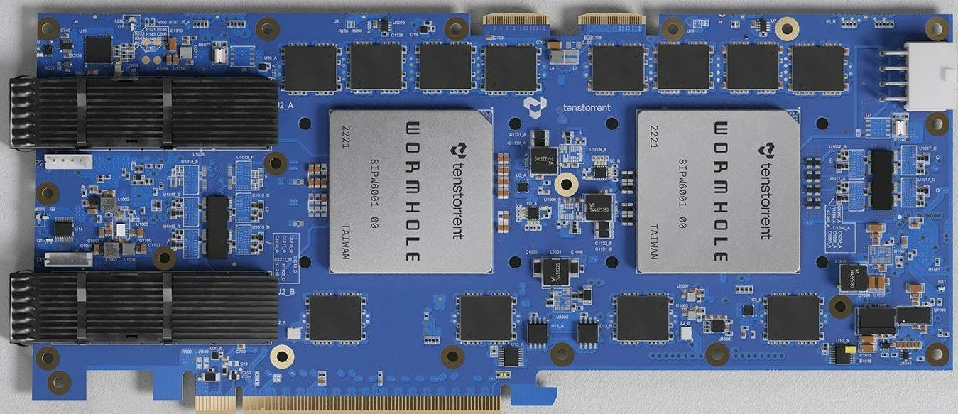


Overview of TT-Metalium SDK: Compute

Slide 2
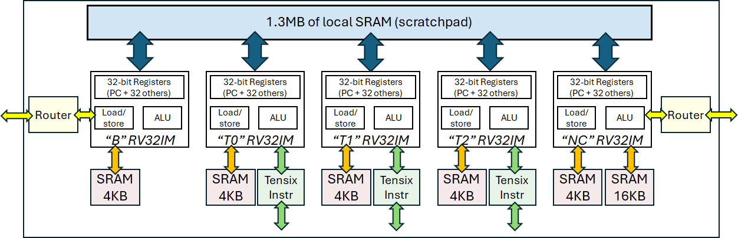
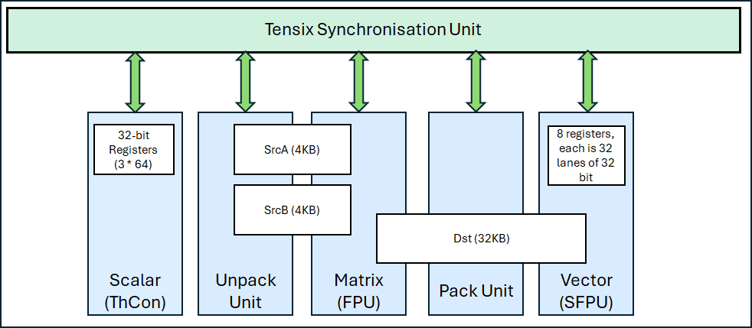
The compute engine has a scalar, matrix and vector unit
SrcA and SrcB are input registers
Dst is an output register (and input register for Vector unit too)

Slide 3
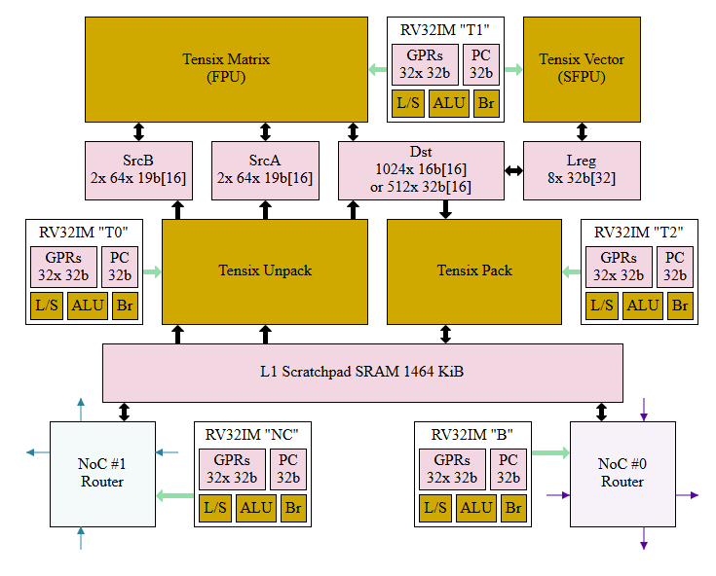
A more accurate diagram….
The matrix unit can perform 2048 FP multiplies and 2048 FP additions per cycle
The vector unit can perform 256 FP32 maths operations per second
This is FP32(ish)
The matrix unit makes several sacrifices to IEEE compliance to achieve this performance
The vector unit is more accurate – so for HPC workloads is probably the one we would use
From Pete Cawley’s blog at https://www.corsix.org/content/tt-wh-part7

Slide 4
Issuing compute operations to matrix unit
To get input data in
To compute
To get results out
Wait for two CBs (LHS and RHS) to be available via cb_wait_front API call
Acquire exclusive compute lock on DST (target) registers using tile_regs_aqcuire API call
Issue corresponding matrix API call such as add_tiles, sub_tiles, mul_tiles with CB index as input
Release exclusive compute lock on DST (target) registers using tile_regs_commit API call
Acquire exclusive pack lock on DST (target) registers using tile_regs_wait API call
Copy results from dst register to target CB via pack_tile API call
Release exclusive pack lock on DST (target) registers using tile_regs_release API call

Slide 5
Issuing compute operations to vector unit
To get input data in
To compute
To get results out
Wait for two CBs (LHS and RHS) to be available via cb_wait_front API call
Acquire exclusive pack lock on DST (target) registers using tile_regs_wait API call
Copy both input tiles into dst register using segment index
Release exclusive pack lock on DST (target) registers using tile_regs_release API call
Acquire exclusive compute lock on DST (target) registers using tile_regs_aqcuire API call
Issue corresponding vector API call such as add_binary_tile, sub_binary_tile with segment index determining inputs (first input overwritten with results)
Release exclusive compute lock on DST (target) registers using tile_regs_commit API call
Acquire exclusive pack lock on DST (target) registers using tile_regs_wait API call
Copy results from dst register to target CB via pack_tile API call
Release exclusive pack lock on DST (target) registers using tile_regs_release API call
Vector unit uses the dst registers for both inputs and output

Slide 6
The key points
Need to initialise with the data type
And reinitialise if change this
Inputs are CBs and the output is a CB
dst register is split into 16 segments
Matters more when using the vector unit
Need to acquire locks on the dst register as this coordinates instructions from the pack, compute and unpack RISC-V cores

Slide 7
Most common maths calls
Vector unit
add_binary_tile
sub_binary_tile
mul_binary_tile
abs_tile
exp_tile
Isinf_tile
Isfinite_tile
Isnan_tile
sqrt_tile
square_time
tan_tile
sin_tile
cos_tile
atan_tile
acos_tile
asin_tile
ltz_tile
eqz_tile
lez_tile
gtz_tile
neq_tile
gez_tile
unary_ne_tile
unary_gt_tile
unary_lt_tile
unary_max_tile
unary_min_tile
Matrix unit
add_tiles
sub_tiles
mul_tiles
matmul_tiles
reduce_tile
transpose_wh_tile
This also explains why the vector unit consumes from dst, as a common ML use-case is to execute with the matrix unit and then run another operation on results via the vector unit
This last column are comparison operations

Slide 8
Three compute cores…
Each Tensix unit has three RISC-V baby cores for compute
Unpacker drives the unpack unit
Maths drives FPU, SFPU, ThCon
Packer drives the pack unit
Programmer’s compute kernel is launched on all three cores which execute it concurrently
In the Metalium API there are explicit sections for different cores, where one (or more) cores will execute some code and additional synchronisation
But we don’t really need to worry about this, however, it explains why there are locks on the dst register to avoid conflict between the math and pack cores

Slide 9
Tiling data to drive compute
Tile 1
Tile 2
We have talked about bringing the FPU into play but the registers are only of a certain size
srcA and srcB are 4KB, so maximum 1024 FP32 and similar if you use the SFPU
Therefore need to tile data across chunks
They use the terminology tile due to the architecture being designed for matrix multiplications, and chunk would be better as a tile can be 1D
Practical three will explore how to do this, before using the matrix multiplication engine in practical four to perform the compute
Tile 3
Tile 4
Tile 1
Tile 2
Tile 3
Tile 4

