Slide 1

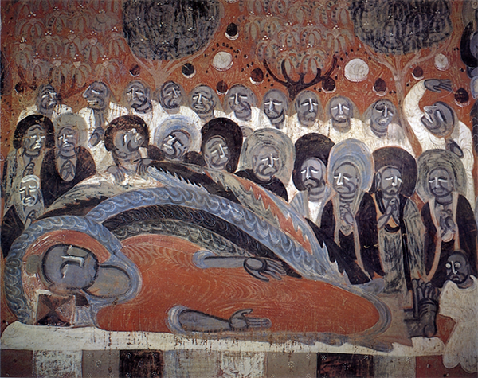
How and Why we Implement SHINE API for CBETA
洪振洲 Jen-Jou (Joey) HUNG
Dharma Drum Institute of Liberal Arts
Technical Leader of the Chinese Buddhist Electronic Text Association
RISE & SHINE Tool Developers Workshop
2020.09.23
Notes:
Hello everybody !!
I am Joey Hung, from Dharma Drum Institute of Liberal Arts in Taiwan.
Today I am very happy to be invited to this workshop to share our experience of implementing the SHINE API for the CBETA Corpus.
In the following talk, I am going to talk about the reasons why we decided to implement SHINE API for the CBETA Corpus and the benefits we have received from it.

Slide 2
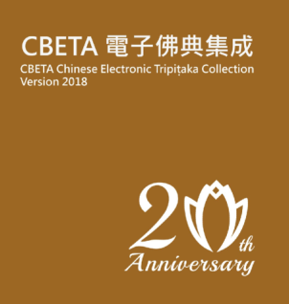
CBETA Chinese Electronic Tripitaka Collection
Collection | Characters
Taishō Tripiṭaka | 78,770,000
Shinsan Zokuzōkyō | 71,220,000
Passages concerning Buddhist activities from the Official Histories | 333,000
Buddhist texts not contained in the Tripiṭaka | 1,663,000
Selection of stone rubbings from the Northern Dynasties Period | 74,000
Supplements from other editions of the Tripiṭaka | 24,193,000
Chinese translations of the Pali Canon | 9,156,000
Selections from the Taiwan National Central Library Buddhist Rare Book Collection | 6,801,000
Supplement to the Chinese Buddhist Canon | 20,478,000
Chinese Buddhist Temple Gazetteers | 1,650,000
Collection of Ven. Yinshun's work | 7,540,000
~2018.07.20 | c.a.223,822,000
The world's largest collection of digital Chinese Buddhist Texts
Since 1998, CBETA has continued to expand data and improve content quality.
Notes:
Ok, firstly, let me give a short introduction about CBETA.
CBETA is the abbreviation of Chinese Buddhist Electronic Text Association.
This is a dedicated group committed to digitizing the Chinese Buddhist scriptures and texts.
They define their missions as: to Collect all Chinese Buddhist scriptures in order to create a digital archive and to develop digitization technologies to improve exchanges about Buddhist scriptures and their applications.
The CBETA corpus is the major product of the CBETA association. Since 1998, CBETA has continued to expand data and improve the content quality of CBETA Corpus. The Corpus is now the largest collection of digital Chinese Buddhist Texts in the world.
The CBETA corpus includes two of the most important collections of Chinese Buddhist texts for research, the Taishō Tripiṭaka and the Shinsan Zokuzōkyō, as well as other related materials and resources.
As of July 2018, it already has more then 223 million Chinese Characters inside the corpus.

Slide 3
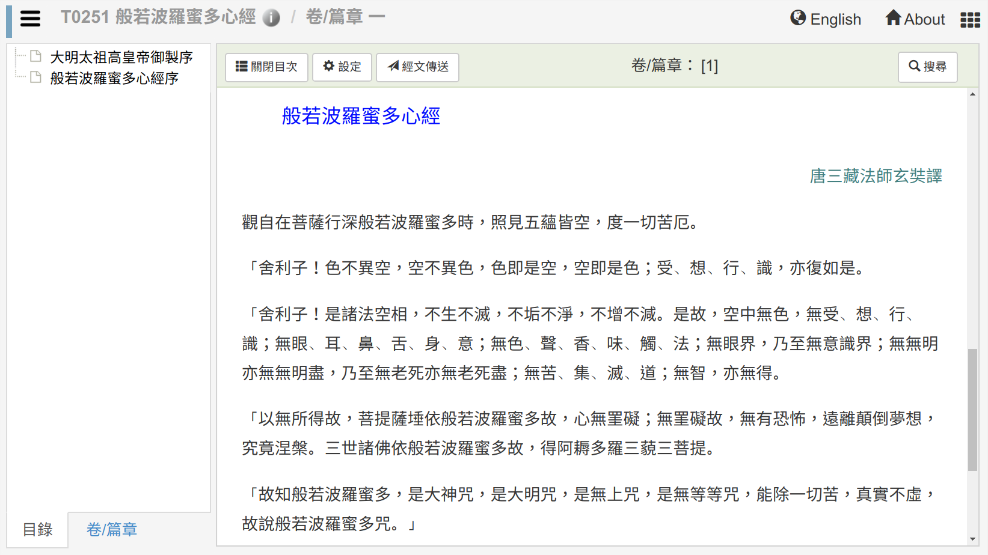
CBETA Online Reader
http://CBETAOnline.dila.edu.tw
藏經掃描影像
IIIF Service
A Web-based Reader for the CBETA Corpus, consisting of over 200 million Chinese Characters.
Notes:
The CBETA Corpus is usually published as a Multimedia DVD disk.
In recent years, as it is more in line with the computer operating habits of modern researchers, we have developed the ‘CBETA Online’ platform, it is an web application for using CBETA Corpus directly with user’s browser.
Here is a screenshot of CBETAOnline, and its address is shown here. Http://cbetaonline.dila.edu.tw. If you are interested in obtaining Chinese Buddhist texts, here would be your best choice.
With this CBETAOnline Website, our users can access over 220 million Characters of Chinese Buddhist texts without the need to install any extra software, nor any authentication required.
We also put a lot of effort to create an easy-to-use interface for our users, and also try to integrate reference materials to the text as much as possible .

Slide 4
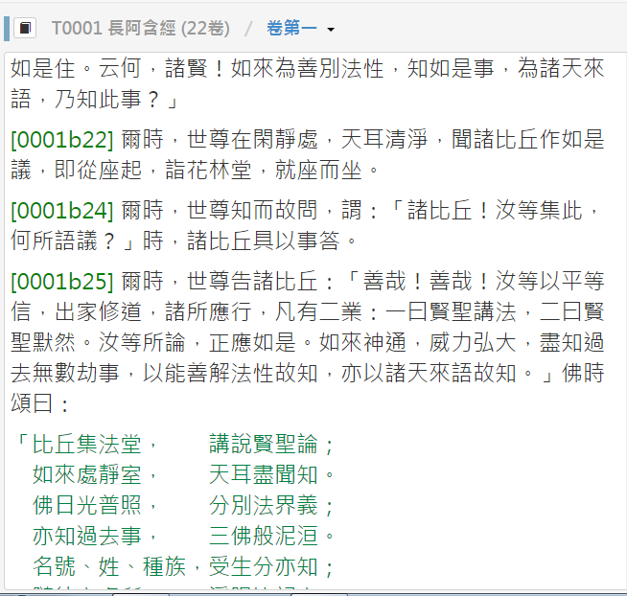


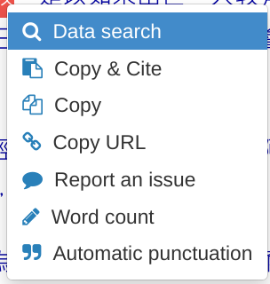
Perform Full-text Search and Lookup Reference with one-click
Full Text Search
Dictionary Look up
Person/Place Information
Phrase Statistics
Bibliography Database
http://CBETAonline.dila.edu.tw
Notes:
We created a one-click text search and reference lookup function.
As shown on the screen, when a user performs the full text search, they are able to look up the dictionary, gazetteers, Bibliography records, and also to retrieve the phrase statistics at the same time.

Slide 5
CBETA Research Platform
CBDATA Service
Core Resource Service
Buddhist Dictionary
Scripture Catalog
Person/Place/Time Authority Database
Secondary Research Resources
Full Content
CBETA Concordance Analysis
DEDU
Parallel Corpus Editing
CBETAOnline
Reader
Other DH Tools
Notes:
Actually, to our mind, we not only just want to create a web reader for the CBETA corpus, but to integrate the related material and make it as the back-end data services.
Then we can create different applications to use the back-end data.
>> Click!!
The online reader is just one example, and we have actually created two other tools for retrieving and visualizing the phrase statistics, and creating a parallel corpus from CBETA texts.
>> Click!!
Besides, we are also considering to let other DH tools obtain data from our data back-end.

Slide 6
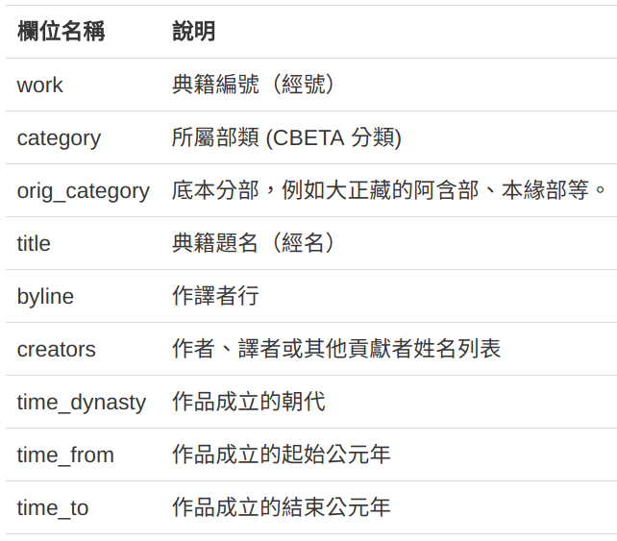
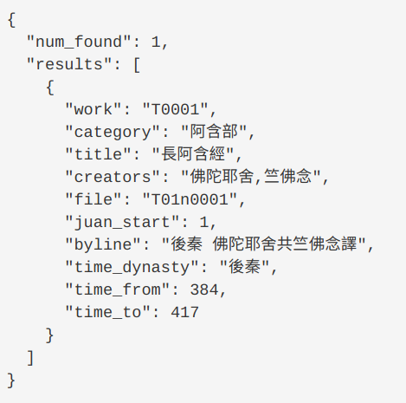
CBETA Data API
Provide an API with complete CBETA data
(http://cbdata.dila.edu.tw/v1.2)
Eg: to get the metadata of a Buddhist sutra（details of T0001）
http://cbdata.dila.edu.tw/v1.2/works?work=T0001
Notes:
So from the very beginning, we decided not to let our application directly access our data repository, but to define a set of CBETA Data API.
The API is open to everybody, in this address, http://cbdata.dila.edu.tw. It is very complete, from retrieving the list of possible texts, accessing the content, and even to perform a search and get search results.
All of them will respond to the standard URL call and return responses in JSON format.

Slide 7
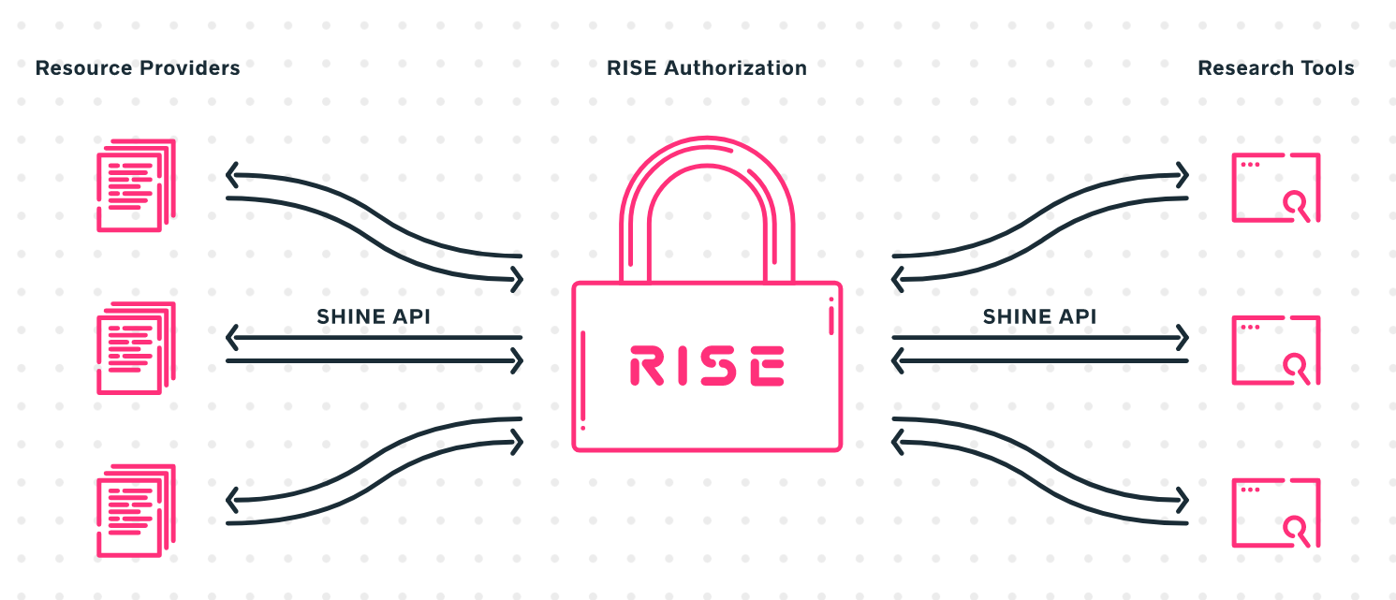


Connect to MARKUS
To make CBETA data to be easily analyzed and marked with Markus tool, we implement SHINE API
Notes:
Then we started to seek cooperation with other research platform and tools. We would like to create an easy way to let researchers to operate those tools with our CBETA Data.
When we contacted with MARKUS platform, at the beginning I wanted to persuade Brent to write a piece of code to connect our data service through our CBETA Data API.
But then I learned about SHINE API, and MARKUS is ready to retrieve data from SHINE API compatible endpoints. So, Brent suggested to us, how about we implement the SHINE API?

Slide 8
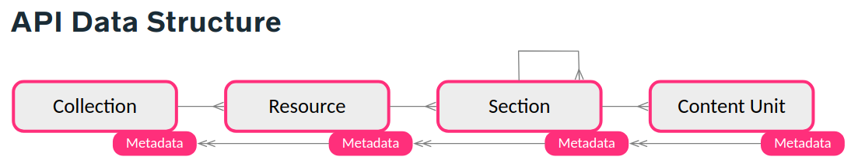
Implementing SHINE API
Collection
Text
Fascicles
Content
Taishō Tripiṭaka
Shinsan Zokuzōkyō
Chinese translations of the Pali Canon
….
T0001 長阿含經
T0002 七佛經
T0003 毘婆尸佛經
T0001 長阿含經 卷1
T0001 長阿含經 卷2
T0001 長阿含經 卷3
則導之以契經；演幽微，則辨之以法相。然則三藏之作也，本於殊應，會之有宗，則異途同趣矣。禁律，律藏也，
Notes:
So, I did a little study on the SHINE API, and it seems quite straight forward to me. The structure of the Collection > Resource > Section and Content unit is very similar to what we have done in our Data API.
We very quickly decided the mapping of those four-layers structure to our data, as shown in this slide. We both have collection ideas, and the Resource in SHINE API can map to an individual text in the CBETA corpus, and Section equals to a Fascicle, and Content unit is the actual text belonging to a Fascicle.

Slide 9
Implemented SHINE APIs
http://cbdata.dila.edu.tw/v1.2/static_pages/rise-shine
Module | Description | API
Collections | Get the list of all collections | api/collections
 | Get the list of all resources for a collection | /api/collections/{uuid}/resources
Resources | Get the list of all sections for a resource | /api/resources/{uuid}/sections
Sections | Get one section's information | /api/sections/{uuid}
 | Get the list of all content units for a section | /api/sections/{uuid}/content_units
Notes:
In fact we only had to rewrite a part of our Data API, and created the five APIs for communicating with MARKUS.
We probably only implemented the minimal set of SHINE API, but it is enough for us.

Slide 10
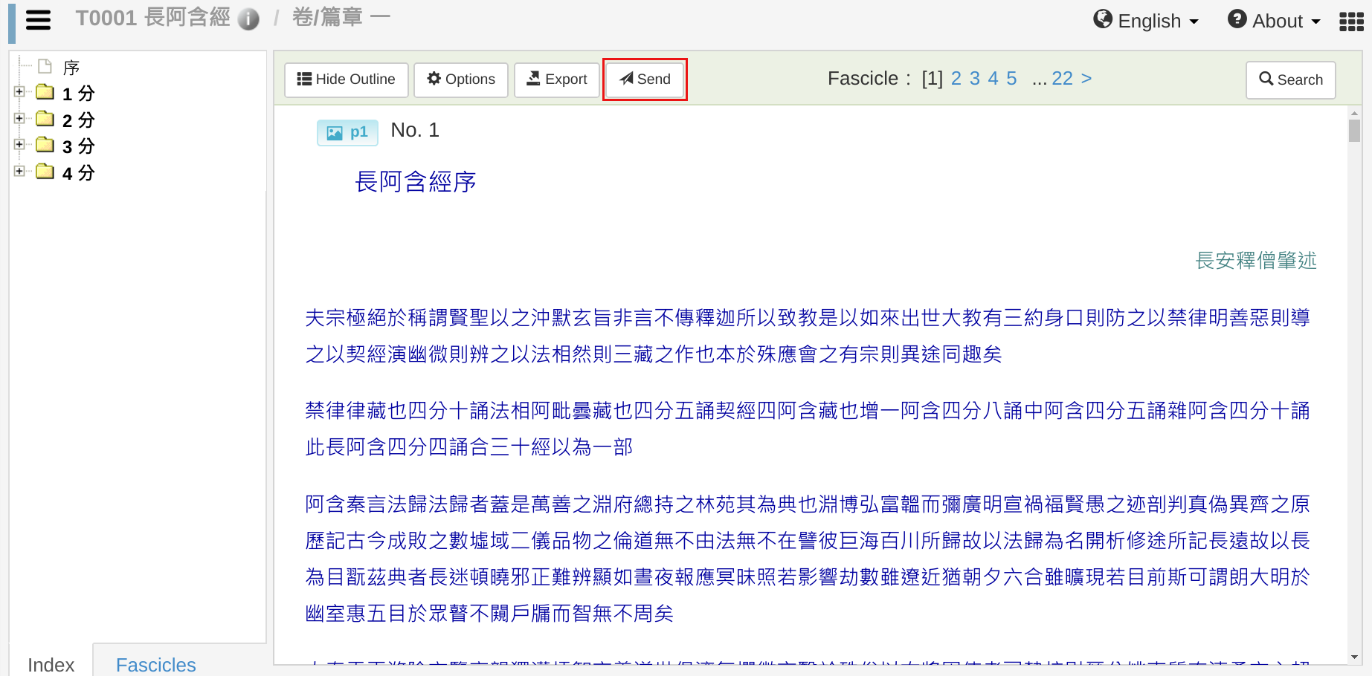
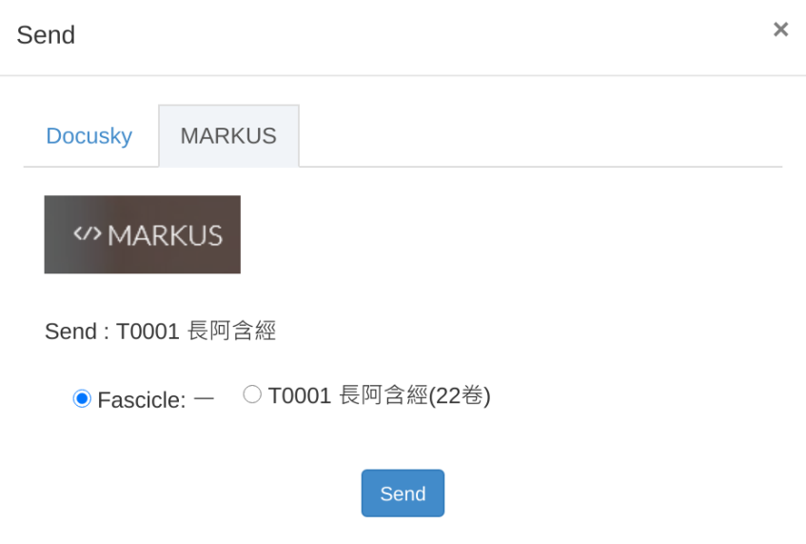
Send To MARKUS function
Notes:
So now, in our reader interface, we can have this “SEND to MARKUS” function.
It is used to let our users send the text being read to the MARKUS platform for further use.
It runs quite smoothly.

Slide 11
Other Benefits of using SHINE API
Because we have created a complete set of Data API, it is a very low cost investment of implementing SHINE API.
If more Tool Developers can make their tools compatible with SHINE API endpoints, then more people can use our data for different purposes. That is what we want to see.
Notes:
About the benefit.
Because we have created a complete set of Data API, it is a very low cost investment of implementing SHINE API.
If more Tool Developers can make their tools compatible with SHINE API endpoints, then more people can use our data for different purposes. That is what we want to see.

Slide 12
Thank You for Listening.
Q & A !!
Notes:
[end]

