Slide 1
Brief introduction to version control with Git
Dr. Maximilian Hindermann

Slide 2

This section’s goal

Slide 3
Get you in a position to decide if Git might be useful for your work.

Slide 4
What is Git?
Git is a distributed version control system (VCS).
A VCS is “a system that records changes to a file or set of files over time so that specific versions can be recalled later” (Chacon & Straub 2014: 10).
Git is very well suited for text-like data such as code, but of course also for text-like data such as:
an ALTO-XML file encoding the transcript of a medieval manuscript
a CSV file recording numerical weather data for Basel
a JSON-LD file containing a Tropy database
an SVG file of a research project’s fancy new logo
a TXT file containing a novel from Project Gutenberg
Git is less well suited for binary data such as audio data, images or video (changes in these files are opaque), especially if these files are large (>100MB); use Git Large File Storage extensionin such cases.

Slide 5
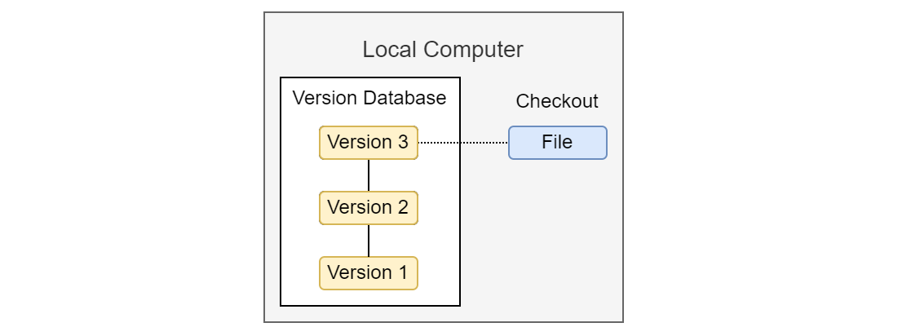
Local version control

Slide 6
Solves the problem of error-prone manual versioning of files.

Slide 7
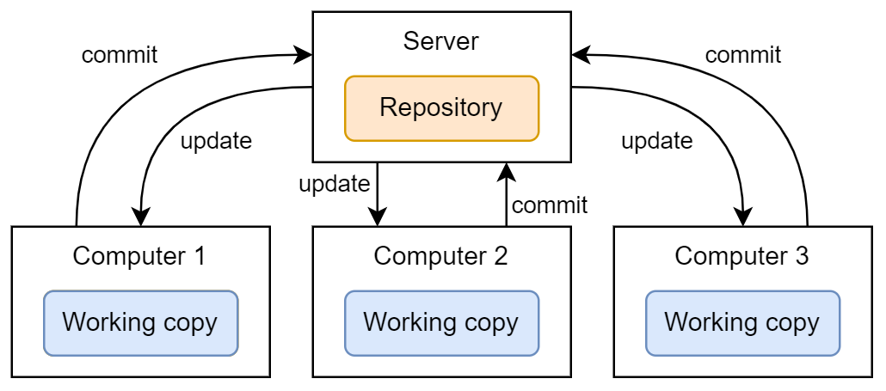
Centralized version control

Slide 8
Solves the problem of how to work on the same files together on different computers.

Slide 9
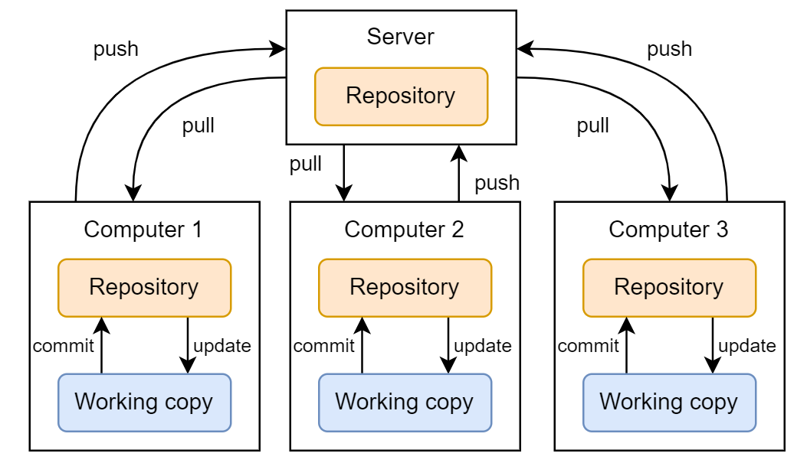
Distributed version control

Slide 10
Solves the problem of being dependent on central server for work and backup.

Slide 11
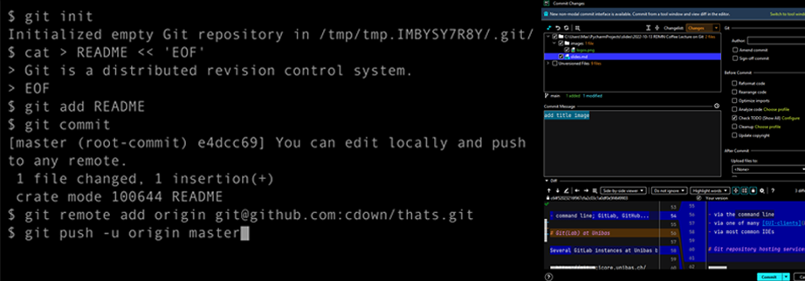
Using Git

Slide 12
After installation on your computer, you can use Git:
via the command line
via one of many GUI-clients
via most common IDEs

Slide 13
Git repository hosting services
But where do I host my Git repository? Do I have to configure a server myself?
No. In practice, most users rely on a commercial Git repository hosting service such as GitHub, GitLab, Bitbucket, or others.
Git repository hosting services do not replace but extend Git!

Slide 14
GitLab at Unibas
In contrast to GitHub, GitLab can be installed on your own infrastructure (e.g., required for sensitive data).
There are several GitLab instances at Unibas but none run as official university-wide service:
https://git.scicore.unibas.ch/
https://gitlab.psychologie.unibas.ch/
https://gitlab.switch.ch/ub-unibas/
https://gitlab.its.unibas.ch/

Slide 15
National infrastructure
Switch offers a GitLab instance, c4science supports Git:
https://gitlab.switch.ch/
https://c4science.ch/

Slide 16

Looking at a sample GitHub repository

Slide 17
GitHub repo for these slides: https://github.com/RISE-UNIBAS/clean-code/git
Image credit: Alex Eylar, “Inception”, CC BY-NA-SA 2.0.

Slide 18

Further reading

Slide 19
Tons of material online and in print
Scott Chacon and Ben Straub (2014): Pro Git, Apress
Bernd Öggl and Michael Kofler (2022): Git. Projektverwaltung für Entwickler und DevOps-Teams, Rheinwerk Computing

