Slide 1
Project topic- E-commerce Products Recommendation system
Under the Mentorship of By-
Amit Gupta Name-Rishabh Nauni
Associate Professor University roll no. -2319402 Section- L1
Class Roll No.- 41

Slide 2
Introduction
Recommendation system is very important or crucial for various aspect like personalize user experience, help customers what they need quickly and efficiently.
E-commerce has evolved the retailing world by allowing businesses to reach a global audience and destroy geographical barriers.
Advanced algorithms and machine learning techniques can take a recommendation system a long way to improve user experience and generate higher sales.
In this we explores different recommendation techniques; these include content-based filtering, collaborative filtering, and hybrid approaches. Content-based filtering.

Slide 3
Problem statement
INACCURATE RECOMMENDATION- Many e-commerce platforms struggle with providing relevant and personalized products recommendations, leading to customer frustration and lost sales.
Cold Start Problem- New users or products lack sufficient historical data, making it difficult for traditional methods to generate accurate recommendations.
Data Sparsity- E-commerce dataset often exhibit sparsity, with limited user-item interactions, posing a challenge for collaborative filtering techniques.

Slide 4
Objective
Improve Recommendation Accuracy- Develop a hybrid recommendation model that combine the strength of content-based and collaborative filtering to enhance recommendation accuracy.
Address Cold Start Problem- Utilize content-based feature to generate recommendations for new users or products with limited historical data.
Mitigate Data Sparsity- Leverage collaborative filtering techniques to provide recommendations even with limited user interactions.

Slide 5
Literature Review
This field has seen a great deal of research and development over the past few years, leading to the potential for diverse techniques and approaches.
Content -based recommendation systems suggest items to users based on the attributes or features of the items and the user’s previous preferences. But for new users with limited interaction history, the selection of items is restricted.
Collaborative filtering is a technique used in recommendation to make predictions about a user’s preference based on the preferences of many users. but it can cause problems such as low ratings and difficulty with recommendation to new users or items with limited ratings.
Hybrid Approaches combining the strengths of content-based and collaborative filtering techniques, hybrid recommendation models provide recommendations that are more diverse and precise.

Slide 6
Rating Base-Recommendation
when we are first time opening the e-commerce website we don’t know about the preference of the user, so we just gave the top most rated item to the feed. This can be done by the rating base recommendation system.
Algorithm:
Group Data- Group the train_data by Name, ReviewCount, Brand and ImageURL.
Calculate Mean Rating- Compute the mean rating for each group.
Sort by Rating- Sort the grouped data by the Rating column in descending order.
Select Top 10- Select the top 10 item based on the higher ratings.
Display- Print top rated item.

Slide 7
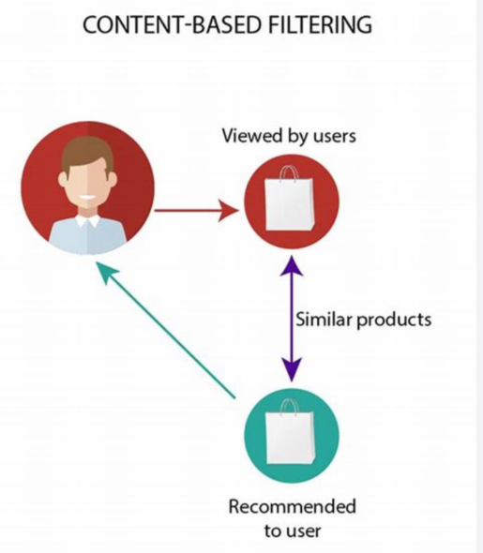
Content-Based Filtering Approach
Content -based recommendation systems suggest items to users based on the attributes or features of the items and the user’s previous preferences.
Product features- Extract relevant feature from product description, categories, and attributes.
Similarity Calculation- Compute similarity between products based on their feature vectors.
Recommendation Generation- Recommend products that are most similar to those a user has interacted with in the past

Slide 8
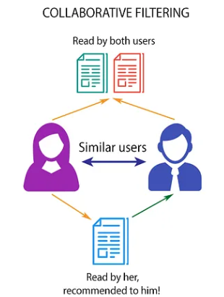
Collaborative Base Recommendation
Collaborative filtering is a technique used in recommendation to make predictions about a user’s preference based on the preferences of many users.
User-Item Matrix- Construct a matrix that represents user interactions with different products.
Similarity Calculation- Calculate similarity between users or items based on their on their interactions with products.
Recommendation Generation- Recommend items that users with similar preferences have interacted with in the past.

Slide 9
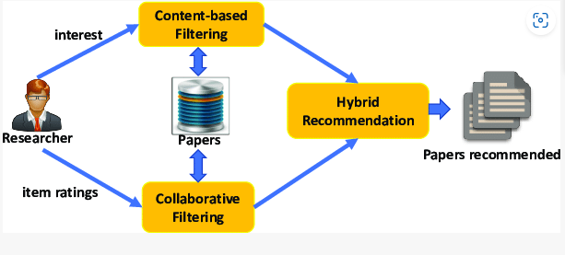
Hybrid Approach
Hybrid recommendation systems combine two or more recommendation techniques to leverage the strength of each and reduce their weaknesses.
Combine - Integrate both content-based and collaborative filtering approaches into one model.
Weighting - Assign weights to individual filtering method based on their performance and relevance.
Recommendation- Generate a final recommendation by combining predictions from both approaches.

Slide 10
Conclusion
Recommendation systems can help customers find product recommendations that match their preferences by personalizing product suggestions, which in turn may increase the engagement and loyalty of customers
For future research, new strategies could include the implementation of social influence, contextual information, and advanced algorithms in machine learning to further enhance accuracy and relevance in recommendations.

Slide 11
THANK YOU

