Slide 1
CUSTOMER ANALYTICS · POWER BI
Customer shopping behavior
From 4,000 transaction records to a Power BI-ready view of customers, products, profit, seasonality, subscriptions, promotions, and returns.

Slide 2
ANALYTICS WORKFLOW
The project connects four analytics layers into one business view
01
02
03
04
Prepare
Analyze
Measure
Communicate
Validate and standardize the dataset in Python.
Use exploratory analysis and PostgreSQL queries to surface patterns.
Define reusable DAX metrics for revenue, profit, orders, customers, and returns.
Bring the findings together in a multi-page Power BI dashboard.

Slide 3
DATA FOUNDATION
The dataset is complete enough to support a broad diagnostic
4,000
Dimension | Value
Rows | 4,000
Columns | 24
Missing values | 0 across all columns
Unique products · Categories | 25 · 4
Locations · Seasons | 50 · 4
rows · 24 columns · 0 missing values
Customers span ages 18–70. Purchase window: 2024-01-02 to 2026-09-14.

Slide 4
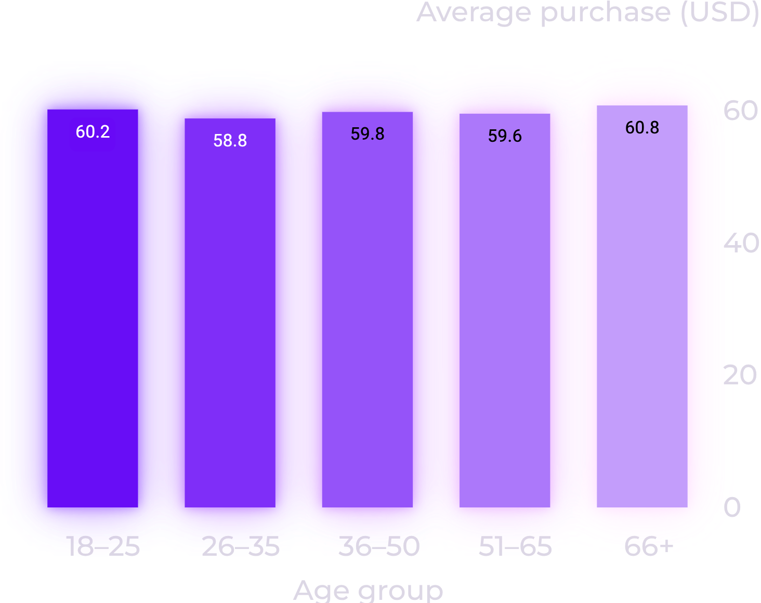
AGE-GROUP COMPARISON
Average purchase value is remarkably stable across age groups
The observed averages stay within roughly two dollars, from USD 58.83 for ages 26–35 to USD 60.80 for ages 66+.
Average purchase amount by age group · USD

Slide 5
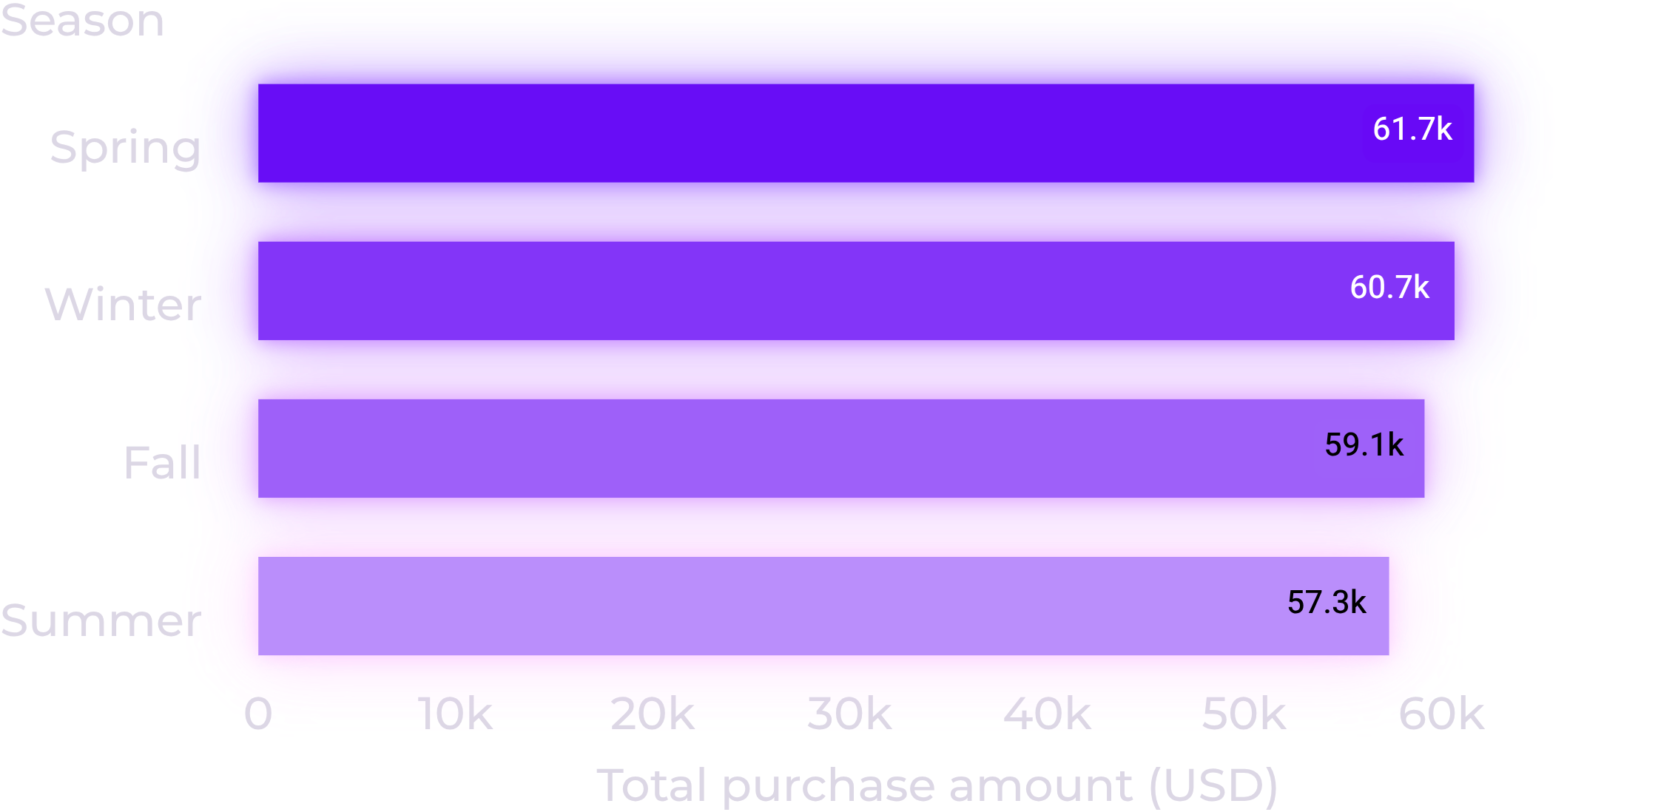
SEASONAL REVENUE
Spring leads seasonal revenue, but the spread is modest
Spring records the highest total purchase amount at USD 61,655, while Summer is lowest at USD 57,341.
The pattern should be read alongside month, category, and segment views.

Slide 6
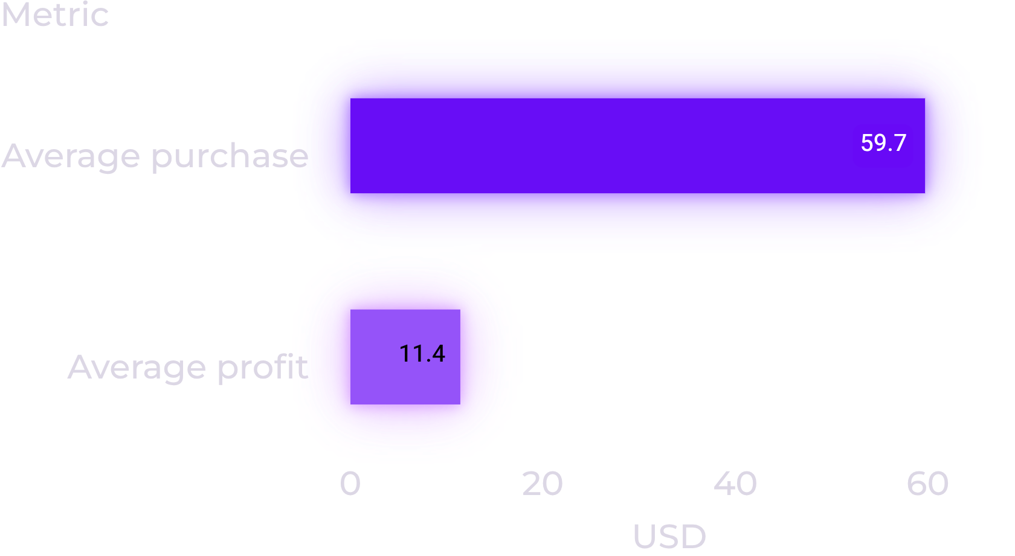
BASELINE ECONOMICS
The sample is volume-heavy, so value and profit need to be read together
Volume leaders
Clothing
1,725 purchases; largest category by records.
Loyal
2,780 records; largest segment.
Baseline economics per transaction

Slide 7
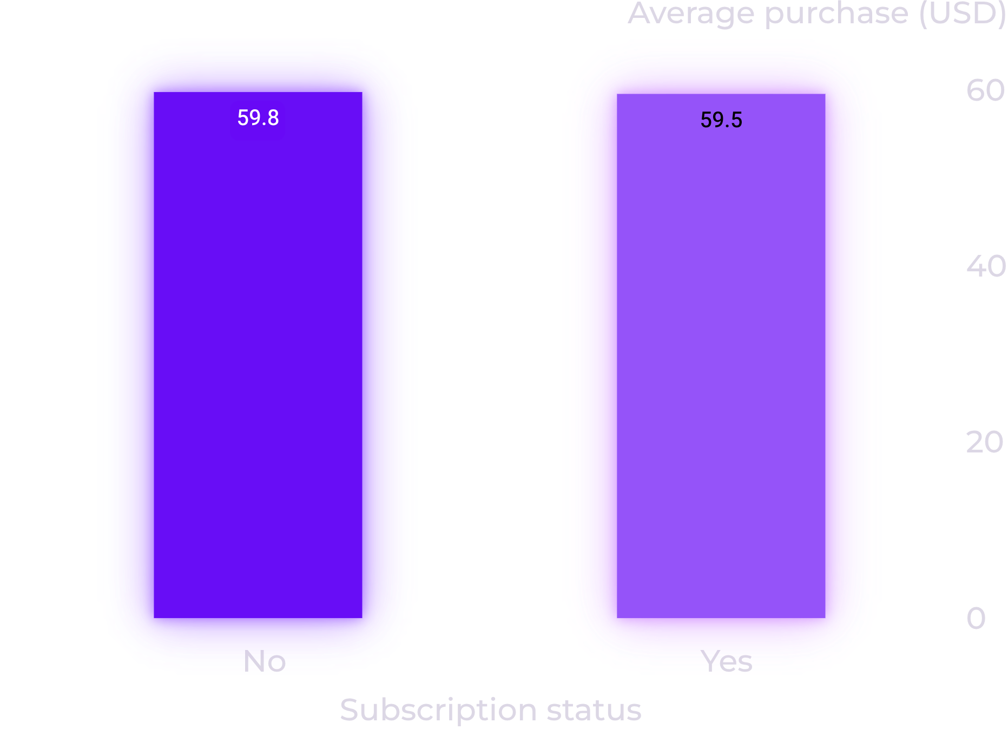
SUBSCRIPTION STATUS
Subscription status does not separate average purchase value in this sample
Subscribers average about USD 59.54 per purchase versus USD 59.75 for non-subscribers. This is an observed association, not evidence of causality.
Average purchase values are nearly identical for subscribers and non-subscribers.

Slide 8




RECURRING MONITORING
The dashboard turns business questions into recurring monitoring
Executive overview
Customer analytics
Revenue, profit, orders, average purchase, return rate, and trends.
Segments, demographics, subscription behavior, and repeat purchase history.
Product analytics
Sales and returns
Top products, category performance, ratings, profit, and returns.
Monthly movement, seasonality, discount and promo usage, and category-level returns.

Slide 9
TEST THE NEXT DECISIONS
The next decisions are about testing, not assuming
01
02
03
04
Seasonal demand
Promotions
Returns
Subscriptions
Plan inventory and campaigns around seasonal demand; validate the pattern across more periods.
Evaluate discounts and promotions on profit as well as sales volume.
Investigate high-return products by category, sizing, quality, and customer expectations.
Measure success through retention, purchase frequency, and lifetime value—not average spending alone.

Slide 10
FROM ANALYSIS TO USE
Power BI makes the analysis usable beyond the notebook
The project’s value is the end-to-end workflow: clean data, business questions, reusable measures, and an interactive dashboard that keeps revenue, profit, customers, products, subscriptions, discounts, and returns in view.

