Slide 1
Product Recommendation System
Personalized recommendations for Laptops and Electronics
By Rishana Sherin K
18-07-24

Slide 2
Contents
Introduction: Project Overview, Objective
Data: Description of datasets used
Methods: Explanation of the recommendation algorithm
Results: Example recommendations, screenshots
Conclusion: Summary of findings, future work
Contact Information

Slide 3
Introduction
Project Overview
Objective
Recommending alternative products based on user queries.
Leveraging the power of machine learning, the system uses a content-based filtering approach to provide personalized product recommendations.
The application is built using Streamlit, providing a user-friendly interface for input and displaying recommendations.
The primary objective of this project is to develop a recommendation system that can suggest laptops and electronic products based on user input.
The system aims to enhance the shopping experience by filtering through a vast array of products and presenting the most relevant options to the user.
By doing so, it saves time and effort for users in making purchasing decisions and ensures they find products that best meet their requirements.

Slide 4
Data: Description of datasets used
Laptops
Electronics Products
Dataset:'ecommerce_data.csv’ Contains detailed specifications and features of various laptops.
Columns:
Company, TypeName, Inches, Screen Resolution, Cpu, Ram, Memory, Gpu, OpSys, Weight, Price.
Dataset:'electronics_product.csv’ Contains information on various electronic products, including customer feedback.
Columns:
name, main_category, sub_category, image, link, ratings, no_of_ratings, discount_price, actual_price

Slide 5
Data Preprocessing:
Steps Taken:
Dropped unnecessary columns.
Handled missing values.
Converted text to lowercase for uniformity.
Combined features into a single string for similarity comparison.

Slide 6
Methods: Explanation of the Recommendation Algorithm
The recommendation system implemented in this project utilizes a content-based filtering approach. This method focuses on the attributes and features of the products themselves to generate recommendations. Here’s a detailed explanation of the algorithm:
Feature Engineering: Combined Features: For each dataset, a new feature (combined_features) is created by concatenating relevant attributes (e.g., Company, TypeName, ScreenResolution, Cpu, Ram, Memory, Gpu, OpSys for laptops) into a single string. This allows the algorithm to capture the overall characteristics of each product.

Slide 7
TF-IDF Vectorization: Term Frequency-Inverse Document Frequency (TF-IDF): Each dataset's combined_features column is transformed using TF-IDF vectorization. This technique assigns weights to words based on their importance in each product's feature set relative to the entire dataset. It helps in identifying key features that distinguish one product from another.
Similarity Calculation: Cosine Similarity: Once the datasets are vectorized, cosine similarity is computed between all pairs of products. Cosine similarity measures the cosine of the angle between two vectors, providing a metric of similarity based on the direction of the vectors (i.e., how closely the products align in feature space).
Recommendation Generation: Top-N Recommendations: When a user inputs preferences (e.g., for a laptop or an electronic product), the system calculates the similarity between the input and all products using cosine similarity. It then retrieves the top-N most similar products as recommendations.
Implementation in Streamlit: The recommendation system is integrated into a Streamlit web application. Users interact with the application by inputting their preferences through a sidebar interface. Upon submission, the system retrieves and displays the recommended products based on the input criteria.

Slide 8
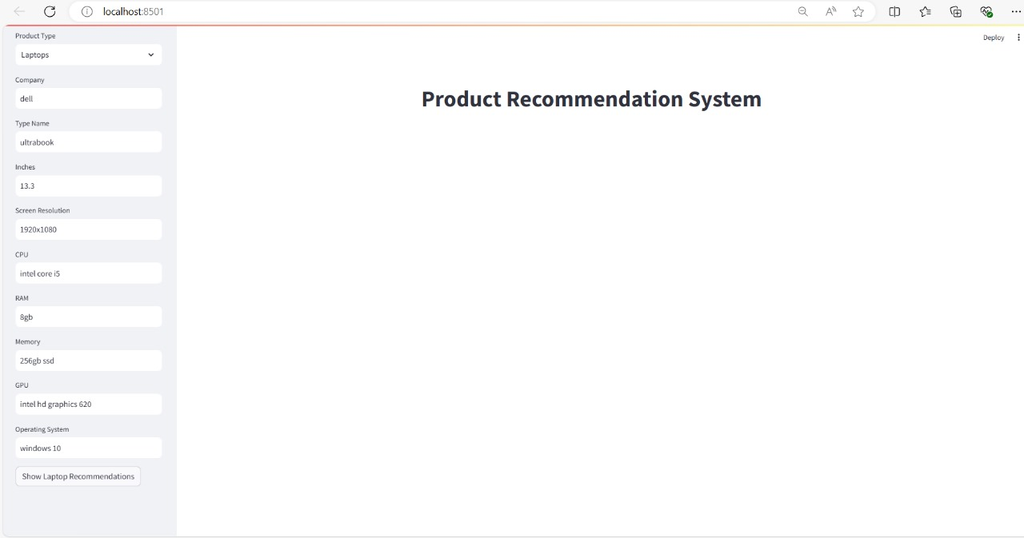
Results Laptop Recommendations:

Slide 9
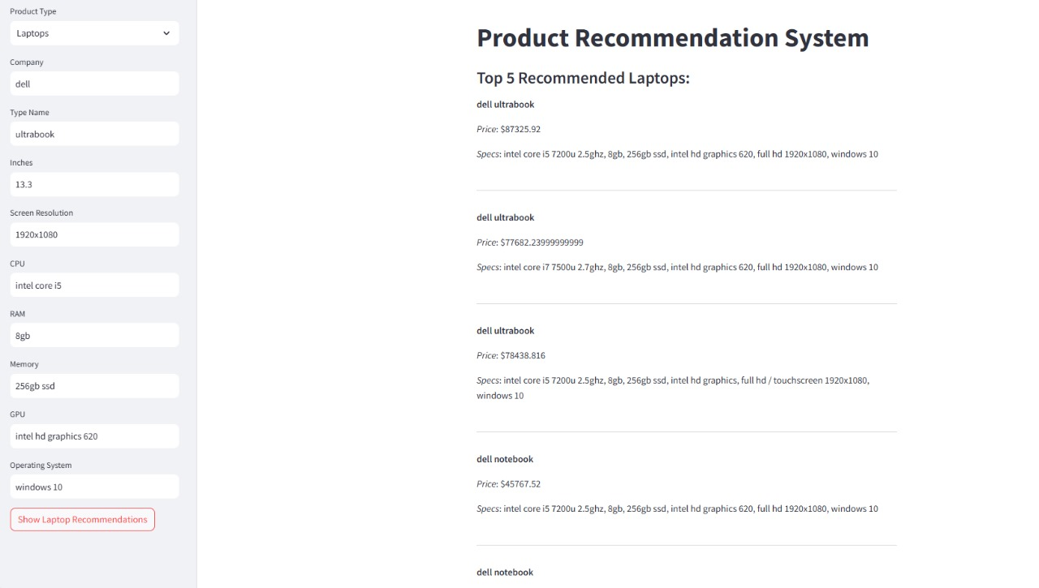

Slide 10
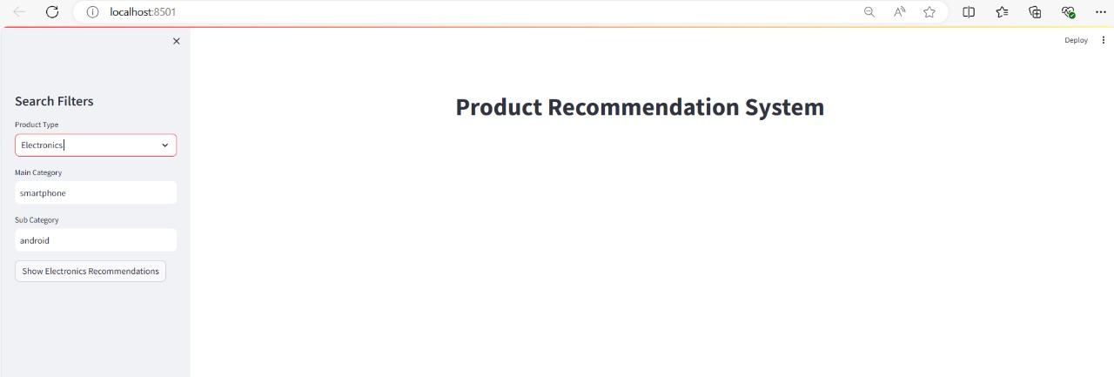
Electronics Recommendations:

Slide 11
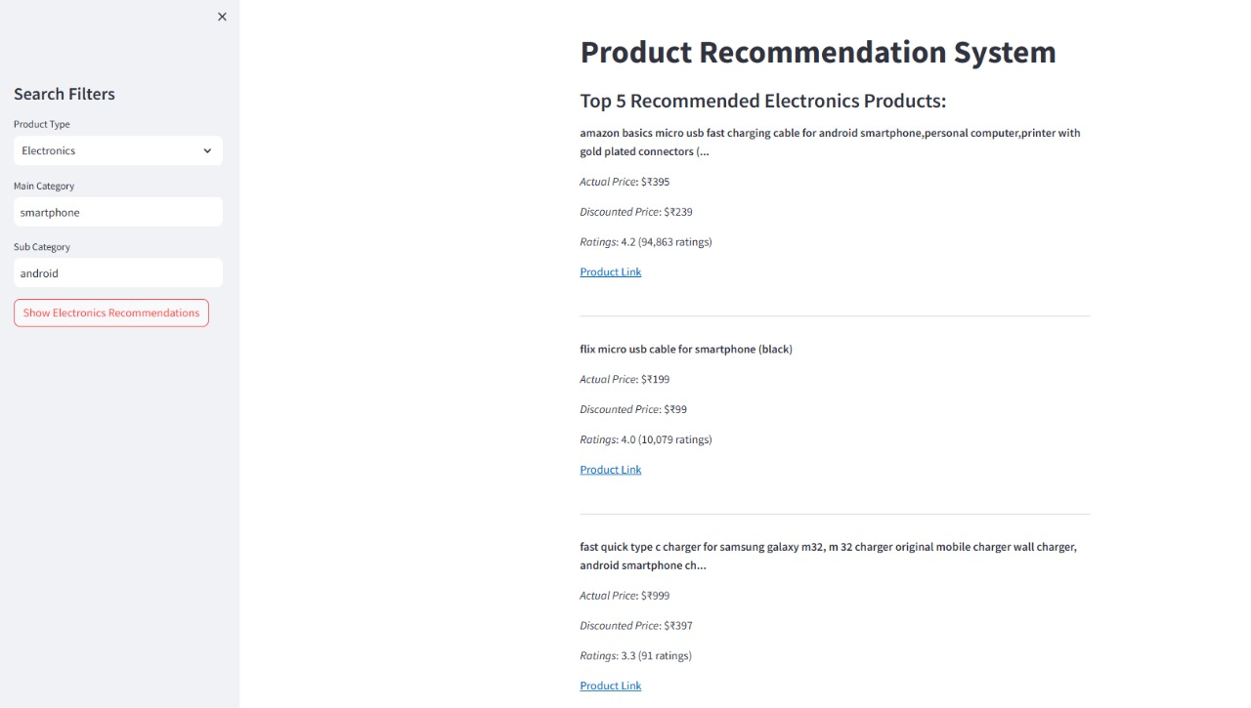

Slide 12
Conclusion: Summary of Findings, Future Work
Summary of Findings:
The recommendation system effectively provides personalized suggestions for laptops and electronics. The user interface is intuitive, displaying clear product details and recommendations. The TF-IDF and cosine similarity approach efficiently handles feature comparison and provides accurate recommendations.
Future Work:
Dataset Enhancement: Include more product categories and regularly update datasets.
Algorithm Improvement: Implement advanced algorithms like collaborative filtering and deep learning.

Slide 13
UI Enhancements:
- Add more interactive elements and improve visual design.
E-commerce Integration:
- Develop APIs for real-time recommendations on e-commerce platforms.
Performance Optimization:
- Optimize backend infrastructure and implement caching mechanisms.
User Feedback Integration:
- Incorporate user reviews and sentiments for better personalization.

Slide 14
THANK YOU
Rishana Sherin K
Email: rishanasherink00@gmail.com
GitHub: https://github.com/RISHANASHERINK/
LinkedIn: www.linkedin.com/in/rishana-sherin

