Slide 1

JAWAHARLAL NEHRU TECHNOLOGICAL UNIVERSITY HYDERABAD
UNIVERSITY COLLEGE OF ENGINEERING MANTHANI
Centenary Colony(Po), Pannur(Vill), Ramagiri(Mdl), Peddapalli, Telangana - 505212, India
TCS INDUSTRIAL PROJECT
SUPERSTORE PROFIT ANALYSIS
PRESENTED BY :-
N. RISHIVARUN - 22VD1A6628
1

Slide 2
Contents
Introduction
Existing system
Limitations of Existing system
Problem Statement
Proposed system
System Requirement Specification
System Design
Implementation
Accuracy
Conclusion

Slide 3
Introduction
Retail businesses generate large volumes of transactional data.
Analyzing this data allows businesses to make informed decisions regarding inventory, customer preferences, and sales strategies.
This project focuses on analyzing the Superstore dataset to uncover insights on sales trends, profit margins, regional performance, and customer behavior using Python and SQL.

Slide 4
Scope of the Project
This project aims to provide a comprehensive analysis of retail sales data from the Superstore dataset to support strategic business decisions. The scope includes:
Data Preparation: Cleaning and transforming raw CSV data for analysis.
Database Integration: Designing and populating a structured SQL database to enable efficient querying.
Sales & Profit Analysis: Identifying top-performing regions, categories, and customers using SQL and Python.
Customer Segmentation: Analyzing customer types and purchase patterns to uncover loyalty and spending behavior.
Data Visualization: Creating charts and optional interactive dashboards for stakeholders using Matplotlib/Seaborn and Power BI.
Business Recommendations: Delivering actionable strategies based on insights from the data.
c

Slide 5
Existing System:-
  In the existing retail setup, reports are often generated manually or through basic spreadsheet summaries.
  This process lacks interactivity, scalability, and in-depth insights. Data is scattered across different tools without integration for comprehensive analysis.
Limitations of Existing System:-
  Limited Automation: Manual report generation is time-consuming and error-prone.
  Lack of Visualization: No clear visual representation of trends or performance metrics.
  Poor Data Utilization: Large volumes of data go underutilized due to lack of analytics.
  No Predictive Capability: Cannot identify future trends or high-performing regions/customers.

Slide 6
Problem Statement
Retail businesses often generate large volumes of transactional data but struggle to derive meaningful insights due to the lack of integrated analytical tools and process. The absence of automated systems for analyzing sales, profit margins, regional performance, and customer behavior limits a company’s ability to make informed, data-driven decisions.
The core problem is the inefficient use of sales data—leading to missed opportunities in market targeting, product optimization, discount strategies, and customer retention.
C

Slide 7
Proposed System:-
The proposed system is a data-driven analytics framework designed to process, analyze, and visualize retail sales data for improved business decision-making. It addresses the inefficiencies of manual reporting by implementing an automated, structured workflow.
The system ultimately delivers actionable insights into product category performance, discount impact, and top customer behavior. Designed for scalability and reproducibility, the solution empowers businesses to transition from reactive decisions to proactive, insight-driven strategies using modern business intelligence techniques.

Slide 8
System Requirement Specification
Hardware Requirements
  Processor: Intel i5 or equivalent (minimum)
  RAM: 4 GB (8 GB recommended)
  Storage: 2 GB of free disk space for data and logs
  Operating System: Windows 10 / Linux / macOS
Software Requirements
  Python 3.x (with Pandas, Matplotlib, Seaborn, Jupyter Notebook)
  MySQL / Any Relational DBMS
  Power BI / Tableau (optional for dashboarding)
11

Slide 9
Implementation
Data Cleaning: Imported superstore.csv into Python (Pandas) to remove missing values, correct data types, and drop duplicates.
Database Integration: Designed a relational schema and imported cleaned data into MySQL, creating structured tables with keys.
SQL Analysis: Executed queries to analyze sales, profit, and discounts by region, category, and customer segment using GROUP BY, JOIN, and ORDER BY.
Visualization: Used Matplotlib and Seaborn to create bar charts, line plots, and KPI visuals. Optionally connected to Power BI for interactive dashboards.
Reporting: Generated summary outputs, charts, and business recommendations to support data-driven decisions.
17

Slide 10
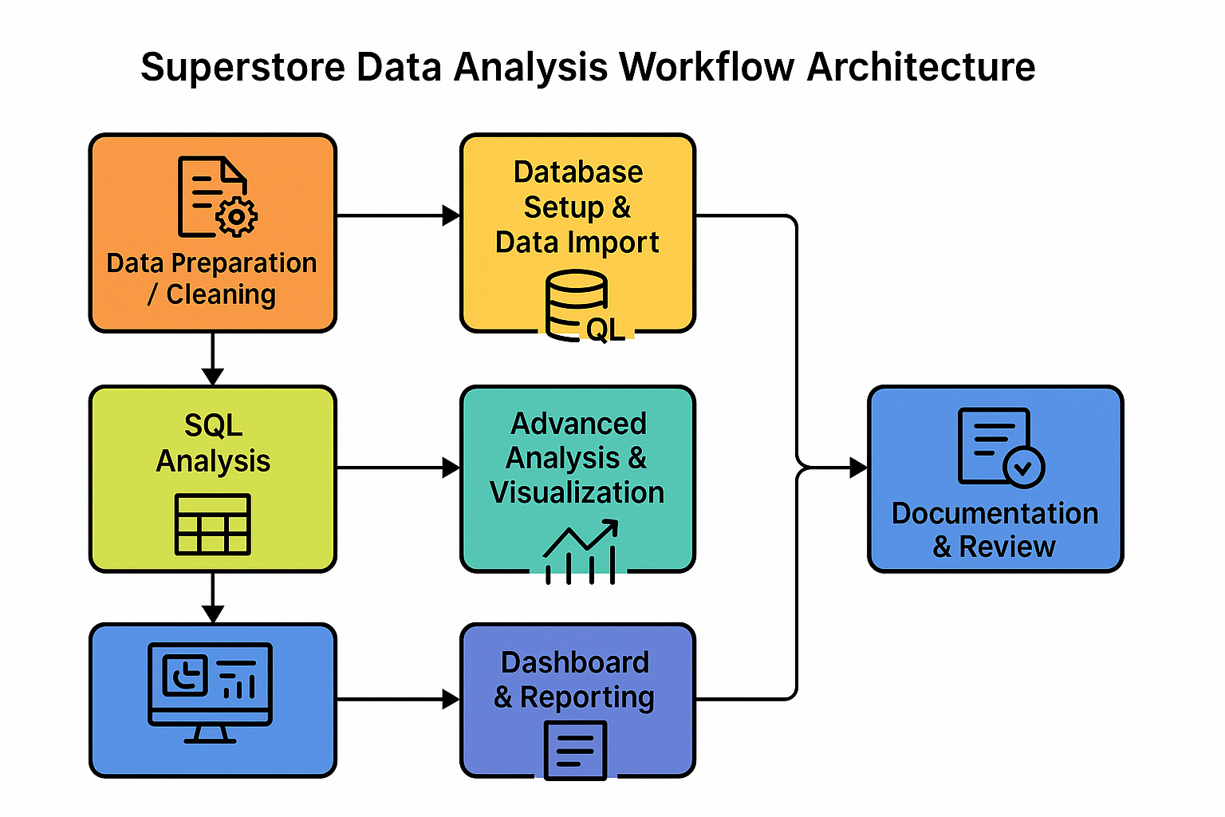

Slide 11
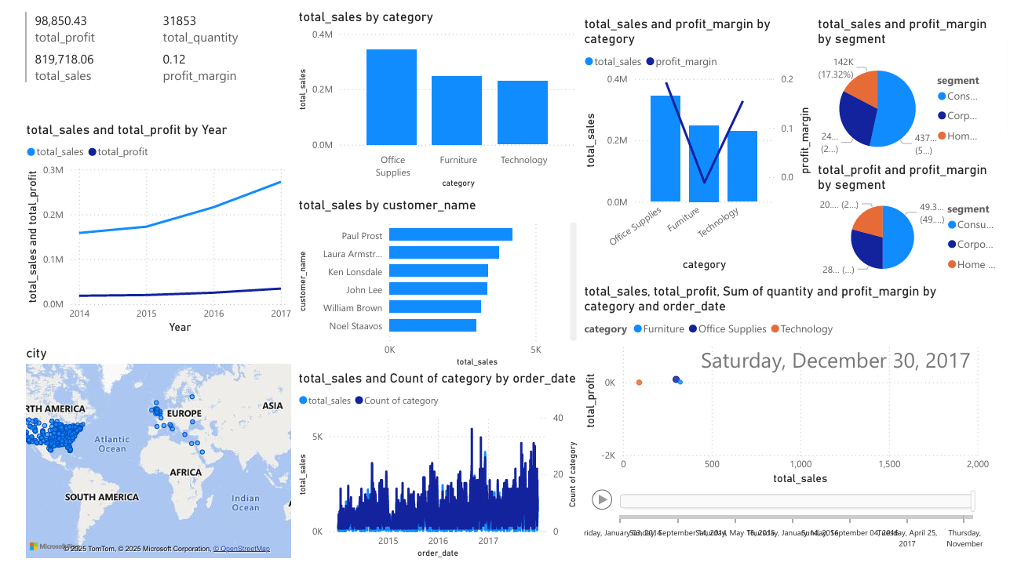
OUTPUT

Slide 12
Conclusion
The Superstore Sales Data Analysis project demonstrates how data analytics can transform raw retail data into actionable business insights.
By integrating Python, SQL, and visualization tools, the system effectively identifies trends in sales, profit, customer behavior, and regional performance.
The analysis highlighted key findings, such as the dominance of the West region, the high profitability of Technology and Office Supplies, and the negative impact of deep discounts, especially in the Furniture category.
The proposed system is scalable, modular, and suited for real-world business applications.
These insights empower the organization to make data-driven decisions, optimize operations, and improve customer engagement and profitability.
21

Slide 13
Thank You…

