Slide 1

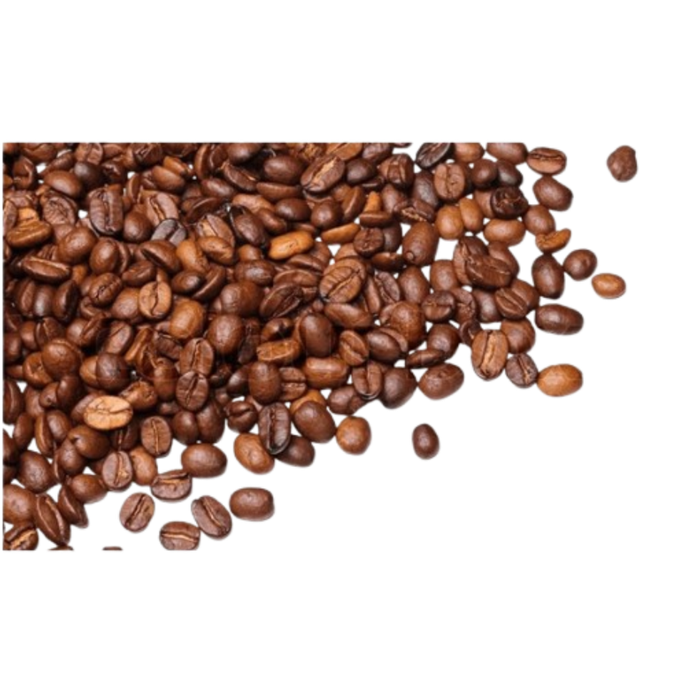
Cafe Sales Performance and Customer Behaviour Analysis
Sector Name: Retail Team ID : Group-16
Team Members : Faculty Mentor : Archit Sir
•Ananya Narang (2401020087)
•Divy Kumar Jain (2401010157 )
•Hrishabh Prajapati (2401020027)
•Preet Vardhan(2401010352)
•Rishik (2401010381)
•Shubham Jain (2401010452)

Slide 2
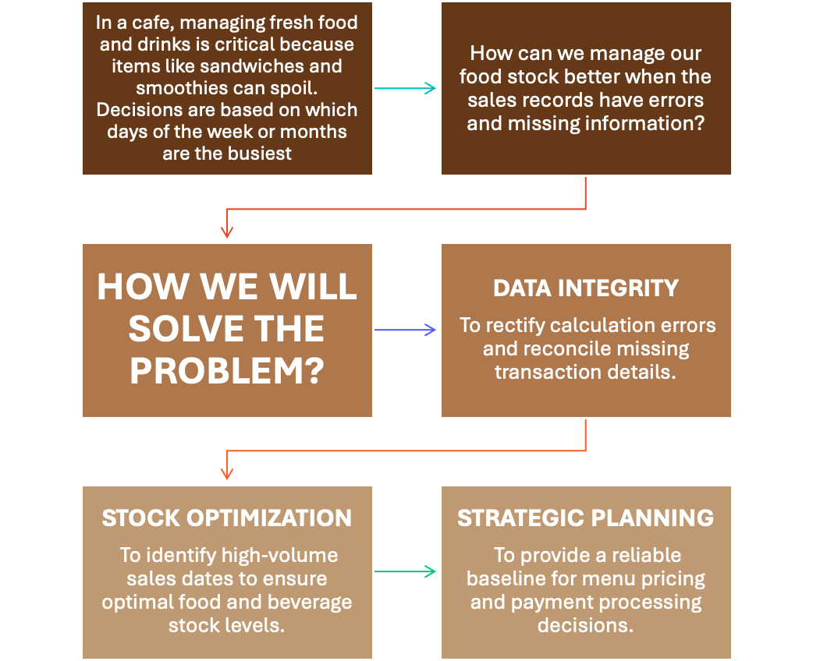
Context and Problem Statement

Slide 3

Data Engineering
SOURCE
CLEANING
DICTIONARY
MISSING VALUES
Rows with missing/"ERROR" in critical fields removed. Calculation integrity ensured.
STANDARDIZATION
Ambiguous/empty Payment Method/Location grouped into "Unknown."
DATA CONVERSION
Quantity, Price, Total Spent to numeric; Transaction Date to Datetime.
Mathematical Validation
"Total Spent" recalculated (Quantity × Price) to eliminate entry errors.
FINAL VERDICT
Comprehensive check confirms 7,774 transactions meet type/completeness standards for analysis.
Transaction ID
Item
Quantity
Price Per Unit
Total Spent
Payment Method
Location
Transaction Date
Name
Cafe_Sales.csv;
Rows/Cols
7774 transactions;
Time Period
Full Year 2023.

Slide 4


KPI & Metrics Framework
Total Revenue
Total Quantity
Total Transactions
69459
23505
7773
Linking Metrics to Business Model:
Solving the Revenue Leakage: By measuring True Gross Revenue, we address the problem of underreporting caused by the "ERROR" logs in the raw data.
Wate Reduction: Volume by Item directly links to our problem statement of managing perishable stock.
Resource Allocation: By measuring Channel Contribution, the decision maker can decide whether to spend more on "Takeaway" packaging or "In-store" seating and staffing.

Slide 5
Key Insights (EDA)
Strategic Observations
Coffee remains the most frequent purchase, indicating high customer retention and daily habits.
Salad contributes 21.4% of total revenue, indicating it is more expensive than rest of the items.
Low-cost items like Cookies are consistently paired with larger orders.
October and June are the highest performing periods.
Smoothie demand increased by 70%, whereas Sandwich demand decreased by 20% between January and June.
Sales are nearly perfectly balanced between In-store and Takeaway, requiring a Hybrid service focus.
Digital Wallet and Credit Card payments are now equal to Cash, suggesting a shift toward a cashless model.

Slide 6
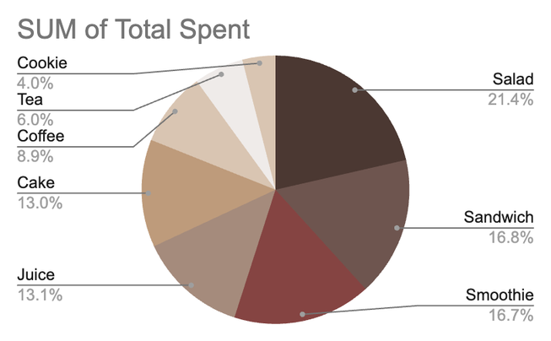
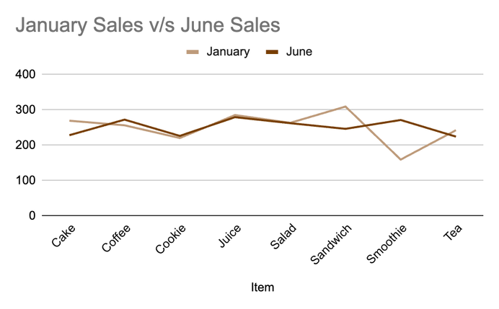
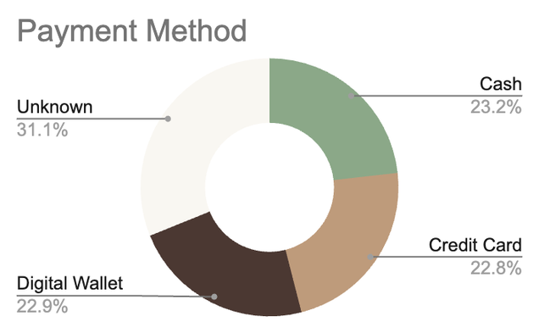
Advanced Analysis
Seasonal Variance Analysis:
A comparative study between January and June reveals a 70.4% surge in Smoothie demand, indicating high sensitivity to summer temperature peaks.
Conversely, "Heavy" items like Sandwiches and Cakes saw a 15–20% decline during the same period, suggesting a seasonal shift in consumer appetite.
Location-Menu Affinity:
Takeaway orders are dominated by Quick Consumables like Coffee and Cookies (900+ units each)
In-store dining shows a higher preference for "Meal-based" items like Salads and Juices.
Systemic Data Gaps:
The 31.6% "Unknown" payment rate shows no seasonal pattern, confirming it is a year-round technical glitch rather than a human error.

Slide 7
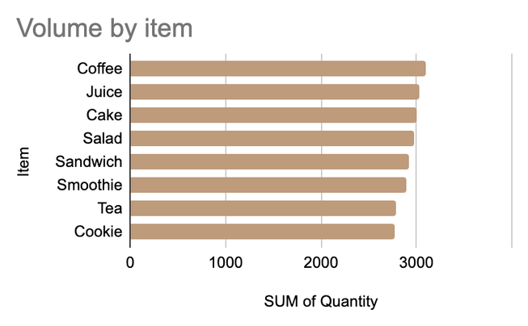
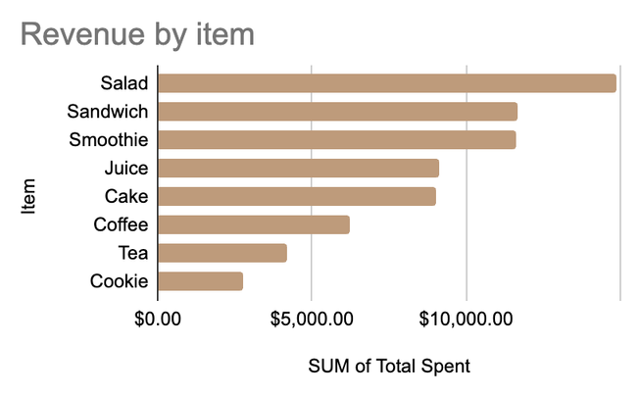
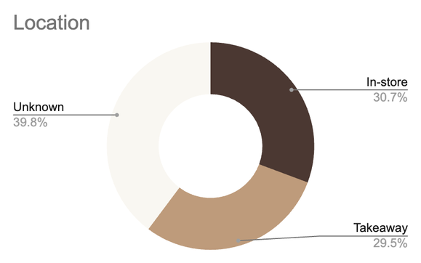
Dashboard Walkthrough
Coffee, Juice, and Cake are the most frequently ordered items.
Sandwiches and Smoothies also show strong, consistent demand across all months.
Cash, Credit Card, and Digital Wallets are used almost equally (~23% each).
31.1% of transactions are marked "Unknown," highlighting a critical need for system reconciliation.
Salads and Sandwiches generate the highest total revenue.
Monthly revenue remains stable at approximately $6,000, totaling $69,459 annually.
Orders are evenly split between In-store (30.7%) and Takeaway (29.5%).
A significant 39.8% of orders have an "Unknown" location, hindering logistics planning.

Slide 8
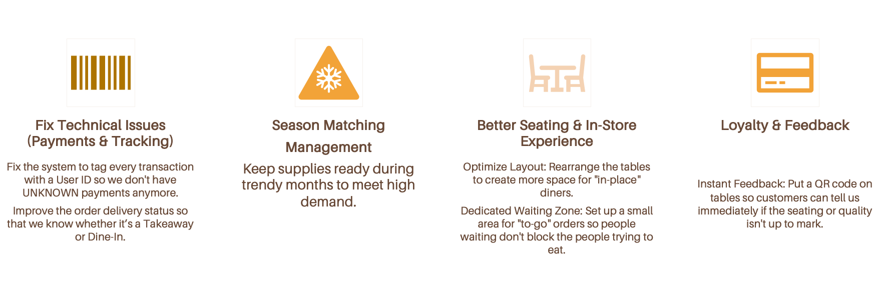
Recommendations

Slide 9

Impact & Value
Revenue & Growth
Operational Efficiency
Accuracy & Trust
By maintaining season specialist stock, we can prevent stock-outs and capture a 20-30% increase in seasonal revenue.
The loyalty program and QR feedback will help convert one-time visitors into regulars, increasing long-term sales.
Improving the seating layout and adding a waiting zone will speed up the flow of both Dine-In and Takeaway orders.
Proper season management ensures staff spend less time dealing with shortages and more time serving customers.
Fixing the UNKNOWN payments issue ensures every transaction is tracked, eliminating revenue leakage and accounting errors.
Clearer order status reduces confusion for the kitchen staff and ensures customers get their orders exactly how they want them.

Slide 10
Limitations & Next Steps
Limitations
Next Steps
Incorporate cost and margin data to enable profitability and contribution margin analysis.
Improve POS data validation to eliminate missing location and payment entries.
Apply forecasting techniques to predict future sales and support inventory and staffing planning.
Extend the analysis using advanced visualization or BI tools for enhanced interactivity and scalability.
Current data doesn't show exactly why payments are failing, only that they are "UNKNOWN.”
The physical size of the shop might limit how many new seats we can actually add.
Summer demand can fluctuate based on heatwaves or rain, making stock management tricky.

