Slide 1

Python Finance Fundamentals

Slide 2
Python for Finance
Now we will begin to really focus on using Python for finance and trading!
In this section we will cover some key concepts in regards to trading.

Slide 3
Python for Finance
We will discuss:
  Portfolio Allocation
  Sharpe Ratio
  Portfolio Optimization
  Efficient Frontier
  CAPM - Capital Asset Pricing Model

Slide 4
Python for Finance
We will also be introducing several other financial topics, like how the market works, how orders get made, and general arbitrage opportunities.

Slide 5
Python for Finance
We will interchange shorter quick discussions of general finance topics, with longer, more detailed discussions of the actual implementation of these topics.
Let’s get started!

Slide 6
Portfolio and Statistics

Slide 7
Python for Finance
So far we’ve really only analyzed individual stocks, now we will shift our attention to understanding a portfolio of multiple stocks.
So what is a portfolio?

Slide 8
Python for Finance
Put simply a portfolio is just a set of allocations in a variety of securities.
For example:
  20 % in APPL
  30 % in FB
  50% in GOOG

Slide 9
Python for Finance
These percentages should add up to 100% (or if defined as weights they should add up to 1).
Let’s review a few key statistics for a portfolio!

Slide 10
Python for Finance
Daily Returns - The percent returned from 1 day to the next for a stock.
Cumulative Return - The amount returned after an entire time period.
Avg. Daily Return - Mean of Daily Returns
Std. Daily Return - Std. Dev of Daily Returns

Slide 11
Python for Finance
But there is still one critical statistic we haven’t discussed yet, the Sharpe Ratio!
Before we explain what it is, let’s give you an intuitive understanding of why it is necessary!
Let’s imagine 3 portfolio comparisons...

Slide 12
Python for Finance
For each case, which portfolio is better?
12%
8%
5%
5%
5%
6%
Case 1 Case 2 Case 3

Slide 13
Python for Finance
The Sharpe Ratio is a measure for calculating risk-adjusted return, and this ratio has become the industry standard for such calculations.
It was developed by Nobel laureate William F. Sharpe.

Slide 14
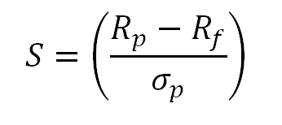
Python for Finance
The formula for the Sharpe Ratio:
Rp is Expected Portfolio return
Rf is Risk-Free Return
Sigma p is Portfolio Standard Deviation

Slide 15
Python for Finance
What is risk free return?
The return you would receive if you put your money in an investment such as a bank savings account, LIBOR, Treasury Bonds that are essentially “risk-free”.

Slide 16
Python for Finance
Currently in the United States (early 2017), these returns are very close to 0%, so its just easier to approximate Rf as 0.
Keep in mind though, the Federal Reserve may continue to raise interest rates in the future, effecting this result!

Slide 17
Python for Finance
For now, assuming Rf is 0, we get:
  SR = Mean Return / Std. Dev.
Keep in mind that Sharpe originally thought of this as a yearly metric (as in mean yearly return vs. mean daily return)
This is easy to fix for us though!

Slide 18
Python for Finance
The annualized Sharpe Ratio can be obtained by multiplying against a K-Factor based off your Sampling Rate:
  Daily: K= sqrt(252)
  Weekly: K=sqrt(52)
  Monthly: K=sqrt(12)
So that you just calculate ASR = K * SR

Slide 19
Python for Finance
Let’s see how to do all of this with Python!

Slide 20
Portfolio Allocation &
Sharpe Ratio

Slide 21
Python for Finance
Let’s jump to the notebook and code it out!
All the stock information is available as csv files in case Quandl or pandas-datareader are unavailable for you.

Slide 22
Portfolio Allocation &
Sharpe Ratio Code Along
Part Two

Slide 23
Portfolio Optimization

Slide 24
Python for Finance
Now that we have a nice metric to evaluate Portfolio Allocations against each other, how can we optimize the portfolio holdings?
We could just guess and check a bunch of random allocations and see which one has the best Sharpe Ratio!

Slide 25
Python for Finance
This is known as Monte Carlo Simulation.
We randomly assign a weight to each security in our portfolio, then calculate its mean daily return and std. dev. of daily return.

Slide 26
Python for Finance
This allows us to calculate the Sharpe Ratio for thousands of randomly selected allocations.
We can then plot the allocations on a chart showing return vs. volatility, colored by the Sharpe Ratio.

Slide 27
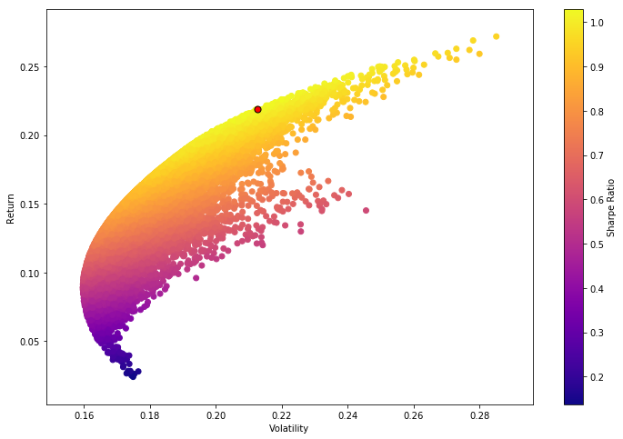
Python for Finance
We will create something like this:

Slide 28
Python for Finance
Red dot indicates the highest Sharpe Ratio

Slide 29
Python for Finance
However guessing and checking is not very efficient, instead we can use math to figure out the optimal Sharpe Ratio for any given portfolio.
To understand optimization algorithms, we need to understand minimization!

Slide 30
Python for Finance
Before we discuss optimization directly, let’s discuss minimization, which is a very similar concept!
Let’s say we are given simple equations:
  y = x²
  y = ( 2 - x)²

Slide 31
Python for Finance
What value of x will minimize y?
  y = x² ----> x = 0
  y = ( 2 - x)² ----> x = 2
This idea of using a minimizer will allow us to build an optimizer.
Luckily for more complex equations, SciPy can do the heavy math for us!

Slide 32
Python for Finance
Referring back to our Sharpe Ratio, we want to actually maximize the Sharpe Ratio, meaning we can create an optimizer that will attempt to minimize the negative Sharpe Ratio!

Slide 33
Python for Finance
We will use SciPy’s built-in optimization algorithms to calculate the optimal weight allocation for our portfolio (optimized by Sharpe Ratio).
Let’s go back to the return vs. volatility plot again

Slide 34
Python for Finance
Notice the shape of the plot.

Slide 35
Python for Finance
It seems to create a border.

Slide 36
Python for Finance
This indicates the highest return for volatility

Slide 37
Python for Finance
Anything below the border is a bad choice.

Slide 38
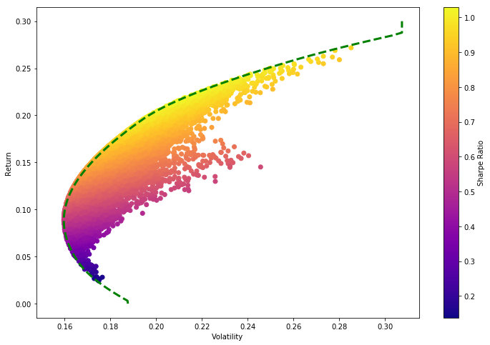
Python for Finance
This border is known as the efficient frontier.

Slide 39
Python for Finance
Let’s walk through using Python to calculate all of these metrics and topics!

Slide 40
Portfolio Optimization Code Along

Slide 41
Financial Market Concepts

Slide 42
Python for Finance
In this series of lectures we will go over a few key financial topics
  Types of Funds
  Order Books
  Latency Arbitrage (HFT)
  Short Selling

Slide 43
Let’s get started!

Slide 44
Types of Funds

Slide 45
Python for Finance
There are 3 major fund types:
  ETF - Exchange Traded Funds
  Mutual Funds
  Hedge Funds
These funds vary by fees, transparency, regulation, and more.
Let’s discuss their differences.

Slide 46
Python for Finance
ETFs are exchange traded funds that are constituted of a basket of funds, bonds, commodities etc…
Their holdings are completely public and transparent and individuals can buy and trade the marketable security

Slide 47
Python for Finance
Typically people investing in ETFs are more interested in a diversified portfolio and want to keep their investment in an ETF for a longer period of time.
One of the most common ETFs is the Spider (SPY) which tracks the S&P500

Slide 48
Python for Finance
A mutual fund is an investment vehicle made up of a pool of funds collected from many investors for the purpose of investing in securities such as stocks, bonds, money market instruments and similar assets.

Slide 49
Python for Finance
Mutual funds are operated by money managers, who invest the fund's capital and attempt to produce capital gains and income for the fund's investors.

Slide 50
Python for Finance
A mutual fund's portfolio is structured and maintained to match the investment objectives stated in its prospectus.
Mutual Funds disclose their holdings typically once a quarter, although this can vary by fund.

Slide 51
Python for Finance
Hedge funds are alternative investments using pooled funds that employ numerous different strategies to earn active return, or alpha, for their investors.

Slide 52
Python for Finance
Hedge funds may be aggressively managed or make use of derivatives and leverage in both domestic and international markets with the goal of generating high returns (either in an absolute sense or over a specified market benchmark).

Slide 53
Python for Finance
It is important to note that hedge funds are generally only accessible to accredited investors as they require less SEC regulations than other funds.

Slide 54
Python for Finance
One aspect that has set the hedge fund industry apart is the fact that hedge funds face less regulation than mutual funds and other investment vehicles.
Much of what we do in this course, mimics the way a hedge fund would operate.

Slide 55
Python for Finance
We will try to use python and math to attempt to beat some benchmark.
We also won’t need to disclose our strategy.
Let’s discuss the fee structure for these three fund types.

Slide 56
Python for Finance
What are the fees associated with each?
ETF Funds
  Expense Ratio - 0.01% - 1%
Mutual Funds
  Expense Ratio - 0.5% - 3%
Hedge Funds
  2% of Fund. 20% of profits.

Slide 57
Python for Finance
What is the liquidity with each?
ETF Funds
  Buy/Sell just like a stock.
Mutual Funds
  Buy/Sell at end of day through broker.
Hedge Funds
  Depends on agreement

Slide 58
Python for Finance
That is all we really need to know about the basics of the different fund types!
Up next, let’s discuss what actually happens when we buy or sell a stock on an exchange!

Slide 59
Order Books

Slide 60
Python for Finance
So you’ve decided to buy/sell a stock!
You log on to your brokerage account (Robinhood, E*Trade, Ameritrade, etc…).
You click on the stock you want to buy/sell and then you either pay or receive money.
But what actually happens when you click?
Let’s go through the process!

Slide 61
Python for Finance
Making an Order includes the following:
  Buy or Sell
  Symbol
  Number of Shares
  LIMIT or MARKET
  Price (only needed for a LIMIT order)

Slide 62
Python for Finance
Example orders:
  BUY, AAPL, 200, MARKET
  SELL, TSLA, 400, MARKET
  BUY, AMD, 2000, LIMIT, 13.95
  SELL, NVDA, 150,LIMIT,160.99

Slide 63
Python for Finance
Once you’ve sent an order (usually to your broker), it goes to an exchange (for a larger order it can go to multiple exchanges, but more on that later)
Once an exchange receives your order, it goes into an order book.

Slide 64
Python for Finance
Let’s build out an order book!
NYSE BAC ORDER BOOK
BUY ORDERS |  |  |  | SELL ORDERS
SHARES |  | BID |  | ASK |  | SHARES

Slide 65
Python for Finance
(BUY,BAC,200,LIMIT,199.95)
NYSE BAC ORDER BOOK
BUY ORDERS |  |  |  | SELL ORDERS
SHARES |  | BID |  | ASK |  | SHARES
200 |  | 199.95

Slide 66
Python for Finance
(SELL,BAC,100,LIMIT,199.90)
NYSE BAC ORDER BOOK
BUY ORDERS |  |  |  | SELL ORDERS
SHARES |  | BID |  | ASK |  | SHARES
200 |  | 199.95 |  | 199.90 |  | 100

Slide 67
Python for Finance
(SELL,BAC,50,LIMIT,199.91)
NYSE BAC ORDER BOOK
BUY ORDERS |  |  |  | SELL ORDERS
SHARES |  | BID |  | ASK |  | SHARES
200 |  | 199.95 |  | 199.90 |  | 100
 |  |  |  | 199.91 |  | 50

Slide 68
Python for Finance
(SELL,BAC,50,LIMIT,199.92)
NYSE BAC ORDER BOOK
BUY ORDERS |  |  |  | SELL ORDERS
SHARES |  | BID |  | ASK |  | SHARES
200 |  | 199.95 |  | 199.90 |  | 100
 |  |  |  | 199.91 |  | 50
 |  |  |  | 199.92 |  | 50

Slide 69
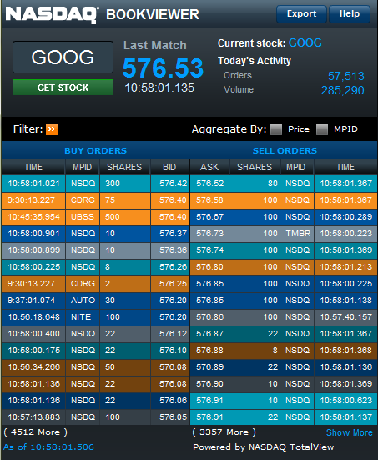
Python for Finance
Example of an order book:

Slide 70
Python for Finance
So how does an order actually get to the exchange?
Let’s walk through the steps, we’ll also explain how certain HFT (High Frequency Trading) firms can attempt Latency Arbitrage!

Slide 71
Scenario #1 : Simple Buy
NYSE
Order Book
BUY
YOU
BROKER
NASDAQ
Order Book
BATS
Order Book

Slide 72
Scenario #2 : Broker Buy/Sell
NYSE
Order Book
BUY
YOU
BROKER
Other
SELL
NASDAQ
Order Book
This can all happen within the broker, without ever reaching the exchange.
By law the broker must provide the same price you could have gotten on the exchange.
BATS
Order Book

Slide 73
Scenario #3 : Dark Pool
NYSE
Order Book
BUY
YOU
BROKER 1
DARK POOL
NASDAQ
Order Book
SELL
Other
BROKER 2
Dark pool pays brokers to see orders before they hit the exchange.
BATS
Order Book

Slide 74
Python for Finance
You may have heard of the term “High Frequency Trading”.
HFT firms take advantage of latency differences due to geographical distances.
These times are on the order of microseconds.

Slide 75
Python for Finance
Discussion about HFTs were popularized by Michael Lewis’ book “Flash Boys”, about Brad Katsuyama and the IEX.
Let’s briefly explain the basic idea of HFT, but keep in mind this is an area that changes extremely fast due to technology!

Slide 76
Scenario #4 : HFT
NYSE
Order Book
Buy 30K Shares
A large bank or institution puts out an order that is large enough that it will need multiple exchanges to fulfill the order.
NASDAQ
Order Book
Buy 30K Shares
BANK
Buy 90K Shares
BATS
Order Book
Buy 30K Shares

Slide 77
Scenario #4 : HFT
NYSE
Order Book
Buy 30K Shares
It takes about 2 ms between the order first reaching BATS (closest) to the last exchange NYSE (furthest away)
For reference, it takes 300ms to blink an eye.
NASDAQ
Order Book
Buy 30K Shares
BANK
Buy 90K Shares
BATS
Order Book
Buy 30K Shares

Slide 78
Scenario #4 : HFT
NYSE
Order Book
Buy 30K Shares
HFT builds “colocated” servers. Literally placing their servers as close to the order book server as possible!
NASDAQ
Order Book
Buy 30K Shares
BANK
Buy 90K Shares
BATS
Order Book
Buy 30K Shares

Slide 79
Scenario #4 : HFT
HFT builds “colocated” servers. Literally placing their servers as close to the order book server as possible!
They can reach the NYSE in around 476 microseconds!
NYSE
Order Book
Buy 30K Shares
NASDAQ
Order Book
Buy 30K Shares
BANK
Buy 90K Shares
BATS
Order Book
HFT
“Colocated” Server
Buy 30K Shares

Slide 80
Python for Finance
This was a simplified overview, check out the resource links if this is a topic that interests you.
HFT in general is not really relevant for our scale or approach to trading.

Slide 81
Short Selling

Slide 82
Python for Finance
Let’s quickly discuss short-selling!
Short-selling allows you to profit if a stock drops in price, however it comes with a great risk, due to the fact that there can be no ceiling to the amount of money you could possibly lose!

Slide 83
Python for Finance
10 Shares
Of GOOG
You
Step 0: GOOG is currently valued at $500. You think it will drop in the future!
RED has 10 shares of GOOG.
The Market
Current Price of GOOG
$500

Slide 84
Python for Finance
10 Shares
Of GOOG
You
Step 1: You borrow RED’s shares of GOOG.
Promise to return them at a future date!
The Market
Current Price of GOOG
$500

Slide 85
Python for Finance
$5000
You
Step 2: You now go and sell them out in the market.
$500*10 = $5000
The Market
10 Shares
Of GOOG
Current Price of GOOG
$500

Slide 86
Python for Finance
$4000
-$1000
10 Shares
Of GOOG
You
Step 3: The price of google has now dropped to $100.
You go out and buy 10 Shares for $1000.
The Market
10 Shares
Of GOOG
Current Price of GOOG
$100

Slide 87
Python for Finance
$4000
10 Shares
Of GOOG
-$1000
You
Step 4: Now you can give back the 10 Shares you owe back to RED.
And you’ve made $4000!
The Market
10 Shares
Of GOOG
Current Price of GOOG
$100

Slide 88
Python for Finance
You should note, that if the price goes up instead of down, you will lose money buying back the stock to give it back to RED!
Also all these transactions would happen through a broker, not directly.

Slide 89
Python for Finance
Let’s now move on to discussing CAPM--Capital Asset Pricing Model!

Slide 90
CAPM

Slide 91
Python for Finance
The Capital Assets Pricing Model (CAPM) is one of the most fundamental topics in investing!
It is a model that helps describe risk and separating market return versus your portfolio return.

Slide 92
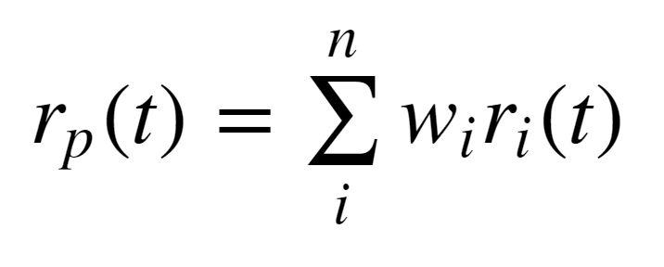
Python for Finance
Remember that a portfolio is a set of weighted securities. We can define the returns as the following:

Slide 93
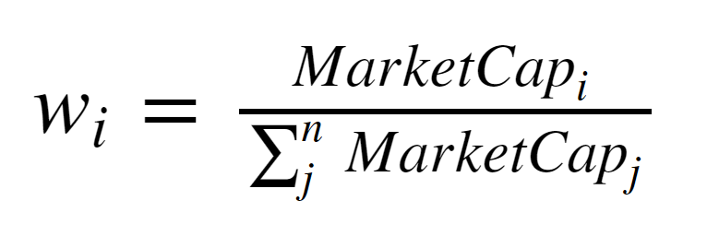
Python for Finance
We can also imagine the entire market as a portfolio, for example the S&P500
How do we get weights for each company?
Using the market cap (# shares * price)

Slide 94
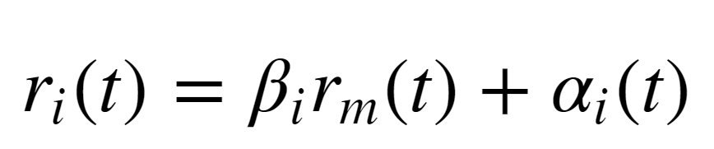
Python for Finance
The CAPM equation is states the following:

Slide 95
Python for Finance
There are two terms here, the Beta term and the Alpha term.
Note how this models a simple regression line: y = mx +b

Slide 96
Python for Finance
The CAPM equation describes the return of some individual stock i.
Comprised of two terms, Beta and Alpha.

Slide 97
Python for Finance
The Beta term implies that the return of a stock is equivalent to the return of the market multiplied by this Beta factor plus some residual alpha term.

Slide 98
Python for Finance
You could imagine that is Beta=1 than this stock moves in line with the market.
If Beta=2 , then this stock moves up and down twice as much as the general market.

Slide 99
Python for Finance
Since the return for a stock “i” is not going to match exactly with the Beta term, we add some alpha term.
CAPM states that you expect this alpha term to be zero.

Slide 100
Python for Finance
With CAPM stating that alpha should be expected to be zero, it basically implies that you can not beat the general market!
CAPM also says that alpha is random and can not be predicted!

Slide 101
Python for Finance
This basically creates the argument of passive versus active investment.
Active investors (like us) believe we can predict alpha to some degree.

Slide 102
Python for Finance
Remember that we don’t need to be 100% correct on alpha, we should just be able to predict it correctly more than 50% of the time for our portfolio.

Slide 103
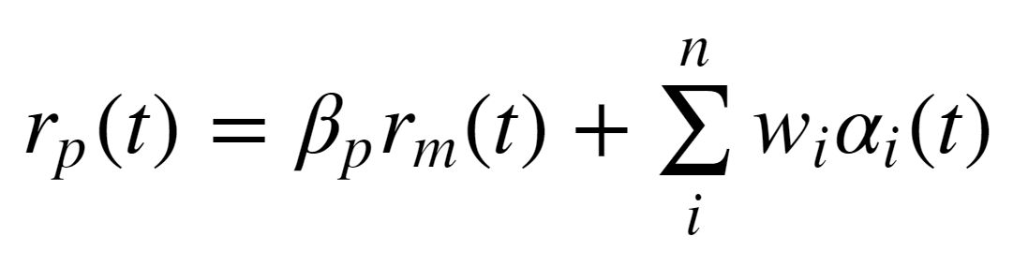
Python for Finance
Since we believe we can have a good idea for values of alpha, we can break it up per security:

Slide 104
Python for Finance
Since we believe we can have a good idea for values of alpha, we can break it up per security:

Slide 105
Python for Finance
We could even continue to break up Beta into various Betas per sector of the market (Energy, Manufacturing, Tech, Finance, etc)

Slide 106
Python for Finance
The main point here we want to get across is that there will be some relationship between our portfolio return and the overall market return.
This is the Beta term.

Slide 107
Python for Finance
CAPM says that the alpha term can not be predicted, however, we will fundamentally disagree with that model of thinking.
We will see if we can create strategies that allow us to have significant alpha terms, meaning our strategy beats the market.

Slide 108
Python for Finance
These two terms (beta and alpha) will come up again once we learn how to use the Quantopian platform.
For now let’s go ahead and quickly use Python to create an example of CAPM in the next lecture!

Slide 109
CAPM Code Along

Slide 110
Stock Splits & Dividends

Slide 111
Python for Finance
Let’s quickly discuss why companies split their stock and dividends.
Stock splits usually occur if the price for an individual stock becomes unreasonably high, so companies essentially just create a ratio split (e.g. 2:1 , 3:1 , 4:1).

Slide 112
Python for Finance
Because stock splits could cause errors for algorithms looking for price changes, we use the Adj. Close , which adjusts the historical prices to match up and take into account the stock splits.

Slide 113
Python for Finance
Often stocks also pay dividends, for each unit of stock, each shareholder receives some payout.
This causes the price to jump before the dividend announcement, and then drop after the dividend is paid out.

Slide 114
Python for Finance
The adjusted close price also takes this into account.
It is important to always use adjusted close prices, otherwise you may be affected by stock splits and dividends in your pricing strategies.

Slide 115
Python for Finance
One last thing to take into account is “Survivorship Bias”.
If we take a look at the S&P500 benchmark today, it is a different set of companies than say in the year 1999 (the peak of the dot-com bubble).

Slide 116
Python for Finance
After the dot-com crash many companies that were in the S&P500 no longer existed or became to small to be part of the 500.
Meaning the time you pick S&P500 could possibly matter!

Slide 117
Python for Finance
If we were creating strategies in the early 2000s, we may have heavily used the S&P500, but if we didn’t take into account the earlier make-up of the S&P500 we would end up having a bias in our results!

Slide 118
Python for Finance
Many of the strategies we provide later on won’t be affected by this, but keep it in mind in case you end up using a benchmark as part of your strategy and you backtest to 2007 (financial crisis).

Slide 119
Python for Finance
You can buy Survivor Bias Free data from a variety of sources (including Quandl), keep in mind it is usually not free (although it isn’t very expensive either, check Quandl premium or other sources for the latest pricing).

Slide 120
Efficient Market Hypothesis

Slide 121
Python for Finance
EMH is an investment theory that states it is impossible to "beat the market" because stock market efficiency causes existing share prices to always incorporate and reflect all relevant information.

Slide 122
Python for Finance
According to the EMH, stocks always trade at their fair value on stock exchanges, making it impossible for investors to either purchase undervalued stocks or sell stocks for inflated prices.

Slide 123
Python for Finance
As such, it should be impossible to outperform the overall market through expert stock selection or market timing, and the only way an investor can possibly obtain higher returns is by purchasing riskier investments.

Slide 124
Python for Finance
So is EMH true?
If the EMH is true, then a lot of what we will learn in this course doesn’t have a point to it.
It would also imply that many hedge funds are just extremely lucky.

Slide 125
Python for Finance
The success of different strategies and hedge funds implies the the strongest interpretation of EMH is probably not true.
There are also events that have shown the market to be overvalued at certain points in history (financial crisis, dot com bubble, etc)

Slide 126
Python for Finance
While some aspects of EMH certainly are true, especially as information is more widely acceptable, we will continue on with the assumption that the market is not 100% efficient!

