Slide 1


IBM University Engagement Project Submission
“Exploring the Power of Agentic AI with IBM Granite and IBM Bob”

Slide 2

Project Tile – DevArchitect AI
Domain of Project – Artificial Intelligence (AI) & Software Engineering
Student Name | Recent Passport Photo | Email ID | Mobile number [WhatsApp]
N RISHI VARDHAN RAO |  | rishivardhanraonadava@gmail.com | 9110599614
Notes:
1.7.2013
‹#›

Slide 3
Problem Statement -
Problem Statement: DevArchitect AI – Multi-Agent Software Engineering Assistant
The Challenge:
Modern software projects are complex and difficult to understand, maintain, and secure. Developers often use multiple tools for code review, security analysis, documentation, and performance optimization, leading to fragmented workflows, reduced productivity, and increased development time.
The Objective
Build an AI-powered Multi-Agent Software Engineering Assistant that helps developers analyze, understand, and improve software repositories. The solution should provide:
Repository Analysis – Detect technologies, dependencies, and project structure.
Architecture Visualization – Generate architecture summaries and diagrams.
AI Code Review – Identify code quality issues and best practices.
Security Analysis – Detect vulnerabilities and suggest fixes.
Documentation Generation – Automatically create README and API documentation.
Repository Q&A (RAG) – Answer natural language questions about the codebase.
Multi-Agent System
Repository Analysis Agent
Architecture Agent
Code Review Agent
Security Analysis Agent
Documentation Agent
Repository Q&A Agent
Visualization Dashboard
Display repository health, code quality, security findings, architecture diagrams, and AI-generated insights in an interactive dashboard.
Notes:
1.7.2013
‹#›

Slide 4
Proposed Solution -
Proposed Solution: DevArchitect AI – Multi-Agent Software Engineering Assistant
The proposed solution is a Multi-Agent AI-powered Software Engineering Assistant built using IBM Bob, IBM watsonx.ai, and Granite Models to help developers analyze, understand, secure, and optimize software repositories. The system simplifies software maintenance by providing intelligent code insights through a modular agent-based architecture.
At its core, the solution uses a Retrieval-Augmented Generation (RAG) pipeline to index repository files into a vector database, enabling Granite models to answer repository-related questions with contextual understanding.
The system consists of six key agents:
Repository Analysis Agent – Analyzes project structure, technologies, dependencies, and repository health.
Architecture Agent – Generates architecture summaries, dependency graphs, and Mermaid diagrams.
Code Review Agent – Detects code smells, duplicate code, and recommends best coding practices.
Security Analysis Agent – Identifies vulnerabilities, insecure coding practices, and provides remediation suggestions.
Documentation Agent – Automatically generates README files, API documentation, and developer guides.
Repository Q&A Agent – Enables developers to interact with the codebase using natural language through RAG.
The solution includes an interactive dashboard that displays repository health, code quality metrics, security findings, architecture visualizations, and AI-generated insights.
IBM Bob orchestrates the multi-agent workflow, IBM watsonx.ai manages AI model deployment and governance, while Granite Models power repository understanding, reasoning, code analysis, documentation generation, and intelligent developer assistance.
Notes:
1.7.2013
‹#›

Slide 5
Technology Used
IBM Bob Platform – For designing and orchestrating multi-agent workflows visually, enabling seamless collaboration between specialized AI agents.
IBM Granite Model (e.g., ibm-granite-3-8b-instruct / ibm-granite-34b-code-instruct) – For code understanding, repository analysis, software architecture reasoning, documentation generation, and intelligent code review.
IBM Cloud – Provides a secure, scalable, and reliable cloud infrastructure to build, deploy, and manage the DevArchitect AI application.
RAG (Retrieval-Augmented Generation) – Retrieves relevant repository files and project context before generating responses, enabling accurate code explanations and repository-aware AI assistance.
IBM watsonx.ai – For model deployment, prompt orchestration, embeddings, AI governance, and integration with Granite models.
Vector Database (FAISS/ChromaDB) – Stores embeddings of repository files and documentation to enable semantic search and RAG-based code retrieval.
Notes:
1.7.2013
‹#›

Slide 6

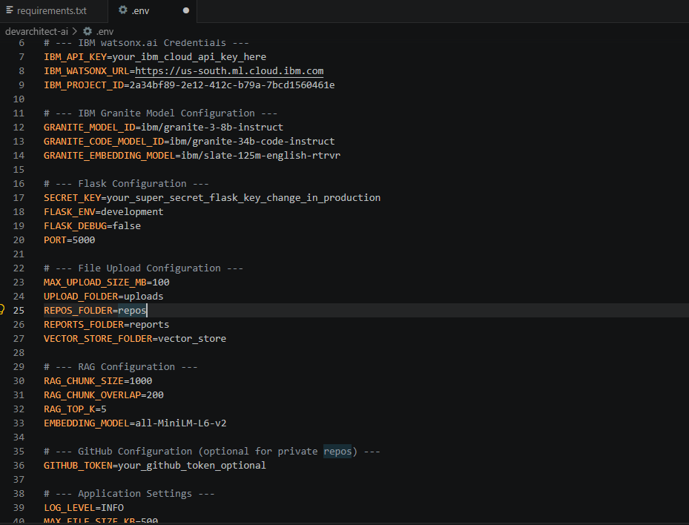
Required Files created using IBM bob -
App.py
Requirements.txt
Style.css
.env
Index.html
Notes:
1.7.2013
‹#›

Slide 7
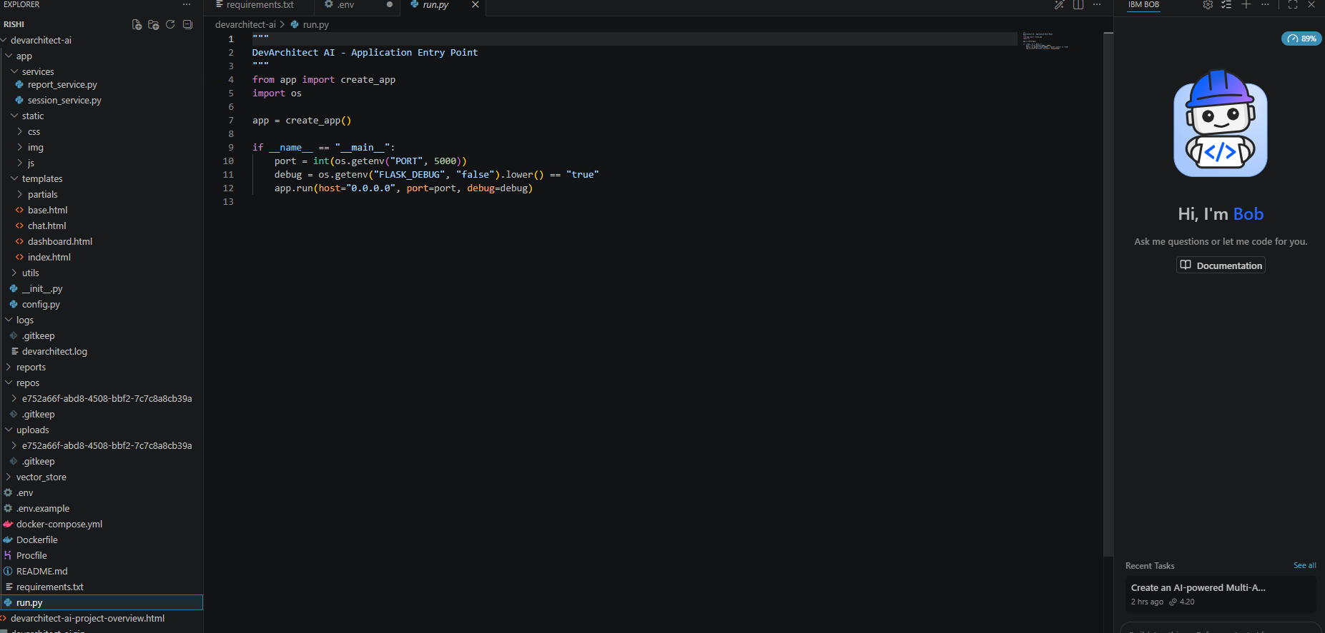
IBM Bob Screenshots:
Notes:
1.7.2013
‹#›

Slide 8
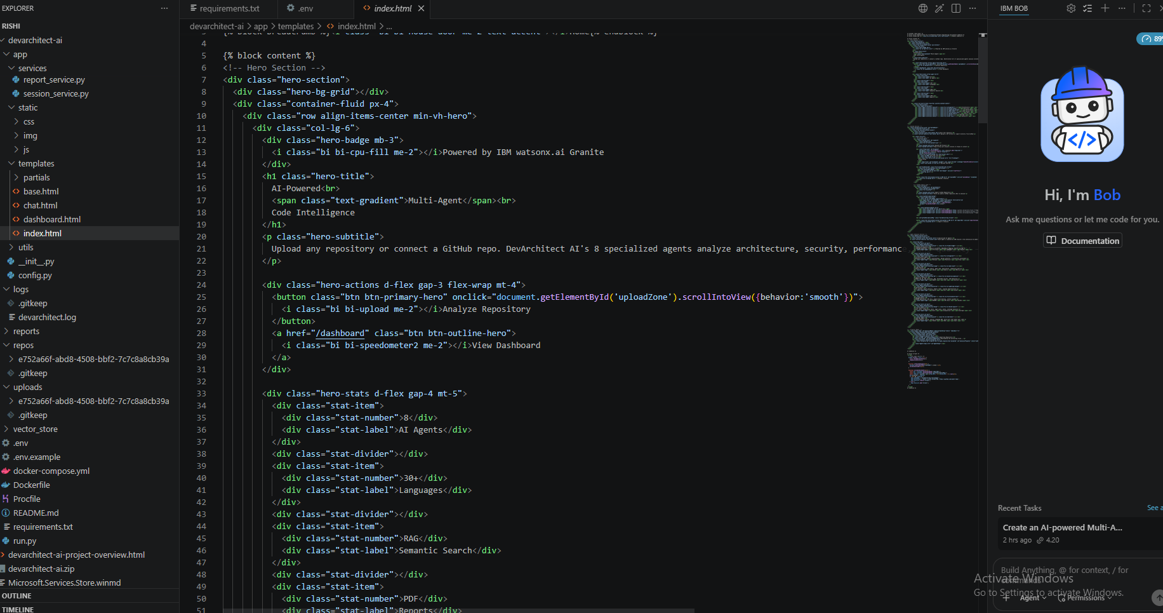

Slide 9
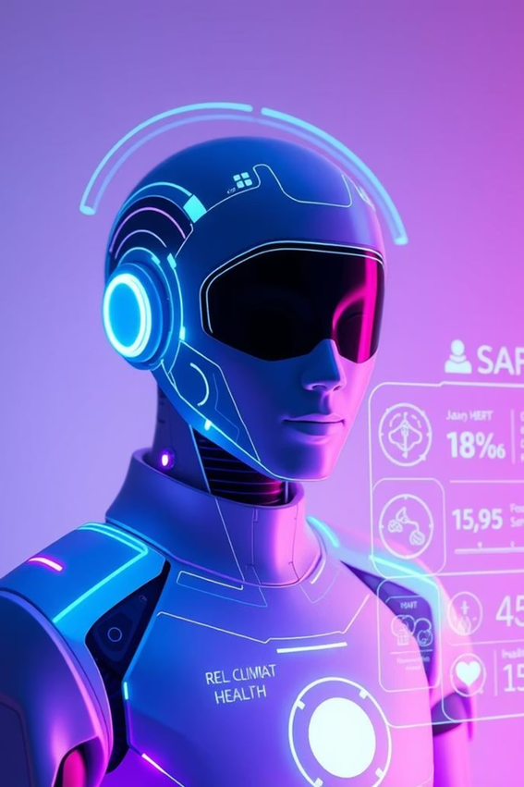
Role of Agentic AI in the solution
Agentic AI enables DevArchitect AI to function as an intelligent, autonomous software engineering assistant rather than a traditional code analysis tool. Using IBM watsonx.ai and IBM Granite models, it coordinates multiple specialized agents to analyze, understand, and improve software repositories.
Each agent performs a specific role—such as repository analysis, architecture generation, code review, security assessment, documentation generation, and repository Q&A—while collaborating to provide comprehensive insights. This multi-agent approach improves accuracy, efficiency, and automation throughout the software development lifecycle.
Agentic AI also provides context-aware reasoning by understanding the project's structure, programming languages, dependencies, and business logic. It delivers repository-specific recommendations instead of generic suggestions and adapts its analysis based on the uploaded codebase.
Additionally, the agents communicate and share findings with one another, enabling better decision-making, more accurate recommendations, and a unified view of the repository.
Overall, Agentic AI transforms DevArchitect AI into a proactive, intelligent software engineering assistant that helps developers understand, maintain, secure, and optimize complex codebases more efficiently.
Notes:
1.7.2013
‹#›

Slide 10
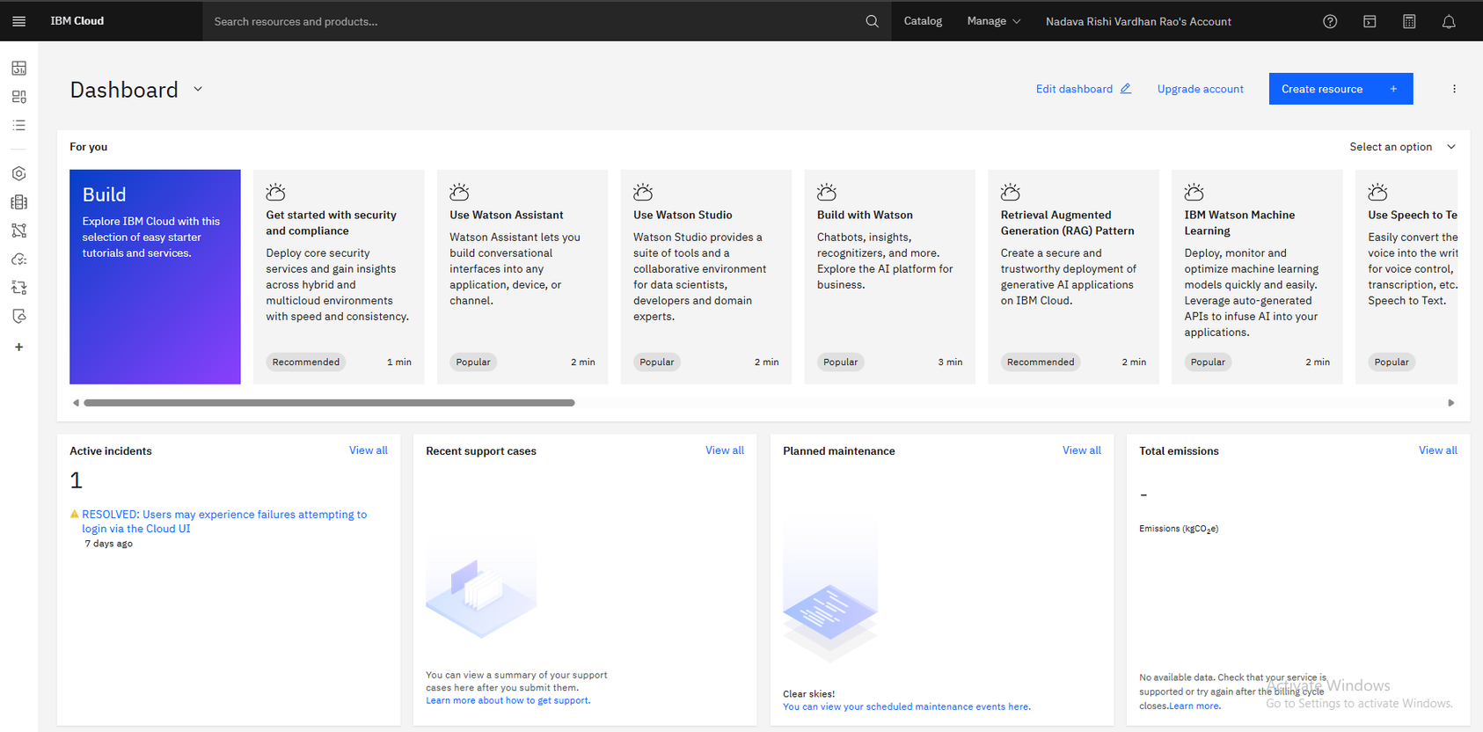
IBM Cloud Dashboard
·
·
·
Notes:
1.7.2013
‹#›

Slide 11
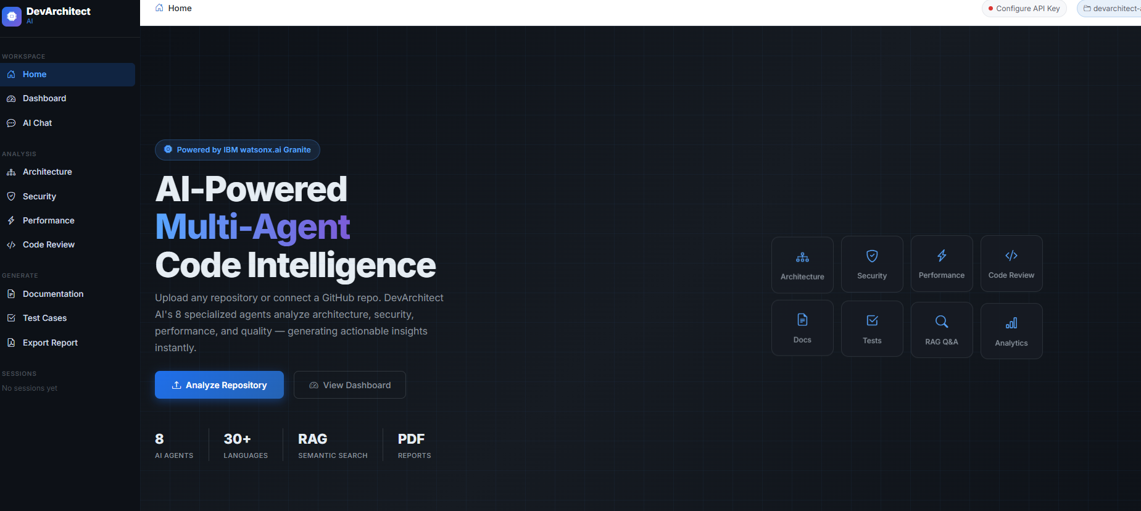
Project Output Screenshot
Please put IBM Bob output screenshots with 2-3 prompts.
You can take 2-3 more slides for each screenshot
·
·
·
Notes:
1.7.2013
‹#›

Slide 12
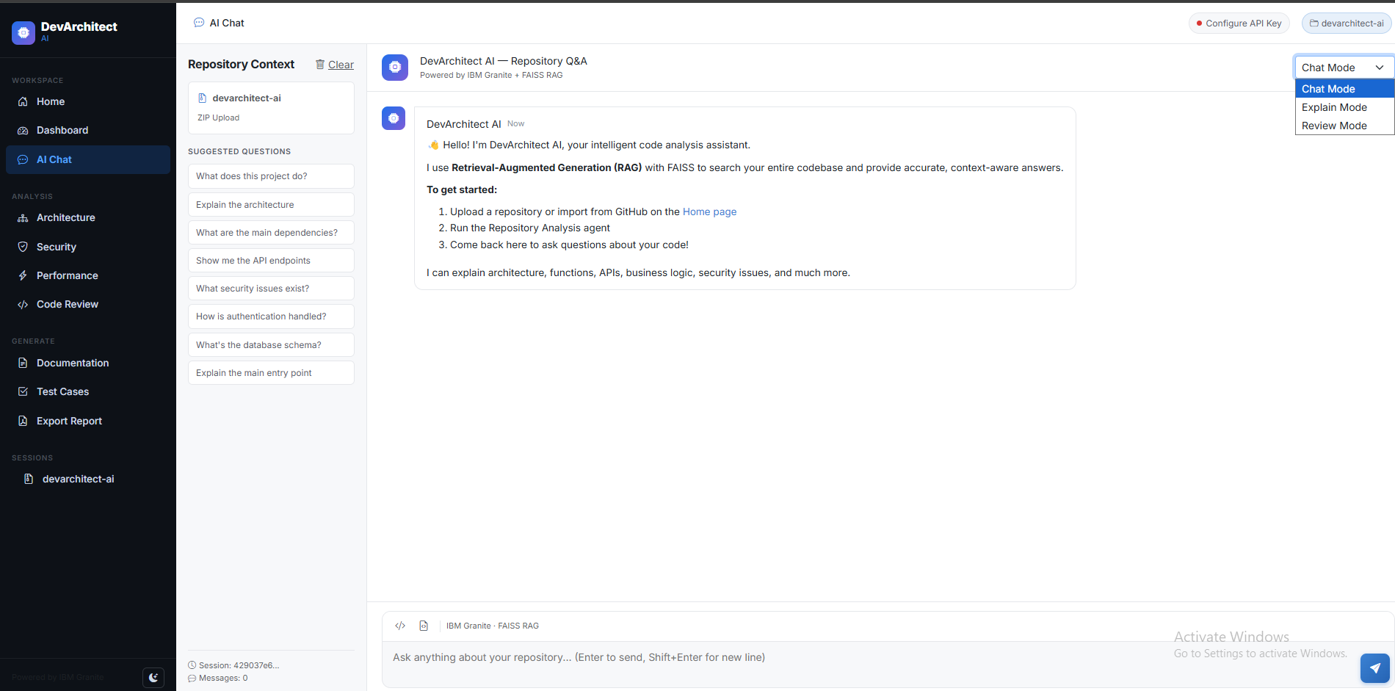
Project Output Screenshot
Please put IBM Bob output screenshots with 2-3 prompts.
You can take 2-3 more slides for each screenshot
·
·
·
Notes:
1.7.2013
‹#›

Slide 13
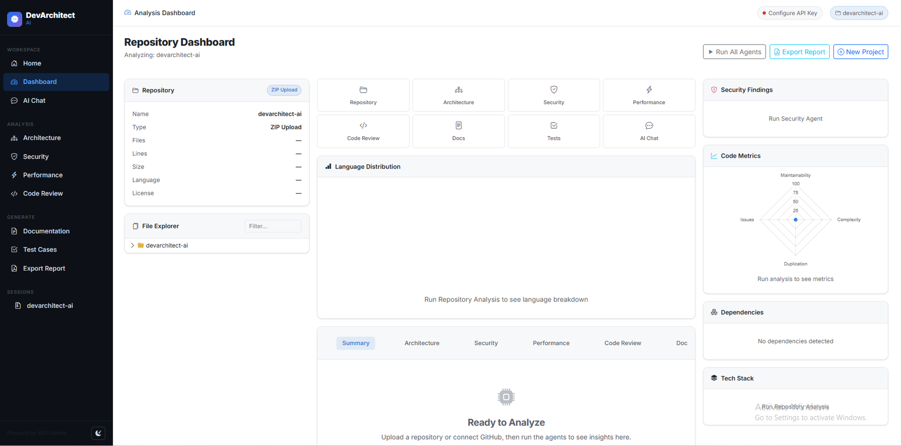
Project Output Screenshot
Please put IBM Bob output screenshots with 2-3 prompts.
You can take 2-3 more slides for each screenshot
·
·
·
Notes:
1.7.2013
‹#›

Slide 14
Novelty and Uniqueness
Key Innovation of DevArchitect AI
The proposed DevArchitect AI stands out by combining Agentic AI, RAG, and intelligent code analysis into a single software engineering platform.
Multi-Agent Intelligence – Multiple specialized AI agents collaborate to perform repository analysis, code review, security assessment, documentation generation, and architecture understanding.
RAG-Based Repository Understanding – Uses Retrieval-Augmented Generation to retrieve relevant code and project context before generating accurate, repository-specific responses.
Context-Aware Code Analysis – Understands project structure, programming languages, dependencies, and business logic to provide precise recommendations.
Automated Documentation – Generates README files, API documentation, architecture summaries, and developer guides automatically.
Integrated Security & Performance Insights – Detects vulnerabilities, code quality issues, and performance bottlenecks while suggesting actionable improvements.
Natural Language Repository Q&A – Enables developers to interact with the entire codebase using simple natural language queries.
Scalable & Enterprise-Ready – Built on IBM watsonx.ai with IBM Granite models, ensuring scalability, AI governance, and reliable enterprise-grade performance.
This makes DevArchitect AI an intelligent, proactive software engineering assistant rather than just a traditional code analysis tool.
Notes:
1.7.2013
‹#›

Slide 15
Git Hub Link
https://github.com/RISHIVARDHANRAO/DevArchitect
·
·
Notes:
1.7.2013
‹#›

Slide 16
Future Scope
Future Enhancements
1. CI/CD & GitHub Integration
The system can be integrated with GitHub, GitLab, and CI/CD platforms to automatically analyze repositories on every commit or pull request. This enables continuous code review, security scanning, documentation updates, and quality checks, helping development teams maintain high code standards throughout the software lifecycle.
2. AI Pair Programmer & Team Collaboration
DevArchitect AI can be enhanced with an AI-powered coding assistant that provides real-time code suggestions, bug fixes, refactoring recommendations, and test case generation within popular IDEs. Team collaboration features such as shared repository insights, review history, and personalized developer recommendations can further improve productivity and streamline software development.
·
·
·
Notes:
1.7.2013
‹#›

Slide 17
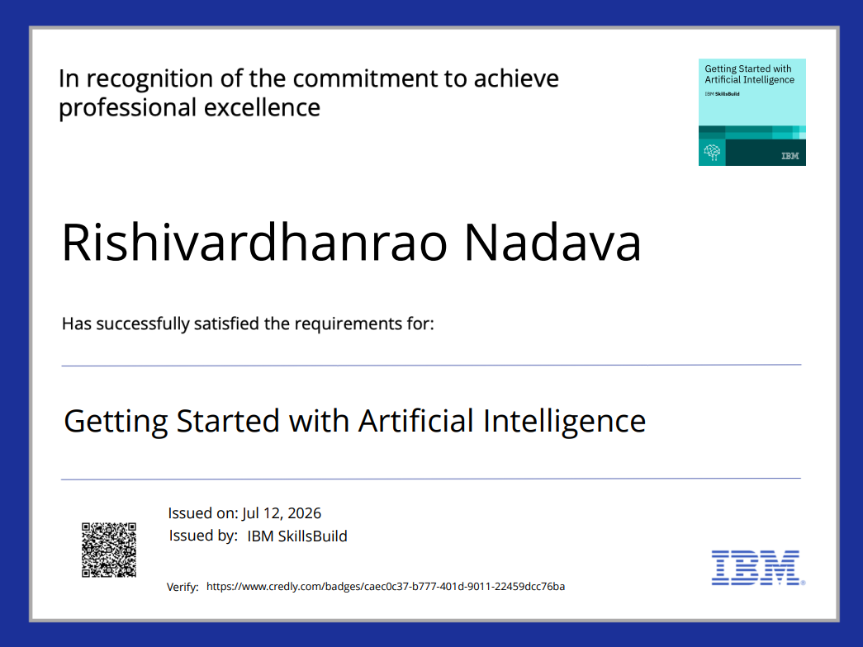
Certificates Earned:

Slide 18
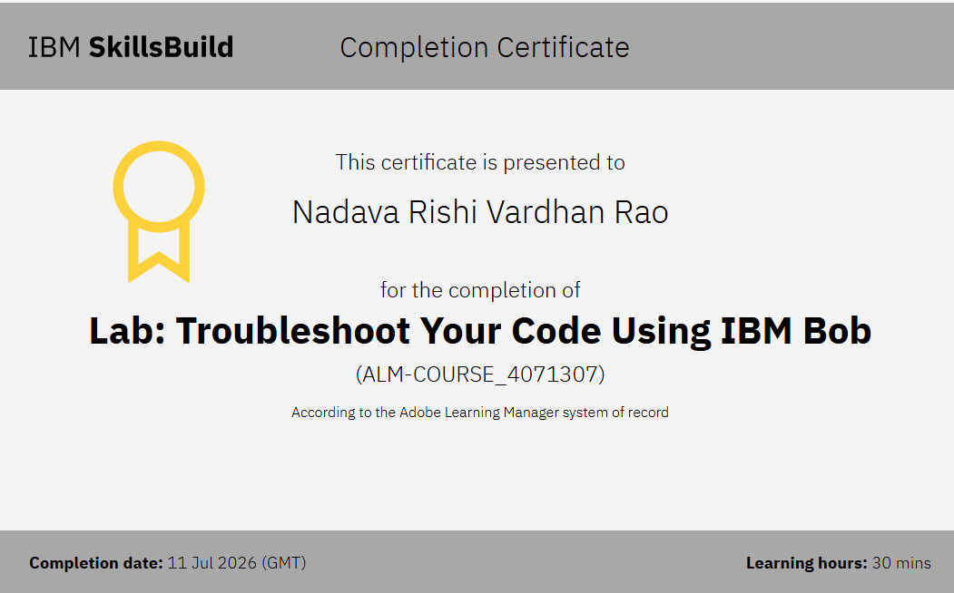
Certificates Earned:​
Add your IBM BOB Certificate

Slide 19

Notes:
1.7.2013
‹#›

