Slide 1

Fault-Tolerant Computing
Hardware Design Methods

Slide 2
About This Presentation
This presentation has been prepared for the graduate course ECE 257A (Fault-Tolerant Computing) by Behrooz Parhami, Professor of Electrical and Computer Engineering at University of California, Santa Barbara. The material contained herein can be used freely in classroom teaching or any other educational setting. Unauthorized uses are prohibited. © Behrooz Parhami
Edition | Released | Revised | Revised
First | Oct. 2006 | Nov. 2007

Slide 3

Self-Checking Modules

Slide 4




Earl checks his balance at the bank.

Slide 5
Multilevel Model of Dependable Computing
Level →
Component
Logic
Information
System
Service
Result
Ideal
Defective
Faulty
Erroneous
Malfunctioning
Degraded
Failed
Unimpaired
Low-Level Impaired
Mid-Level Impaired
High-Level Impaired
Legend:
Entry
Deviation
Remedy
Tolerance

Slide 6
Main Ideas of Self-Checking Design
Function unit designed in a way that faults/errors/malfns manifest themselves as invalid (error-space) outputs, which are detectable by an external code checker
Encoded input
Function
unit
Encoded output
Self-checking code checker
Status
Four possibilities:
Both function unit and checker okay
Implementation of the desired functionality with coded values
Code space
Code space
f
Only function unit okay (false alarm may be raised, but this is safe)
f_{φ}
OR
Only checker okay (we have either no output error or a detectable error)
Circuit function with the fault φ
Error space
Error space
Neither function unit nor checker okay (use 2-output checker; a single check signal stuck-at-okay goes undetected, leading to fault accumulation)
Input
Output

Slide 7
Cascading of Self-Checking Modules
Given self-checking modules that have been designed separately, how does one combine them into a self-checking system?
Input
Output
Code space
Code space
f
f_{φ}
OR
Input unchecked
Error space
f
Error space
f_{φ}
Input checked (don’t care)
?
Encoded output
Encoded input
Function
unit 1
Function
unit 2
Self-checking checker
Self-checking checker
Can remove this checker
if we do not expect both units to fail and Function unit 2 translates any noncodeword input into noncode output
Output of multiple checkers may be combined in self-checking manner

Slide 8
Totally-Self-Checking Error Signal Combining
Encoded output
Encoded input
Function
unit 1
Function
unit 2
In Out
0 0 0 0 0 0
0 0 0 1 0 0
0 0 1 0 0 0
0 0 1 1 0 0
0 1 0 0 0 0
0 1 0 1 0 1
0 1 1 0 1 0
0 1 1 1 1 1
1 0 0 0 0 0
1 0 0 1 1 0
1 0 1 0 0 1
1 0 1 1 1 1
1 1 0 0 0 0
1 1 0 1 1 1
1 1 1 0 1 1
1 1 1 1 1 1
Simplified truth table
if we denote
01 and 10 as G,
00 and 11 as B
In Out
B B B
B G B
G B B
G G G
Self-checking checker
Self-checking checker
01 or 10: G
00 or 11: B
Circuit to combine error signals
(two-rail checker)
Show that this circuit is self-testing

Slide 9
Totally Self-Checking Design
A module is totally self-checking
if it is self-checking and self-testing
Input
Output
Code space
Code space
f
f_{φ}
OR
If the dashed red arrow option is used too often, faults may go undetected for long periods of time, raising the danger of a second fault invalidating the self-checking design
Input unchecked
Error space
f
Error space
f_{φ}
Input checked (don’t care)
?
A self-checking circuit is self-testing if any fault from the class covered is revealed at output by at least one code-space input, so that the fault is guaranteed to be detectable during normal circuit operation
Note that if we don’t explicitly ensure this, tests for some of the faults may belong to the input error space
The self-testing property allows us to focus on a small set of faults, thus leading to more economical self-checking circuit implementations
(with a large fault set, cost would be prohibitive)

Slide 10
Self-Monitoring Design
A module is self monitoring with respect to the fault class F if it is
(1) Self-checking with respect to F, or
(2) Totally self-checking wrt the fault class F_{init} ⊆ F, chosen such that
all faults in F develop in time as a sequence of simpler faults,
the first of which is in F_{init}
Example:
A unit that is totally-self-checking wrt single faults may be deemed self-monitoring wrt to multiple faults, provided that multiple faults develop one by one and slowly over time
Fault-free
F_{init}
F – F_{init}
φ₃
φ₁
φ₂
The self-monitoring design approach requires the more stringent totally-self-checking property to be satisfied for a small, manageable set of faults, while also protecting the unit against a broader fault class

Slide 11
Totally Self-Checking Checkers
Conventional code checker
Example: 5-input odd-parity checker
Input
Code space
f
s-a-0 fault on output?
Output
0
1
e
Error space
f
Self-checking code checker
Example: 5-input odd-parity checker
Input
Code space
Output
f
Pleasant surprise:
The self-checking version is simpler!
01
f
e₀
10
f_{φ}
00
11
e₁
f
Error space
f_{φ}
?
Notes:
Try to produce 01 and 10 for roughly equal numbers of code-space inputs

Slide 12
TSC Checker for m-out-of-2m Code
Divide the 2m bits into two disjoint subsets A and B of m bits each
Let v and w be the weight of (number of 1s in) A and B, respectively
Implement the two code checker outputs e₀ and e₁ as follows:
e₀ = ∨ (v ≥ i)(w ≥ m – i)
m
i = 0
(i even)
v 1s
w 1s
e₁ = ∨ (v ≥ j)(w ≥ m – j)
m bits
m bits
m
Subset A
Subset B
j = 1
(j odd)
v 1s
w 1s
Example: 3-out-of-6 code checker, m = 3, A = {a, b, c}, B = { f, g, h}
e₀ = (v ≥ 0)(w ≥ 3) ∨ (v ≥ 2)(w ≥ 1) = fgh ∨ (ab ∨ bc ∨ ca)(f ∨ g ∨ h)
e₁ = (v ≥ 1)(w ≥ 2) ∨ (v ≥ 3)(w ≥ 0) = (a ∨ b ∨ c)(fg ∨ gh ∨ hf) ∨ abc
Always satisfied

Slide 13
Another TSC m-out-of-2m Code Checker
Cellular realization, due to J. E. Smith:
This design is testable with only 2m inputs,
all having m consecutive 1s (in cyclic order)
m – 1 stages
.
.
.
.
.
.
.
.
.
.
.
.
.
.
.
.
.
.
Notes:
Smith, J.E., “ The Design of Totally Self-Checking Check Circuits for a Class of Unordered Codes,” J. Design Automation and Fault-Tolerant Computing, Vol. 2, pp. 321-343, 1977.

Slide 14
Using 2-out-of-4 Checkers as Building Blocks
Building m-out-of-2m TSC checkers, 3 ≤ m ≤ 6, from 2-out-of-4 checkers
(construction due to Lala, Busaba, and Zhao):
Examples: 3-out-of-6 and 4-out-of-8 TSC checkers are depicted below
(only the structure is shown; some design details are missing)
1 2 3 4
5 6
1 2
3 4 5 6
1 2 3 4
5 6 7 8
3 4 7 8
1 2 5 6
2-out-of-4
2-out-of-4
2-out-of-4
2-out-of-4
2-out-of-4
2-out-of-4
2-out-of-4
2-out-of-4
2-out-of-4
2-out-of-4
Slightly different from an ordinary
2-out-of-4 checker
2-rail checker
2-rail checker
3-out-of-6
4-out-of-8
Notes:
Smith, J.E., “ The Design of Totally Self-Checking Check Circuits for a Class of Unordered Codes,” J. Design Automation and Fault-Tolerant Computing, Vol. 2, pp. 321-343, 1977.

Slide 15
TSC Checker for k-out-of-n Code
2-out-of-5
One design strategy is to proceed in 3 stages:
Convert the k-out-of-n code to a 1-out-of-( ) code
Convert the latter code to an m-out-of-2m code
Check the m-out-of-2m code using a TSC checker
This approach is impractical for many codes
5 bits
n
k
10 AND gates
1-out-of-10
10 bits
3-out-of-6
6 OR gates
6 bits
TSC checker
A procedure due to Marouf and Friedman:
Implement 6 functions of the general form
(these have different subsets of bits as
inputs and constitute a 1-out-of-6 code)
Use a TSC 1-out-of-6 to 2-out-of-4 converter
Use a TSC 2-out-of-4 code checker
The process above works for 2k + 2 ≤ n ≤ 4k
It can be somewhat simplified for n = 2k + 1
e₀ = ∨ (v ≥ j)(w ≥ m – j)
m
j = 1
(j even)
e₀ e₁ e₂ e₃ e₄ e₅
1-out-of-6
6 bits
2-out-of-4
OR gates
4 bits
TSC checker
Notes:
Marouf. M.A., and A.D. Friedman, “Efficient Design of Self-Checking Checker for any m-out-of-n Code,” IEEE Trans. Computers, Vol. 27, pp. 482-490, June 1978. [Also, in Lala’s book, p. 91]

Slide 16
TSC Checkers for Separable Codes
Here is a general strategy for designing totally-self-checking checkers for separable codes
Generate complement of check bits
n – k
Two-rail checker
k data bits
e₀
n – k
e₁
n – k check bits
Input word
Checker outputs
TSC code checker
For many codes, direct synthesis will produce a faster and/or more compact totally-self-checking checker
Google search for “totally self checking checker” produces 817 hits

Slide 17
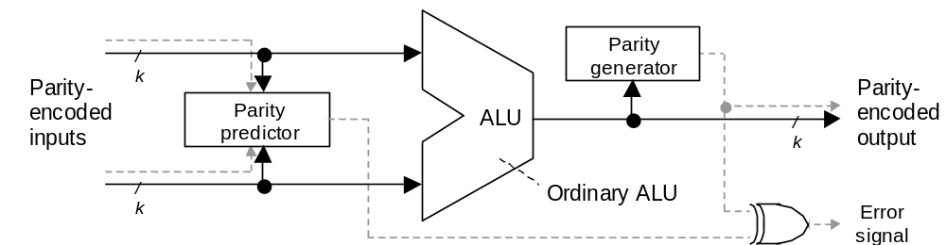
TSC Design with Parity Prediction
Recall our discussion of parity prediction as an alternative to duplication
If the parity predictor produces the complement of the output parity, and the XOR gate is removed, we have a self-checking design
To ensure the TSC property, we must also verify that the parity predictor is testable only with input codewords

Slide 18
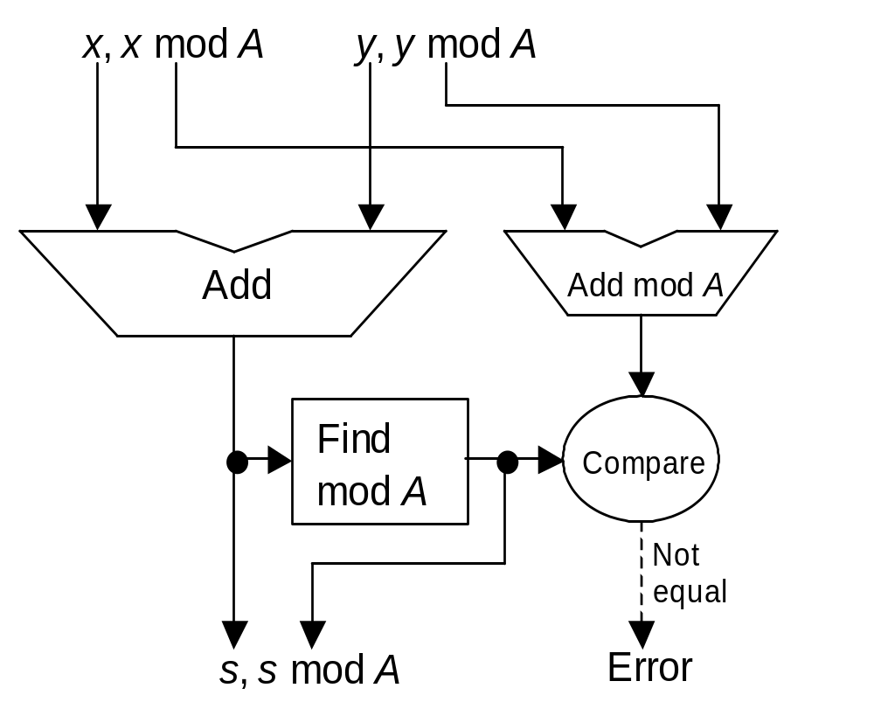
TSC Design with Residue Encoding
Residue checking is applicable directly to addition, subtraction, and multiplication, and with some extra effort to other arithmetic operations
To make this scheme TSC:
Modify the “Find mod A” box
to produce the complement
of the residue
Use two-rail checker instead of comparator
Verify the self-testing property if the residue channel is not completely independent of the main computation (not needed for add/subtract and multiply)

Slide 19
Self-Checking Design with FPGAs
LUT-based FPGAs can suffer from the following fault types:
Single s-a faults in RAM cells
Single s-a faults on signal lines
Functional faults in a multiplexer within a single CLB
Functional faults in a D flip-flop within a single CLB
Single s-a faults in pass transistors connecting CLBs
LUT
Synthesis algorithm:
(1) Use scripts in the Berkeley synthesis tool SIS to decompose an SOP expression into an optimal collection of parts with 4 or fewer variables
(2) Assign each part to a functional cell that produces a 2-rail output
(3) Connect the outputs of a pair of intermediate functional cells to the inputs of a checker cell and find the output equations for that cell
(4) Cascade the checker cells to form a checker tree
Ref.: P.K. Lala, and A.L. Burress, IEEE Trans. Instrumentation and Measurement, Vol. 52, No. 5, pp. 1391-1398, October 2003

Slide 20
Synthesis of TSC Systems from TSC Modules
System consists of a set of modules, with interconnections modeled by a directed graph
Theorem 1: A sufficient condition for a system to be TSC with respect to all single-module failures is to add checkers to the system such that if a path leads from a module M_{i} to itself (a loop), then it encounters at least one checker
Theorem 2: A sufficient condition for a system to be TSC with respect to all multiple module failures in the module set A = {M_{i}} is to have no loop containing two modules in A in its path and at least one checker in any path leading from one module in A to any other module in A
Optimal placement of checkers to satisfy these condition
Easily solved, when checker cost is the same at every interface
Notes:
Parhami, B., “Design of Self-Monitoring Logic Circuits for Applications in Fault-Tolerant Digital Systems,” Proc. ISCAS, 1976.

Slide 21
Partially Self-Checking Units
Some ALU functions, such as logical operations, cannot be checked using low-redundancy codes
Such an ALU can be made partially self-checking by circumventing the error-checking process in cases where codes are not applicable
Self-checking ALU
with residue code
01, 10 = G (top)
01 = D, 10 = C (bottom)
00, 11 = B
In Out
X B B
B C B
B D G
G C G
G D G
Residue-check error signal
ALU error indicator
0 1
1 0
Do not check
Check
The check/do-not-check indicator is produced by the control unit
Normal operation
01
10

Slide 22
Self-Checking State Machines
Design method for Moore-type machines, due to Diaz and Azema:
Inputs and outputs are encoded using two-rail code
States are encoded as n/2-out-of-n codewords
Fact: If the states are encoded using a k-out-of-n code, one can express the next-state functions (one for each bit of the next state) via monotonic expressions; i.e., without complemented variables
Monotonic functions can be realized with only AND and OR gates, hence the unidirectional error detection capability
Input Output
State x = 0 x = 1 z
A C A 1
B D C 1
C B D 0
D C A 0
Input Output
State x = 01 x = 10 z
0011 1010 0011 10
0101 1001 1010 10
1010 0101 1001 01
1001 1010 0011 01
Notes:
See page 134 of Lala’s book.
Ozguner presents a method for designing Mealy machine, using 1-out-of-n encoding for inputs and states.

