Slide 1
BIG DATA MACHINE LEARNING MINI PROJECT
Predicting Credit Card
Payment Default
A Spark ML Big Data Pipeline for Binary Classification
Application Area 5: Credit Card | UCI “Default of Credit Card Clients” Dataset
Group Members RADS BANDARA — 31834 MAM RISKY — 31839
Big Data Analytics | NSBM Green University

Slide 2
OVERVIEW
Agenda
01
Problem & Business Case
05
Results & Comparison
Why credit-default prediction matters
3 models, 5 metrics
02
Dataset & Data Quality
06
Big Data Scalability
30,000 clients, cleaning findings
From 30K to 100M+ rows
03
Exploratory Data Analysis
07
Conclusion & Recommendation
What drives default risk
What we’d deploy, and why
04
Spark ML Pipeline
Feature engineering → models
2

Slide 3
PROBLEM DEFINITION
Why Predict Credit Card Default?
Stakeholders
The Business Problem
Credit Risk & Collections
Card issuers lose money when clients default — and lose goodwill when they over-restrict reliable customers. A model that flags high-risk clients in advance lets the risk team intervene early: adjust limits, restructure repayment, or prioritise collections.
Act directly on the risk score
Finance / Treasury
Cares about aggregate bad-debt exposure
Objective
Predict default payment next month (binary) from a client’s demographics, credit limit, and last 6 months of billing / repayment history, using at least two Spark ML models.
Clients
Affected by credit-limit decisions
Why ML? Repayment behaviour × utilisation × demographics interact non-linearly — too complex for hand-written rules at 30,000+ clients.
3

Slide 4
DATASET
UCI “Default of Credit Card Clients”
30,000
24
22.1%
0
Client records
Predictor features
Default rate
Missing values
Feature Groups
Source
Demographics
LIMIT_BAL, SEX, EDUCATION, MARRIAGE, AGE
UCI Machine Learning Repository — I-C. Yeh, Taiwanese bank, Oct 2005 payments.
Repayment status
PAY_0, PAY_2…PAY_6 (last 6 months)
Bill / payment amounts
BILL_AMT1-6, PAY_AMT1-6
Usage
Target
default payment next month (1 / 0)
Public research dataset; anonymised codes only; used strictly as an educational ML exercise.
4

Slide 5
DATA PREPROCESSING
Cleaning Findings (Real Issues Found)
Duplicates
Missing Values
EDUCATION Codes
MARRIAGE Codes
0 removed
0 nulls
468 fixed
377 fixed
All 30,000 rows are unique clients
Every column fully populated across all rows
Undocumented codes 0/5/6 merged into “Others” (4)
Undocumented code 0 merged into “Others” (3)
Rather than dropping ~2.8% of clients with undocumented category codes, we collapsed them into the closest documented category — preserving every client while removing encoding ambiguity.
All cleaning performed with Spark DataFrame operations (groupBy, when/otherwise) — not pandas.
5

Slide 6
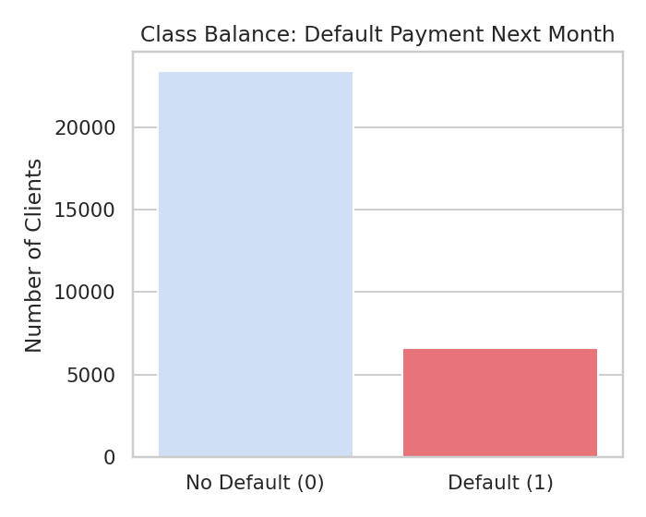
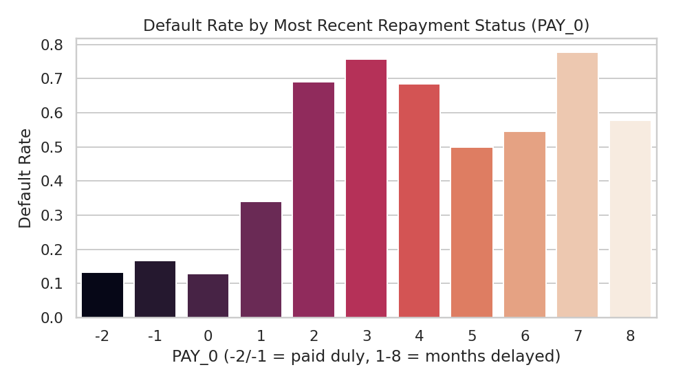
EXPLORATORY DATA ANALYSIS
Class Balance & the Strongest Predictor
22.1% of clients defaulted — an imbalanced target, so Accuracy alone would mislead.
PAY_0 (most recent repayment status) is the clearest single signal: on-time clients default at ~13–17%; any month of delay pushes that to 34–69%+.
6

Slide 7
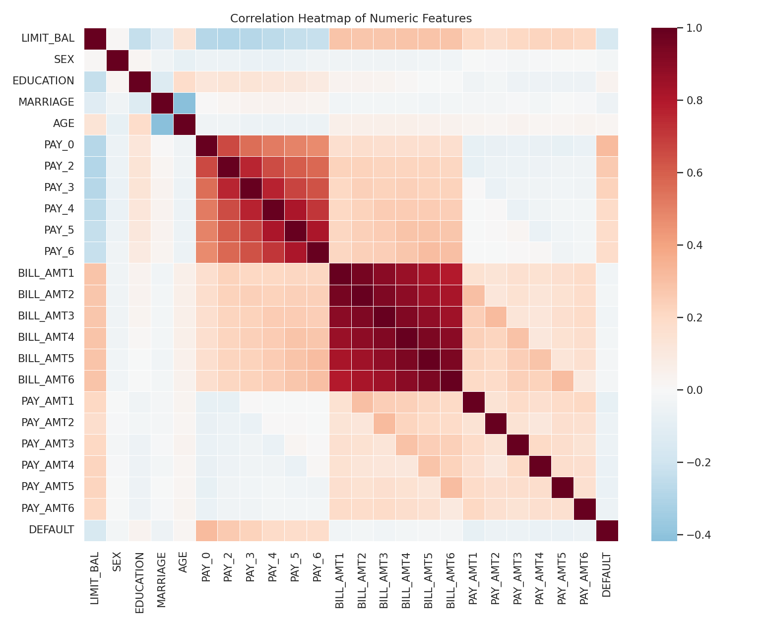
EXPLORATORY DATA ANALYSIS
What Correlates With Default?
Key Correlations
PAY_0
r ≈ 0.316 — strongest positive correlate
PAY_2, PAY_3
r ≈ 0.26, 0.23 — recent delay history
LIMIT_BAL
r ≈ -0.157 — strongest negative correlate
BILL_AMT*
Weakly correlated alone — the bill/pay ratio matters more
7

Slide 8
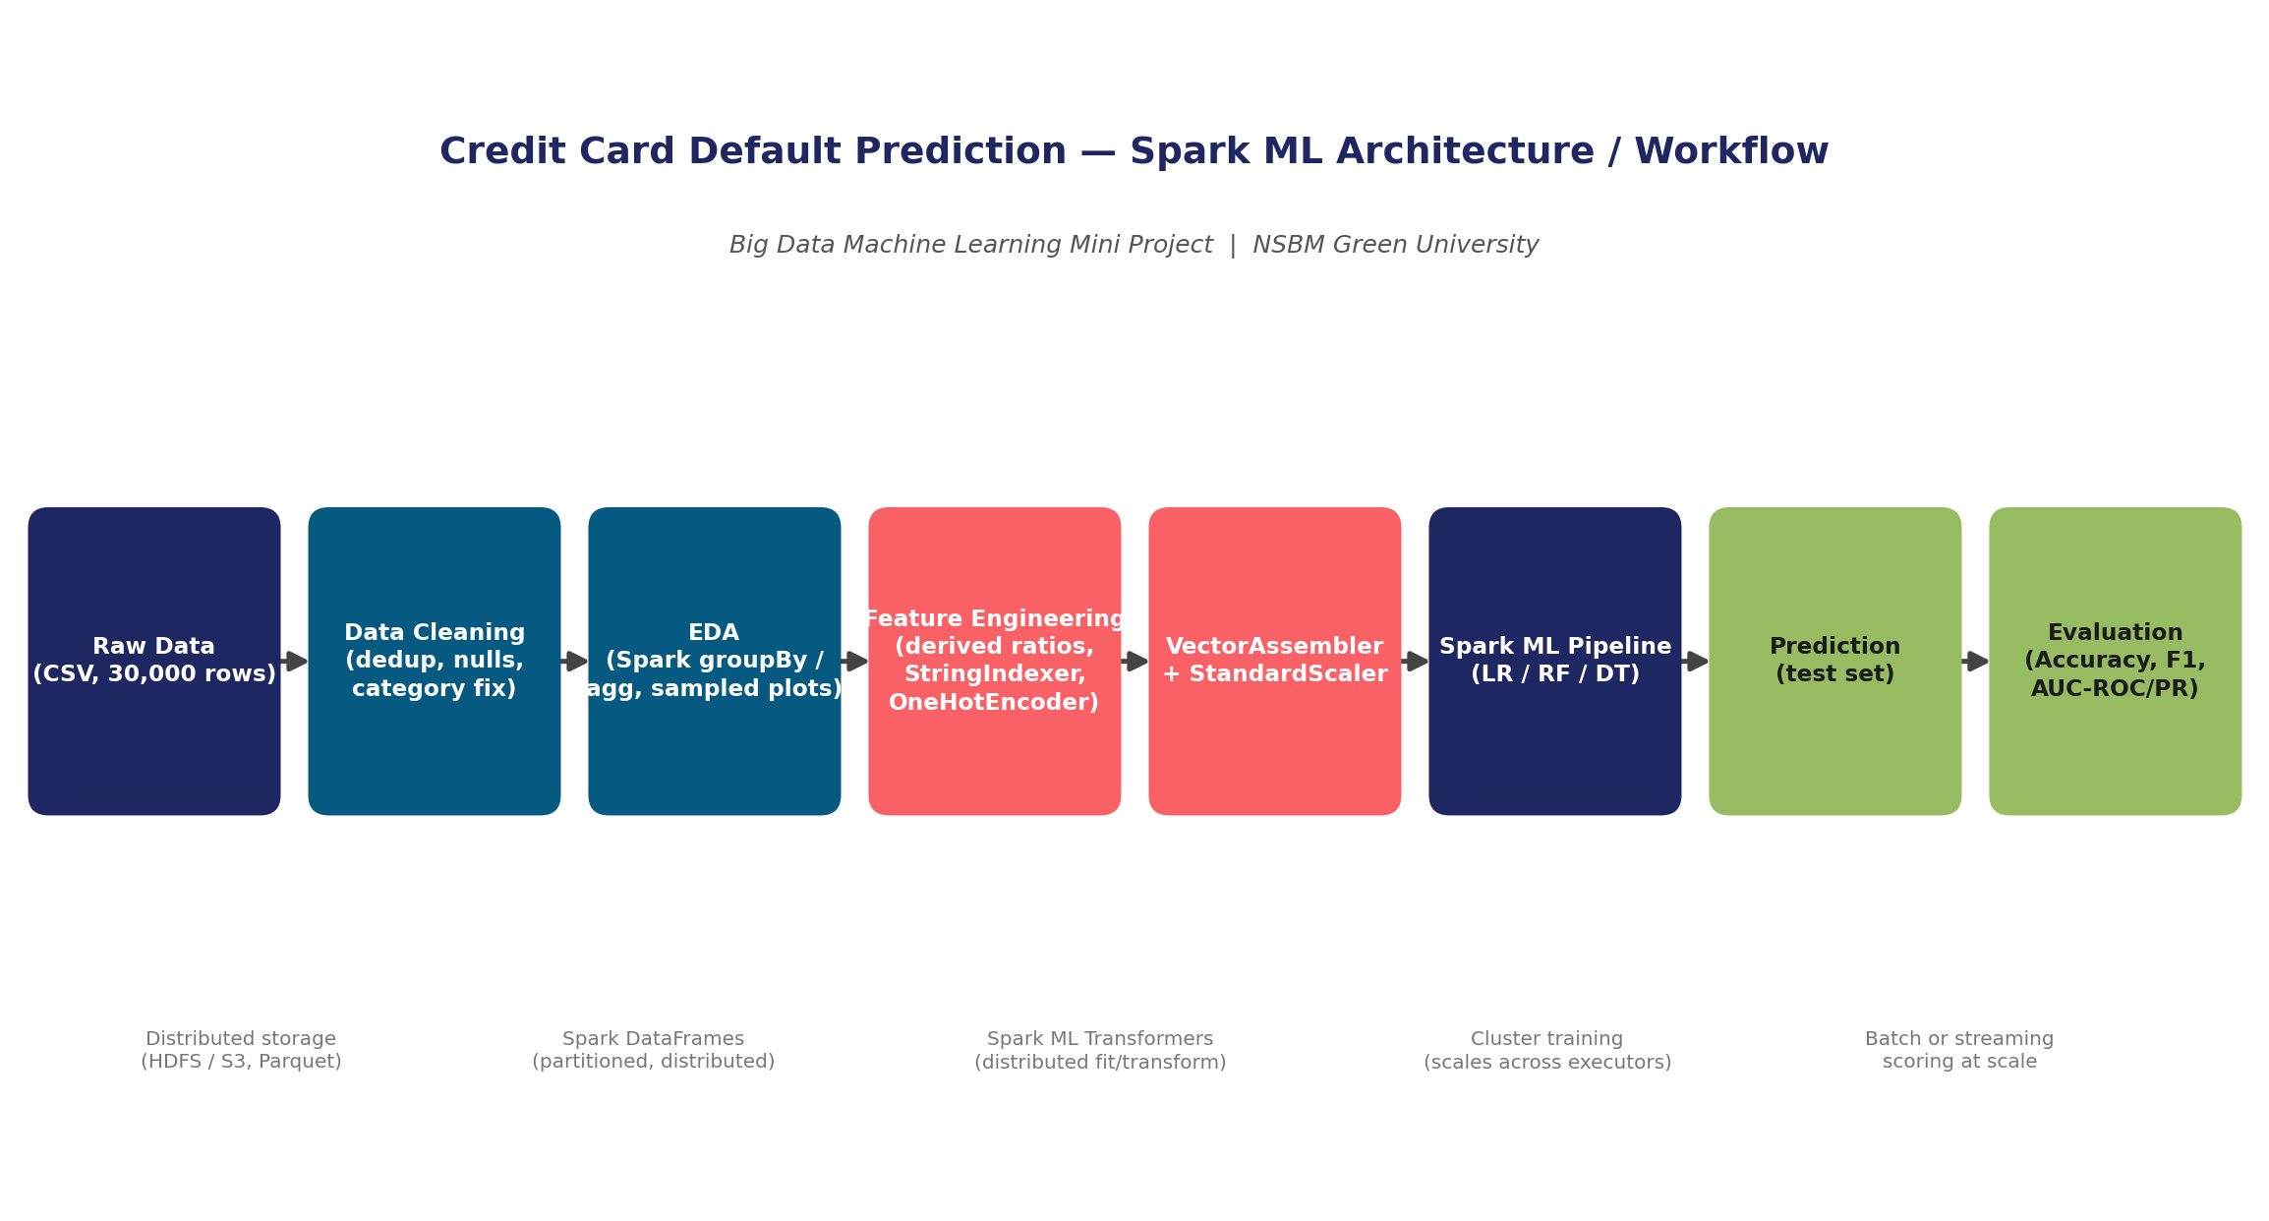
FEATURE ENGINEERING
From Raw Columns to Model-Ready Vectors
Derived Features (Spark DataFrame expressions)
AVG_BILL_AMT / AVG_PAY_AMT
6-month averages, smoothing single-month noise
CREDIT_UTILIZATION
avg bill ÷ credit limit
PAY_TO_BILL_RATIO
avg payment ÷ avg bill
MONTHS_DELAYED
count of delayed months (of 6)
Spark ML Transformers
28 total feature columns → one Spark ML Pipeline object per model — satisfying the mandatory Pipeline requirement.
StringIndexer → OneHotEncoder (SEX, EDUCATION, MARRIAGE) → VectorAssembler → StandardScaler
8

Slide 9
MACHINE LEARNING METHODOLOGY
Three Spark ML Classifiers Compared
1
2
3
Logistic Regression
Random Forest
Decision Tree
Interpretable linear baseline
150-tree ensemble
Single tree, fastest to train
maxIter=50, regParam=0.01
numTrees=150, maxDepth=8
maxDepth=6
All three trained through an identical Spark ML Pipeline on an 80/20 train-test split (24,032 / 5,968 rows, seed=42), satisfying the “at least two models” requirement with one extra for comparison.
9

Slide 10
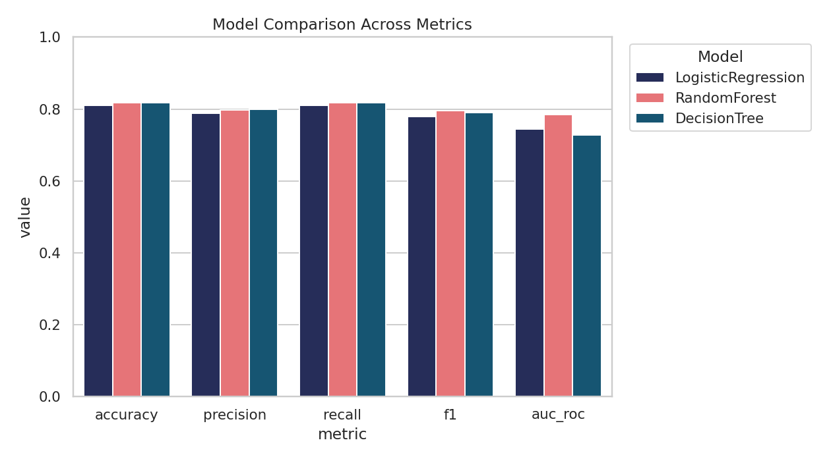
RESULTS
Model Comparison Across Metrics
Model
Acc.
F1
AUC-ROC
Logistic Regression
0.811
0.780
0.745
Random Forest
0.817
0.795
0.785
Decision Tree
0.818
0.790
0.729
★ Random Forest wins on AUC-ROC — best at ranking clients by risk
Full metrics (Precision, Recall, AUC-PR) and confusion matrices for all 3 models are in the technical report, Section 11.
10

Slide 11
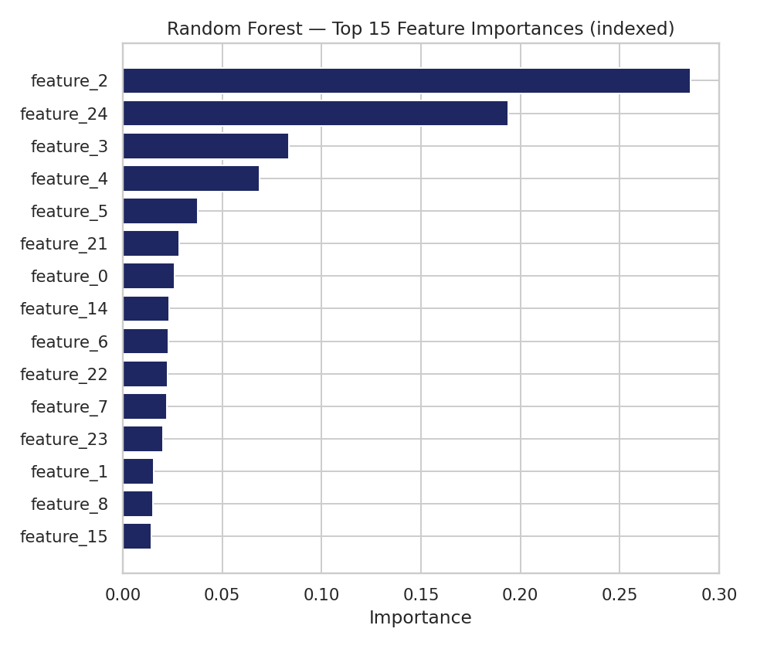
INTERPRETATION
What Drives the Model’s Predictions?
Key Takeaways
Recent repayment status (PAY_0, PAY_2) and MONTHS_DELAYED dominate — consistent with the correlation analysis.
Random Forest’s ensemble captures non-linear interactions (e.g. PAY_0 × CREDIT_UTILIZATION) a linear model misses.
All models find defaulters harder to catch than non-defaulters — a direct effect of 78/22 class imbalance.
These are associations, not proven causes — repayment delay and default risk likely share an unobserved financial-stress driver.
11

Slide 12
BIG DATA SCALABILITY
From 30,000 Rows to 100M+
This pipeline never leaves Spark DataFrames / Spark ML — so scaling changes only the compute pointed at the same code.
Storage
Compute
Partitioning
Local CSV → distributed HDFS / S3, columnar Parquet for fast scans
local[*] → YARN / Kubernetes cluster across many executor nodes
Tune shuffle.partitions to cluster cores; partition by month/region
EDA
Training
Serving
Keep aggregating in Spark groupBy; never collect full data to pandas
RF & LR already distribute natively — no algorithm swap needed
Persist the PipelineModel; batch-score millions of new rows/month
12

Slide 13
HONEST ASSESSMENT
Limitations
Single institution, single period (Taiwan, 2005) — may not transfer to other markets without retraining
Class imbalance — recall on defaulters remains the main weakness across all 3 models
Association, not causation — feature importance shows what predicts default, not why
Random 80/20 split, not time-based — doesn’t test generalisation to future periods
Hyperparameters set to reasonable defaults, not tuned via cross-validation, due to project scope
13

Slide 14
CONCLUSION
Recommendation
30,000
clients analysed end-to-end in Spark
Deploy: Random Forest
Best AUC-ROC (0.785) and AUC-PR (0.551) — the strongest at ranking clients by risk, which is what a collections team actually needs.
3
Spark ML models trained & compared
Retain: Logistic Regression
As an interpretable, low-latency fallback and explainability check on individual high-risk flags.
0.785
best AUC-ROC (Random Forest)
Before production: tune the decision threshold / class weighting for the bank’s real cost of a missed defaulter vs. a false alarm.
100M+
rows the same pipeline is ready to scale to
14

Slide 15
Thank You
Questions & Discussion
Notebook, technical report, architecture diagram, and dataset are available in the submitted project folder.
RADS BANDARA • MAM RISKY
Big Data Analytics — NSBM Green University

