Slide 1

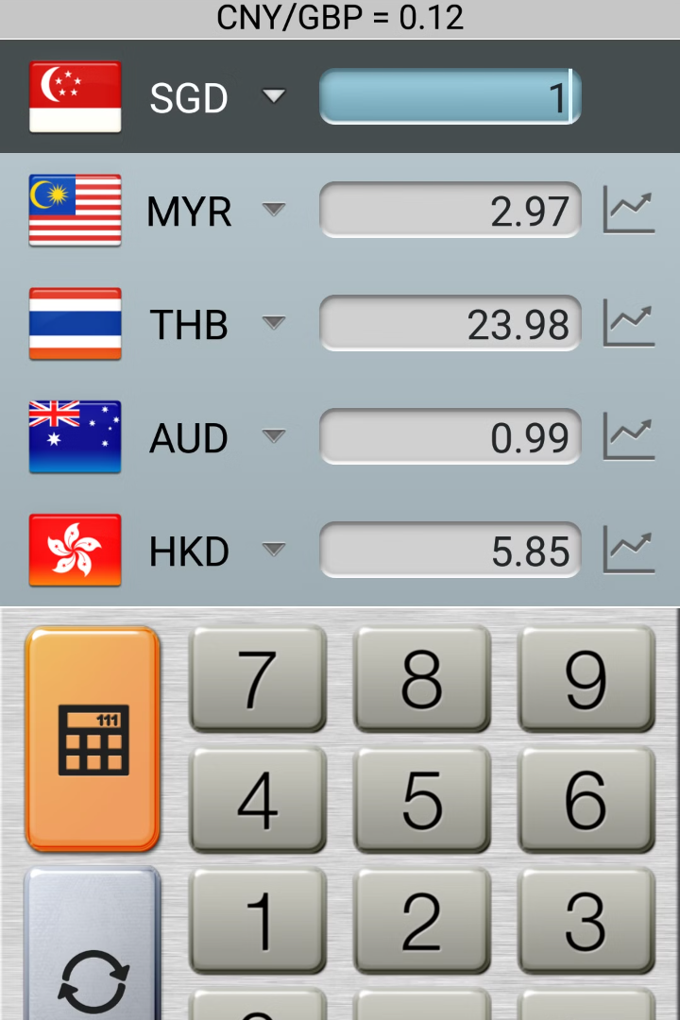

Introduction to Currency Converter
A currency converter is a tool that allows individuals to convert the value of one currency into another. It is commonly used for financial transactions and for determining the equivalent value of money in different countries. Currency converters are essential for travelers, businesses, and investors alike.
by Risshith Saravanan (192210021)
Mano (192225084)
Manoj Prabhu (192121136)
Da

Slide 2

Problem statement
Lack of insight: Many people struggle to understand exchange rates and their impact.
Inaccurate conversions: Currency conversions often result in confusion due to varying rates.
Hidden costs: Users are unaware of additional fees and charges applied during conversions.

Slide 3
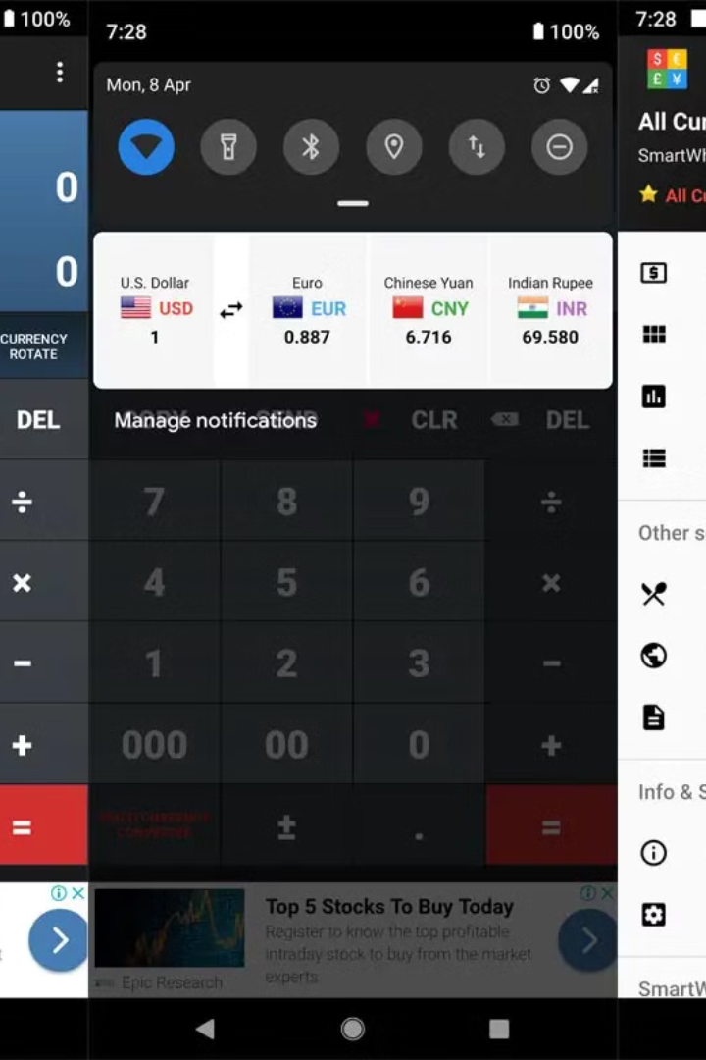
Key Components and Functionalities
A currency converter app typically includes real-time exchange rates, historical data, and multi-currency support.
It also provides features such as currency conversion, favorites list, and currency charts for analysis.

Slide 4



Popular Currency Conversion Tools
Calculator
Mobile Apps
Online Platforms
Basic tool for quick conversions and calculations.
Convenient for on-the-go currency exchange needs.
Offering real-time rates and historical data for analysis.

Slide 5

Benefits of Using a Currency Converter
Using a currency converter provides real-time exchange rates, allowing for accurate financial planning.
It enables seamless international transactions, avoiding hidden fees and unfavorable exchange rates.
Travelers can easily track and compare currency values, making budgeting and spending more efficient.

Slide 6
Factors Affecting Exchange Rates
Economic indicators
Interest rates, inflation, and GDP can impact exchange rates.
Market psychology
Investor perception and sentiment can influence currency valuation.
Political stability
Government stability and policies affect currency strength.
Trade balance
Imports and exports can impact demand for a country's currency.

Slide 7
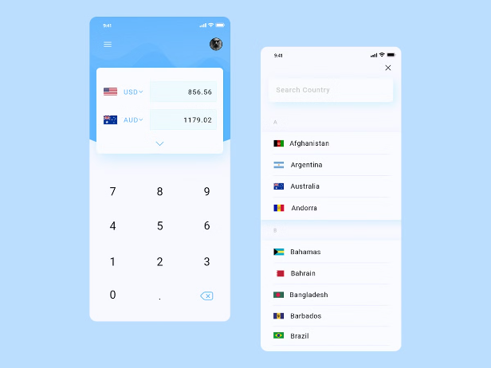
Login and Sign up process in a currency converter
When using a currency converter, the login and sign-up process is straightforward and secure.
Users can create accounts with personal details or sign in with social media credentials.
The verification process ensures the security of user data and transactions.
Once logged in, users can access personalized features and historical conversion data.

Slide 8
Risks and Limitations of Currency Conversion
Exchange Rate Fluctuations
1
Volatility can pose risks to currency conversion.
Transaction Costs
2
Hidden fees and charges may affect the overall value.
Information Security
3
Concerns about data privacy and cyber threats.
Regulatory Changes
4
Government policies may impact currency exchange.

Slide 9
Future Trends in Currency Conversion
Blockchain Integration
AI and Machine Learning
Expect increased use of blockchain technology for secure and transparent currency transactions.
Advancements in AI and machine learning will lead to more accurate exchange rate predictions.
Digital Wallet Adoption
Decentralized Finance (DeFi)
Greater adoption of digital wallets for seamless international transactions and currency exchanges.
Growth of decentralized finance platforms offering innovative currency conversion services.

Slide 10

Conclusion and Key Takeaways
1
Convenience
Access real-time exchange rates and convert currencies effortlessly.
2
Global Connectivity
Enables seamless transactions and investments across different currencies.
3
Financial Planning
Assists in budgeting for international travel and managing foreign investments.

