Slide 1

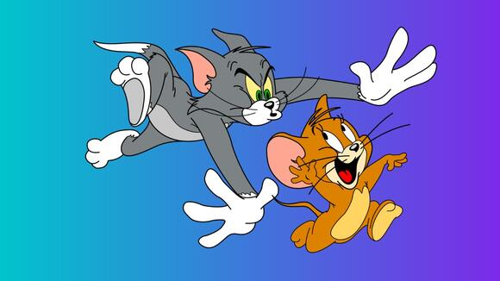
Tom vs Jerry
Abdullah Sakayl, Chris Figura, Derian Stenglein, Joseph Vita, Mike Atanasoff, Rachel Reed, Samuel Olson, Sean Carroll, Steven Shadders, and Travis Hill

Slide 2
Tom and Jerry Competition Overview
Red team is Tom
Blue team is Jerry
Red team gains one point for every 3 minutes a service is down
Blue team gains one point for every 3 minutes a service is up
Red team can obtain points by getting “cheese” (flags) on Blue Team machines
Blue team obtains points for the “cheese” that is not found

Slide 3
Competition Scoring Information
Both teams start with 0 points.
Services are scored on whether they are running or down. (75 pts per day)
For every 3 minutes a service is down red team will earn 1 point
For every 3 minutes a service is running blue team will earn 1 point
Flags give red team extra points proportional to the difficulty of accessing the flag
If the flags remain uncaptured by the end of the competition, they are added to blue team score
Minus one point for every incorrect submission to the score engine

Slide 4
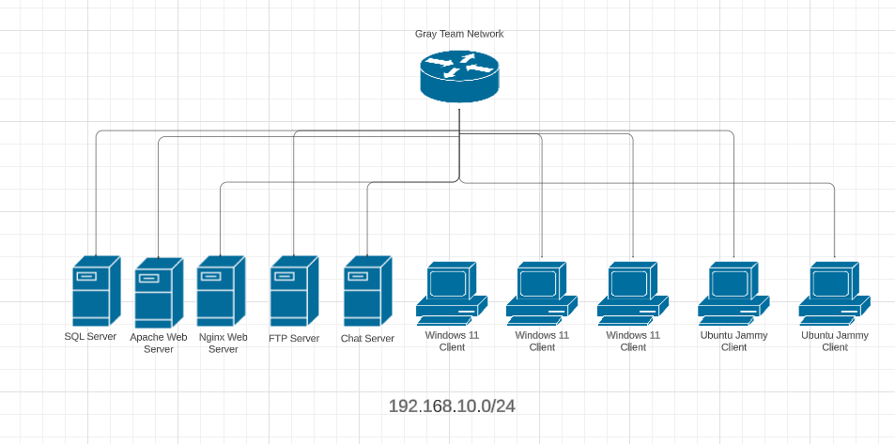
Topology

Slide 5
Competition Schedule
10/25 - Setup Day! Gray team will deploy the machines for Blue team can use the class time to prebake their tools on the Blue team machines.
After class - Red team can ssh into machines and use time to prebake
10/30 - Day 1 of the competition. Red team has hands off keyboards for the first 10 minutes of the competition. Blue team may use this time to set up their machines.
11/1 - Day 2 of the competition. The first inject makes its appearance! (Possibly second?)
11/5 - Day 3 of the competition. The second inject makes its appearance! (Possibly third?)
11/7 - Purple Team Day of the competition. Gray team deploys fresh boxes for the Blue and Red team to discuss techniques used to learn from each other.
11/13 - Competition 2 Recap, lessons, and debrief. Congratulations on another successful competition!

Slide 6
Packets
Make sure to read all of the packets
Rules are included in the packets
Useful information for both teams that you don’t want to miss

Slide 7
Questions?

