Slide 1
Turmoil in Thudor
Civil Political Discourse in Dungeons & Dragons

Slide 2

Project Members
Team Members:
Evan Dine, Project Lead
Quinn Foster, Narrative Lead
Dakota Hinchman, Lead Researcher
Faculty Advisors:
Prof. David Simkins, Game Design
Dr. Michael Brown, Historical & Political Analysis
Scan for our website!

Slide 3

Problem
Having meaningful political discussions is difficult.
Reasons:
Societal stigma
Biased spaces
Fear of reprisal
Outcomes:
Heated vitriol
Nothing is learned
Further debate is discouraged

Slide 4
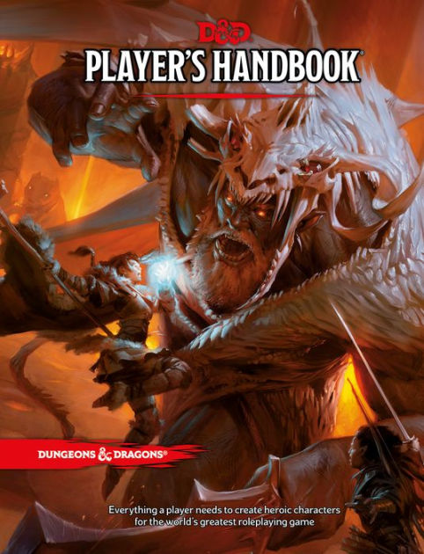
Solution
A fantasy role-playing game (RPG) like Dungeons & Dragons 5e can create a neutral environment for political conversations.
System of mediation between the Dungeon Master (DM) and players
Fantastical representation of political issues
Building empathy in players through embodied learning.

Slide 5
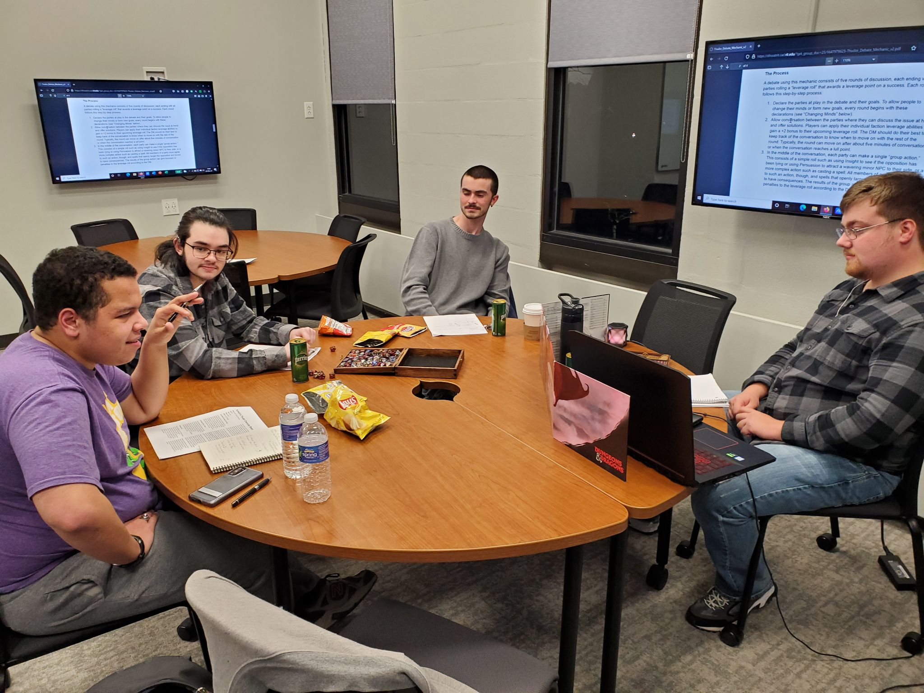
Why D&D?
Widespread accessibility
Easy to learn
Opportunities for in-depth
role-playing

Slide 6
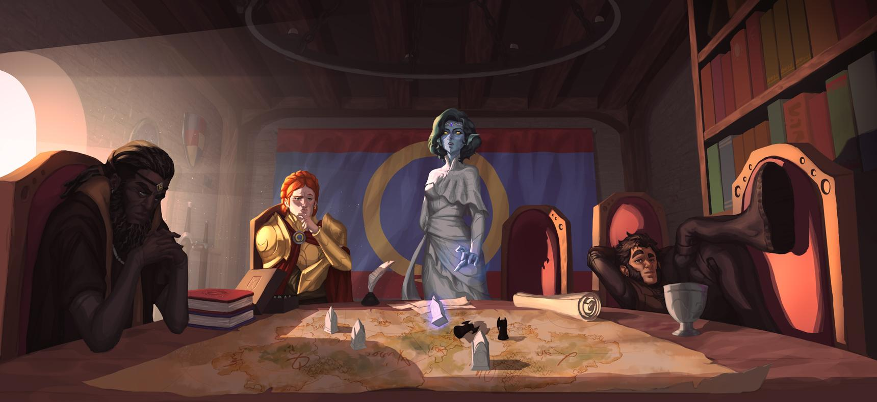
What is Turmoil in Thudor?
Turmoil in Thudor is a free, online module for D&D 5e devoted to creating environments for civil political discourse.
An original fantasy kingdom in
tumultuous times
Characters are members of
different political factions
New game mechanics and advice
to encourage political discussion

Slide 7
Project Components
The project exists in three components:
Website: Stores project’s resources and information publicly
Adventure: A “one-shot” that demonstrates how to play a Turmoil in Thudor-style game
Procedural Generator: Tool that randomly assigns character background traits unique to the project

Slide 8
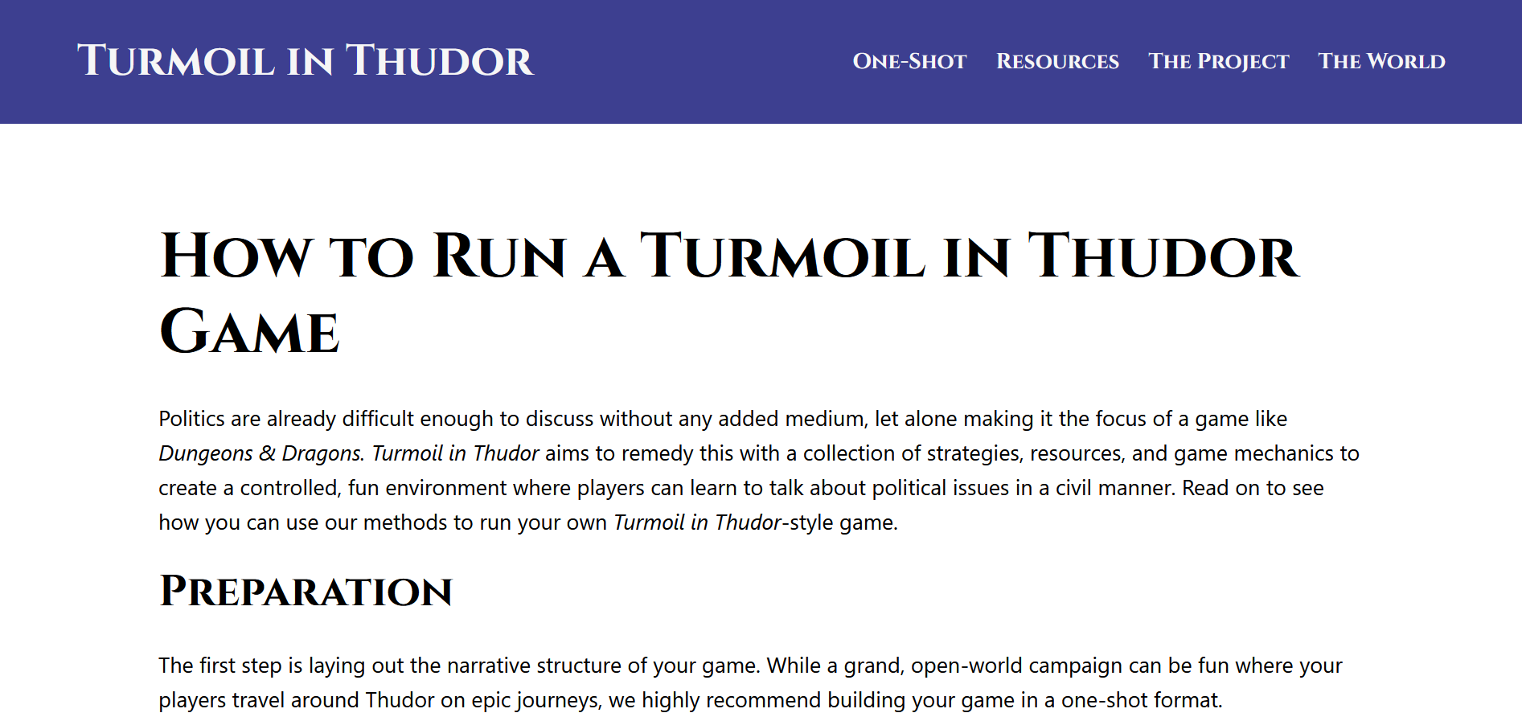
The Website
Created using WordPress. Hosts all the information/resources needed to run a Turmoil in Thudor game.
Pages:
One-Shot Download
Resources (articles,
mechanics, etc.)
Project Information
World/Setting Information

Slide 9
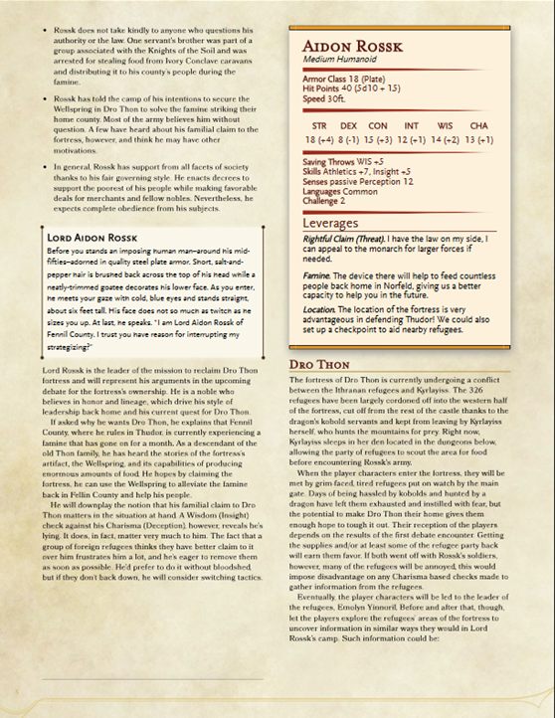
The Adventure
“Denizens of Dro Thon” has players mediate between refugees and a nobleman laying claim to an ancient fortress and the magical artifact inside.
Confronts issues of:
Refugee crises
Land disputes

Slide 10
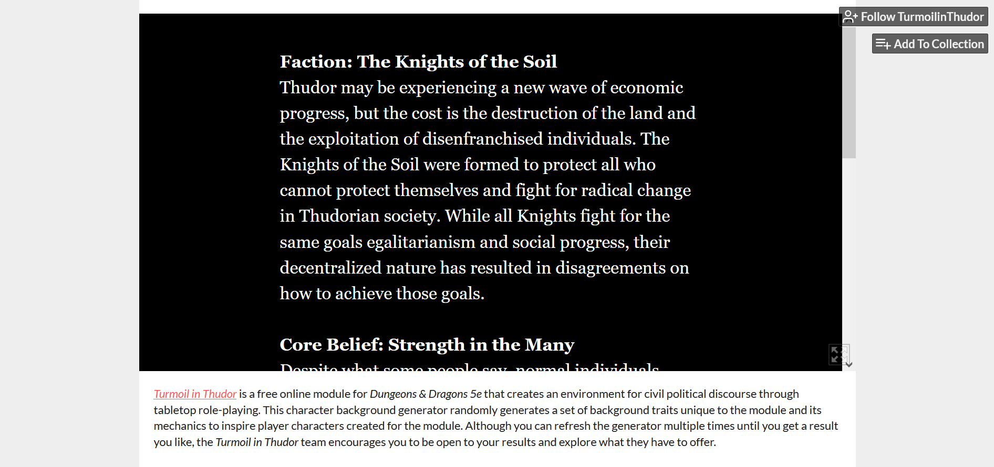
The Generator
Constructed with Twine, the character background generator assigns special background traits that can be used as inspiration when creating characters.
Faction alignment
Core belief
Leverage
Hosted on itch.io with links to
and from the website.

Slide 11
Sharing & Licensing
Turmoil in Thudor is licensed under a Creative Commons Attribution-NonCommercial-ShareAlike 4.0 International license.
People can:
Share the project in any medium
Adapt, transform, or build on the project
As long as:
They give appropriate credit
Don’t make money off of their work
Use the same license

Slide 12
Obstacles
Some obstacles inhibited the project from reaching its full potential:
Time constraints
Lack of playtesting
Late website deployment
Wordpress, Quest/Figma, back to Wordpress
Learning during COVID

Slide 13
Conclusion
In spite of the challenges, we succeeded in our goal of creating a module that teaches how to use RPGs to learn how to discuss politics in a civil manner.
The website’s status as a free, public resource, alongside its Creative Commons license, empowers users to utilize and add to the project’s contents to create their own games that further this purpose.

Slide 14
Special Thanks
Dr. Jessica Lieberman, Capstone Coordinator
Prof. David Simkins, Faculty Advisor
Dr. Michael Brown, Faculty Advisor
Tiago Pinheiro, Artist

Slide 15
Fin

