Slide 1
Secure Data Hiding in image Using Steganography
CAPSTONE PROJECT
Presented By: Ritesh Kumar
Student Name : Ritesh Kumar
College Name : G. P. Barauni, Begusarai
Department : Computer Science & Engg

Slide 2

OUTLINE
Problem Statement
Technology used
Wow factor
End users
Result
Conclusion
Git-hub Link
Future scope

Slide 3
PROBLEM STATEMENT
In the digital age, secure communication is a major concern. Traditional encryption methods are often detected, so we need a way to hide messages inside images without raising suspicion.

Slide 4
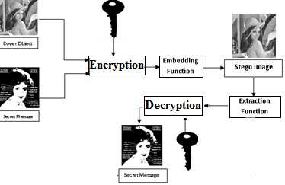
TECHNOLOGY USED
Django (Python Framework)
OpenCV (Image Processing)
NumPy (Handling Image Arrays)
HTML (Frontend - Structure)
CSS (Frontend - design)
OS (file open)
render (related for django)

Slide 5
WOW FACTORS
Uses Image Steganography to hide messages securely
Password protection for added security
Simple web-based interface for encoding and decoding messages
No external storage needed, as messages are hidden inside the image pixels

Slide 6





END USERS
Cybersecurity Enthusiasts
Secret Agencies
Government Officials
Journalists & Whistleblowers
Personal Users who want to secure their messages

Slide 7
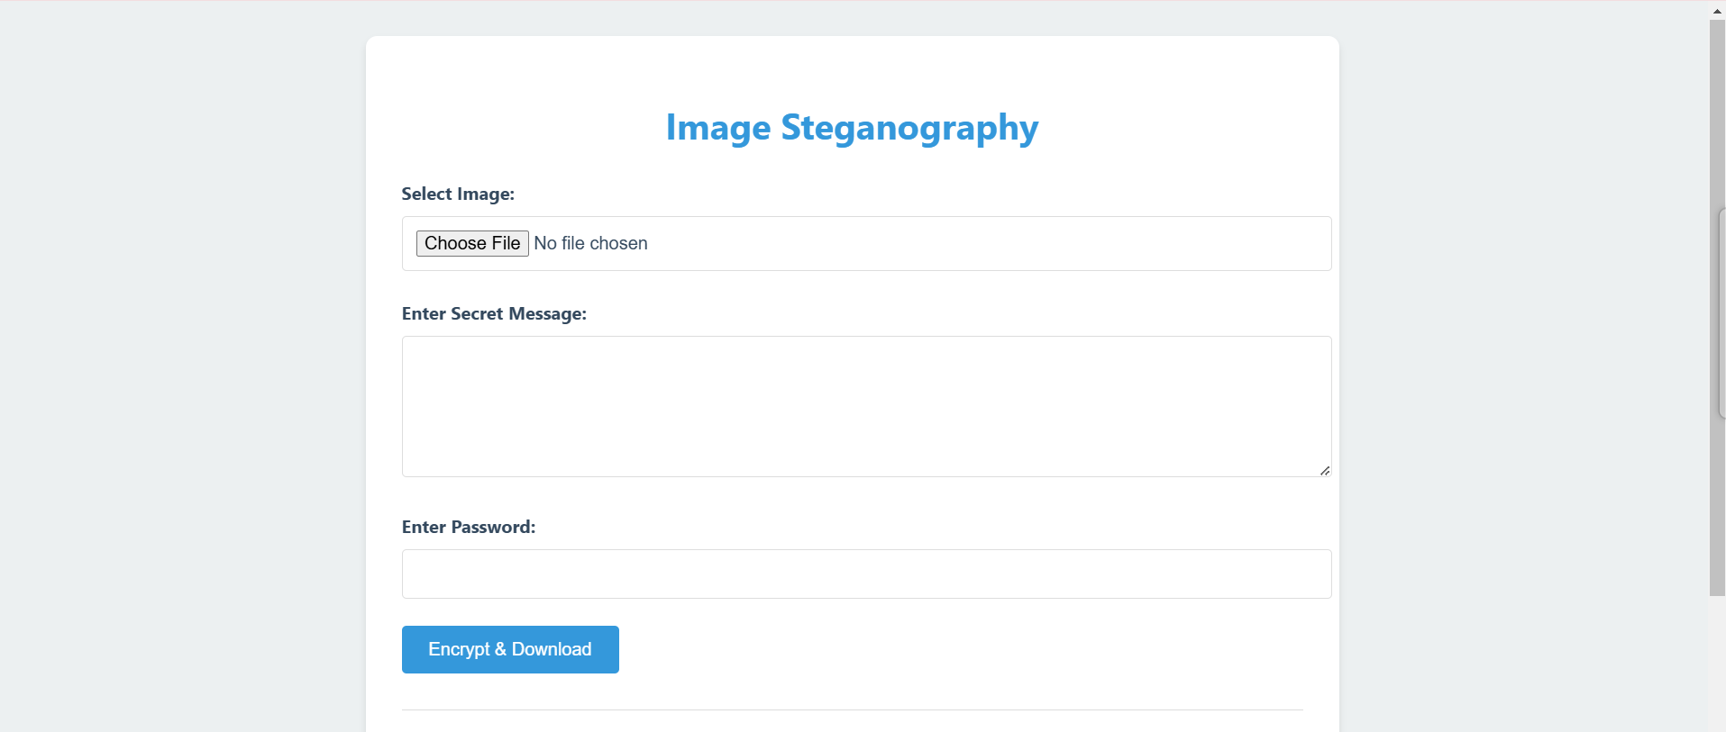
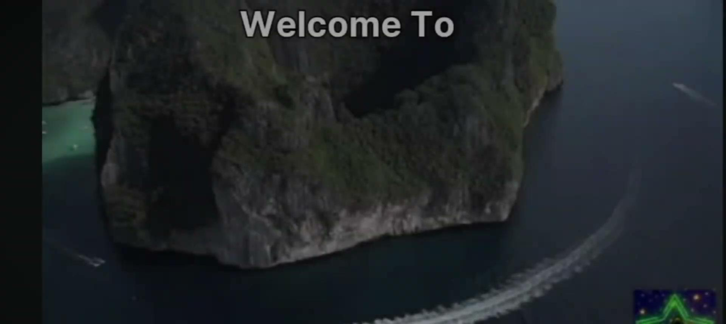
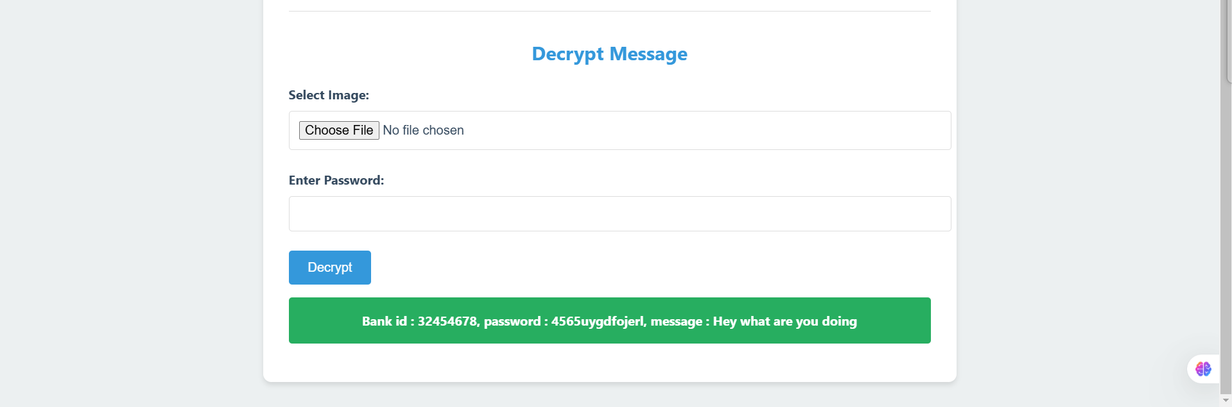
RESULTS

Slide 8
CONCLUSION
This project provides a secure and efficient way to hide sensitive messages inside images.
By using Django, OpenCV, and NumPy, it ensures data confidentiality while maintaining image integrity.
With a password-protected system, only authorized users can retrieve the hidden message, preventing unauthorized access.

Slide 9
GITHUB LINK
Link : https://github.com/RIT8603/steganography

Slide 10
FUTURE SCOPE
🚀 Stronger Encryption Algorithms – To further enhance security.
Support for Multiple Image Formats – (JPEG, BMP, etc.) for wider compatibility.
📲 Mobile App Integration – For easy steganography on smartphones.
🧠 AI-based Image Processing – To improve message hiding techniques.
🔄 Two-Way Communication – Hiding and retrieving messages across multiple images.

Slide 11
THANK YOU

