Slide 1

JBrick Project Reflection
(Spring 2011)
Abhishek Shrestha, Corey Cooney, Hugo Pilco,
Victor Alvarez

Slide 2
JAWS
  Tested with JAWS screen reader
  JAWS compatibility list document

Slide 3
New Architectures
  Piano Composer
  NXT Communication
  Joystick

Slide 4
Piano Composer
  Decomposition of Piano Composer (PianoComposite)
  Design patterns: Flyweight
  Before: A single file containing UI + model (>1000 LOC)
  After Redesign: 8 classes (max: 335)
  New Features:
    show more than 2 octaves
    start out with any Note
    mapping of keyboard character with music notes
    octave scale arrangement
      continuous
      block

Slide 5
NXT Communications
  Centralization of functionality for the Brick communication and connection polling
  Design patterns: Façade and Observer
  Enabled Download functionality
  Same underlying interface for compiling and downloading based on the same tool: nbc.exe
  Support for Brick disconnection
  Support for both USB and Bluetooth connections at the same time, but only one active at the moment
  Refactoring allowed us the introduction of unit testing

Slide 6
Joystick
  Decomposition of the Joystick dialog
  Design patterns: Mediator and Observer
  Before it was a single file with roughly:
    100 lines for Fields
    600 lines for GUI
    200 lines for polling
  Decomposed into roughly:
    11 different classes including GUI
    max 350 lines of code on a single file, including comments
  Refactoring allowed us the introduction of unit testing

Slide 7
Unit Testing
  Testing of some non-GUI classes
    NXT Communication classes
    Joystick-related classes
  JUnit
    Unit testing framework
  Mockito
    Mocking framework for Java
    Mock the connection to a brick
    Mock the connection to an Xbox360 controller
  Automation
    Integration with Ant
    Tests execution before packaging to JAR

Slide 8
SWT Testing
  SWTBot
  Marathon
  Abbot
  JFCUnit
  UISpec4J
  JUnit testing seems more viable
    A lightweight custom framework could make unit testing composites more manageable
    Handle finding and interacting with components

Slide 9
Bug fixes
  Go to window
    Single window instance of a widget composite
    GotoDialog should extend from TrayDialog.
  Find and Replace window
    Single window instance of a widget composite
    FindReplaceDialog should extend from TrayDialog.
  New line in the Editor
    Undo&Redo function should be executed after any space, no after an ENTER.

Slide 10
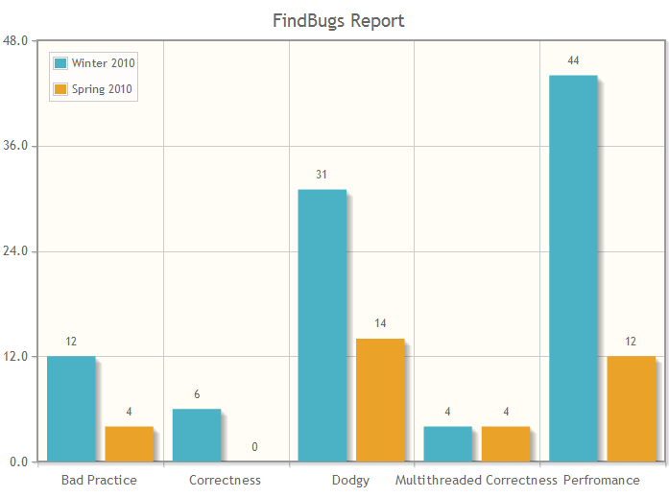
FindBugs Report

Slide 11
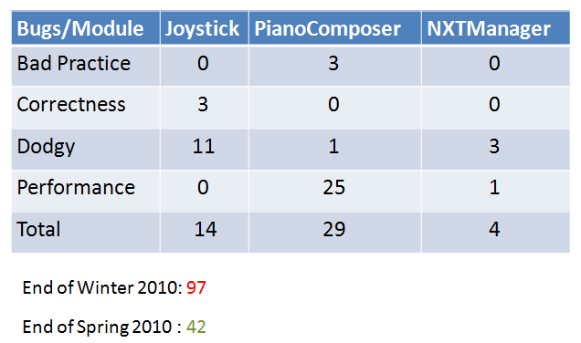
FindBugs Report Detailed

Slide 12
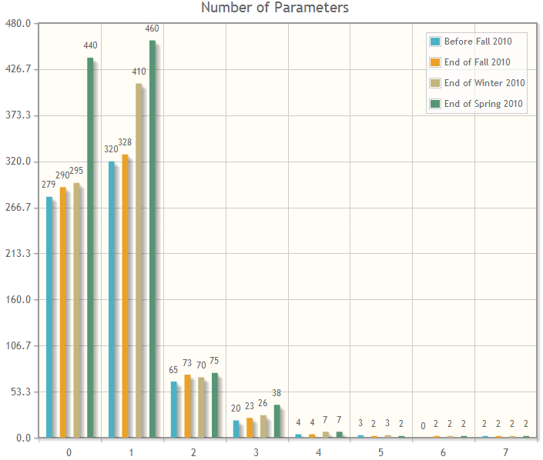
Metrics: Number of Parameters

Slide 13
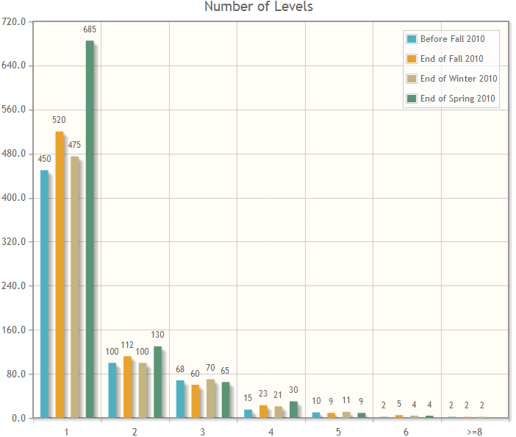
Metrics: Number of Levels

Slide 14
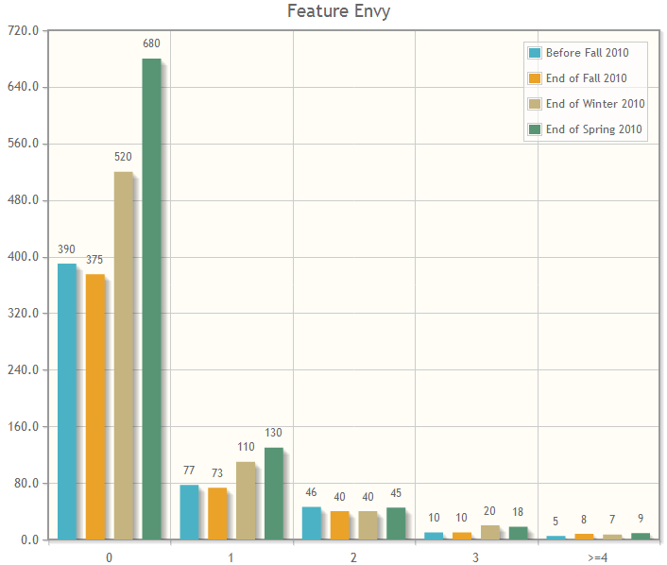
Metrics: Feature Envy

Slide 15
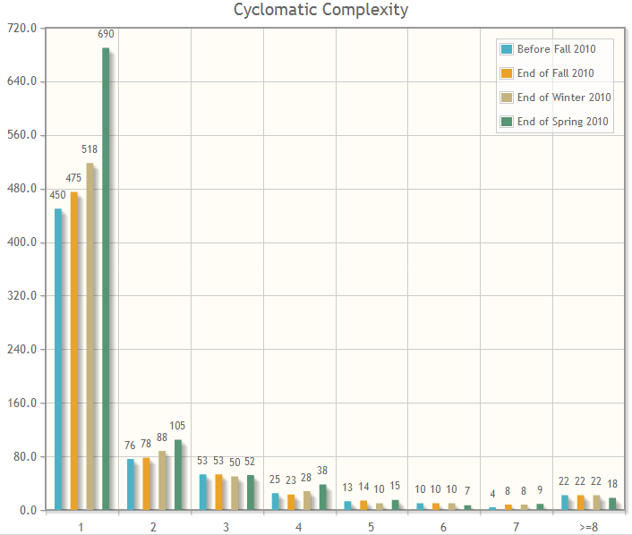
Metrics: Cyclomatic Complexity

Slide 16
Future Work
  Better JAWS integration
  GUI Testing with automation
  Auto-completion function in Jbrick Editor
  Easier way of connecting and disconnecting bricks
    With the support of both USB and Bluetooth connections, right now the GUI is not as easy to understand
  Due to the variety of Jbrick code, it would be interesting to use it for evaluating some reengineering tools like; Clone detection tools, Pattern detection tools, Java refactoring tools.

