Slide 1

JBrick Project Reflection
(Winter Qtr 2010-2011)
Abhishek Shrestha, Corey Cooney, Hugo Pilco,
Victor Alvarez
Notes:
We present our ugly template... whose idea was this?

Slide 2

Overview of Requirements: Iteration I
S.N.
Feature
Implemented By
1.
Compile Errors
Corey
2.
Remove dependency to the Main Window Class
Victor
3.
Remove dependency to the JBrickEditor class
Victor
4.
Opening single window instance for piano, joystick, find brick, and direct controller
Abhishek
5.
Allow compiling without saving first
Corey
6.
Fix refreshing of Editor on Preference Dialog close
Abhishek
7.
Improve Undo and Redo Functions
Hugo
8.
Compiling empty files
Hugo

Slide 3
Overview of Requirements: Iteration I
S.N.
Feature
Implemented By
9.
Update User Profile
Corey
10.
Undo Redo Shortcut
Hugo
11.
JBrick NXT Connection and State Management of related buttons
Abhishek
12.
Closing Save Bug
Corey
13.
Help Content – Stop Button – Bug
Hugo

Slide 4
Overview of Requirements: Iteration II
S.N.
Feature
Implemented By
1.
Keywords background color
Victor
2.
Color configuration
Victor
3.
Restore Defaults Button
Victor
4.
Brick connection polling
Abhishek
5.
Centralization of Connection module
Abhishek
6.
Piano - complete keyword
Hugo
7.
Piano Copy Button Functionality
Corey
8.
Piano Key Recording
Corey
9.
Piano Play and Clear Button Functionality
Corey

Slide 5
Overview of Requirements: Iteration II
S.N.
Feature
Implemented By
10.
Piano Help Button Functionality
Hugo
11.
Piano Save Button Functionality
Hugo
12.
Piano Rest Button Functionality
Hugo
13.
Change the line numbers font
Victor

Slide 6
Overview of Requirements: Iteration III
S.N.
Feature
Implemented By
1.
Fix the building process
Victor
2.
Fix the line number border width
Victor
3.
Centralize the tools path
Victor
4.
Single instance of HelpBrowser and MethodTemplates
Victor
5.
Replace Find brick and Direct Controller icons
Abhishek
6.
Fix detection of Fantom driver
Abhishek
7.
Fix Find Brick dialog
Abhishek
8.
Piano Help Button - Open Help at Piano Tutorial
Hugo
9.
Piano Play Button Causes Window to not Respond
Corey

Slide 7
Overview of Requirements: Iteration III
S.N.
Feature
Implemented By
10.
Piano Save Dialog
Hugo
11.
Piano Add NoteLength and WaitLength Form Fields
Corey
12.
Ensure Downloading Programs to Brick is Working
Corey
13.
Update Piano Help
Corey
14.
Help Browser stop button
Hugo

Slide 8
Role Assignment
Role
Team Member
Testing
Abhishek Shrestha
Project Management
Hugo Pilco
Design Architect
Victor Alvarez
Requirements
Corey Cooney

Slide 9
Challenges
  External Tools
  Testing
  Version Control Management

Slide 10
The External Tools
  nbc: The compiler for the NXC language has binaries for Windows, Linux and Mac OS X
    How does it compile the code?
      We're not sure
      BricxCC doesn't know either
      There's no file output
    It can download an NXC program to the Brick
      first compiles nxc file
      download only if compilation succeeds
    NeXTTool: Windows only
      So far we know it was used for the download function
    BrickTool: Windows only
      We think it's not used at all

Slide 11
Testing
  If a feature breaks, who is responsible for fixing it?
  If a bug is found and fixed, how do we notice some other feature was not broken in the process?
  The list of test cases is increasing drastically each quarter
  The lack of automatic testing makes it a cumbersome task

Slide 12
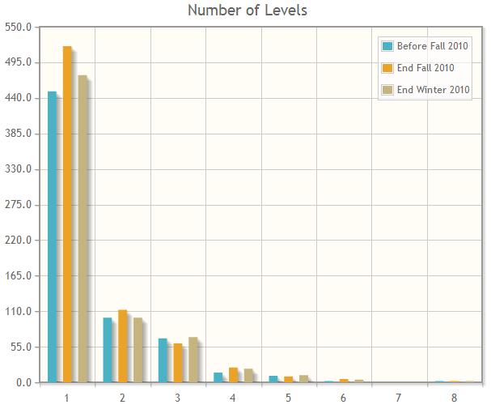
Metrics

Slide 13
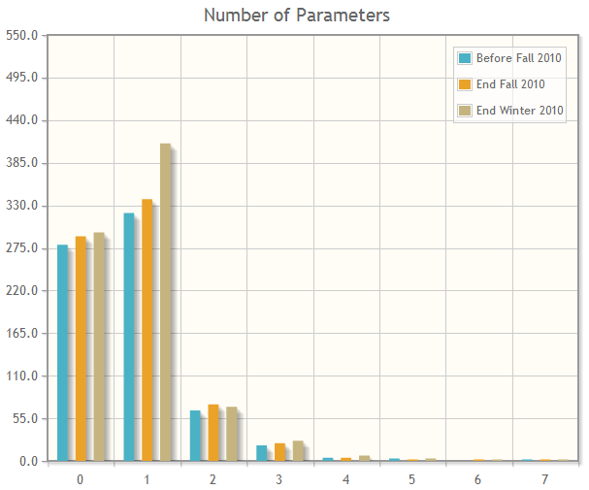
Metrics

Slide 14
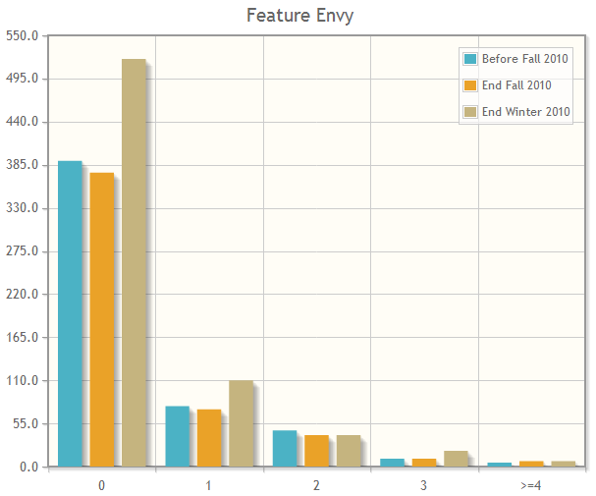
Metrics

Slide 15
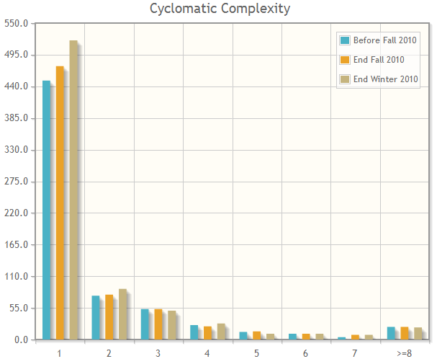
Metrics

Slide 16
Project Reflection
  Reflection
    moving from bug fixes to feature improvement
    documentation is getting better (organized?)
    a process for JBrick
  Features For Next Quarter
    focus on accessibility
    fix download
    work on Joystick and possibly Direct Controller

