Slide 1
Problem Statement: CrossSell_UpSell
Team: Professionals
Team Members:
Ramprasad | Jose | Ritesh
College: IIT Madras

Slide 2
Outline
Preprocessing
Rating Algorithm
ML Modelling
Final recommender

Slide 3
Preprocessing
Dropping rows with a floating point as order
Dates converted to timestamp
0 for HL delivered was considered as a missing value and is filled.
Only rows with delivery flag 1 are considered
HL delivered threshold of 200 is kept.
Item and user features filled. Unknown users and items are kept the same
All user-ids and item-ids are encoded using LabelEncoder.
We have 66557 rows after preprocessing

Slide 4
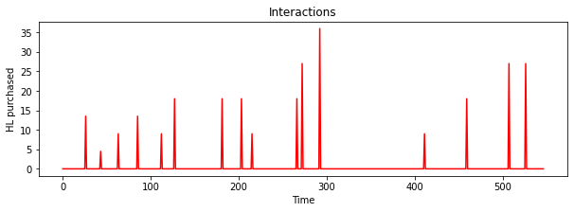
Rating Algorithm
Assumptions
Data of all purchases in the time period of users is given.
Items are available throughout the period.
How rating is calculated?
Spikes correspond to a purchase
Directly proportional to height of the spike. (HL purchased)
Inversely proportional to distance between two spikes. (number of days for the next purchase)
Normalized to the range of 0-1 for all users.
Score(1) = (1 height)/(1-2 distance).
Compute scores for all spikes.
For the last spike take the distance till latest date.
Rating = normalised(Average of scores of all spikes)
Spike 1
distance
Spike 2

Slide 5
ML Modelling
20%
Validation
20%
Validation strategy
First split – users are split, stratified with number of unique items purchased.
Second split – done for of each user separately based on their purchases.
80%
178 users 176 items
0.2517 sparse
Train
80%
We used 2 types of collaborative filtering models. (user based)
Variational Autoencoder Based Collaborative Filtering
Implemented with TensorFlow.
Based on neural networks.
Evaluated on
RNDCG – Ranked Normalized Discounted Cumulative Gain
MSE – Mean Square Error
PI – Personalization Index
Matrix Factorization Based Collaborative Filtering
Implemented with scikit-surprise.
Based on Funk SVD (Singular Value Decomposition).
Evaluated on
RNDCG – Ranked Normalized Discounted Cumulative Gain
MSE – Mean Square Error
PI – Personalization Index

Slide 6
Variational Autoencoder Based
176
176
Input
178x176
80
80
Output
178x176
40
sigmoid
RNDCG increased from 0.5→0.90
MSE decreased from 0.25→0.057
PI increased from 0→0.155
Reparameterization trick
Input is the user-item interaction matrix with -1 for non-interacted user-item pair and (0-1) rating for interacted pair.
Output is the predicted rating for all user-item pairs.
Trained with MSE loss and evaluated on validation dataset based on RNDCG metric.
MSE loss for only interacted items are taken.
200 epochs with an early stopping of 10.
Adam optimizer, learning rate →0.01

Slide 7
Non-Negative Matrix Factorization Based
B
RNDCG increased from 0.5→0.88
MSE decreased from 0.25→0.055
PI increased from 0→0.724
A
C
178x176
10x176
Find the latent vectors such that their cross product gives the user-interaction matrix.
n_factors of 10 is used.
10 epochs of gradient descent was done.
Trained on Funk-SVD loss which only considers MSE loss of interacted items and ignores non-interacted.
A X B = C
178x10
Given C, find A and B

Slide 8
Which model to choose?
Why did we work with both of these models? Why 2 not one?
VAE was benchmarked to be better for MSE
NMF was benchmarked for better personalization
Why not combine both?
RNDCG increased from 0.5→0.90
MSE decreased from 0.25→0.057
PI increased from 0→0.155
RNDCG increased from 0.5→0.88
MSE decreased from 0.25→0.055
PI increased from 0→0.724
Variational Autoencoder
Based Collaborative Filtering
Non-negative Matrix factorization Based Collaborative Filtering
Both have similar RNDCG and MSE metrics.
NMF model has much better personalization score than VAE model.

Slide 9
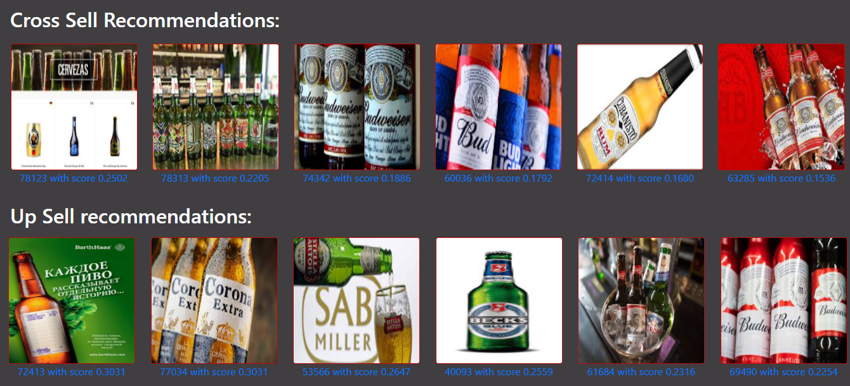
Our Hybrid Recommender
The different types of recommendations given are as follows:
Cross Sell Recommendations
Upsell Recommendations
User History Based Recommendations
Popularity based Recommendation
Item Content Based Recommendations
Screenshot from our User-Interface

Slide 10
Cross-sell Recommendations
Recommends products that has not yet been ordered by the user but has a high predicted rating.
For the given user, the items with the highest rating which has not been purchased yet is recommended.
The user will be most likely to buy this product compared to other non-interacted products.
VAE Model
NMF Model
0.1
+
0.9
Final model
Final RNDCG increased from 0.5→0.88
Final MSE decreased from 0.25→0.065
Final PI increased from 0→0.624

Slide 11
Other Recommendations
User History Recommendations (user based)
Sorted in decreasing value of ratings of interacted it.
Gives the products which the user likes based on the history.
Upsell recommendations (user based)
Using cosine similarity.
Given the user’s favourite products, similar products are found out using the item features.
Recommended if we see an upsell chance comparing the MACO/HL costs.
MACO/HL assumed for the ones not given.
Done only for products where item features are given
Content Based Matching (item)
Gives the products that has higher similarity scores when compared with all of the user’s favourite products.
The favourite products are the ones given by user history recommendations.
Popularity based
The total number of transactions for each item is considered and the item included in most transactions is considered to be more popular.

Slide 12
Our User Interface (Flask app on local server)
Getting recommendations for a given user.
Feedback on why the product was recommended for the sales team and additional insights.
Option to add new sales.
Option to retrain based on the new sales added. (end-end pipeline)

Slide 13


