Slide 1

VALOR
Premium Men's Fashion Shopping Application
Institute of Technology of Cambodia (ITC) Introduction to Mobile Application Development Instructor: Mr. HOK TIN • Class: I4-GIC-C RIN NAIRITH (e20221557) CHHUM PANHA (e20220815) github.com/rith-1437/valor

Slide 2
01 — THE CHALLENGE
Problem Statement
✕
◷
$
Fragmented Experience
Lack of Personalization
Style & Budget Gap
Premium menswear scattered across many platforms
No tailored sizing or style guidance for individuals
Hard to balance taste, fit, and price in one place
VALOR • Premium Men's Fashion
2 / 15

Slide 3
02 — OBJECTIVES
Project Objectives
01
Build a cross-platform Flutter app for premium men's fashion
02
Provide AI-powered size recommendation and styling
03
Integrate real-time chat, booking, and nearby store locator
04
Deliver seamless UX with dark mode and responsive design
VALOR • Premium Men's Fashion
3 / 15

Slide 4
03 — OVERVIEW
Project Overview
VALOR is a luxury fashion super-app crafted for the modern man who values premium style, personalization, and convenience — all in one place.
iOS + Android
Flutter
Laravel
Luxury
Cross-platform
Mobile Framework
Backend Engine
Brand Positioning
VALOR • Premium Men's Fashion
4 / 15

Slide 5
04 — FEATURES
System Features
◆
Home
◆
Categories
◆
Product Detail
◆
Wishlist
◆
Cart
◆
Checkout
◆
Reviews
◆
AI Size Rec.
◆
AI Stylist
◆
Promotions
◆
Booking
◆
Chat
◆
Nearby Stores
◆
Store Locator
◆
Lookbook
◆
Dark Mode
◆
Responsive
VALOR • Premium Men's Fashion
5 / 15

Slide 6
05 — STACK
Technology Stack
FRONTEND
BACKEND
Mobile Application
Server & Database
▸ Flutter
▸ Dart
▸ Laravel
▸ PHP
▸ Material 3
▸ Riverpod
▸ JWT Auth
▸ REST API
▸ go_router
▸ SharedPreferences
▸ MySQL
▸ Eloquent ORM
VALOR • Premium Men's Fashion
6 / 15

Slide 7
06 — ARCHITECTURE
System Architecture
Flutter App
Riverpod
Repository
REST API
Laravel
MySQL
▶
▶
▶
▶
▶
UI Layer
State Management
Data Layer
HTTP / JWT
Backend Service
Database
Bi-directional data flow with JWT-secured REST communication
VALOR • Premium Men's Fashion
7 / 15

Slide 8
07 — DATA MODEL
Database ER Diagram
Product Images
Users
Categories
Products
Product Sizes
Addresses
Product Colors
Wishlist
Reviews
Orders
Payments
Cart
Cart Items
VALOR • Premium Men's Fashion
Order Items
8 / 15

Slide 9
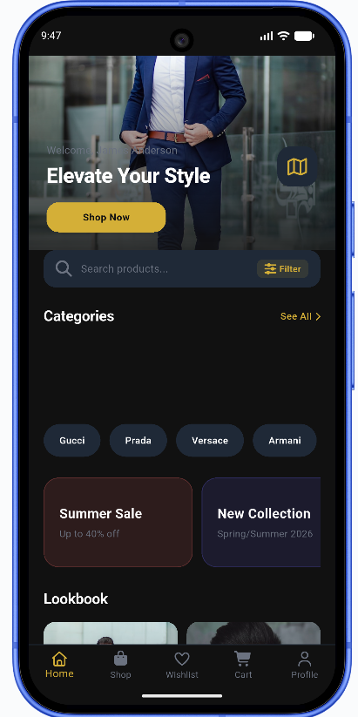
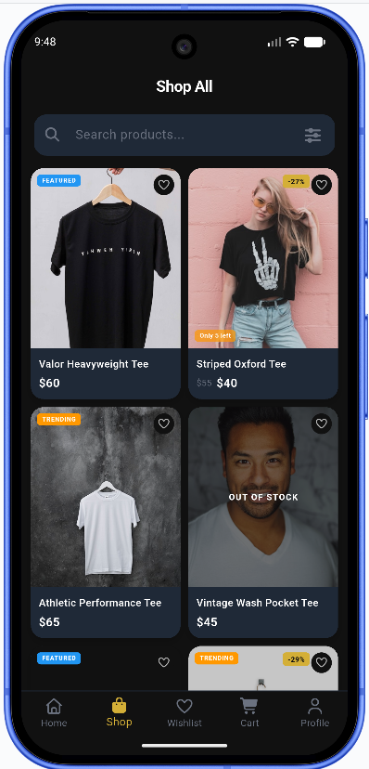
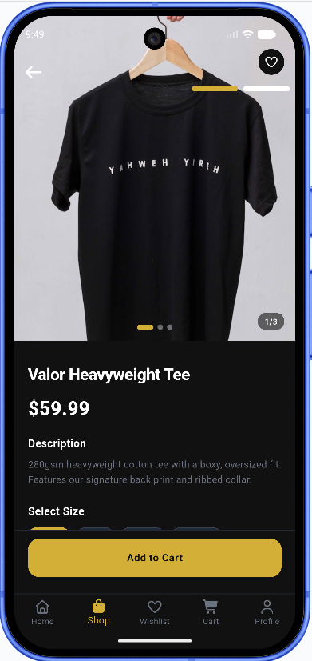
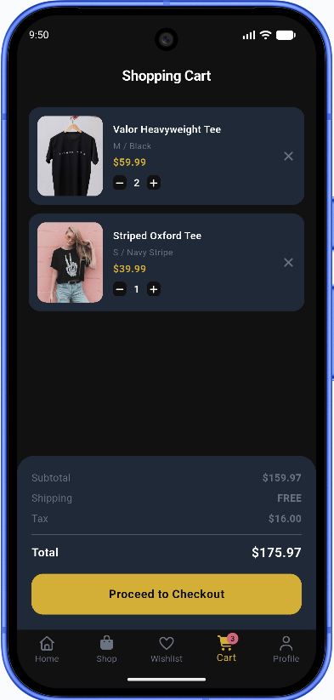
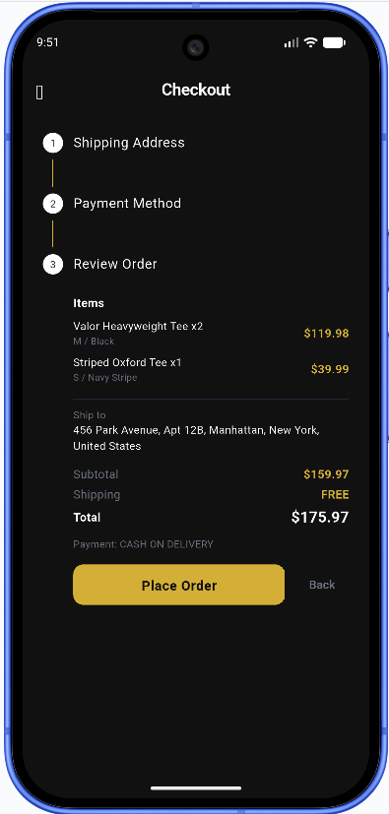
08 — DESIGN
UI Showcase
Home
Listing
Detail
Cart
Checkout
VALOR • Premium Men's Fashion
9 / 15

Slide 10
09 — BONUS
Backend REST API
⚡ Exceeds assignment requirements with a full Laravel REST backend
Endpoint
Method
Description
/api/auth
POST
Login, register, JWT issuance
/api/products
GET
Product catalog & filtering
/api/cart
GET/POST
Manage user cart items
/api/wishlist
GET/POST
User wishlist sync
/api/orders
GET/POST
Order placement & history
/api/reviews
GET/POST
Product reviews & ratings
/api/payments
POST
Payment transactions
VALOR • Premium Men's Fashion
10 / 15
🔐 Secured with JWT Authentication • Built on Laravel + MySQL

Slide 11
10 — JOURNEY
Challenges & Solutions
⚠ State management complexity
→
✓ Adopted Riverpod for scalable, testable state architecture
⚠ Backend integration
→
✓ Repository pattern abstracting REST API calls
⚠ AI feature implementation
→
✓ Integrated AI recommendation engine for sizing & styling
⚠ Responsive UI across devices
→
✓ Material 3 adaptive design with breakpoints
VALOR • Premium Men's Fashion
11 / 15

Slide 12
11 — ROADMAP
Future Improvements
01
02
03
AR Try-On
Loyalty Rewards
Multi-Vendor
Virtual fitting through device camera
Points, tiers, and exclusive perks
Marketplace for premium boutiques
04
05
Style Community
Push Notifications
Social sharing & curated lookbooks
Drops, restocks, and order updates
VALOR • Premium Men's Fashion
12 / 15

Slide 13
12 — DELIVERABLES
Requirement Checklist
CORE FEATURES
BONUS ✦
✓ Categories
✓ Wishlist
✓ Map
★ Laravel Backend
✓ Nearby
✓ Promotions
✓ Booking
★ JWT Authentication
✓ Chat
✓ Reviews
✓ Photos & Videos
★ REST API
✓ Responsive
✓ Dark Mode
✓ SharedPreferences
★ MySQL Database
✓ Riverpod
✓ go_router
✓ Material 3
★ AI Features
13 / 15
VALOR • Premium Men's Fashion

Slide 14
13 — REFLECTION
Conclusion
VALOR is a complete, production-ready luxury fashion app — bridging elegant mobile UX with a robust backend engine.
WHAT WE LEARNED
◆
Flutter development
◆
State management with Riverpod
◆
Responsive UI design
◆
Backend integration
◆
REST API development
◆
Team collaboration
14 / 15
VALOR • Premium Men's Fashion

Slide 15
THANK YOU
Questions?
github.com/rith-1437/valor
RIN NAIRITH • CHHUM PANHA — Institute of Technology of Cambodia

