Slide 1

PANIMALAR ENGINEERING COLLEGE
Department of Electronics and Communication Engineering
21EC1811 - Project Work – 2025-2026
AI- POWERED MULTI-OBJECTIVE INVERSE DESIGN OF RF MICROSTRIP FILTERS
GUIDED BY: N.PRITHA , DEPARTMENT OF ECE , PANIMALAR ENGINEERING COLLEGE ,CHENNAI
PRESENTED BY :
ANUSRIPRIYA S [211422106039]
HINDUJAA K P [211422106162]
ABINAYA G [211422106004]

Slide 2
INTRODUCTION
The Challenge: Traditional wideband microstrip filter design relies on repeated, iterative electromagnetic (EM) simulations.
The Problem: This conventional "forward design" process is time-consuming, labor-intensive, and requires significant computational effort.
The Solution: A real-time “Inverse Design” technique using Deep Neural Networks (DNN) and Edge AI.
Key Advantage: Enables instantaneous synthesis of filter geometry based on user-specified spectral requirements.

Slide 3
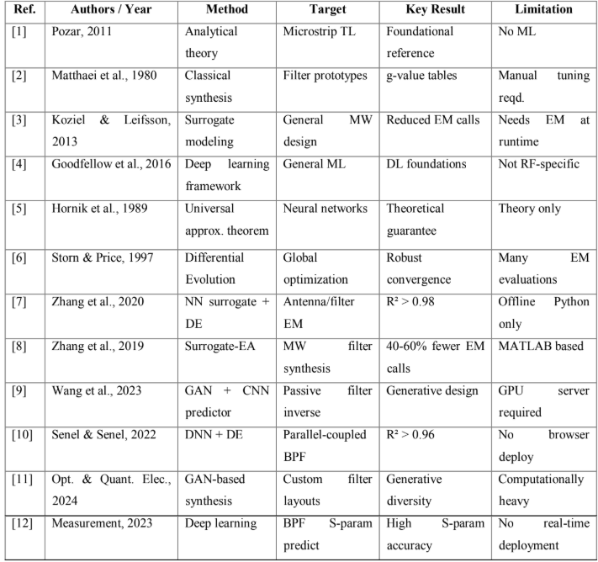
LITERATURE SURVEY

Slide 4
PROJECT OUTCOMES (POS)
PO1: Apply the knowledge of engineering fundamentals to identify and solve complex problems.
PO2: Design and develop effective solutions with consideration for societal and environmental aspects.
PO3: Conduct investigations using research-based methods, data analysis, and interpretation to draw valid conclusions.
PO4: Use modern tools and technologies for modeling, simulation, and implementation of solutions.
PO5: Communicate effectively in technical and professional contexts through reports, presentations, and documentation.

Slide 5
SDG’s
SDG 9 – Industry, Innovation and Infrastructure
Build resilient infrastructure, promote sustainable industrialization, and foster innovation.
SDG 12 – Responsible Consumption and Production
Ensure sustainable consumption and production patterns.

Slide 6
PROPOSED SYSTEM FRAMEWORK
Inverse Modeling Approach: Inputs: Performance parameters like Center Frequency (fc) and Bandwidth (BW).
Outputs: Predicted geometric parameters: Length (L), Width (W), and Spacing (S).
Filter Architecture: Ultra-wideband band-pass design using multi-mode resonators, coupled lines, and shunt quarter-wave impedance transformers.
Hardware Efficiency: Deployment on Edge AI platforms using ONNX Runtime Web for browser-level execution

Slide 7
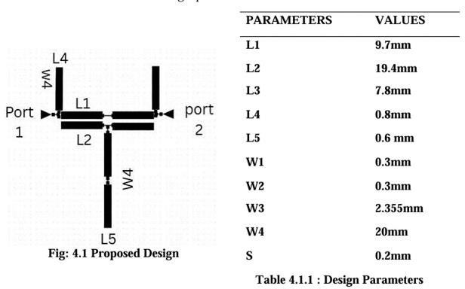
PROPOSED DESIGN

Slide 8
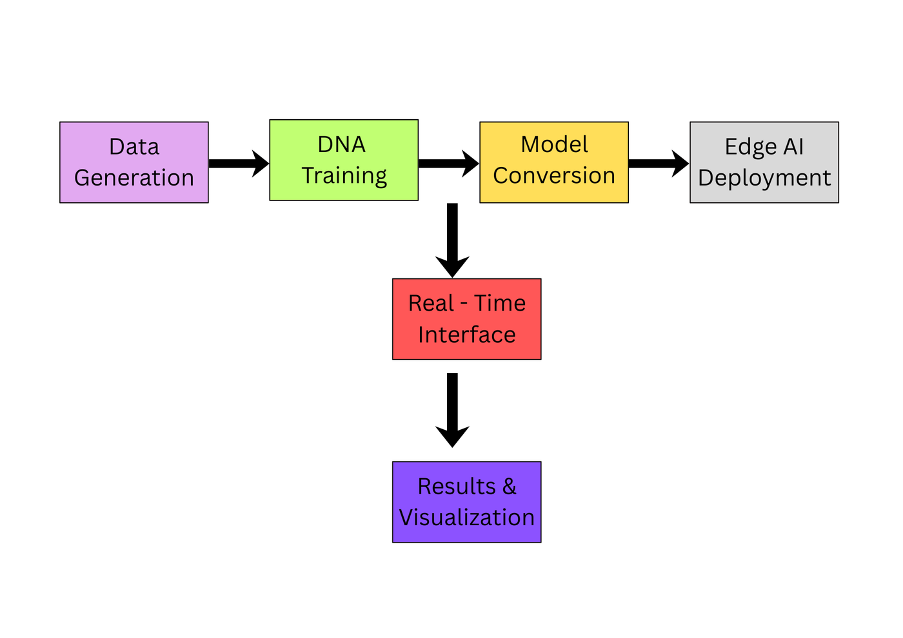
SYSTEM ARCHITECTURE

Slide 9
METHODOLOGY & IMPLEMENTATION
Stochastic Data Generation: Created a physics-informed dataset of 10,000 samples for Rogers 4350B substrate using Python scripts.
Feature Engineering: Applied Z-Score Normalization to ensure numerical stability across different parameter scales.
Model Architecture: Deep MLP using PyTorch.
Three hidden layers (64, 128, 64 neurons) with ReLU activation.
Trained for 100 epochs using the Adam optimizer.
Serialization: Exported the model to ONNX format for cross-platform compatibility.

Slide 10
EXPERIMENTAL RESULTS
High Accuracy: Achieved a total Mean Squared Error (MSE) of 9.1 Xtimes 10^{-5}.
Correlation: R-Squared (R^2) values for L, W, and S were all above 0.995, indicating the model explains almost all variance.
Physical Consistency: Validated that predicted length (L) decreases as center frequency increases, adhering to quarter-wave resonance .
reallygreatsite.com

Slide 11
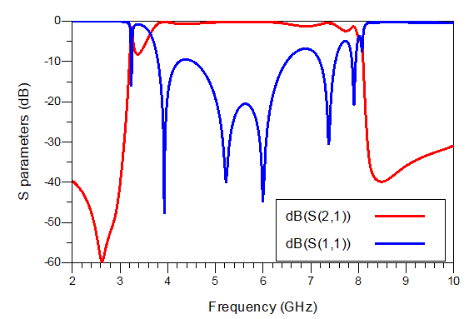
ANALYSIS

Slide 12
EDGE AI DEPLOYMENT & PERFORMANCE
Paradigm Shift: Moving from Cloud-based AI to Client-Side Edge Inference.
Model Serialization: Conversion of PyTorch MLP model to ONNX (Open Neural Network Exchange) format.
Inference Engine: Integration with ONNX Runtime Web via WebAssembly (WASM).
Secure Context: Implementation of COOP/COEP headers to enable hardware acceleration.
Zero-Dependency: No requirement for external Python environments or licensed EM software (CST/HFSS) at runtime.

Slide 13
REAL-TIME INFERENCE PERFORMANCE
Hardware Configuration | Inference Latency
Desktop (High-End GPU) | 4–7 ms
Laptop (Standard CPU) | 12–18 ms
Mobile (Smartphone Browser) | 25–40 ms

Slide 14

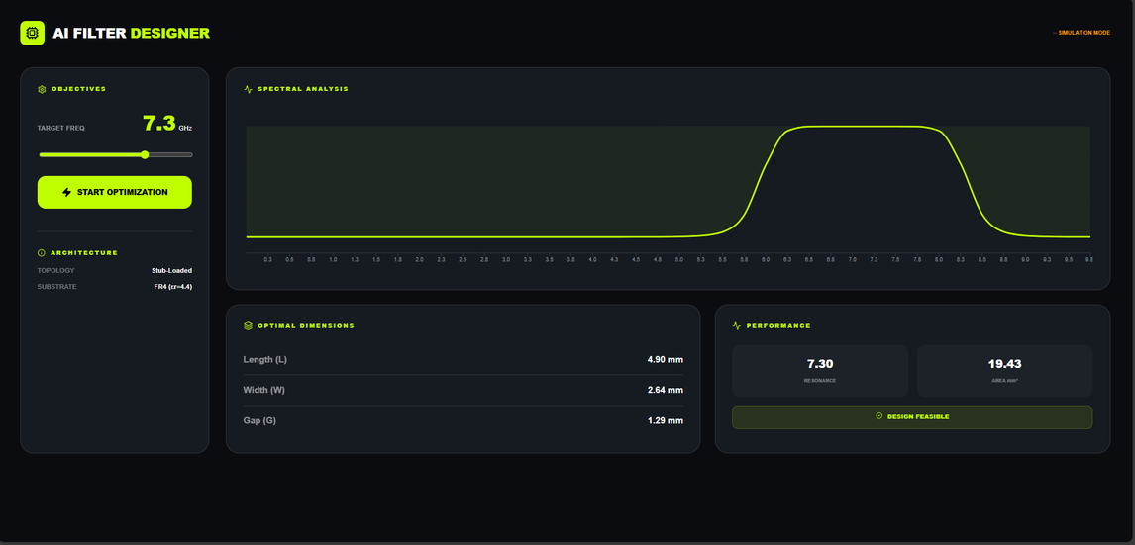
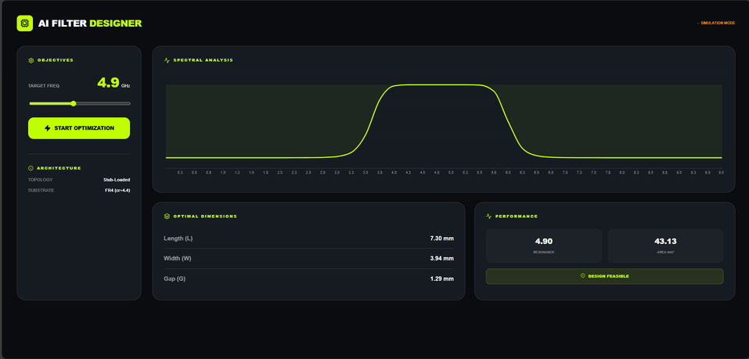
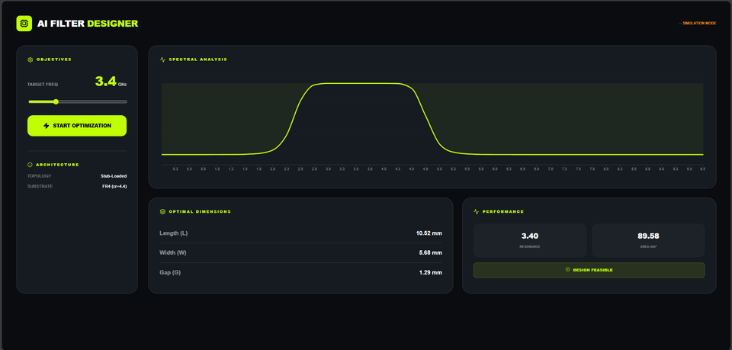
OUTPUT VISUALIZATION OF INVERSE DESIGN FRAMEWORK

Slide 15
MODEL PERFORMANCE METRICS
Parameter | Mean Absolute Error (MAE) | R-Squared (R2)
Length (L) | 0.012 mm | 0.998
Width (W) | 0.008 mm | 0.997
Spacing (S) | 0.003 mm | 0.995
Total Model | 9.1 × 10−5 (MSE) | 0.997

Slide 16
CONCLUSION
Summary of Achievements
We successfully developed an AI-Powered Inverse Design Synthesizer that transforms a complex, weeks-long engineering task into an instantaneous process.
The core achievement was implementing pre-trained ANNs that accurately learned the complex physics of microstrip filters.
The final interactive application serves as a powerful proof-of-concept, validating that AI can be used for direct, real-time synthesis of complex RF components.
Key Takeaway
This project demonstrates a significant acceleration of the RF design cycle, reducing it from days to mere seconds.

Slide 17
REFERENCES
[1] D. M. Pozar, Microwave Engineering, 4th ed. Hoboken, NJ, USA: Wiley, 2011.
[2] G. L. Matthaei, L. Young, and E. M. T. Jones, Microwave Filters, Impedance-Matching Networks, and Coupling Structures. Dedham, MA, USA: Artech House,
1980.
[3] S. Koziel and L. Leifsson, Simulation-Driven Design Optimization and Modeling for Microwave Engineering. London, U.K.: Imperial College Press, 2013.
[4] I. Goodfellow, Y. Bengio, and A. Courville, Deep Learning. Cambridge, MA, USA: MIT Press, 2016.
[5] K. Hornik, M. Stinchcombe, and H. White, “Multilayer feedforward networks are universal approximators,” Neural Networks, vol. 2, no. 5, pp. 359–366, 1989.
[6] R. Storn and K. Price, “Differential evolution—A simple and efficient heuristic for global optimization over continuous spaces,” Journal of Global Optimization, vol. 11, no. 4, pp. 341–359, 1997.
[7] J. Zhang, M. Liu, and Q. J. Zhang, “Machine learning based surrogate modeling for electromagnetic design,” IEEE Trans. Antennas Propag., vol. 68, no. 7, pp. 5183–5194,
2020.

Slide 18
REFERENCES
[8] X. Zhang, Y. Jin, and J. Cheng, “Surrogate-assisted evolutionary optimization of microwave filters,” IEEE Trans. Microw. Theory Techn., vol. 67, no. 6, pp. 2350–
2363, 2019.
[9] H. Wang et al., “Inverse design methodology for passive microstrip filters using generative adversarial networks and CNN predictors,” J. Electromagn. Waves Appl., 2023.
[10] M. Senel and F. Senel, “Parallel-coupled microstrip bandpass filters using DNN surrogate models and differential evolution,” Int. J. RF Microw. Comput.-Aided
Eng., 2022.
[11] “Generative AI and GAN architectures for customized filter layouts,” Optical and Quantum Electronics, 2024.
[12] “Deep learning application in bandpass filter optimization for S-parameter accuracy,” Measurement, 2023.

Slide 19
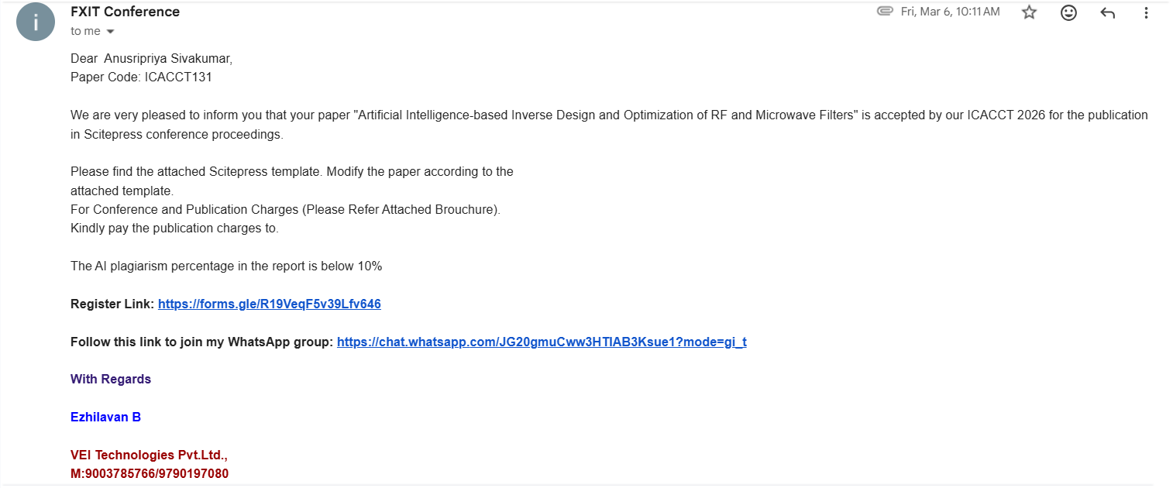
APPENDIX 1

Slide 20

APPENDIX 2

Slide 21
https://zingy-sherbet-a4f08c.netlify.app/

Slide 22
THANK YOU

