Slide 1


MECLABS
Bring your ideas to life today

Slide 2
"The process is not an event, it's a journey. And the journey is where the real value lies." - Jen Louden

Slide 3
Smart Street Illumination System
A Smart Street Illumination System for efficient energy capture and utilization for a sustainable future.

Slide 4




𝙇𝙀𝘼𝙂𝙐𝙀22 ⚡
NAME OF TEAM MEMBER | PHONE NUMBER | EMAIL ID | PHOTO
ABHISHEK PAVITHRAN | +91 73562 73612 | abhishekpavithranth.mec@gmail.com
RITHICK R KUMAR | +91 6238293832 | rithickrkumar.mec@gmail.com
ASWIN K SUNIL | +91 82899 07278 | aswinksunil.mec@gmail.com
AKASH JOSHI | +91 98461 25652 | akashjoshi.mec@gmail.com

Slide 5
SMART STREET ilLUMINATION SYSTEM (SSLS)
The Smart Street Illumination System (SSLS) is an intelligent lighting solution for public streets and roadways. It utilizes advanced technology to provide efficient and effective illumination, while maximizing energy production and reducing the overall carbon footprint.
The SSLS incorporates sensors such as ambient light sensors which are used to detect the intensity level of natural light. This information is then used to adjust the direction of the solar panel accordingly to ensure the efficient production of energy.

Slide 6
The system can also be equipped with wireless communication technology, allowing for remote monitoring. This enables maintenance teams to quickly identify and address any issues that may arise due to faulty components.
Overall, the SSLS is a cost-effective and environmentally friendly solution for public lighting that can improve efficiency and maximize energy production.

Slide 7
Total Expenditure
Component | Quantity | Cost (Rs)
Arduino Uno | 1 | 450
Servo Motor | 2 | 300
LDR | 4 | 25
Solar Panel | 1 | 140
Jumper Wires | 10 | 40
Resistors | 4 | 10
Breadboard | 1 | 80
Dual axis gimbal | 1 | 485
Total amount |  | 1530

Slide 8
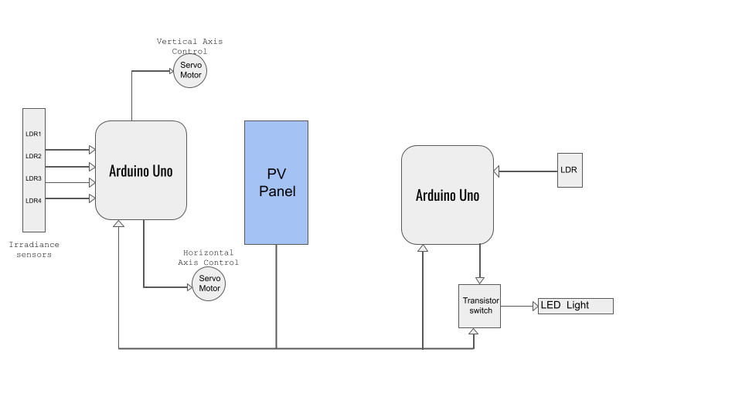
Overall BLOCK DIAGRAM

Slide 9
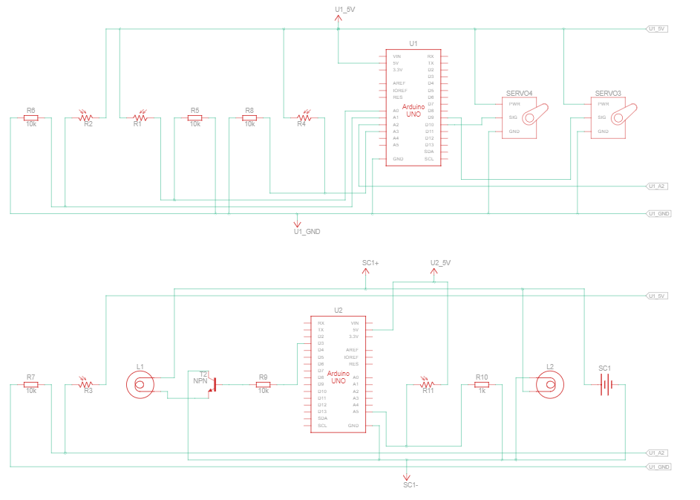
OVERALL SCHEMATIC

Slide 10
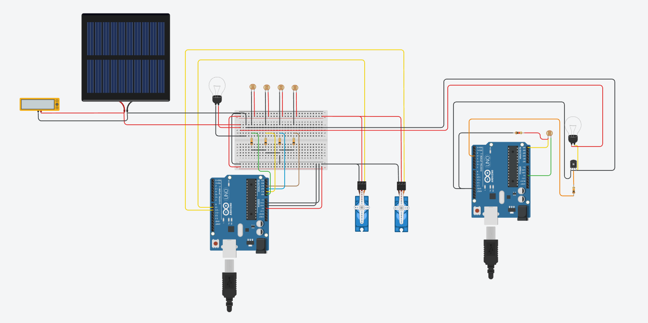
OVERALL TINKERCAD CIRCUIT

Slide 11
For better understanding, we have divided the project into 2 parts:
Automatic streetlight
Sun tracking solar panels

Slide 12
1. AUTOMATIC STREETLIGHT
An automatic streetlight utilizes the Arduino microcontroller board to automate the switching of street lights based on the ambient light levels. This project is designed to maximize energy production when compared to traditional street lighting systems.
The basic concept of an automatic streetlight system is to turn “on” the streetlights automatically when it gets dark and turn them “off” when the sun rises. The system works by sensing the ambient light levels using a light-dependent resistor (LDR) and triggering a transistor to turn “on” or “off” the streetlights based on the light levels.

Slide 13
COMPONENTS USED
Arduino board (e.g., Arduino Uno)
Light-dependent resistor (LDR)
NPN Transistor
LED lights
Resistors
Jumper wires
Breadboard
9V battery or power supply

Slide 14
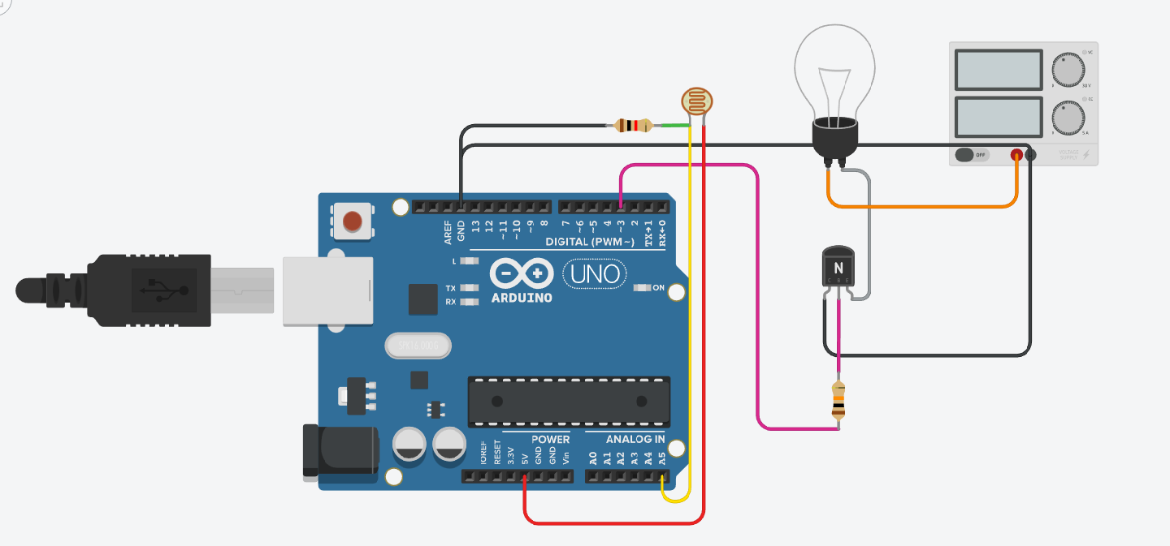
TINKERCAD MODEL

Slide 15
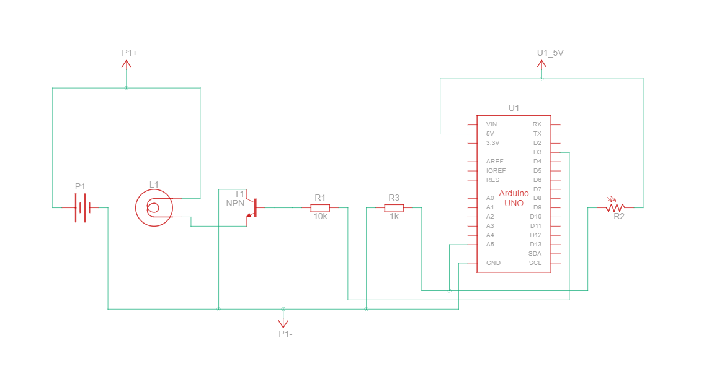
CIRCUIT DIAGRAM

Slide 16
WORKING
The automatic streetlight system here works by measuring the intensity of ambient light of the surroundings and turning on the street lighting system when the ambient light falls below a particular level of intensity.
This process is done using the LDR to receive the light input’s electrical analog and the Arduino provides a signal to the street lighting system to turn it “on”.

Slide 17
2. SUN TRACKING SOLAR PANELS
A sun tracker is a device used in SSLS to automatically align the solar panels or arrays with the sun to maximize its exposure to sunlight throughout the day. This allows the solar panels to capture the maximum amount of sunlight to generate more energy and increases its efficiency.
A sun tracker typically consists of a mechanical structure that supports the solar panel and a control system that adjusts the position of the solar panel in response to the movement of the sun. The control system uses sensors and motors to move the solar panel and keep it aligned with the sun as it moves across the sky.

Slide 18
There are two main types of sun trackers: single-axis and dual-axis. Single-axis trackers move the solar panel in one direction to track the sun's east-to-west movement, while dual-axis trackers move the panel in two directions to track both the east-to-west and north-to-south movement of the sun. Dual-axis trackers are more efficient than single-axis trackers but are also more complex and expensive.
Sun trackers can significantly increase the energy output of a solar panel or array, typically by 25% to 40% depending on the location and weather conditions. They are especially useful in areas with high latitudes or variable weather conditions, where the angle and intensity of sunlight change rapidly throughout the day.

Slide 19
COMPONENTS USED
Arduino board (e.g., Arduino Uno)
Light-dependent resistor (LDR)
Servo Motors
Resistors
Solar Panel
Jumper wires
Breadboard
9V battery or power supply

Slide 20
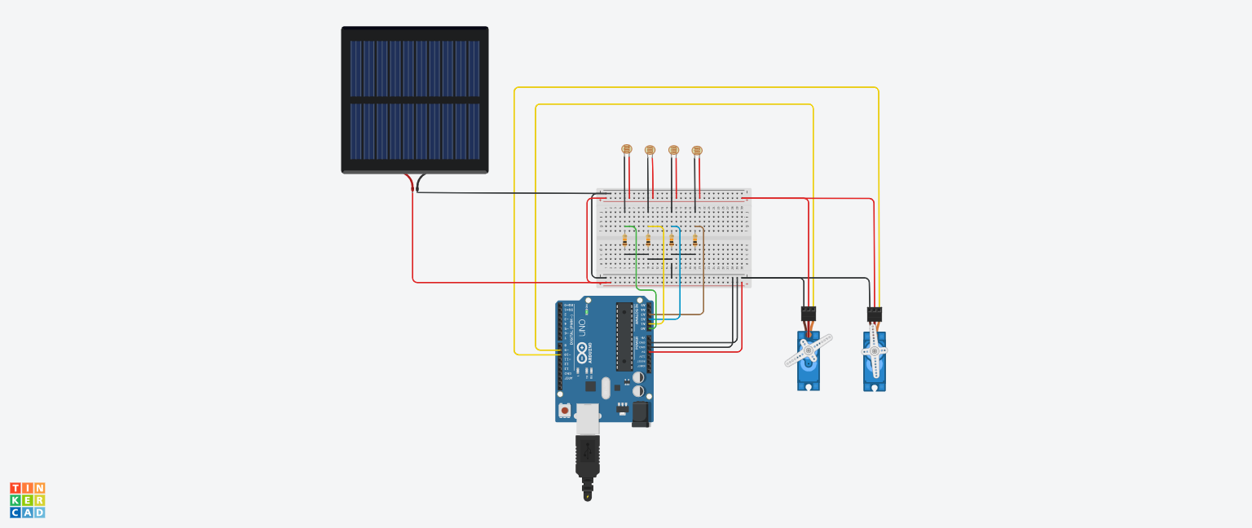
TINKERCAD MODEL

Slide 21
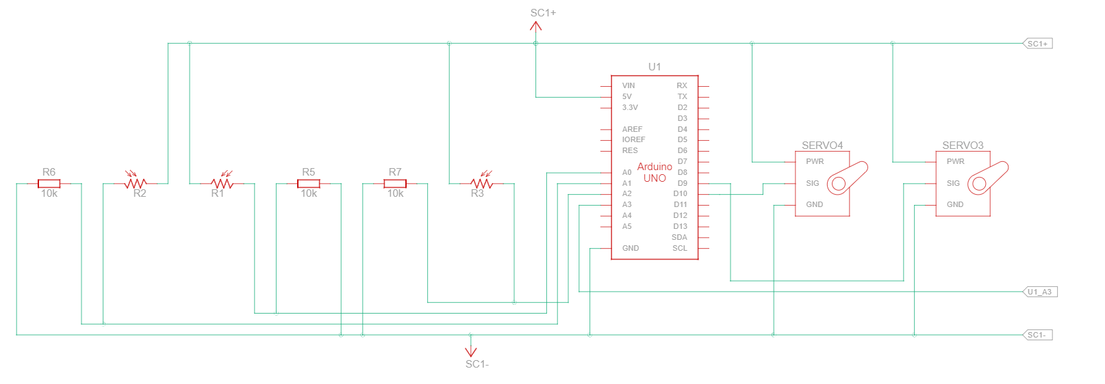
CIRCUIT DIAGRAM

Slide 22
WORKING
In the Sun tracking solar panels, the LDR senses the light and gives back the analog data to the Arduino board. 4 LDR sensors are used for alignment in all four different directions Top, Bottom, Right and Left. The intensity of the light on all 4 sensors is used to calculate the movement of the gimbal.
These calculations are done by the Arduino board. If the intensity on the right side is more, then the gimbal will move towards the right and similarly if the intensity on the top side is more, then the gimbal will move towards the top.
The movement of the gimbal is done by rotation of the servos. The commands are given to the servos as per the calculations done by the Arduino board.

Slide 23
CODE Files
https://github.com/che3t3rking/SSIS.git

Slide 24
HOW IT IS USEFUL
Energy Efficiency: Smart solar illumination systems are designed to use renewable energy from the sun, which can significantly reduce electricity bills and carbon emissions. They are also equipped with energy-efficient LED lights, which consume less power and have a longer lifespan than traditional lighting sources.
Cost-Effective: Since smart solar illumination systems use solar power, there are no ongoing electricity costs or maintenance costs associated with them. They also require minimal installation costs compared to traditional lighting systems that require wiring and infrastructure.

Slide 25
Easy to Install: Smart solar illumination systems are relatively easy to install, and they don't require any wiring or complex infrastructure. This makes them ideal for outdoor lighting applications, especially in remote areas where access to electricity is limited.
Automatic Control: Smart solar illumination systems are equipped with sensors and programmable controllers that allow for automatic on/off switching and dimming of lights depending on the time of day or ambient light conditions. This feature can significantly reduce energy waste and increase the lifespan of the system.

Slide 26
Scalability: Smart solar illumination systems can be easily scaled up or down depending on the lighting needs. Additional lighting units can be added as needed, and the system can be customized to meet specific lighting requirements.

Slide 27
POWER USAGE SOLAR VS NORMAL
The power usage in solar street lighting and normal street lighting can vary depending on various factors such as the type of lighting fixture, the wattage of the bulbs used, the number of hours of operation, and the efficiency of the system.
In general, solar street illumination systems are designed to be more energy-efficient than normal street lighting systems because they rely on renewable solar energy to power the LED lights. Solar street lights use photovoltaic (PV) panels to convert sunlight into electricity, which is then stored in batteries and used to power the lights at night. Since solar street illumination systems do not require any connection to the grid, they do not incur any electricity bills, making them cost-effective in the long run.

Slide 28
Normal street lighting systems, on the other hand, are typically connected to the grid and rely on electricity from power plants. The power usage of normal streetlights can vary depending on the type of bulb used, the wattage of the bulb, and the duration of operation. In general, normal street lighting systems are less energy-efficient than solar street lighting systems because they rely on non-renewable sources of energy and may incur significant electricity bills over time.
Overall, solar street illumination systems are more energy-efficient and cost-effective than normal street lighting systems, making them a better choice for outdoor lighting applications, especially in areas with limited or no access to electricity.

Slide 29
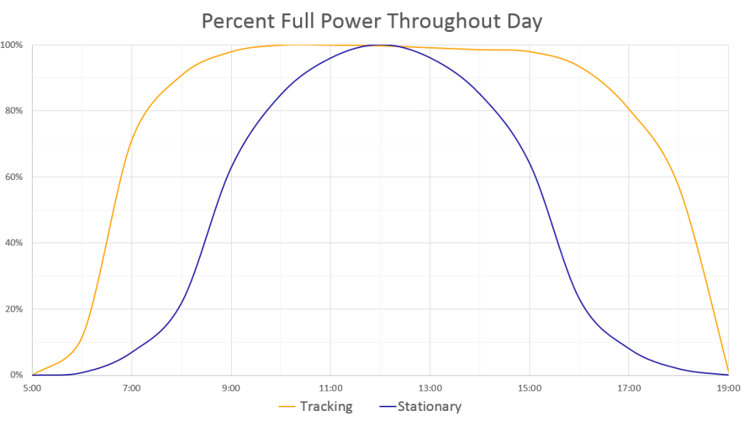
Power output of tracking and stationary solar panels

Slide 30
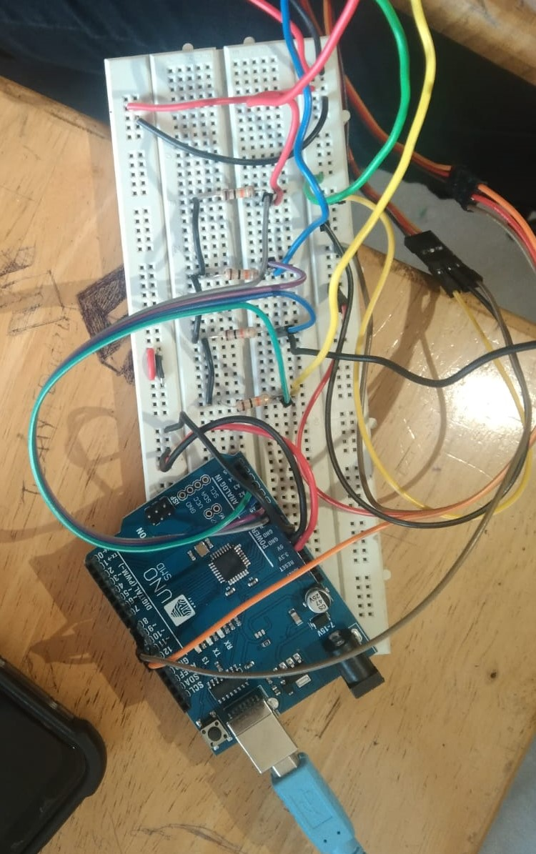
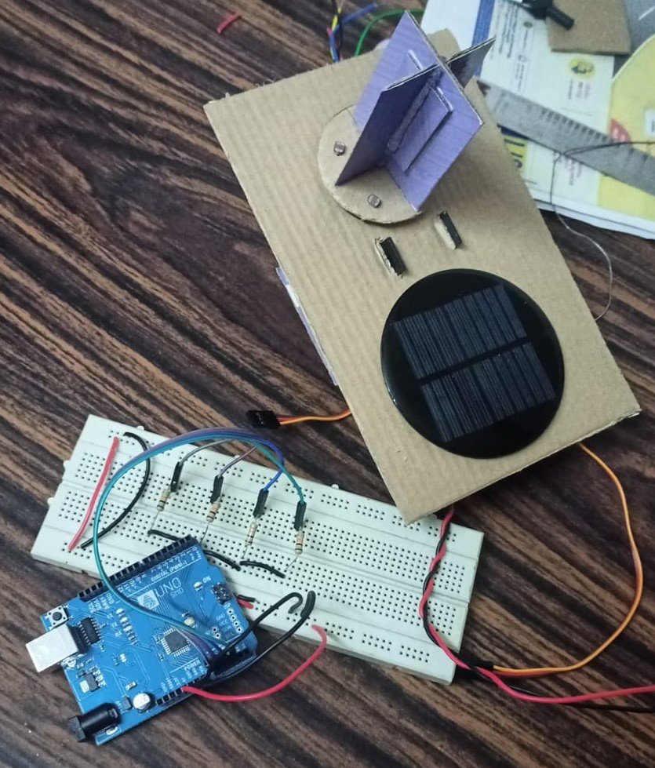
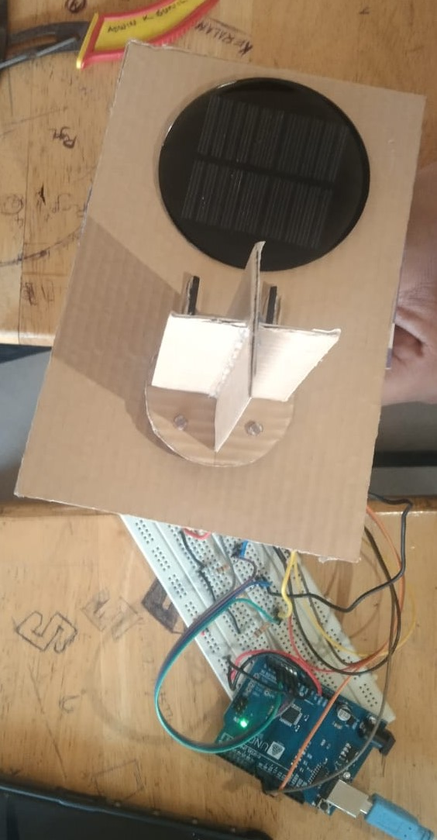

Slide 31
Thank You

