Slide 1
Critical Manufacturing MES
Material Processing Application
Application Walkthrough: Flow Routing, Pass-Through, Track-In Data Collection, Checklist, & Move-Next Data Collection

Slide 2
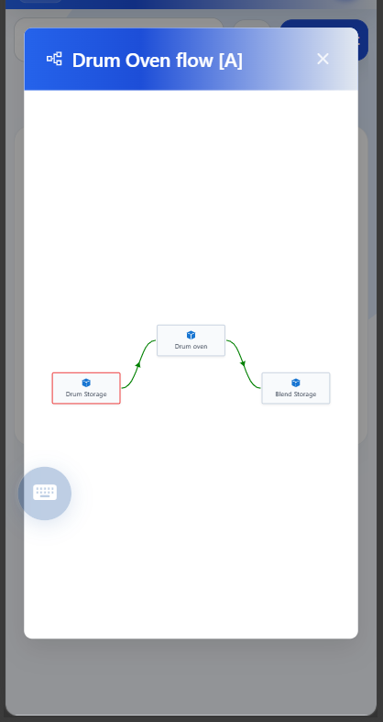
1. Process Flow & Step Sequencing
• Interactive Flow View: Displays the active product routing directly on the shop floor.
• Current Step Position: Highlights where the lot currently resides (Drum Storage) and subsequent steps (Drum oven -> Blend Storage).
• Visual Path Verification: Ensures operators understand next destination before processing.

Slide 3
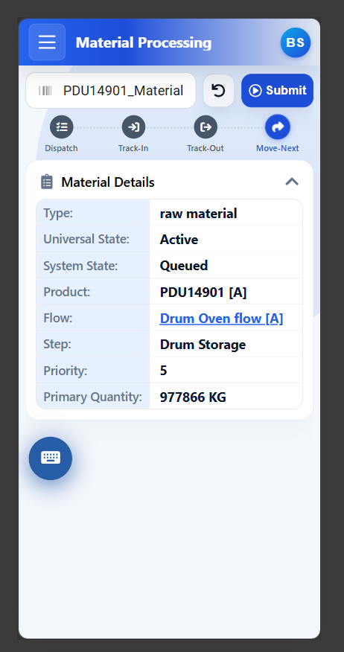
2. Pass-Through Step (Storage Step)
• Dynamic Pass-Through Detection: Checks Step.IsPassThrough === true from CMF metadata.
• Skips Resource Selection: Storage steps do not require machines, so the resource dropdown is hidden.
• Direct Move-Next State: The stepper automatically activates Move-Next.
• One-Click Submit: Clicking Submit moves the material directly into the active production step.

Slide 4
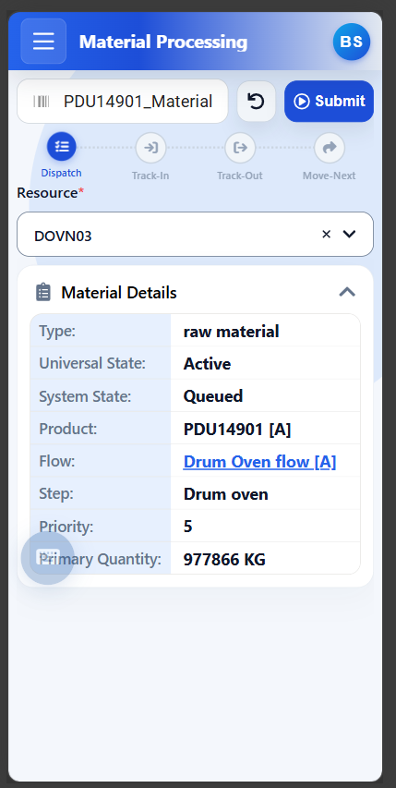
3. Production Step: Resource Selection & Dispatch
• Production Step Requirements: Active processing steps (Drum oven) require equipment assignment.
• Available Equipment List: Populates idle, compatible machines (e.g., DOVN03) using GetDispatchListForMaterial.
• Submit Gating: Submit button remains disabled until an equipment unit is selected.
• Dispatch Execution: Submitting dispatches the material to the chosen resource.

Slide 5
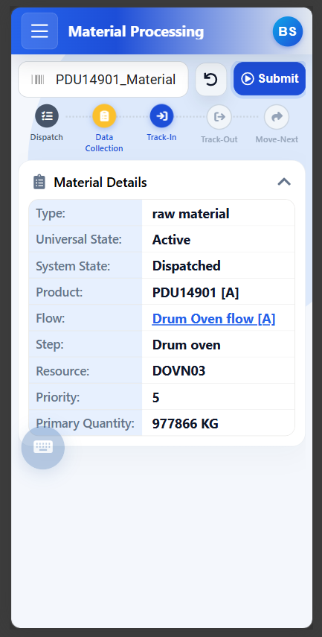
4. Dispatched State & Track-In Stepper
• Material State: Dispatched: Material is successfully assigned to resource DOVN03.
• Data Collection Milestone: Stepper shows a yellow Data Collection indicator before Track-In.
• Operator Prompt: Alerts the operator that mandatory pre-process parameters must be recorded.

Slide 6
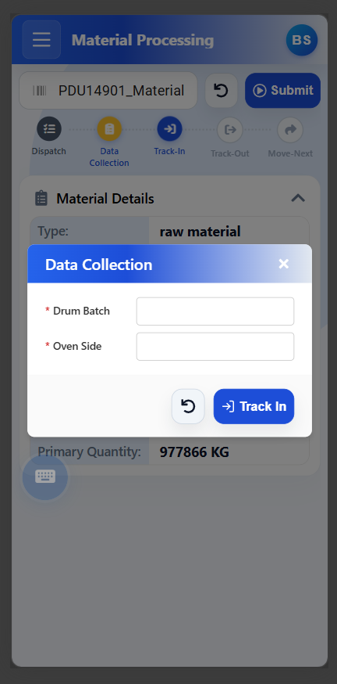
5. Track-In Data Collection
• Purpose: Captures critical pre-process parameters before machine heating begins.
• Mandatory Fields: Operator enters required parameters (* Drum Batch, * Oven Side).
• Integrated Action: Clicking Track In submits both parameter values and track-in execution simultaneously via ComplexTrackInMaterials.
• Result: Material enters InProcess state inside the oven.

Slide 7
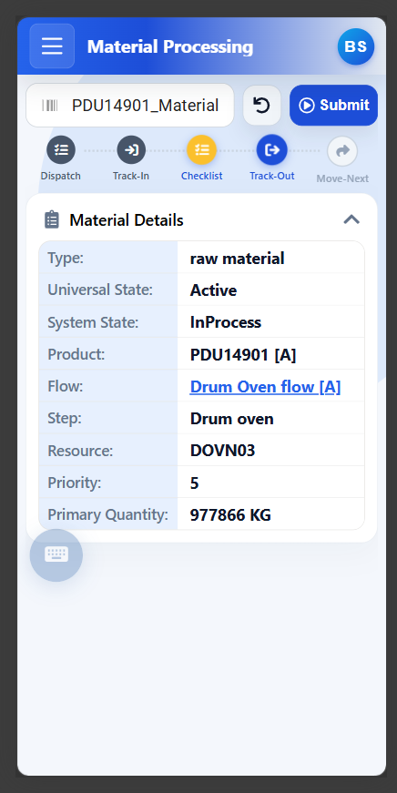
6. In-Process State & Checklist Milestone
• Material State: InProcess: Material is currently undergoing processing in resource DOVN03.
• Checklist Milestone: Stepper shows a yellow Checklist indicator before Track-Out.
• Gated Track-Out: Standard Operating Procedure (SOP) items must be completed before the lot can exit the oven.

Slide 8
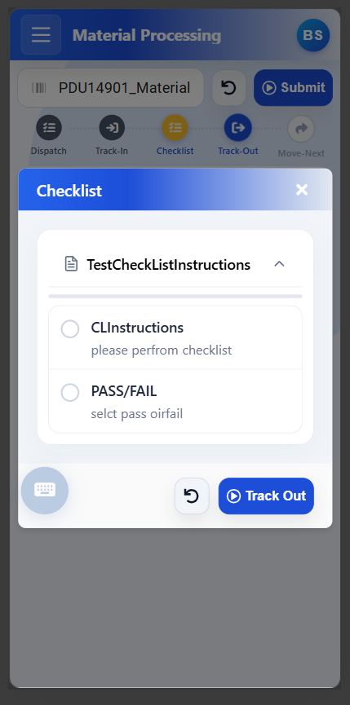
7. In-Process Quality Checklist
• Purpose: Enforces mandatory operator sign-offs (CLInstructions, PASS/FAIL).
• Sequential Execution Order: Items are sorted and submitted strictly by Order (1, 2, 3) to comply with CMF sequence rules.
• Two-Step Operation: Sends Operation 0 (Start) followed by Operation 3 (Close) for uncompleted items.
• Track-Out Advancement: Completing the checklist proceeds straight to Track-Out.

Slide 9
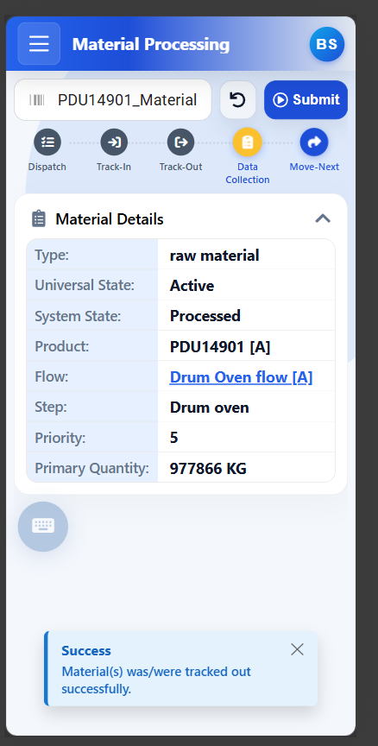
8. Track-Out Completion
• Material State: Processed: Processing cycle finishes and material is tracked out.
• Resource Released: Oven DOVN03 is released back into the equipment pool.
• Move-Next Preparation: Stepper activates Move-Next, and alerts if post-process Data Collection is required.

Slide 10
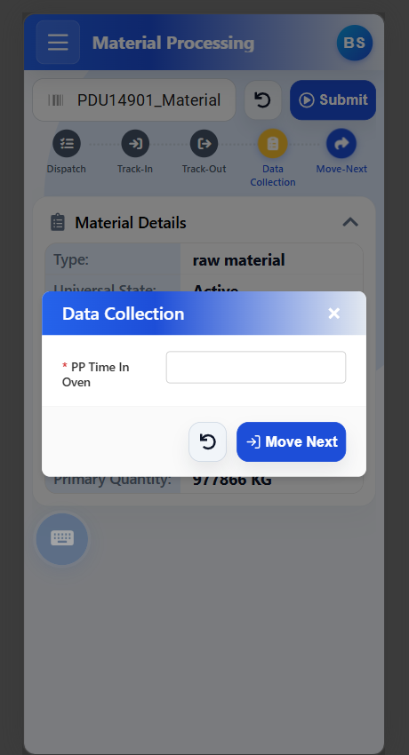
9. Move-Next Data Collection & Completion
• Purpose: Captures final operational metrics (e.g., * PP Time In Oven) for genealogy and batch records.
• Move Next Execution: Clicking Move Next submits data collection points and issues ComplexMoveMaterialsToNextStep.
• Step Progression: Material advances to Blend Storage.
• Screen Auto-Reset: Clears the screen and readies the barcode scanner for the next lot.

Slide 11
KEY TAKEAWAYS
Summary of Business & Operational Value
70% Faster Execution
100% CMF Compliance
Operator-First UX
Replaces complex standard MES menu navigation with a single-screen guided workflow. Automated pass-through saves dozens of clicks per batch.
Enforces mandatory resource dispatch, recipe data collections, and sequential checklists at the exact required milestones without bypasses.
Touch-screen optimized with big touch targets, real-time status banners, barcode scanner auto-focus, and integrated numeric keypad.

