Slide 1


National Education Society®
JNN College of Engineering, Shivamogga
Dept. of Information Science and Engineering
Project(21ISP78) Phase-1
presentation on
“Deep Learning-Based Pneumonia Detection ”
Batch : 02
Under Guidance of : Mrs. Thara K L BE, MTech. Assistant Professor |  | Presented By : Nithish A S – 4JN21IS065 Rithish K R – 4JN21IS080 Shreyas G K – 4JN21IS096 Varun S – 4JN21IS124

Slide 2

Contents
Introduction
Literature Survey
Problem Description
Objectives
System Design & Architecture
Conclusion
References

Slide 3
1. Introduction
Pneumonia is a life-threatening infectious disease affecting one or both lungs in humans commonly caused by bacteria called 'Streptococcus pneumonia
One in three deaths in India is caused due to pneumonia as reported by World Health Organization (WHO).
The signs and symptoms of Pneumonia may include:
1. A cough with phlegm (a slimy substance)
2. Fever
3. Chills
4. trouble breathing etc.

Slide 4
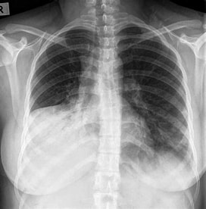
Chest X-Rays are currently the best method to diagnose pneumonia.
However, evaluation of chest X-Rays need expert radiotherapists for evaluation
Thus, developing an automatic system for detecting pneumonia would be beneficial for treating the disease without any delay, particularly in remote areas
11/25/2024
Pneumonia Detection
4

Slide 5
3. Problem Description
The infectious illness known as pneumonia is regularly a result of contamination caused by a bacterium in the lungs’ alveoli. While an infected tissue of the lungs has an infection, it builds up pus in it. To determine if the patient has those illnesses, professionals perform bodily exams and diagnose their patients through Chest X-ray, ultrasound, or biopsy of the lungs. Misdiagnosis, erroneous treatment, and if the disease is overlooked will result in the patient’s lack of lifestyle.
The progression of deep learning contributes to aiding specialists in the decision-making procedure to diagnose sufferers with these illnesses. The look employs a bendy and efficient technique of deep learning, applying the CNN model in predicting and detecting a patient who is unaffected and affected by the sickness using a chest X-ray photograph.

Slide 6
3. Objectives
Following are the Objectives of the project undertaken
1. Data Collection and Preprocessing
Gather a comprehensive dataset of chest X-Ray images, ensuring a balanced representation of Pneumonia-positive and negative cases.
2. Model Development
Design a convolutional neural network (CNN) architecture tailored for image classification tasks.
Implement layers and functions that enhance feature extraction and classification accuracy, including convolutional, pooling, and dropout layers.
3. Training the Model
Train the CNN model using the prepared dataset with a batch size of 32, applying appropriate training techniques such as data augmentation to prevent overfitting.

Slide 7
4. Performance Evaluation
Evaluate the trained model on a separate validation dataset to assess its accuracy, sensitivity, and specificity in detecting Pneumonia.
Aim for an accuracy threshold of over 95% to ensure reliable performance in clinical settings.
5. Implementation and Testing
Develop a user-friendly interface for healthcare professionals to upload chest X-Ray images for analysis.
Conduct real-world testing of the model in clinical environments to validate its effectiveness and gather feedback for further improvement

Slide 8
2. Literature Survey
[2]. "Pneumonia and COVID-19 Detection using Convolutional Neural Networks”
Author : Sammy V. Militante et al
Year Of Publication : 2020
Publisher : IEEE
Description : The study explores the use of six CNN models (Google Net, Le Net, VGG-16, Alex Net, Stride Net, and ResNet-50) to detect pneumonia from chest X-ray images, achieving up to 98% accuracy with Google Net and Le Net. A dataset of 28,000 images, optimized with the Adam optimizer and trained over 500 epochs, was used to evaluate model performance
Advantages :
Use of a Large Dataset
High Accuracy Achieved
Drawbacks :
Risk of Overfitting
Lack of Real-World Validation

Slide 9
2. Literature Survey
[1]. "Transfer Learning from Pneumonia to COVID-19”
Author : Hongen Lu et al.
Publisher: IEEE
Year Of Publication : 2020
Description : This paper explores the use of transfer learning to adapt models trained on pneumonia detection for identifying COVID-19 from chest X-ray images, demonstrating improved accuracy and efficiency.
Advantages :
Relevance to Real-World Problems
Potential for Future Applications
Drawbacks :
Quality and Consistency of Data
Limited Public Data for COVID-19

Slide 10
2.Literature Survey
[3]."Pneumonia Detection through Adaptive Deep Learning Models of Convolutional Neural Networks”
Author : Nanette V. Dionisio et al.
Year Of Publication : 2020
Publisher : IEEE
Description : This paper presents a deep learning approach using Convolutional Neural Networks (CNNs) to detect pneumonia from chest X-ray images, achieving high accuracy and demonstrating the potential for clinical application.
Advantages :
Innovative Approach
High accuracy
Drawbacks :
Data dependency
Complexity

Slide 11
2.Literature Survey
[4].“Grad-CAM: Visual Explanations from Deep Networks via Gradient-Based Localization”
Author : R. R. Selvaraju, M. Cogswell, A. Das, R. Vedantam, D. Parikh and D. Batra.
Year Of Publication : 2017
Publisher : IEEE
Description :The paper "Grad-CAM: Visual Explanations from Deep Networks via Gradient-Based Localization" by R. R. Selvaraju et al. introduces a technique called Gradient-weighted Class Activation Mapping (Grad-CAM) to produce visual explanations for decisions made by Convolutional Neural Networks (CNNs). It highlights important regions in an image for predicting a concept, making CNN models more transparent and interpretable.
Advantages :
Transparency
Applicability
Drawbacks :
Coarse Localization
Complexity

Slide 12
2.Literature Survey
[5].“Bayesian convolutional neural network estimation for pediatric pneumonia detection and diagnosis”
Author : Vandecia Fernandes et al.
Year Of Publication :2021
Publisher : ScienceDirect
Description :This paper introduces a Bayesian convolutional neural network (CNN) model for detecting and diagnosing pediatric pneumonia from chest X-ray images, demonstrating high accuracy and reliability in medical diagnostics.
Advantages :
Improved Accuracy
Explainability
Drawbacks :
Computational Cost
Data Dependancy

Slide 13
2.Literature Survey
[6].“A Review on Early Prediction of Pneumonia Using Deep Learning, Convolutional Neural Network and X-Ray Images”
Author : Hari Krishna Marrapu
Year Of Publication : 2022
Publisher : IEEE
Description : This paper discusses the use of deep learning and convolutional neural networks (CNNs) to analyze X-ray images for the early detection of pneumonia, highlighting advancements in medical imaging and diagnostic accuracy.
Advantages :
Improved Diagnostic Accuracy
Comprehensive Review
Drawbacks :
Data Limitations
Ethical and Privacy Concerns

Slide 14
2.Literature Survey
[7].“Pneumonia Detection Using CNN based Feature Extraction”
Author : Dimpy Varshni, Karthik Thakral
Year Of Publication :2019
Publisher : IEEE
Description : The paper titled "Pneumonia Detection Using CNN based Feature Extraction" by Dimpy Varshni and Karthik Thakral discusses using Convolutional Neural Networks (CNNs) to extract features from chest X-ray images for pneumonia detection, aiming to enhance diagnostic accuracy and efficiency.
Advantages :
Enhanced Diagnostic Accuracy:
Efficient Processing
Drawbacks :
Data Dependency
Resource Intensive

Slide 15
2.Literature Survey
[8].“Pneumonia Identification with Self-supervised Learning and Transfer Learning”
Author : Amer Kareem et al.
Year Of Publication : 2021
Publisher : Springer Nature
Description : he paper "Pneumonia Identification with Self-supervised Learning and Transfer Learning" by Amer Kareem et al. explores the application of self-supervised learning and transfer learning techniques to improve the accuracy and efficiency of pneumonia detection from X-ray images.
Advantages :
Reduced Training Time
Data Efficiency
Drawbacks :
Complexity
Overfitting

Slide 16
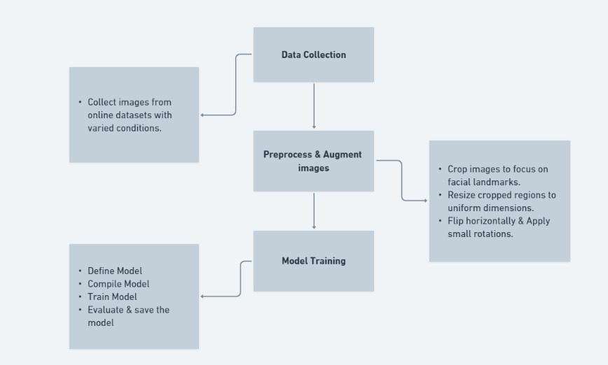
SYSTEM DESIGN

Slide 17
5. System Design and Architecture
1.Model Selection:
A CNN model is used for feature extraction and classification.
Training:
Dataset: 300 labeled images (sleepy/not sleepy).
Loss Function: Categorical Cross-Entropy.
Optimizer: Adam for efficient gradient descent.
Epochs and Batch Size: Configured to balance accuracy and training time.
2. Preprocessing
Feature Extraction:
Haarcascade for detecting facial features like eyes and mouth.
Cropping regions of interest (ROI) for focused analysis.
3. Data Augmentation
To improve model robustness and avoid overfitting:
Transformations: Rotation, flipping, and brightness adjustments.
Noise Injection: Simulate real-world conditions like varying lighting.
Scaling: Resize images to a fixed dimension suitable for the CNN input layer.
4. Key Features
Emphasis on robust preprocessing to ensure high-quality input for training.
Augmented dataset enhances generalization to real-world scenarios.

Slide 18
6. Conclusion
This study describes a CNN-based model aiming to diagnose pneumonia on a chest X-ray image set. Experiments included analyses of different input shapes and loss functions to refine model performance. The approach aims to assist healthcare professionals in early and precise pneumonia detection.
In the future, we will continue the research to explore more accurate classification architectures to diagnose two types of pneumonia, viruses, and bacteria. According to the description discussed above, the CNN-based model is a promising method to diagnose the disease through X-rays.

Slide 19
7. References
[1] Vandecia Fernandes et al., “Bayesian convolutional neural network estimation for pediatric pneumonia detection and diagnosis”, Computer Methods and Programs in Biomedicine, Elsevier, 2021
[2] Hongen Lu et al., “Transfer Learning from Pneumonia to COVID-19”, Asia-Pacific on Computer Science and Data Engineering (CSDE), 2020 IEEE
[3] Sammy V. Militante et al., “Pneumonia and COVID-19 Detection using Convolutional Neural Networks”, 2020 the third International on Vocational Education and Electrical Engineering (ICVEE), IEEE, 2021
[4] Nanette V. Dionisio et al., “Pneumonia Detection through Adaptive Deep Learning Models of Convolutional Neural Networks”, 2020 11th IEEE Control and System Graduate Research Colloquium (ICSGRC 2020), 8 August 2020
[5] Md. Jahid Hasan et al., “Deep Learning-based Detection and Segmentation of COVID-19 & Pneumonia on Chest X-ray Image”, 2021 International Information and Communication Technology for Sustainable Development (ICICT4SD), 27-28 February 2021

Slide 20
7. References
[6] LeCun, Y.; Boser, B.; Denker, J.S.; Henderson, D.; Howard, R.E.; Hubbard, W.; Jackel, L.D. Backpropagation applied to handwritten zip code recognition. Neural Comput. 1989, 1, 541–551.
[7] Krizhevsky, A.; Sutskever, I.; Hinton, G.E. Imagenet classification with deep convolutional neural networks. Adv. Neural Inf. Process. Syst. 2012, 25, 1097–1105.
[8] Simonyan, K.; Zisserman, A. Very deep convolutional networks for large-scale image recognition. arXiv 2014, arXiv:1409.1556
[9] R. R. Selvaraju, M. Cogswell, A. Das, R. Vedantam, D. Parikh and D. Batra, "Grad-CAM: Visual Explanations from Deep Networks via Gradient-Based Localization," 2017 IEEE International Conference on Computer Vision (ICCV), Venice, 2017, pp. 618-626.
[10] L. Wang and A. Wong, "COVID-Net: A tailored deep convolutional neural network design for detection of COVID-19 cases from chest radiography images," arXiv:2003.09871, 2020.

Slide 21
Thank you

