Slide 1
Statistical Computing with R and Python
Credit Card Fraud Detection
Rahul Gautam
Prince Tibadiya
Rithvik Srinivasaiya

Slide 2
Overview
Introduction
Dataset and EDA
Sampling Methodologies
Model Deployment
Conclusion

Slide 3
Introduction

Slide 4
Problem Statement
Developing an efficient credit card fraud detection system to combat rising fraud rates.
The challenge is to accurately identify fraudulent transactions amidst vast data, minimizing false positives and safeguarding both customers and financial institutions.
The goal is a robust solution that enhances security, reduces losses, and maintains customer trust.

Slide 5
Motivation
This project is motivated by the pressing need to combat the increasing threat of credit card fraud.
As online transactions rise, so do sophisticated fraud tactics.
Our goal is to develop a cutting-edge fraud detection system to protect consumers, financial institutions, and the integrity of the credit card system.
By proactively identifying and preventing fraud, we aim to enhance transaction security and build trust in digital payments.

Slide 6
Challenges

Slide 7
Cost of Misclassification
It is crucial to consider the potential consequences of incorrectly classifying a fraudulent transaction as legitimate.
A high recall system in machine learning can help avoid such errors by accurately identifying fraudulent transactions while also distinguishing between legitimate ones.

Slide 8
Class Imbalance
The challenge we face in detecting credit card fraud stems from the class imbalance in real-world datasets. With the majority of transactions being legitimate, fraudulent cases are rare.
This imbalance complicates machine learning models, which must accurately identify these rare instances while not overlooking the abundance of legitimate transactions.

Slide 9
Potential Complications
Class imbalance can lead to several complications:
Overfitting to Majority Class
Biased Models
Reduced Model Performance
Limited Learning from Minority Class
Increased False Alarms

Slide 10
Dataset and EDA

Slide 11
Description
Origin: Kaggle
Dataset size: 284807 records
Features : 31 columns, (Time, V1,V2….V28, Amount, Class)
Class is the target variable.
Rest being the predictor variables.

Slide 12
Dimension Reduction
The dataset consisted of 28 Features labelled from V1,V2….,V28.
These are PCA reduced components.
This could be due to the number of features in the dataset and privacy reasons.

Slide 13
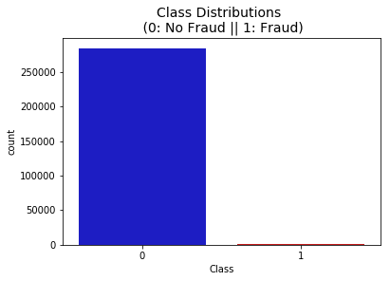
Distribution- Class
0: Non-Fraudulent Transaction
1: Fraudulent Transaction

Slide 14
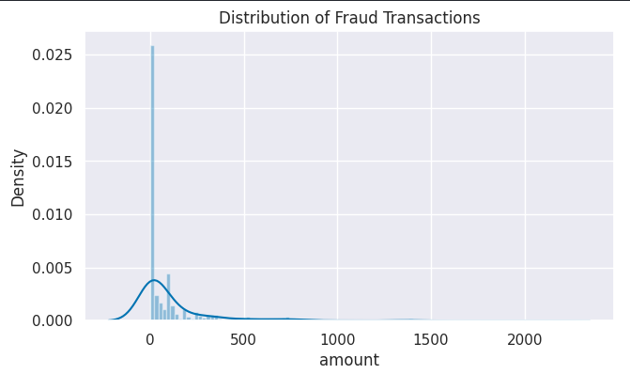
Distributions - Amount
Distribution of Amounts of Fraud Transactions:

Slide 15
Most frequent amount
Frequency of certain transaction amounts
Amount | Frequency
$1 | 113
$99.99 | 27
$0 | 27

Slide 16
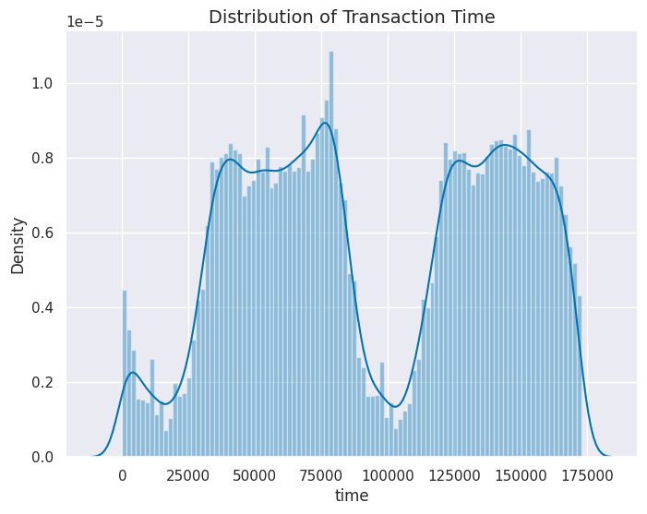
Distribution of Time feature
We see there are two peaks in the graph and there are some local peaks as well.
We can think of these as the time of the day like the peak is the day time when most people do the transactions and the depth is the night time.

Slide 17
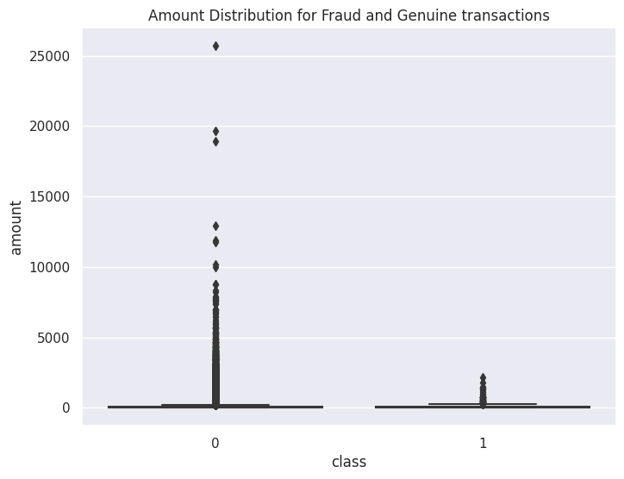
Outliers
Most of the transaction amount falls between 0 and about 3000.
Some very big transactions have been removed from the genuine transactions as they may affect the training data.
Removing fraudulent transactions with very big amounts can make the predicting model biased.

Slide 18
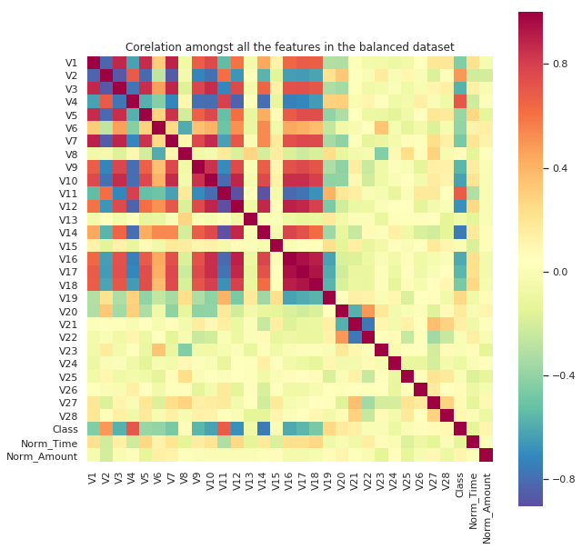
Feature Correlation
In the correlation heatmap above, we can see that there are some features like V2, V4, V11, V19 which has a strong positive correlation to the class label. This means as the value of these features increases, there is a higher chance that a transaction will be fraudulent one.
The features V3, V10, V12, V14 and V16 seems to have a higher negative correlation to the class labels. This means as these value decreases there is a higher chance that a transaction will be a fraudulent one.

Slide 19
Dealing with Imbalance

Slide 20
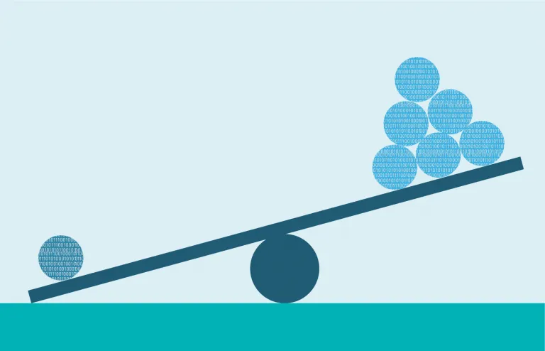
Sampling
What is Sampling?
Sampling is a part of the data preprocessing phase in machine learning.
In the context of imbalanced classes, sampling techniques are used to address the skewed distribution of classes in the dataset.
It is usually done by either increasing the minority class instances or decreasing the majority class instances to prevent models from being biased towards the majority class. There are many other techniques as well.
Types of sampling techniques used:
Random Undersampling
Random Oversampling
Synthetic Minority Over-sampling Technique (SMOTE)
Adaptive Synthetic Sampling (ADASYN)
So we have 5 different datasets now!

Slide 21
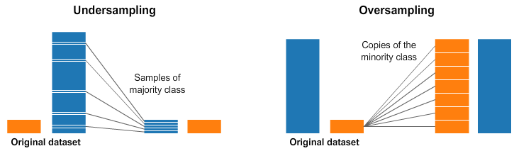
Undersampling & Oversampling
Random Undersampling
Idea: Remove random instances from the majority class to reduce its dominance.
Pros: Helps balance the class distribution.
Cons: May discard potentially useful information, leading to loss of data.
Random Oversampling
Idea: Duplicate random instances from the minority class to increase its representation.
Pros: Simple to implement, does not discard any data.
Cons: May lead to overfitting, as the model sees the same examples multiple times.

Slide 22
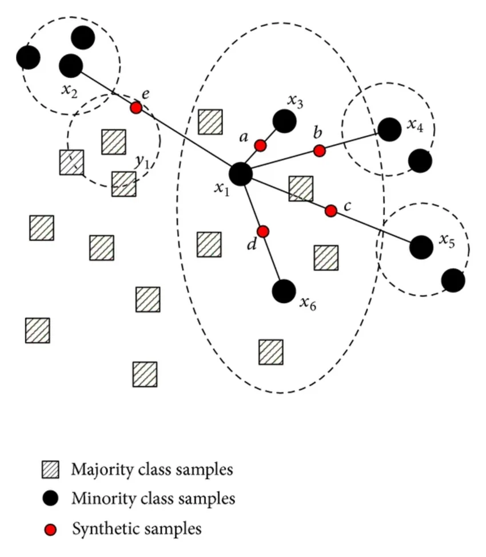
SMOTE
SMOTE (Synthetic Minority Over-sampling Technique)
Idea: Generate synthetic examples for the minority class based on the existing examples.
How it works: For each minority class instance, SMOTE finds its k-nearest
neighbors and creates synthetic examples along the line segments connecting
these neighbors.
Pros: Addresses the imbalance without overfitting, as the synthetic
examples are based on the feature space.
Cons: May introduce noise if the feature space is not well-defined.

Slide 23
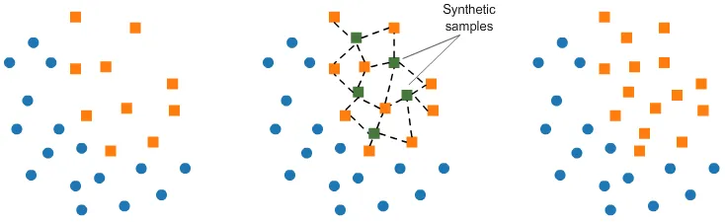
ADASYN
ADASYN (Adaptive Synthetic Sampling)
Idea: Focuses on generating synthetic examples for minority class instances that are harder to learn.
How it works: Similar to SMOTE. It uses a density distribution as a criterion to automatically determine the number of synthetic examples to generate for each minority class instance.
Pros: Can be more effective than SMOTE for datasets where the decision boundary is complex.
Cons: Computationally more intensive than SMOTE.
Imbalanced Dataset
Generating synthetic data points
ADASYN Dataset

Slide 24
MODEL DEPLOYMENT

Slide 25
Models
Logistic Regression
Naive Bayes Classifier
Support Vector Machines
Decision Tree Classifier
Random Forest Classifier
Gradient Boosting Classifier
XGBoost

Slide 26
Logistic Regression
How it Works:
Models the probability of a binary outcome using a logistic function, which maps inputs to a probability between 0 and 1, in our case it is fraud or not fraud.
It uses a decision boundary to classify instances, separating them into the two classes based on the predicted probabilities.
Pros:
Provides clear insights into the impact of each feature on the predicted probability.
Less prone to overfitting: Performs well with small to moderate-sized datasets and avoids complex model structures.
Cons:
Assumes linear relationship: May not capture complex non-linear relationships between features.
Limited to binary outcomes: Directly applicable only to binary classification problems; modifications needed for multi-class classification.

Slide 27
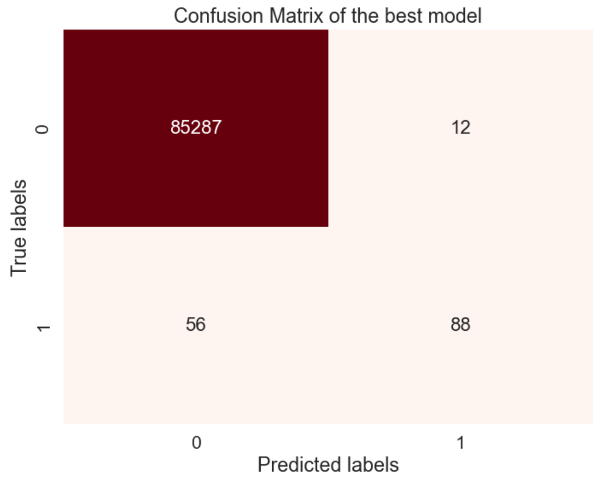
Logistic Regression Results
Logistic Regression | Accuracy | AUC | Precision | Recall | F1
Imbalanced | 0.99920 | 0.80549 | 0.88000 | 0.61111 | 0.72131
Undersampling | 0.97252 | 0.94117 | 0.05312 | 0.90972 | 0.10038
Oversampling | 0.97799 | 0.93698 | 0.06466 | 0.89583 | 0.12062
SMOTE | 0.97604 | 0.93601 | 0.05969 | 0.89583 | 0.11193
ADASYN | 0.91866 | 0.93153 | 0.01921 | 0.94444 | 0.03766
Logistic Regression with imbalanced data performed the best among the other datasets.

Slide 28
Naive Bayes
How it works:
Utilizes Bayes' theorem to calculate the probability of each class given the input features.
Assumes feature independence, meaning it treats each feature as independent of the others, which simplifies the calculation.
Pros:
Simple and Efficient: Easy to implement and computationally inexpensive.
Performs well even with a large number of features compared to instances.
Handles Missing Data Gracefully: Can make predictions even when some features are missing.
Cons:
The "naive" assumption may not hold true in all datasets, leading to inaccurate predictions.
May not capture complex relationships between features.
Can be sensitive to outliers or skewed data distributions.

Slide 29

Naive Bayes Results
Naive Bayes | Accuracy | AUC | Precision | Recall | F1
Imbalanced | 0.97788 | 0.90920 | 0.06087 | 0.84028 | 0.11351
Undersampling | 0.95951 | 0.91386 | 0.03505 | 0.86806 | 0.06739
Oversampling | 0.97411 | 0.91424 | 0.05315 | 0.85417 | 0.10008
SMOTE | 0.97451 | 0.91444 | 0.05395 | 0.85417 | 0.10149
ADASYN | 0.95956 | 0.92082 | 0.03562 | 0.88194 | 0.06848
Naive Bayes with imbalanced data performed the best among the other datasets.

Slide 30
Support Vector Machine
How it works:
Employs a hyperplane to separate different classes in the feature space.
Maximizes the margin between the nearest points of the classes, known as support vectors.
Can handle linear and non-linear data by using different kernel functions to transform the input space into a higher-dimensional space.
Pros:
Well-suited for datasets with many features.
Different kernel functions can be specified for the decision function, catering to various types of data distributions.
Memory Efficiency: Uses a subset of support vectors, leading to a more compact model.
Cons:
Choosing the right kernel function can be tricky.
Requires feature scaling and data normalization for optimal performance.
Can be computationally intensive, especially with large datasets and complex kernel functions.

Slide 31
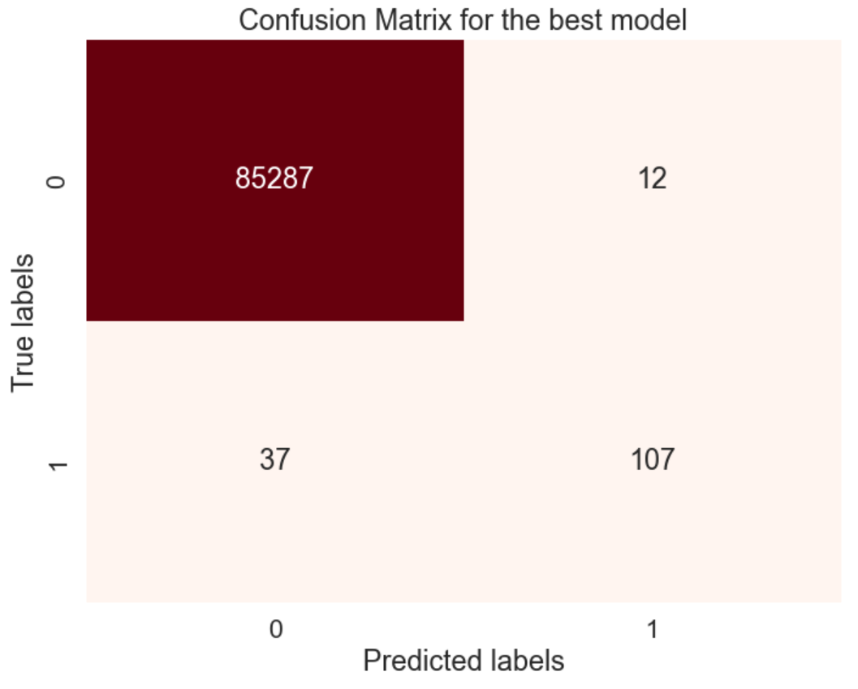
SVM Results
SVM | Accuracy | AUC | Precision | Recall | F1
Imbalanced | 0.99943 | 0.87146 | 0.89916 | 0.74306 | 0.81369
Undersampling | 0.97446 | 0.94215 | 0.05696 | 0.90972 | 0.10720
Oversampling | 0.97885 | 0.93741 | 0.06715 | 0.89583 | 0.12494
SMOTE | 0.97848 | 0.93722 | 0.06605 | 0.89583 | 0.12303
ADASYN | 0.92362 | 0.93402 | 0.02044 | 0.94444 | 0.04001
SVM with imbalanced data performed the best among the other datasets.

Slide 32
Decision Tree Classifier
How it works:
Represents a tree-like structure where each internal node represents a feature, each branch represents a decision based on that feature, and each leaf node represents a class label or a numerical value.
The goal is to split the data into subsets that are as homogeneous as possible with respect to the target variable.
Pros:
Easy to understand and interpret which can explain the reasoning behind the classification decisions.
Helps to capture non-linear relationships between features and target variables without requiring complex transformations.
Provide insights into the importance of different features in predicting the target variable
Cons:
Decision trees are prone to overfitting.
Small variations in the data can lead to different decision tree structures, making them unstable models.
Can be biased towards Majority Classes in classification task.

Slide 33
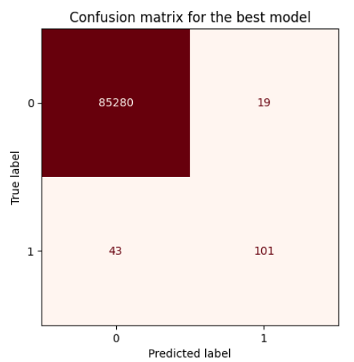
Decision Tree Results
DT | Accuracy | AUC | Precision | Recall | F1
Imbalanced | 0.99912 | 0.88864 | 0.72258 | 0.77778 | 0.74916
Undersampling | 0.89660 | 0.89622 | 0.01442 | 0.89583 | 0.02837
Oversampling | 0.99927 | 0.85058 | 0.84167 | 0.70139 | 0.76515
SMOTE | 0.99792 | 0.88803 | 0.43411 | 0.77778 | 0.55721
ADASYN | 0.99787 | 0.89148 | 0.42803 | 0.78472 | 0.55392
DT with randomly oversampled data performed the best among the other datasets.

Slide 34
Random Forest Classifier
How it works:
An ensemble learning method used for classification and regression tasks.
It operates by constructing multiple decision trees during training and outputs the mode of the individual trees during classification task.
Each decision tree in the forest is trained on a random subset of the training data and a random subset of features, leading to diversity among the trees and reducing overfitting.
Pros:
Tends to produce highly accurate predictions, often outperforming single decision trees.
Less prone to overfitting compared to individual decision trees due to aggregation
Provides a measure of feature importance
Cons:
Training a Random Forest model can be computationally expensive
Less interpretable than a single decision tree due to aggregation of multiple decision trees.
As the number of trees in the forest increases, so does the memory and storage requirements, making deployment on resource-constrained devices challenging.

Slide 35

RF Results
RF | Accuracy | AUC | Precision | Recall | F1
Imbalanced | 0.99958 | 0.89926 | 0.94262 | 0.79861 | 0.86466
Undersampling | 0.96915 | 0.92215 | 0.04592 | 0.87500 | 0.08726
Oversampling | 0.99957 | 0.89579 | 0.94215 | 0.79167 | 0.86038
SMOTE | 0.99954 | 0.91658 | 0.88889 | 0.83333 | 0.86022
ADASYN | 0.99952 | 0.92003 | 0.87050 | 0.84028 | 0.85512
RF with imbalanced data performed the best among the other datasets.

Slide 36
Gradient Boosting Classifier
How it works:
Another ensemble learning technique used for classification tasks.
It works by building a series of decision trees sequentially, where each subsequent tree corrects the errors made by the previous one.
The model minimizes a loss function by adding trees in a greedy manner, where each tree is fitted to the negative gradient of the loss function.
Pros:
Often yields highly accurate predictions, especially when combined with decision trees as base learners.
Less prone to overfitting compared to individual decision trees (boosting sequentially correct errors).
Provides insights into feature importance, aiding in feature selection and interpretation.
Cons:
Hyperparameter tuning can be challenging and time-consuming.
Training can be computationally expensive, especially for large datasets and complex models.
While less prone to overfitting than single decision trees, Gradient Boosting models can still overfit if not properly regularized.

Slide 37

Gradient Boost Results
Gradient Boost | Accuracy | AUC | Precision | Recall | F1
Imbalanced | 0.99910 | 0.79157 | 0.83168 | 0.58333 | 0.68571
Undersampling | 0.96492 | 0.94084 | 0.04235 | 0.91667 | 0.08096
Oversampling | 0.99357 | 0.93439 | 0.19178 | 0.87500 | 0.31461
SMOTE | 0.98770 | 0.93144 | 0.10871 | 0.87500 | 0.19340
ADASYN | 0.96957 | 0.93623 | 0.04786 | 0.90278 | 0.09091
Gradient Boost with imbalanced data performed the best among the other datasets.

Slide 38
Extreme Gradient Boosting
How it works:
An optimized implementation of gradient boosting machines.
It improves upon traditional gradient boosting algorithms by introducing several enhancements, such as regularization, parallelization, and tree pruning, leading to faster training and higher accuracy.
Pros:
High performance and scalability, suitable for large datasets and complex problems.
Offers built-in regularization techniques like L1 and L2 regularization to prevent overfitting.
Provides feature importance scores, helping users understand which features contribute most to the model's predictions.
Cons:
XGBoost has many hyperparameters that need to be tuned, which can make it more challenging to use compared to simpler models.
Training can be resource-intensive, requiring significant computational power and memory.
Less interpretable than simpler models like decision trees.

Slide 39

XGBoost Results
XGBoost | Accuracy | AUC | Precision | Recall | F1
Imbalanced | 0.99956 | 0.89232 | 0.94167 | 0.78472 | 0.85606
Undersampling | 0.96324 | 0.94692 | 0.04104 | 0.93056 | 0.07862
Oversampling | 0.99961 | 0.90968 | 0.94400 | 0.81944 | 0.87732
SMOTE | 0.99939 | 0.92344 | 0.80263 | 0.84722 | 0.82432
ADASYN | 0.99920 | 0.91641 | 0.73171 | 0.83333 | 0.77922
XGBoost with randomly oversampled data performed the best among the other datasets.

Slide 40
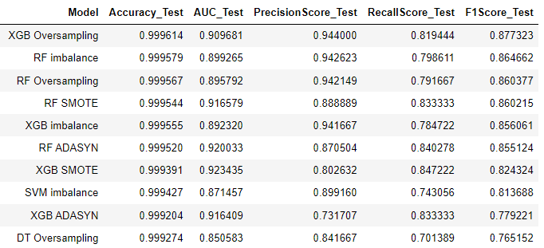
Overall results

Slide 41
CONCLUSION

Slide 42
Conclusion
XGBoost and Random forest were the best models for this case.
Random undersampling performed poorly against the oversampling techniques.
The focus of the project was to maximize the fraud recall with a substantial threshold of false positives.
This threshold can be altered as per requirement as the transactions flagged by our model can be re-checked by human.

Slide 43
Future work
Application of deep learning models to detect more complex relationships.
Generative models with adversarial training can help to reduce imbalance by generating more fraud samples with a relative similar distribution of current fraud samples.
Discovery and implementation of more data can be helpful in improving the model performance.

Slide 44
THANK YOU!

