Slide 1
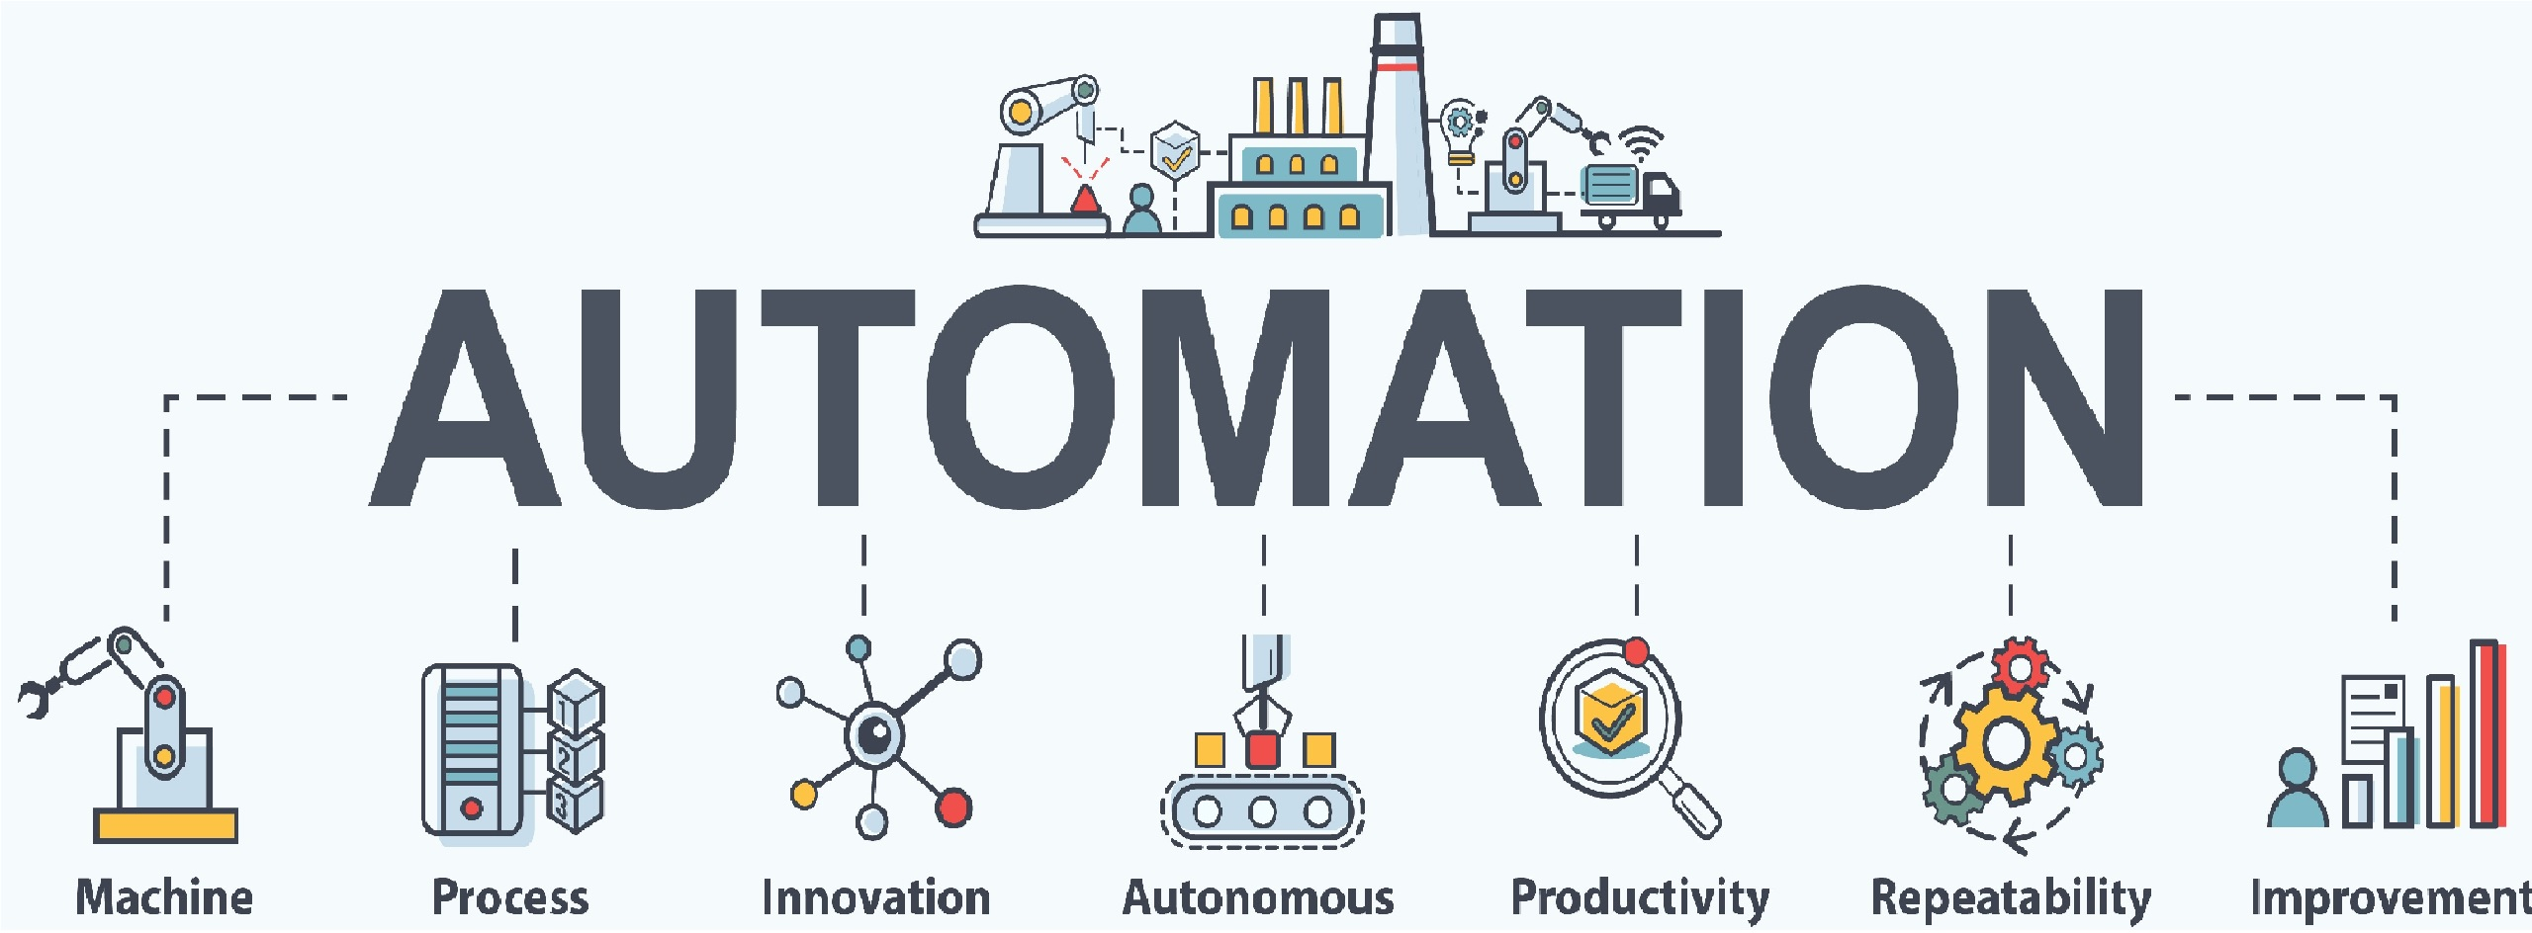
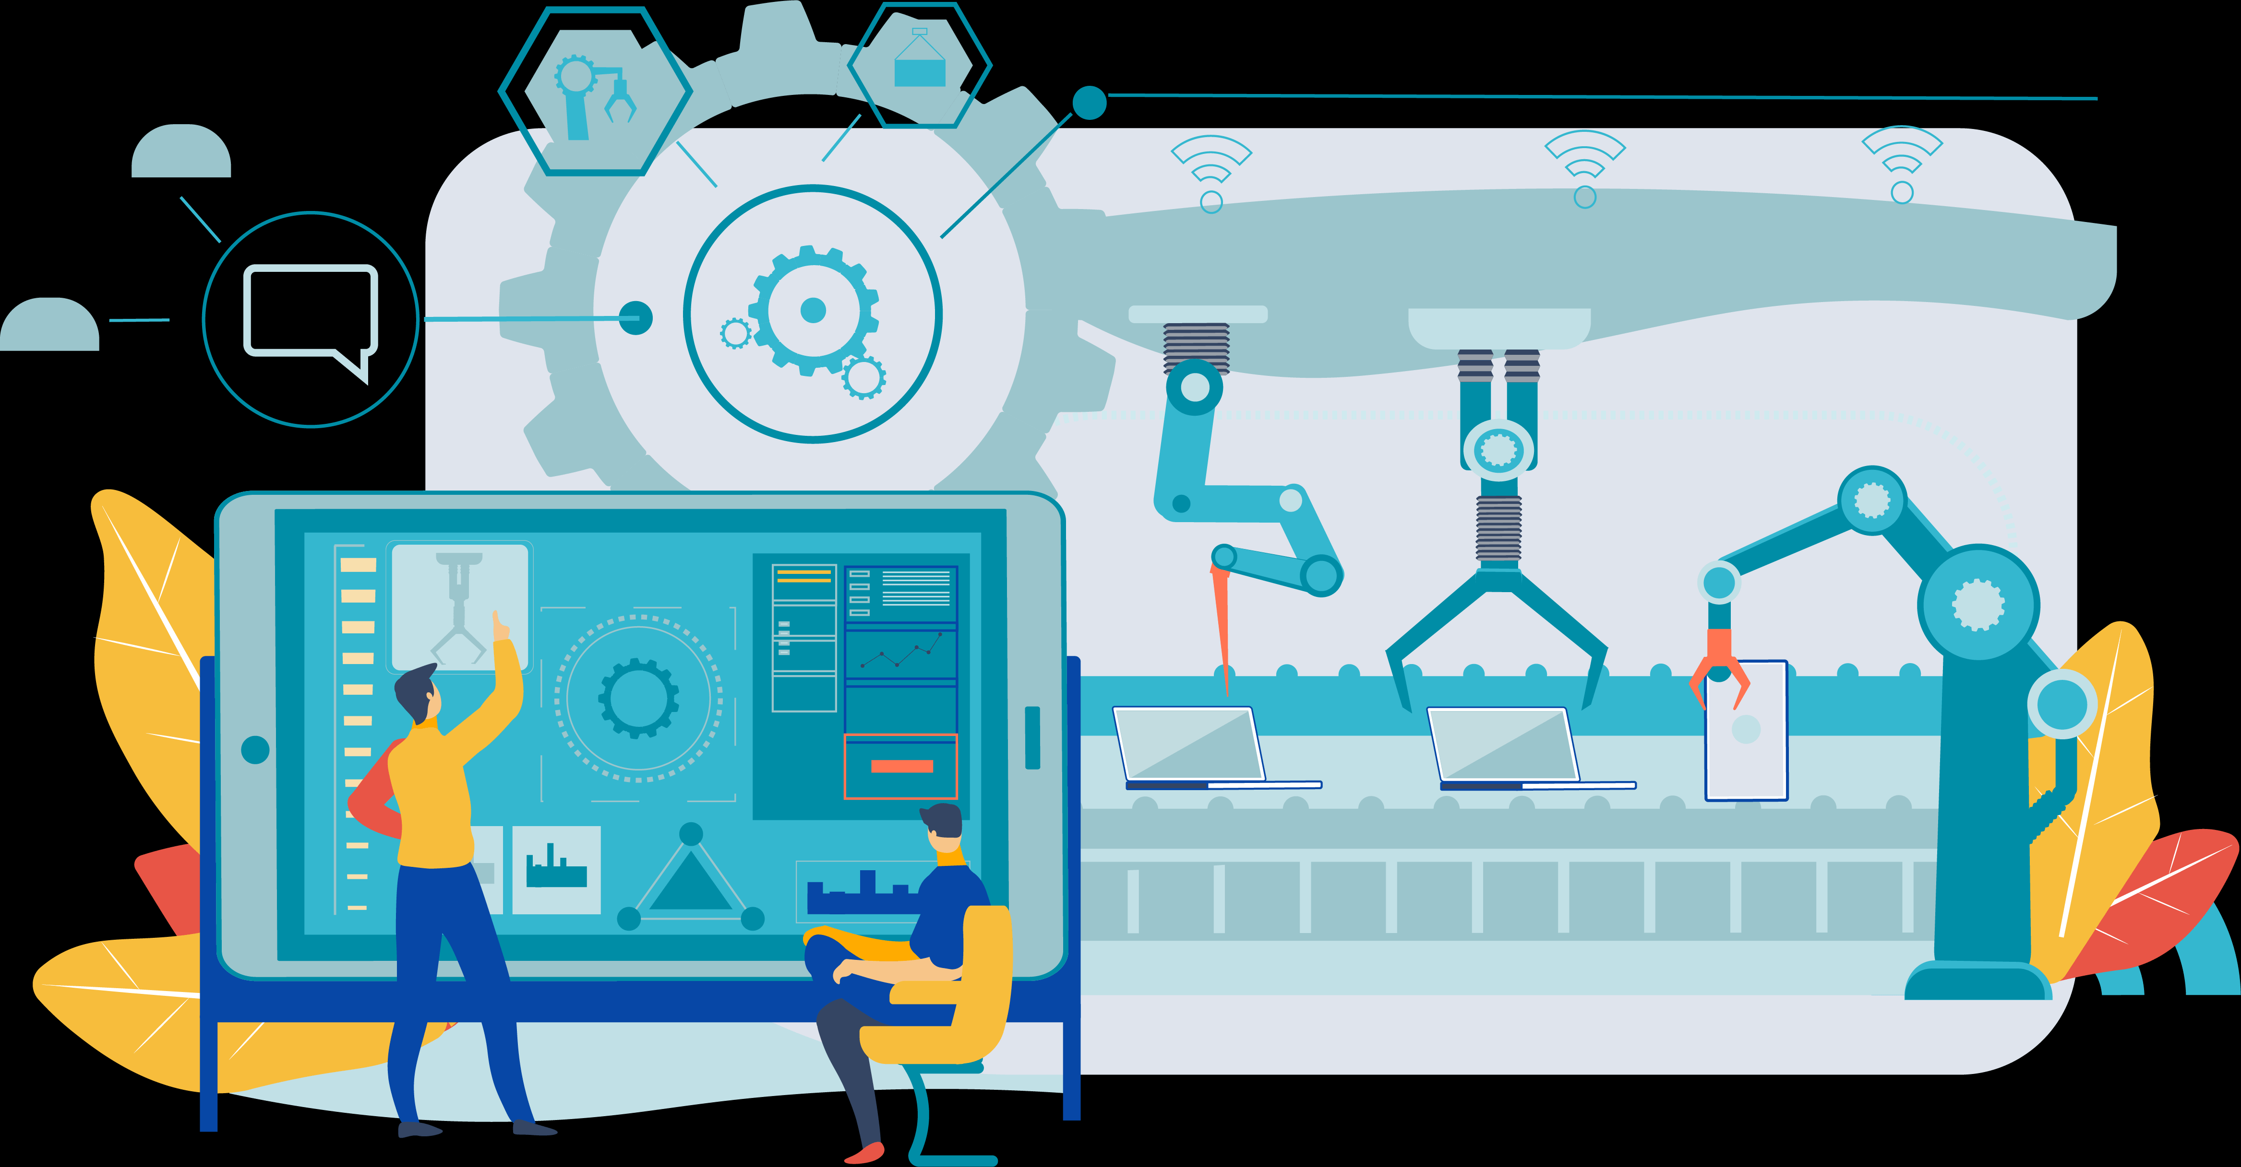
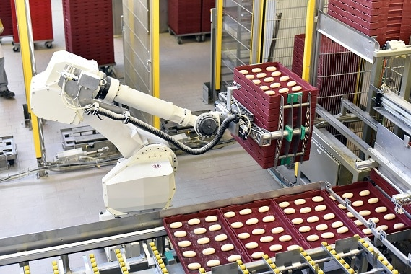
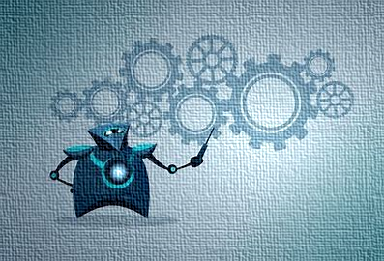
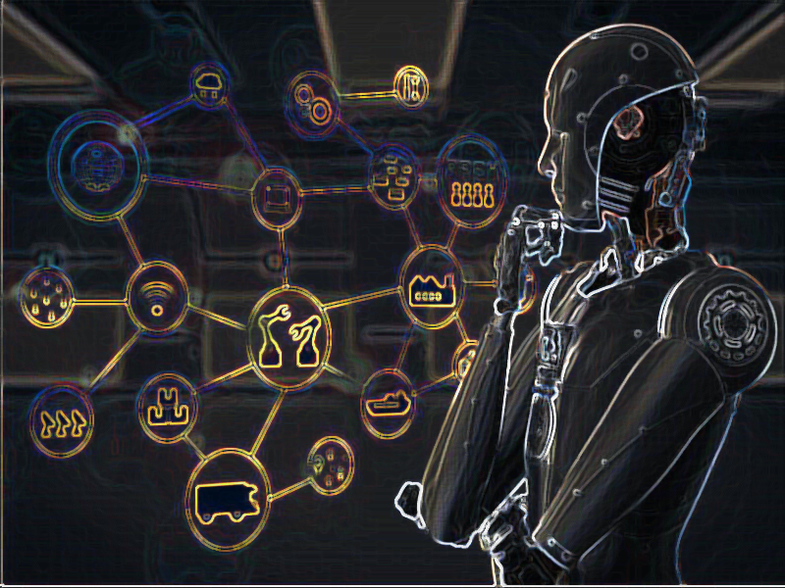
Automation or automatic control is the use of various control systems for operating equipment such as machinery, processes in factories, boilers and heat treating ovens, switching on telephone networks, steering and stabilization of ships, aircraft and other applications and vehicles with minimal or reduced human intervention.

