Slide 1
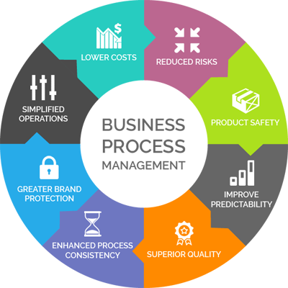
Business Process Management
1) BPM is a process automation technology that includes the efficient coordination of people,system and data
2) The objective of BPM is to ensure that the operational and business process infrastructure is solid. Therefore, it acts as a base layer in the organization, automating the behavior of complex processes that require people to intervene in data entry and decision making, the use of systems at specific moments such as calculations or integrations, control of actions and data generation and storage

Slide 2
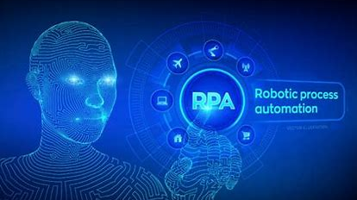
Robotic Process Automation (RPA)
Robotic Process Automation (RPA)is a technology which aims to reduce human intervention in computer applications, especially in repetitive tasks that vary very little in each iteration.
RPA works primarily by interacting with “high level” applications, which are the software layers at the graphic interface level, as oppose to machine language or programming code. Put more simply, it is a type of software that emulates the real interaction that a human would have with conventional computer applications.
This technology is suitable to replace simple and repetitive manual tasks such as data entry in applications. This means that employees have more time to focus on other branches of value for the company such as decision-making or improving customer relations .

Slide 3
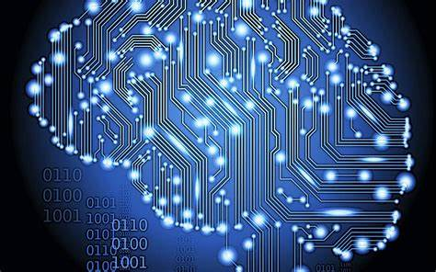
Artificial Intelligence
Artificial Intelligence is the simulation of human intelligence by machines.
Artificial Intelligence encompasses other concepts such as Machine Learning, Deep Learning, Natural Language Processing (NLP), Visual Recognition, Big Data, etc.
Although it is a very broad concept and covers many levels (from simple automations to complex virtual assistants), it is worth highlighting the following virtues in the current business environment:
>Deciphering patterns from previous experience
>Intelligent decision making.
>Prescriptive and predictive analytics.
>Improving the user experience.

Slide 4

Integration
The connection and integration between system.is one of the biggest headaches for a company, since each system or software has its own peculiarities.
They generally offer an Application Programming Interface (API) to interact with, which is usually based on some standard such as SOAP (applied in Web Services) or REST (based on HTTP protocol), for example.
Integrations usually require code, but with a platform such as AuraPortal, in addition to managing BPM processes, you can have native connectors (for example, with SAP or Dynamics CRM) and make connections based on SOAP or REST without using code and in a fast and simple way.
For cases in which it is not possible to integrate via API, we would opt for RPA to undertake a superficial integration at the graphic interface level.

