Slide 1

Student Name : RITIKA CHOUHAN
Student ID : : STU6686cd0fc9d1e1720110351
College Name : UNIVERSITY OF RAJASTHAN

Slide 2
CAPSTONE PROJECT SHOWCASE
Project Title : Exhaustive Analysis of Indian Agriculture Sector Using Power BI
Abstract | Problem Statement | Project Overview | Proposed Solution | Technology Used | Modelling & Results | Conclusion | Q&A

Slide 3
Abstract
This project involves a comprehensive analysis of the Indian agriculture sector using Power BI. It utilizes 19 years of historical data covering 33 states, 646 districts, and 122 unique crops. The primary goal is to uncover trends, analyze regional disparities, and identify key performance indicators (KPIs) to support informed decision-making. The interactive dashboard aims to:
Explore and visualize crop production trends over time.
Identify regional disparities in agricultural productivity.
Analyze factors influencing Minimum Support Prices (MSPs).
Provide actionable insights for policymakers and stakeholders.

Slide 4
Problem Statement
The Indian agriculture sector faces significant challenges despite its vast potential:
Data Overload: The sector generates extensive data annually, but there is no streamlined way to process and analyze it effectively.
Lack of Insights: Stakeholders struggle to derive actionable insights to address issues like uneven productivity and climate impacts.
Regional Disparities: Production is concentrated in certain regions, leading to economic imbalances.
Market Instability: Volatility in prices and inadequate support for farmers hinder sustainable growth.
Need for Policy Tools: Policymakers require tools to evaluate the impact of interventions and develop strategies for equitable agricultural development .

Slide 5

Project Overview
This project leverages Power BI to analyze 19 years of agricultural data from across India. The key features include:
Data Sources:
Historical datasets on crop production, prices, and yields from government and research organizations.
Analysis Goal:
Explore production trends across states, districts, and seasons. Identify the most productive crops, regions, and seasons. Analyze factors affecting yields and minimum support prices (MSPs).
Data Coverage:
States: 33 states analyzed for agricultural output.
Districts: Detailed analysis of 646 districts.
Crops: Trends in 122 unique crops across five seasons.
Deliverables:
Comprehensive dashboards to visualize trends and KPIs.
Predictive models for MSP estimation.
Insights into regional and seasonal variations in productivity.

Slide 6

Proposed Solution
The project proposes an interactive and user-friendly Power BI dashboard
with the following features:
Interactive Visualization :
Visualize crop production trends by state, district, crop, and season.
Drill-down functionality for detailed exploration.
Predictive Analytics:
Predict MSPs using historical data and machine learning models.
Evaluate price trends and market dynamics.
Key Metrics:
Analyze productivity indicators such as yield per hectare and cost efficiency.
Highlight regional disparities in agricultural performance.
Policy Insights:
Support policymakers by identifying priority regions for intervention.
Suggest diversification opportunities to reduce risks.

Slide 7
Technology Used
The following technologies and tools were utilized for the project:
Power BI:
Used for creating interactive dashboards and visualizations.
Drill-through functionality for analyzing data at granular levels.
DAX (Data Analysis Expressions):
Advanced modeling and calculations to derive key metrics.
Used to create custom measures like yield per hectare and cost trends.
CSV Data Sources:
Datasets on agricultural production, prices, and yields for 19 years.
Includes government datasets and research reports.
Microsoft Excel:
Initial data cleaning, preprocessing, and formatting.
Statistical Tools:
Used for regression analysis and trend identification.

Slide 8
Modelling & Results
Key findings and insights from the data analysis:
Total Production: India produced 45 billion tons of agricultural output over 19 years.
Top Crops:
Coconut dominated production with 42 billion tons.
Other major crops include rice, wheat, and maize.
Top Region:
Kerala emerged as the leading state with 33.14 billion tons of output.
Kozhikode district led among all districts with 4.38 billion tons.
Seasonal Insights:
The Kharif season contributed the most to overall production.
Winter was key for wheat production.
Growth Potential:
Regional disparities highlight the need for balanced development.
Crop diversification can enhance productivity and reduce risks.

Slide 9
Modelling & Results
Production Trends Over Time:
Production levels fluctuate yearly due to climate, policies, and market conditions.
Growth is achievable through improved practices, technology, and supportive policies.
Visualizations include:
State-wise production trends.
Seasonal productivity patterns.
Key crop contribution breakdown

Slide 10
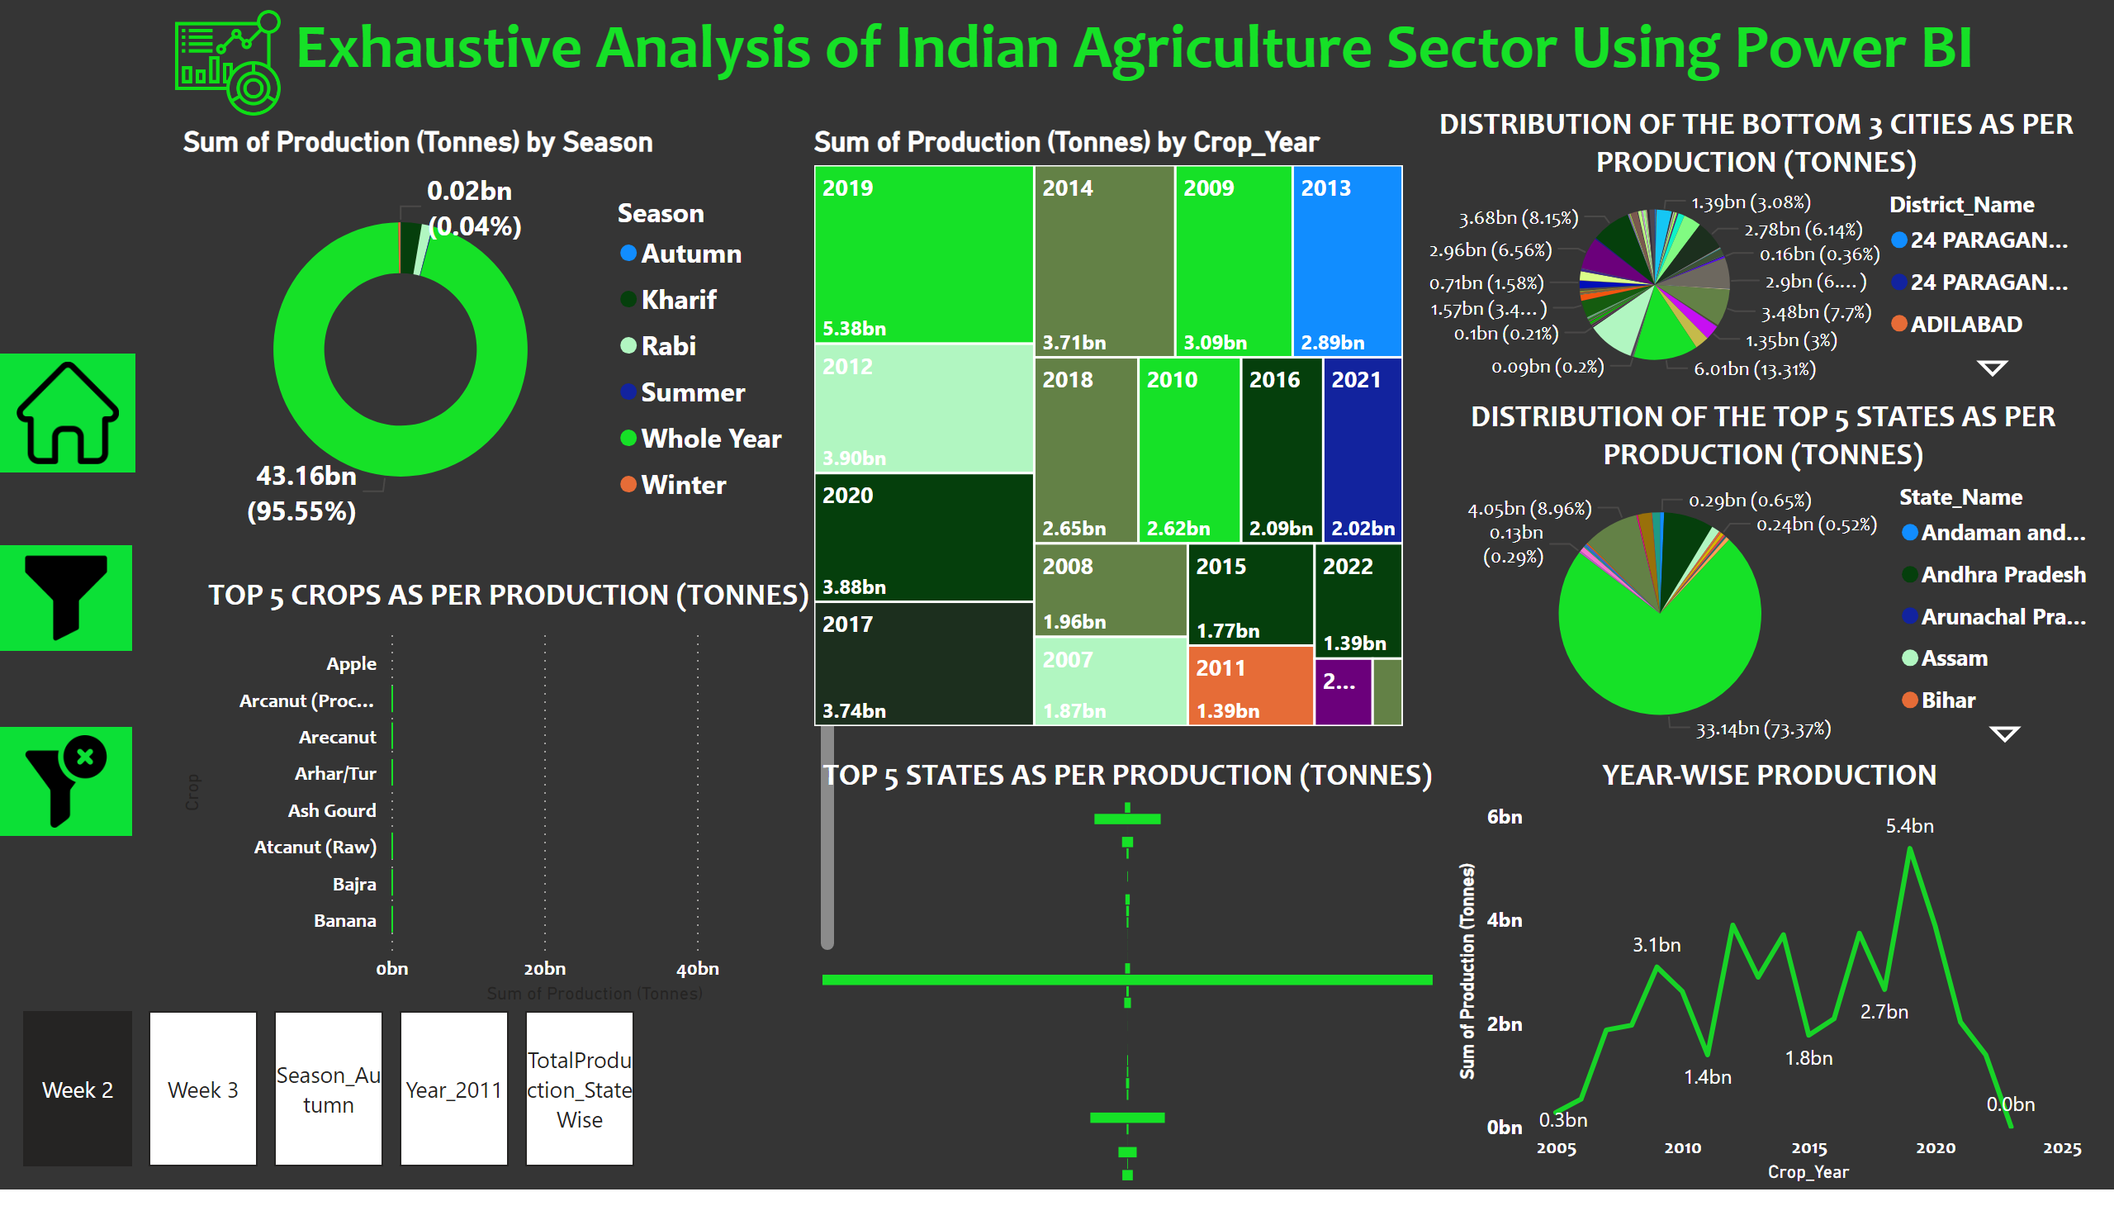
Week 2
Notes:
textbox
8
shape
No alt text provided
shape
No alt text provided
image
No alt text provided
slicer
No alt text provided
slicer
No alt text provided
slicer
No alt text provided
slicer
No alt text provided
image
No alt text provided
image
No alt text provided
TOP 5 CROPS AS PER PRODUCTION (TONNES)
No alt text provided
TOP 5 STATES AS PER PRODUCTION (TONNES)
No alt text provided
YEAR-WISE PRODUCTION
No alt text provided
DISTRIBUTION OF THE TOP 5 STATES AS PER PRODUCTION (TONNES)
No alt text provided
DISTRIBUTION OF THE BOTTOM 3 CITIES AS PER PRODUCTION (TONNES)
No alt text provided
treemap
No alt text provided
donutChart
No alt text provided
image
No alt text provided
image
No alt text provided
pageNavigator
No alt text provided

Slide 11
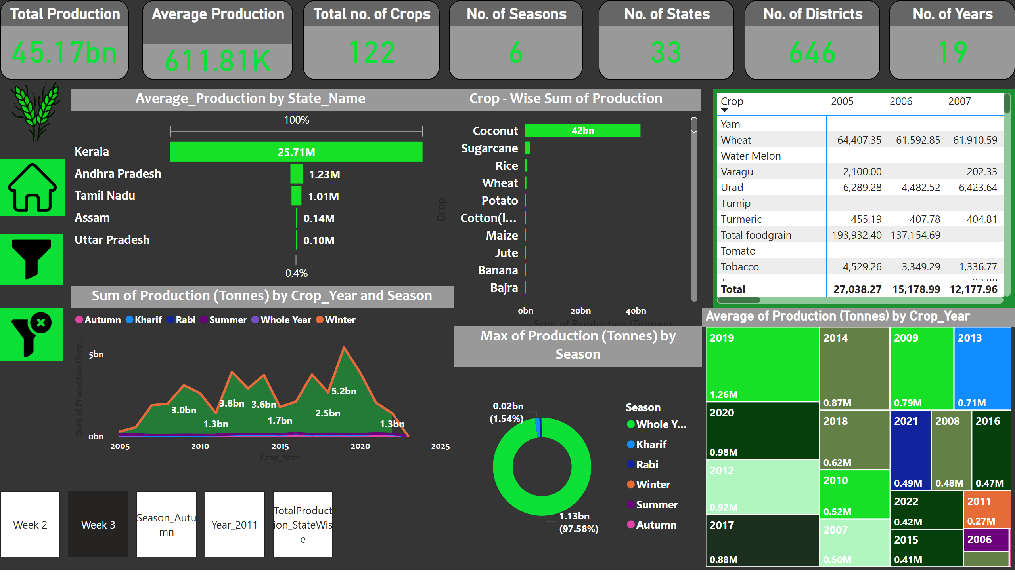
Modelling & Results

Slide 12
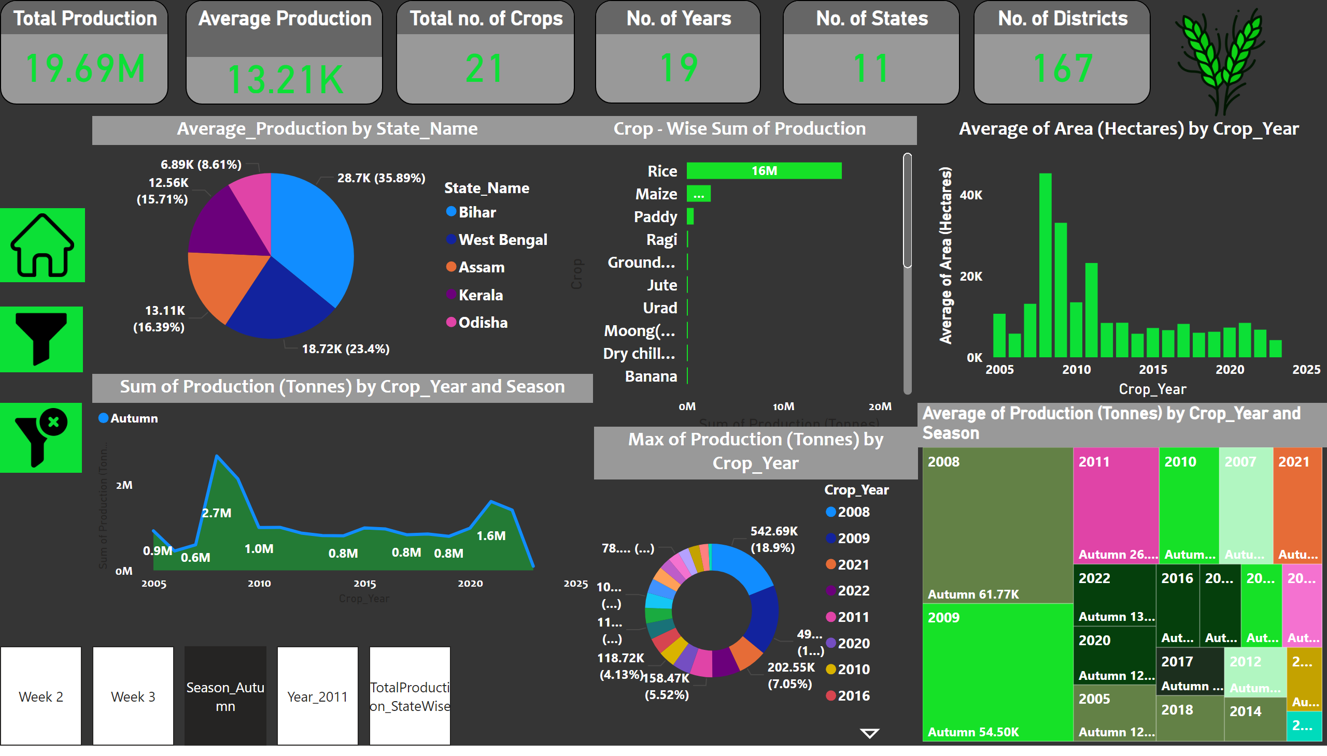
Season_Autumn
Notes:
shape
No alt text provided
shape
No alt text provided
image
No alt text provided
slicer
No alt text provided
slicer
No alt text provided
slicer
No alt text provided
image
No alt text provided
image
No alt text provided
image
No alt text provided
Total Production
No alt text provided
Total no. of Crops
No alt text provided
Average Production
No alt text provided
No. of States
No alt text provided
No. of Years
No alt text provided
No. of Districts
No alt text provided
Crop - Wise Sum of Production
No alt text provided
stackedAreaChart
No alt text provided
image
No alt text provided
pieChart
No alt text provided
lineClusteredColumnComboChart
No alt text provided
treemap
No alt text provided
donutChart
No alt text provided
pageNavigator
No alt text provided

Slide 13
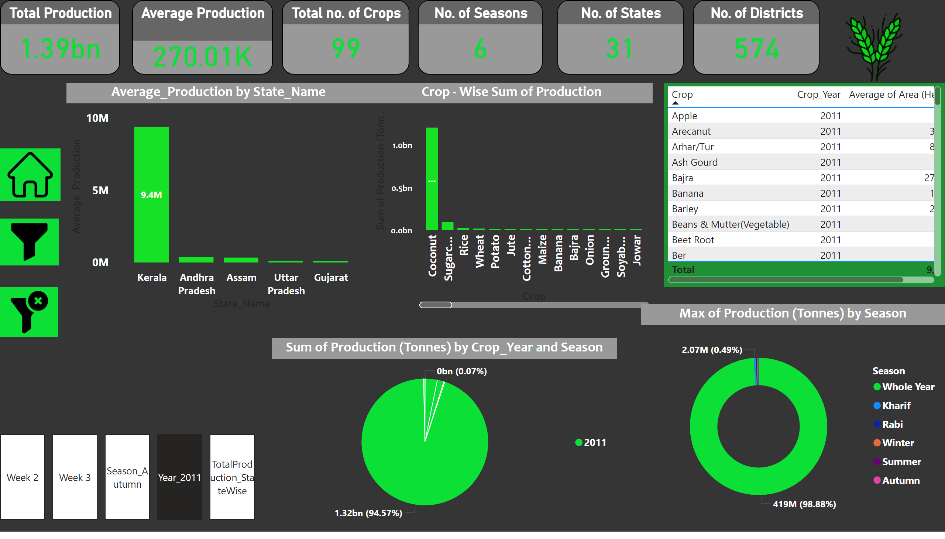
Modelling & Results

Slide 14
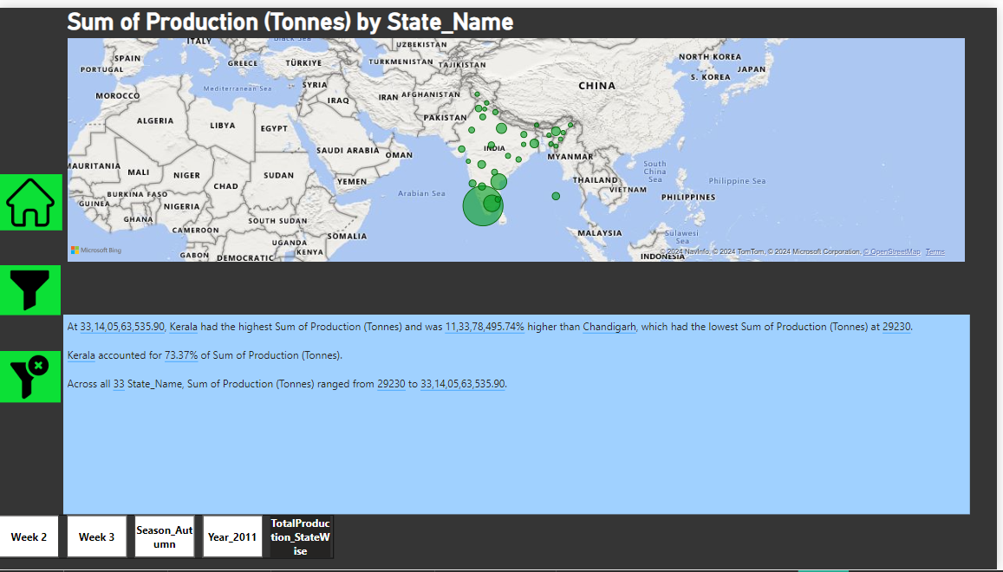
Modelling & Results

Slide 15
Conclusion
The project delivers valuable insights into India’s agriculture sector and its challenges:
Data-Driven Insights:
Identified major crops, productive regions, and seasonal variations.
Highlighted disparities and opportunities for diversification.
Interactive Dashboard:
Provides policymakers with actionable insights.
Supports informed decision-making for equitable development.
Future Potential:
Expand the dashboard to include real-time market data.
Incorporate additional datasets for environmental factors like rainfall and soil quality.
Use machine learning to refine MSP predictions further.
.

Slide 16
Thank You!
Notes:
Thank You !!

