Slide 1
APT3
Ryan Sidebottom
October 30, 2015

Slide 2
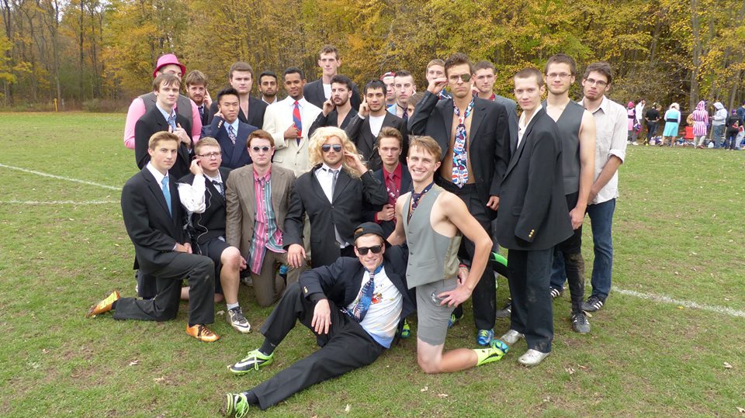
WHY LISTEN TO ME?
Because I play Ultimate Frisbee in suits

Slide 3

SO?
I’m also a second year CSEC student
I know how to physically break things
I also worked with FireEye in creating rules to try and prevent APT 3 this past summer
CoD Zombies circle strategy extraordinaire

Slide 4


WHAT’S AN APT3?
It’s not apartment 3…
APT = Advanced Persistent Threat
It’s actually UPS!!!
A Chinese hacking group called UPS….
Tracked by FireEye as APT3

Slide 5
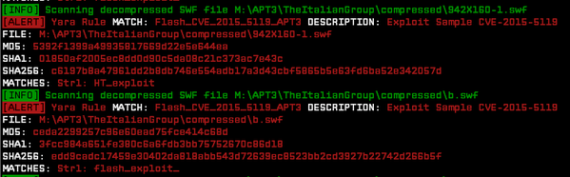
SO WHAT CAN BROWN DO FOR YOU?
Exploit Adobe Flash because who can’t!
Me…lol
Responsible for exploiting an Adobe Flash Player zero-day vulnerability (CVE-2015-3113)
They can also exploit your browser
Also responsible for Operation Clandestine Fox exploit
But that was for IE 9 through 11…

Slide 6
WHO DOESN’T LIKE CHINA?
UPS is one of the more sophisticated threat groups
Has a history of introducing new browser-based zero-day exploits
e.g., Internet Explorer, Firefox, and Adobe Flash Player
After successfully exploiting a target host, they quickly dump credentials, move laterally to additional hosts, and install custom backdoors.
YAY!

Slide 7
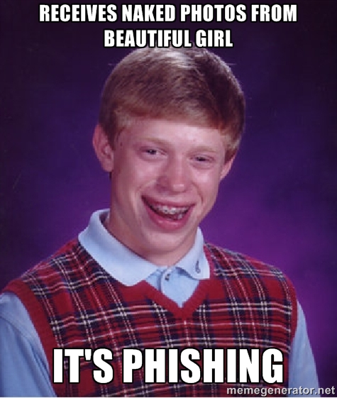
WHAT’S THE THREAT?
Well back in June they launched phishing campaigns against select organizations
Aerospace and Defense
Construction and Engineering
High Tech
Telecommunications
Transportation

Slide 8
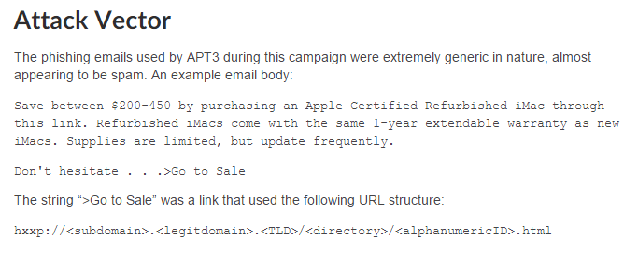
WHAT DID THE PHISHING LEAD TO?
Downloading a custom backdoor, SHOTPUT to victim’s computer

Slide 9
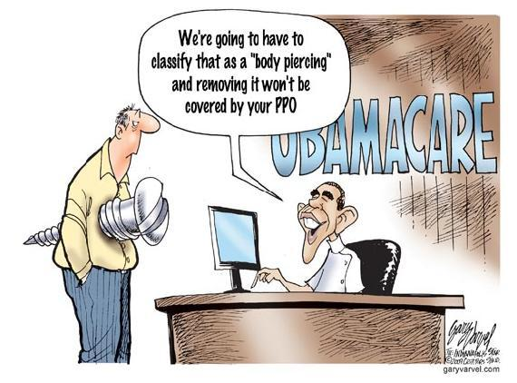
EXPLOIT DEETS
Exploits unpatched vulnerability in how Adobe Flash Player parses Flash Video
Common vector corruption techniques used to bypass Address Space Layout Randomization
Bypasses Data Execution Prevention by using Return-Oriented Programming
Then you’re screwed…

Slide 10
SO YOUR SAYING…?
Once APT 3 is in, you’re their toy
APT 3 works swiftly and is extremely proficient at enumerating and lateral movement

Slide 11
BUT CAN WE STOP THEM?
Well….
They use “zero-day exploits, continually updated custom backdoors, and throwaway CnC infrastructure, making it difficult to track them across campaigns”

Slide 12
WHAT’S THAT MEAN?
Good luck, you’ll need it
Or don’t use Adobe…
While you’re at it, don’t use a computer either
Maybe try and put a condom on it
Lube might be a better purchase for when they screw you over though…

Slide 13
FOR MORE…
https://www.fireeye.com/blog/threat-research/2015/07/demonstrating_hustle.html
Gives you the targets of some Chinese APT groups
https://www.fireeye.com/blog/threat-research/2014/11/operation_doubletap.html
More APT 3 info
https://apt.securelist.com/#firstPage
Interactive listing of malicious files from APTs
http://cybercampaigns.net/
List of some APT groups…some

Slide 14
REFERENCES
https://www.fireeye.com/blog/threat-research/2015/06/operation-clandestine-wolf-adobe-flash-zero-day.html
Google Images

Slide 15
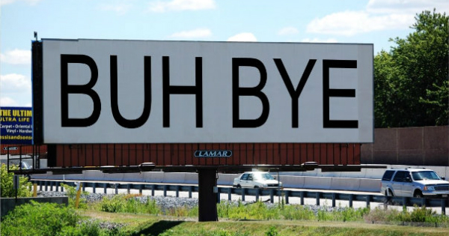
THANKS FOR LISTENING

