Slide 1
Pivoting: How to Get Around
Bryan Harmat

Slide 2
Just in case you forgot Who I Am
I’m just a guy wearing pants

Slide 3
Outline
Intro
OSI Model Review
TCP/UDP
nmap stuff
Firewalls & ACLs
iptables (Common on most Linux distros)
netsh (Windows)
Demo
proxychains
nmap

Slide 4
So what is Pivoting?

Slide 5
So what is Pivoting?
Definitions:
A short rod or shaft on which a related part rotates or swings.
A person or thing on which something depends; the central or crucial factor
The act of turning on a pivot.

Slide 6
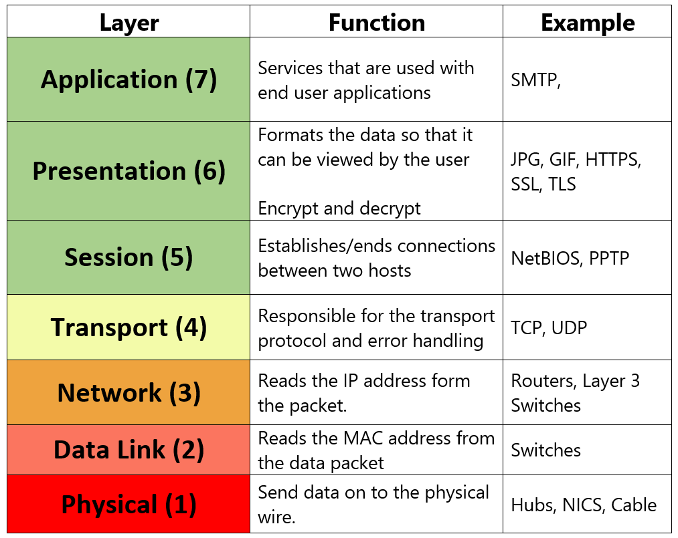

Slide 7
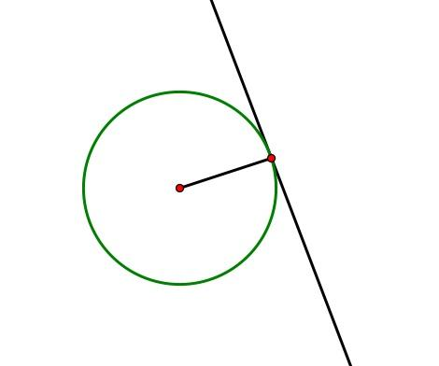
Time for a Tangent

Slide 8
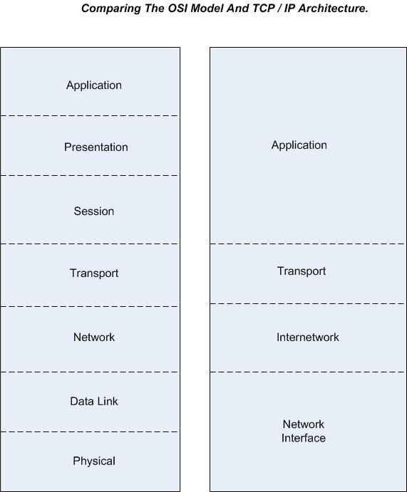
Notes:
I frequently use the jpeg protocol - just another reason why the OSI model blows

Slide 9
Why the OSI Model is Shitty
The Open Systems Interconnection model (OSI Model) is a conceptual model that characterizes and standardizes the communication functions of a telecommunication or computing system without regard of their underlying internal structure and technology. (Wikipedia - OSI Model)

Slide 10




Pivoting
Let’s talk about nmap and ports and walls of fire
Notes:
tcp vs. udp, talk about ports 22,80,443,3389

Slide 11
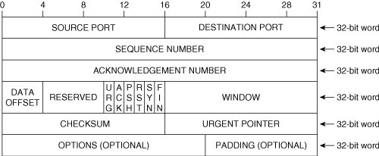
Transmission Control Protocol

Slide 12
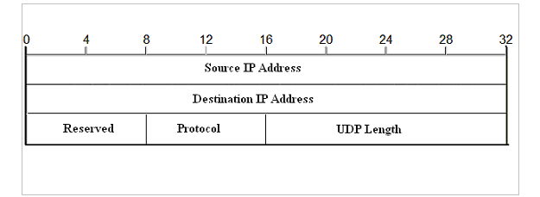
User Datagram Protocol

Slide 13
nmap stuff
-v = verbose
-n = no hostname resolution (speeds scans up so that they don’t do a DNS lookup)
-sT = full TCP connect scan (not stealthy, connections can get logged)
-Pn = assume the host is alive
-T# = speed of scan (0 <= # <= 5)
-p = specified ports to scan

Slide 14
Scenario
We are assuming we are in a post compromise situation and already have valid credentials to systems (through social engineering, or dropping that 0 day we keep in our back pocket)

Slide 15
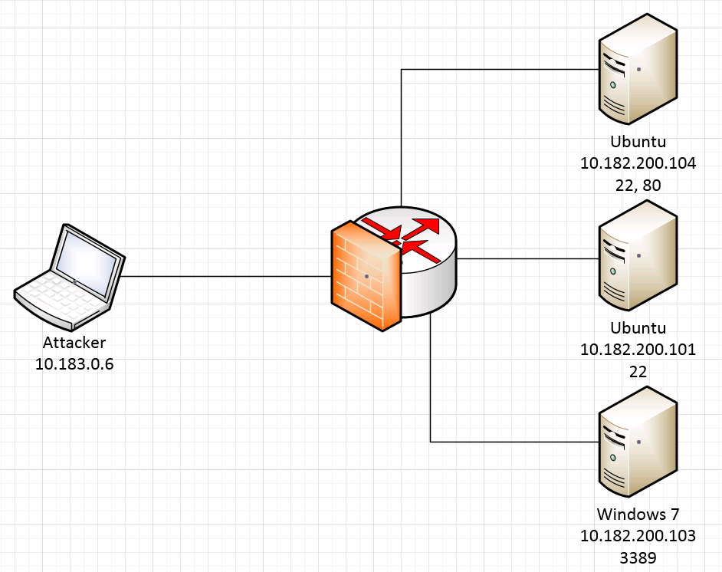
Topology
Notes:
netstat is your friend

Slide 16
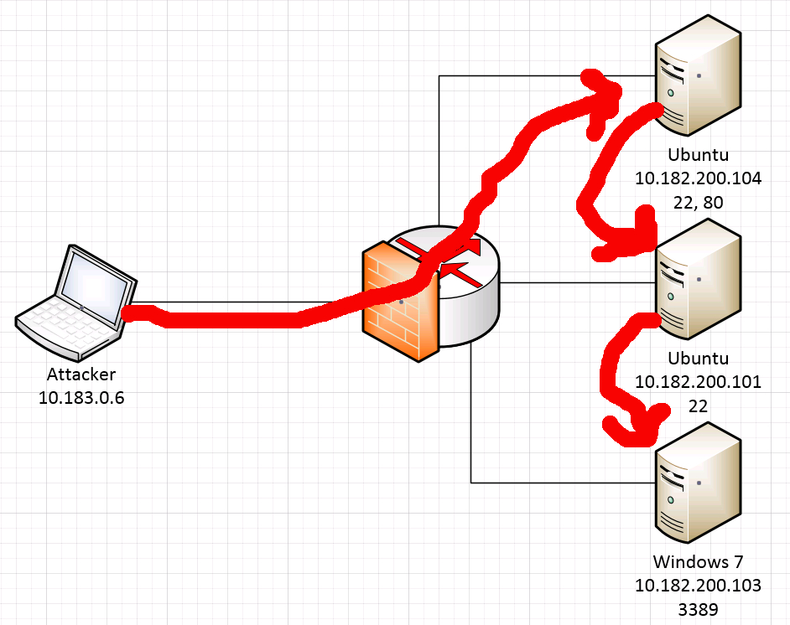
Topology

Slide 17
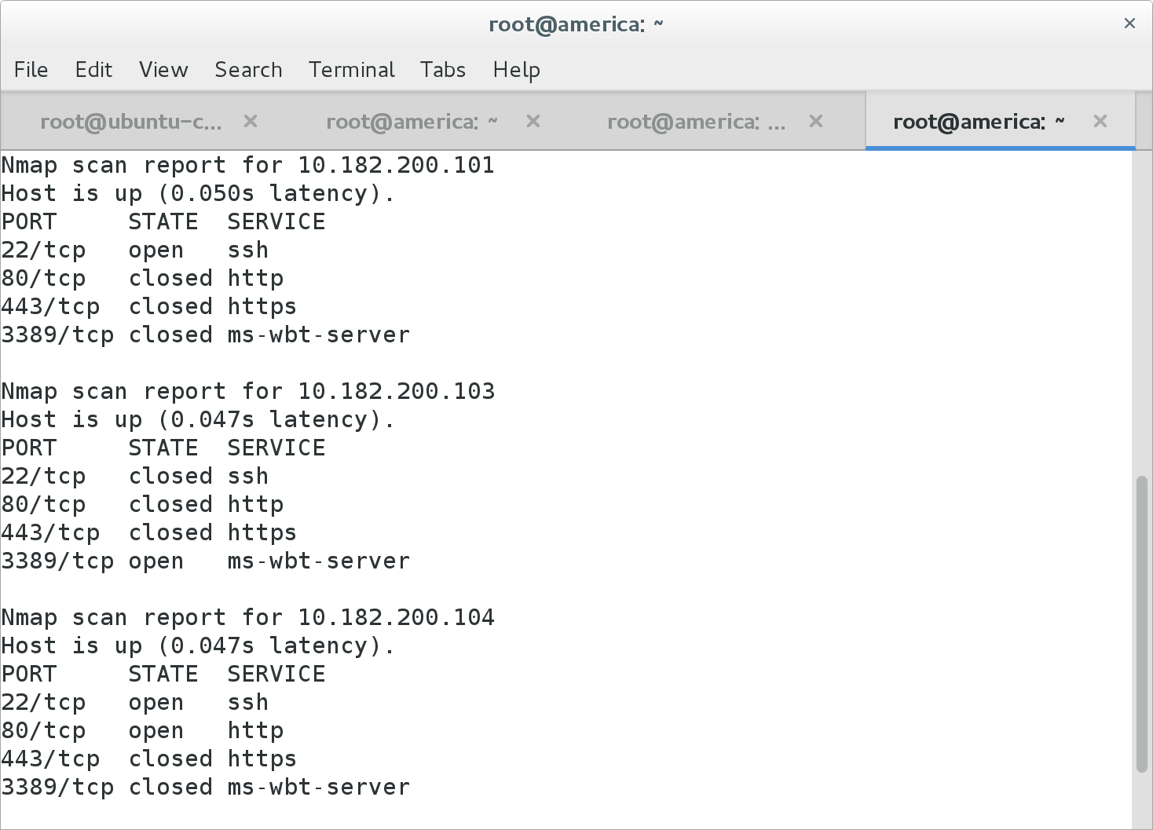
nmap -n -v -T5 -p 22,80,443,3389 10.182.200.101-104
Notes:
this is the scan before host based firewalls were added

Slide 18
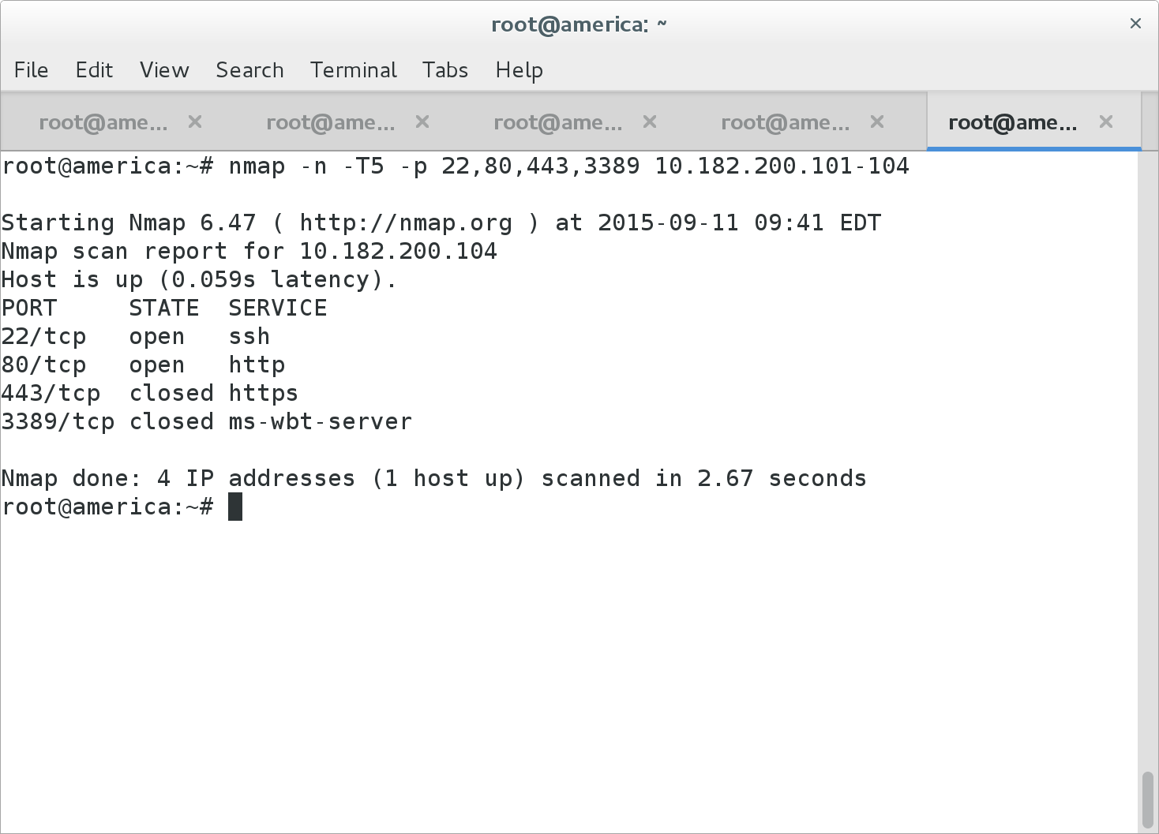

Slide 19
Demo

Slide 20
What we Did
nmap -n -v -T5 -p 22,80,443,3389 10.182.200.101-104
ssh -N -f -D 12345 root@10.182.200.104
-N = ssh should not send any remote commands
-f = background ssh immediately
-D 12345 = have the port forward listen on 127.0.0.1:12345
In /etc/proxychains.conf:
socks4 127.0.0.1 12345
proxychains nmap -n -v -sT -Pn -p 22,80,443,3389 10.182.200.101-104
Notes:
**NOTE** to nmap through a proxy, we need to do full connect scans and assume all hosts are alive (nmap -sT -Pn)

Slide 21
What we Did
To further pivot:
proxychains ssh -f -N -D 12346 root@10.182.200.101
Then change proxychains.conf to:
socks4 127.0.0.1 12346
proxychains nmap -n -v -sT -Pn -p 22,80,443,3389 10.182.200.103
Then
proxychains rdesktop -g 85% 10.182.200.103

Slide 22
10.182.200.101 - iptables
iptables -F
iptables -A INPUT -s 10.182.200.0/24 -j ACCEPT
iptables -A INPUT -i lo -j ACCEPT
iptables -P OUTPUT ACCEPT
iptables -P INPUT DROP

Slide 23
10.182.200.103 - netsh firewall rules
netsh advfirewall reset
netsh advfirewall set allprofiles state on
netsh advfirewall firewall delete rule name=all
netsh advfirewall set allprofiles firewallpolicy blockinbound,blockoutbound
netsh advfirewall firewall add rule name=loopback dir=out remoteip=127.0.0.0/8 action=allow
netsh advfirewall firewall add rule name=loopback dir=in remoteip=127.0.0.0/8 action=allow
netsh advfirewall firewall add rule name=RDP dir=out protocol=tcp localport=3389 remoteip=10.182.200.101 action=allow
netsh advfirewall firewall add rule name=RDP dir=in protocol=tcp localport=3389 remoteip=10.182.200.101 action=allow

Slide 24


