Slide 1
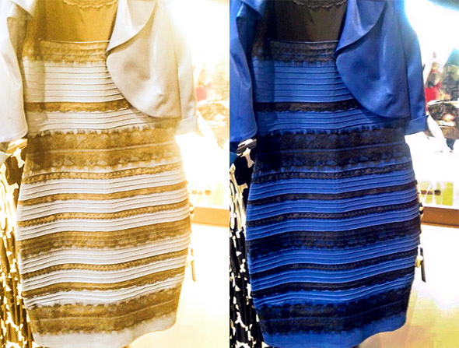
Steganography

Slide 2
Obligatory ME page
Eric Scheler
2nd Computer Engineer
I like computers

