Slide 1
PYTHON
By Peter Muller

Slide 2
Peter
5th year BS/MS computer engineer
SPARSA secretary
Took 1 CSEC class
I break things
  Ask me about it (HACK NIGHTS)
I like turtles Python

Slide 3
Why Python?
Easy to learn
Easy to read
Easy to make things quickly
Powerful tool for extending other programs
  Burp, Yara, etc.

Slide 4
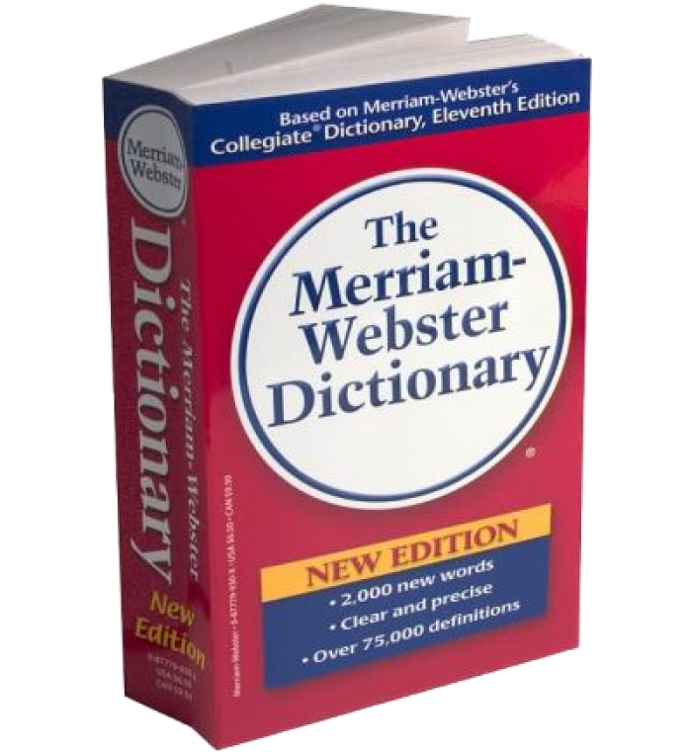
Dictionaries

Slide 5
But actually...
var = dict()
OR
var = {}

Slide 6
Why would I ever need this?
Variable variables
  Key:value pairs
    These are nice- trust me (I'm an engineer)
This is filler
So is this

Slide 7
Application
Caesar cipher
  AKA most secure crypto algorithm ever
  DEMO

Slide 8
Fin
Questions?

