Slide 1

Decoding Default
Machine Learning based Loan Risk Classifier
CDAC DBDA - Feb 2025 – Group 6
Group 6 Members
Anjum Sultana - 250250125011
Joseph George - 250250125026
Palakkal Aiswarya Karunan - 250250125039
Ritul Gaikwad - 250250125048
Swami Veena Ravi - 250250125065
Guided by
Mr.Sujit Pulujkar
Project Engineer
CDAC Bangalore

Slide 2
Introduction

Slide 3
Loan Default
Loan default occurs when a borrower fails to repay their loan according to the agreed terms, leading to financial consequences for both the borrower and lender.
Rising non-performing assets (NPAs) affect financial institutions.
Predicting loan default is critical for risk management.
ML enables data-driven credit scoring.

Slide 4
Project Objectives
Goals of the Loan Default Prediction System
Predict likelihood of loan default.
Important features contributing to loan defaulting.
Build a user-friendly interface using Streamlit.
Provide actionable insights to lenders.

Slide 5
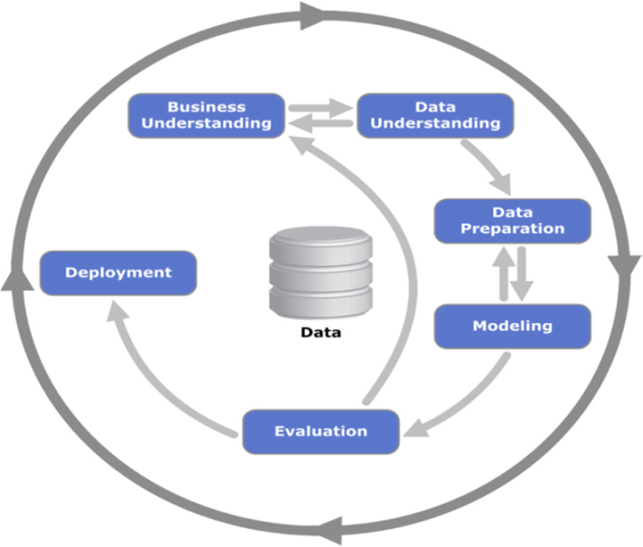
CRISP DM
FRAMEWORK

Slide 6


Dataset Overview
Source:
Dataset : Lending Club Dataset
Size: 3,96,030 records, 27 features
A profiling report explains the dataset statistics

Slide 7
Data Preprocessing
Handling missing values
Replace Zero / None / Other Values
Outlier detection and removal
Encoding categorical variables
Scaling numerical features
Random Undersampler used for class balancing

Slide 8
Feature Engineering
Zip Code Extraction
Extracted zip codes from address column.
Day-Month-Year Extraction from earliest_cr_line and issue_d columns
Column Dropping
Removed highly correlated or irrelevant columns.

Slide 9
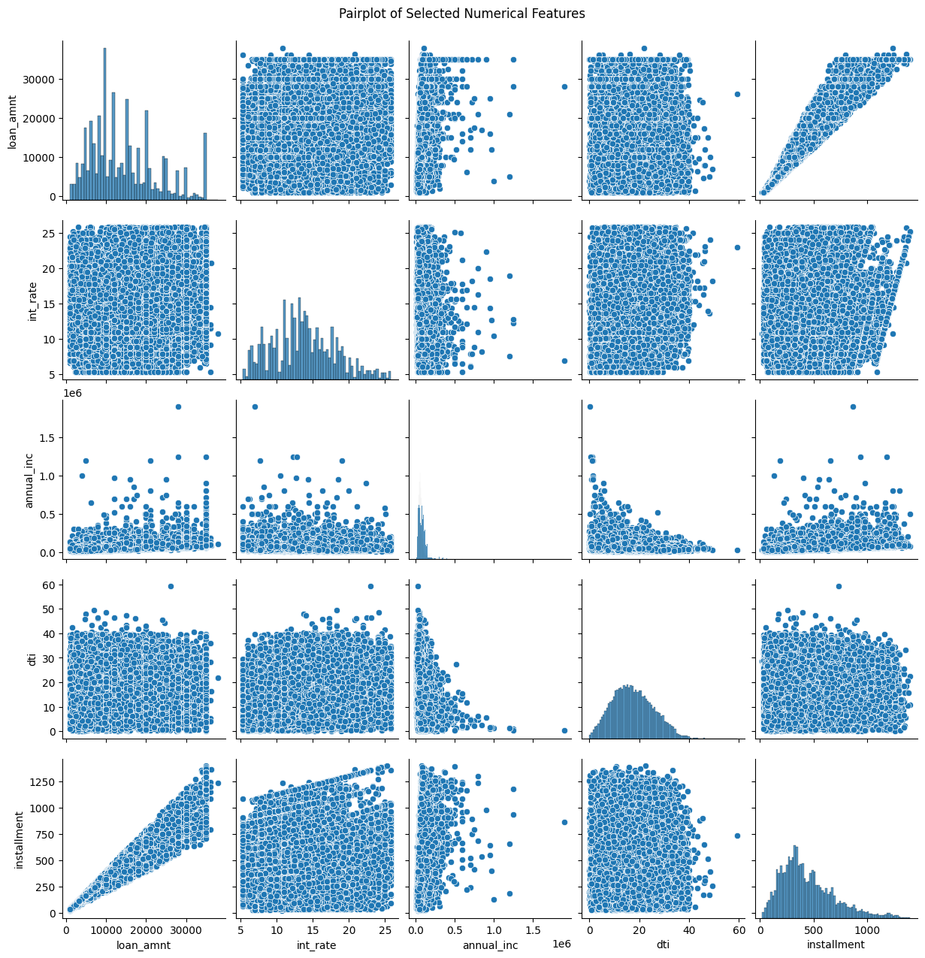
Exploratory Data Analysis (EDA)

Slide 10
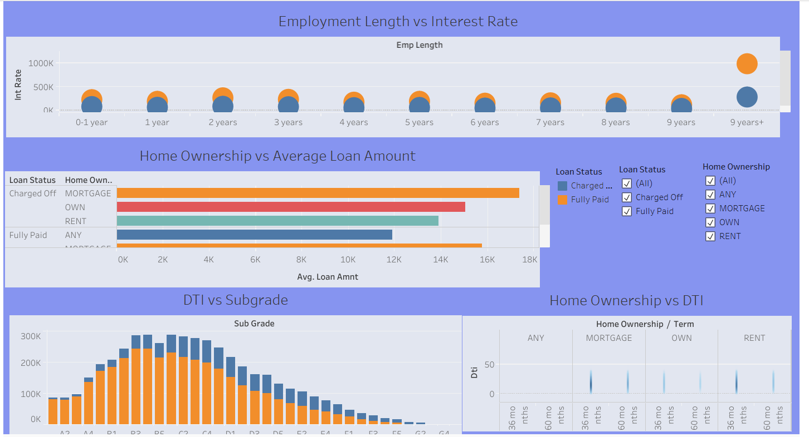
BI Visualization

Slide 11
ML Modelling
Choosing the Right Algorithm
Logistic Regression
Random Forest
GBM
SVM
ANN(Deep Learning)

Slide 12
Model Evaluation
Performance Metrics and Results
Accuracy, Precision, Recall, F1-Score, Confusion matrix, ROC-AUC curve
Best performing model GBM
Logistic Regression
Accuracy=0.66
Random Forest
Accuracy=0.79
GBM
Accuracy=0.80
SVM
Accuracy=0.70
ANN
Accuracy=0.80

Slide 13
Model Performance Improvement
Finding the best combination of model settings (like learning rate, tree depth, number of neighbors, etc.) that minimizes error or maximizes accuracy leading to better results.
Hyperparameter Tuning
Cross-validation
Cross-validation is a technique, splitting the data into multiple parts, training the model on some parts and validating it on the remaining, to ensure it generalizes well to unseen data
Feature Importance
Selecting important features removing irrelevant or redundant data reduces noise, lowers overfitting risk, speeds up training, and enhances the model’s accuracy and interpretability.

Slide 14
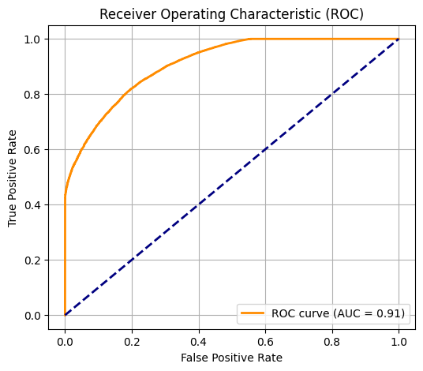
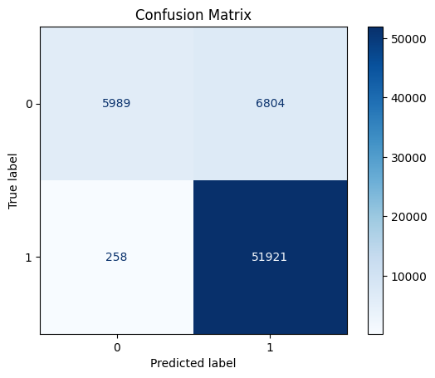
Best Improved Model
Logistic Regression
Accuracy=0.83
Random Forest
Accuracy=0.88
GBM
Accuracy=0.89
SVM
Accuracy=0.83
ANN
Accuracy=0.80
GBM selected based on Metric
GBM with F1-score = 0.88
Accuracy=0.891
Recall = 0.89
Precision =0.90

Slide 15
Streamlit Web App
Saved the best model as pickle file
Created an application python file
Input features selected based on feature importance (top features) for better prediction.
Dynamic charts and insights for exploring loan data
Web app assists lending club or financial bodies to assess risk of defaulting before granting loan to customers

Slide 16
Overview of Application
Input fields: Loan Amount, Annual Income,No of mortgage accounts, Issue month, Issue year, loan term in months, loan grade, Zip code, revolving utilization in percentage, interest rate in percentage.
Output: Default probability
Graphical Visualisation of loan data analytics
Interactive tableau dashboard
Accessible via desktop and mobile devices
Platforms used: GitHub, Amazon S3 Bucket, Streamlit / Render

Slide 17

Application Demo
Live Walkthrough of the Streamlit App

Slide 18
Results & Insights
GBM model identifies high-risk loan applicants with 89.1% accuracy
Features Influencing Loan Default - zip (most contributing factor), grade, term, issue_d_year , int_rate, annual_inc
Streamlit Dashboard Developed - An easy-to-use interface for entering loan details
Actionable Insights for Lenders - Lenders can use instant predictions with visual explanations from web app developed.

Slide 19
Future
Enhancements
Add explainable AI
Integrate with real-time loan databases
Deploy using big data technologies (Pyspark)
Use behavioural data to categorise individuals based on their preference

Slide 20
Conclusion
Machine Learning enhances the accuracy and efficiency of loan default prediction, enabling smarter credit decisions.
Streamlit provides an intuitive, user-friendly interface, making advanced ML models accessible to non-technical users.
This project demonstrates the complete data science pipeline — from data preprocessing to model deployment — in a real-world use case.

Slide 21
“Behind every default is a data pattern waiting to be decoded.”
- ML Enthusiast

Slide 22

Thanks!

